Slide 1
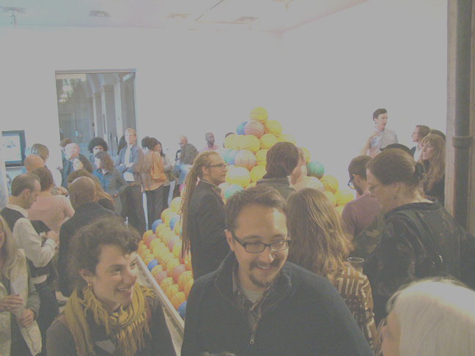
SFAC Galleries Strategic Plan Alignment Report
May, 2015

Slide 2
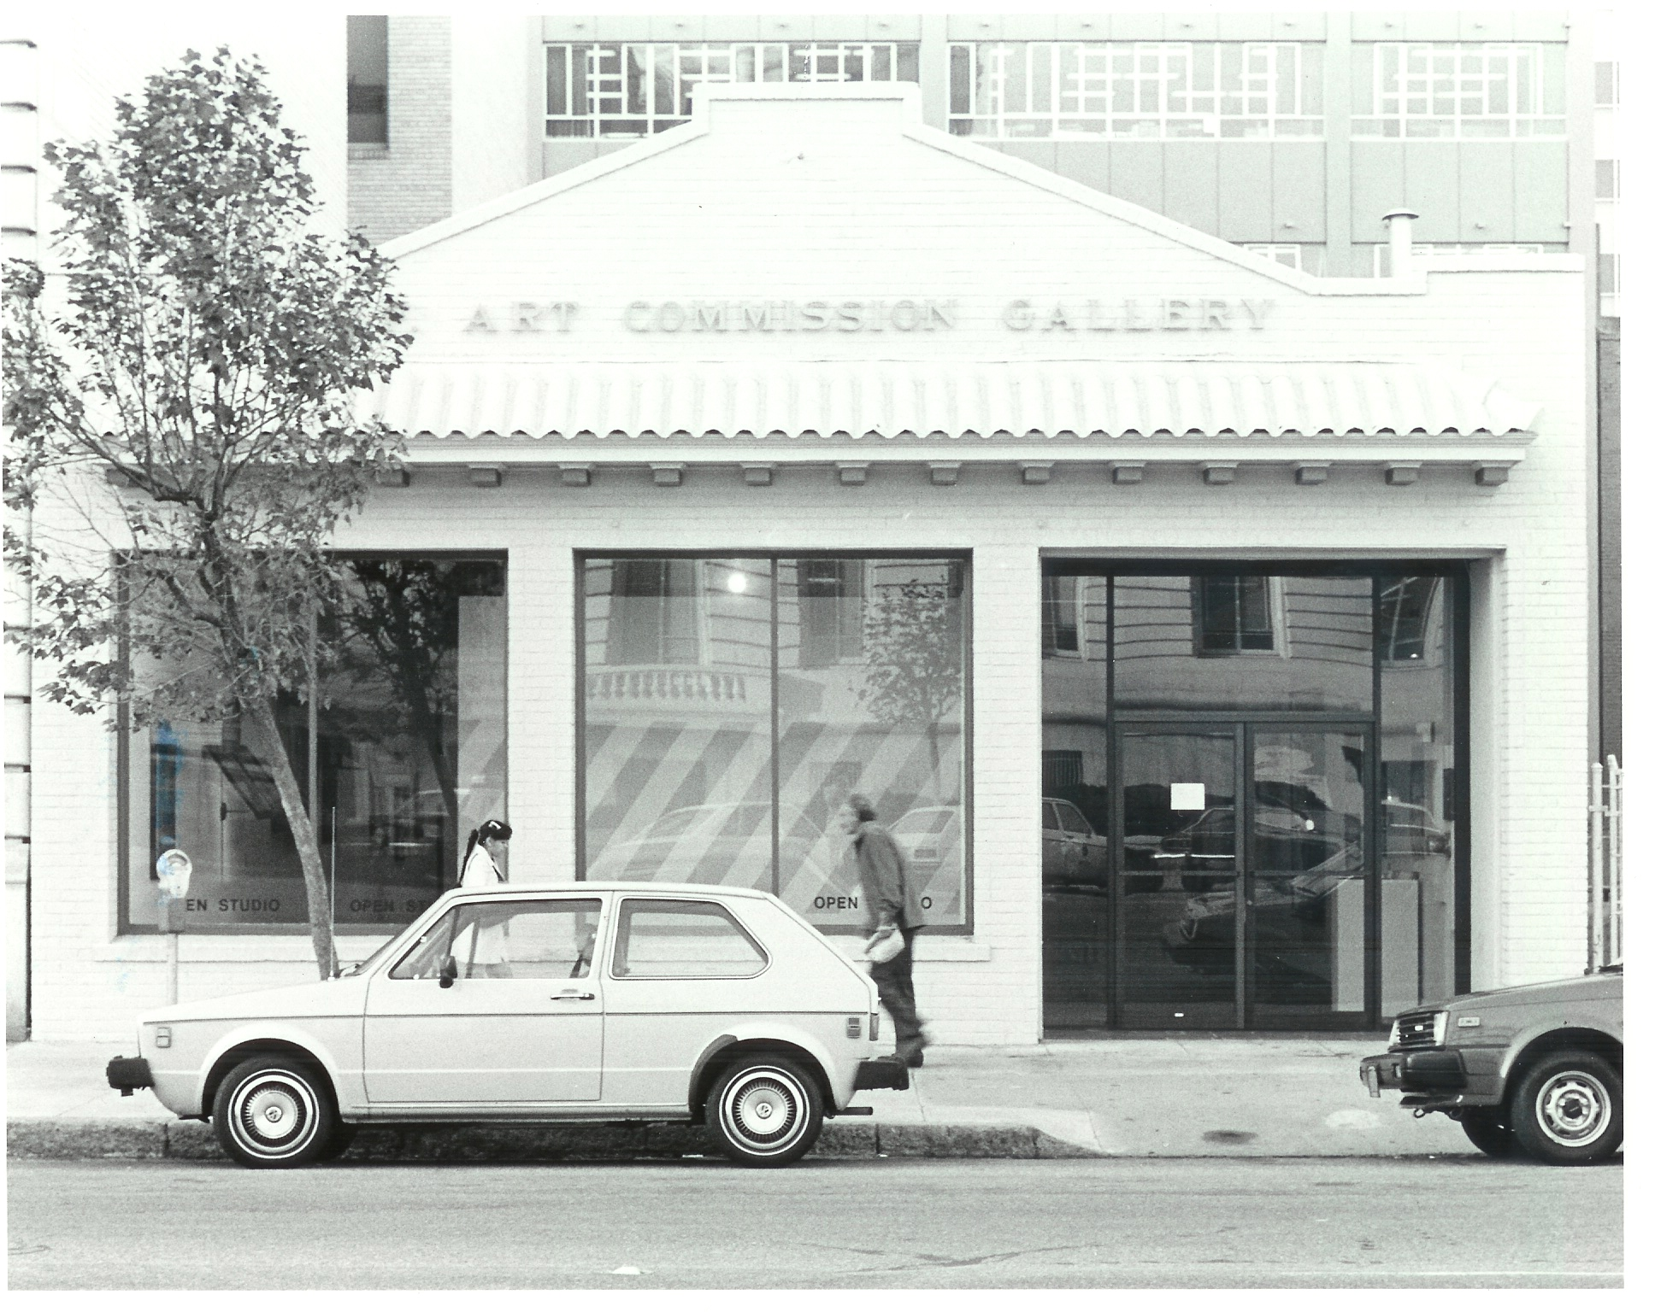
SFAC Galleries Historical Highlights

Slide 3
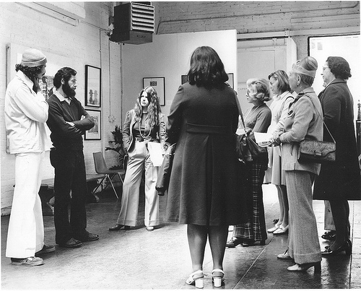
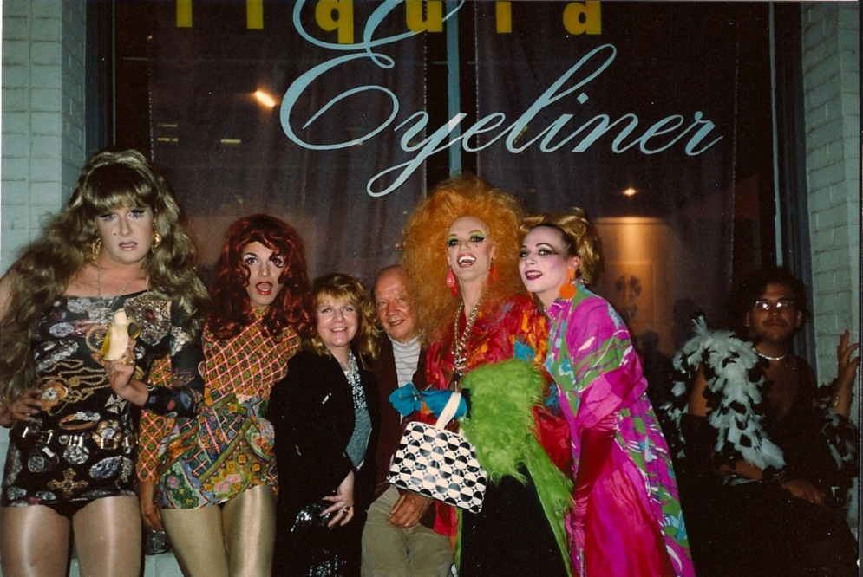
SFAC Galleries Historical Highlights
1970s
In 1968 The SFAC was granted permission to renovate 155 Grove Street
In 1970, Capricorn Asunder opens
Initiated Award of Honor exhibition. Recipients included Ruth Asawa, Imogen Cunningham and Sargent Johnson
1980s
Renamed San Francisco Art Commission Gallery
Mission expanded to include national and international artists
Infamous for tackling issues of the day including censorship and identity politics.
In 1986 the Exploration: City Site program began for site-specific installations in the empty lot next to the Gallery at 165 Grove Street. This program ended in 2001

Slide 4
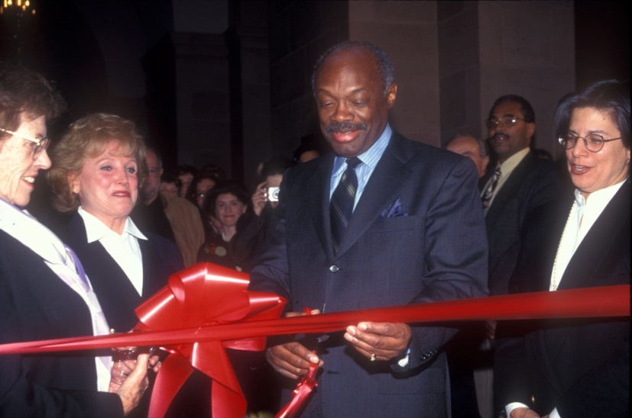
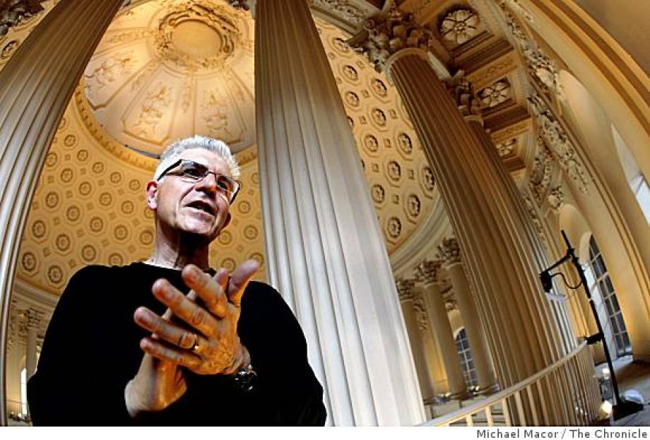
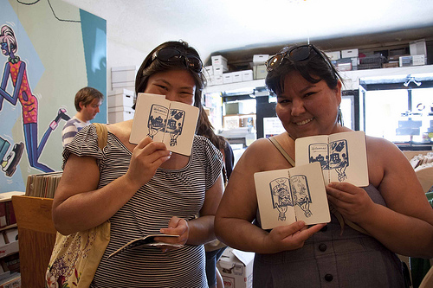
SFAC Galleries Historical Highlights
1990’s
1994, 155 Grove Street declared seismically unfit. Gallery closed, window program began.
A bond measure to renovate 155 Grove Street fails to pass by a slight margin
1996, temporary space in the Veterans Building opened. The Art at City Hall program began
2000’s
Mayor Brown requested plans to developed and renovate 155 and 165 Grove St, but never adopted
City Hall North Light Court banner program initiated
2008, site-specific Bill Fontana project at City Hall
2009, the annual Passport event replaces the annual auction

Slide 5
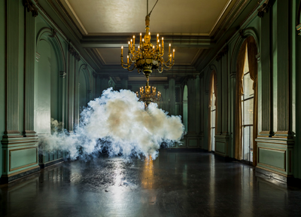
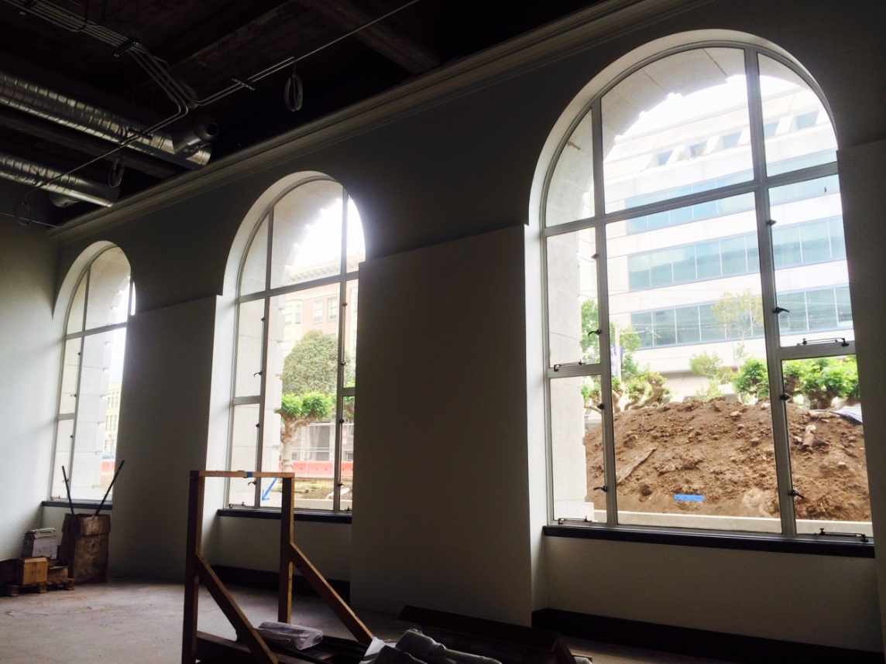
SFAC Galleries Historical Highlights
2010’s
2010, a massive 40th Anniversary historical exhibition was mounted at City Hall
2011, the Sister City Exchange
2012, the program was renamed “San Francisco Arts Commission Galleries”
2013, the SFAC Main Gallery in Veterans Building closed for renovation
Programming continues at City Hall and Grove Street
2016, new Main Gallery opens

Slide 6
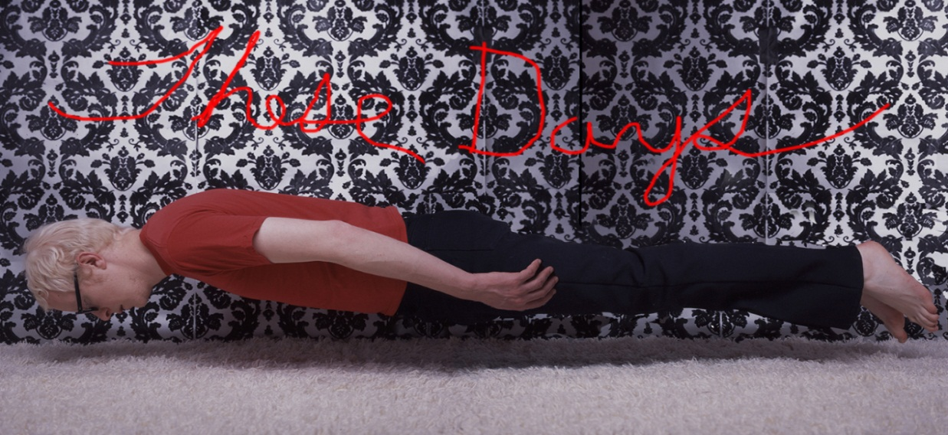
SFAC Galleries Fun Facts
The SFAC Galleries exhibits works by over 150 artists annually in our three Civic Center locations. *
80-90% of the artists we exhibit live in the Bay Area, and over two-thirds of those artists live in San Francisco. *
We produce 9 – 11 exhibitions annually.
We produce 1 – 3 educational public programs per exhibition. Public programs range from panel discussions to family days.
* Statistical data from 1990 - 2013

Slide 7
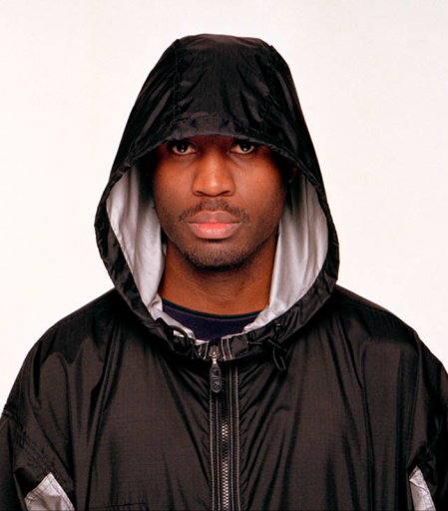
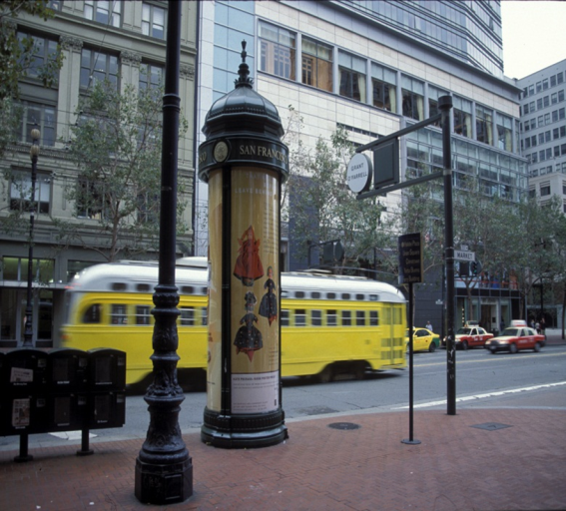
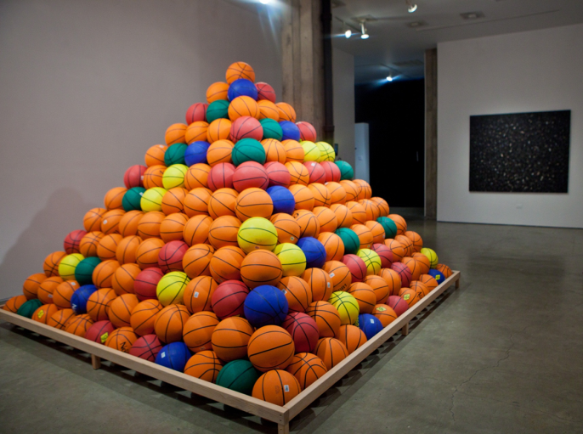
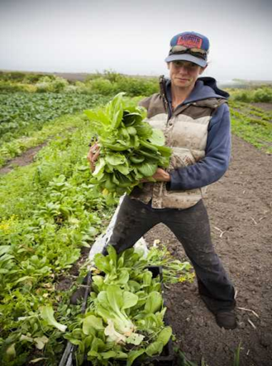
The SFAC Galleries enters into an average of 10 significant programmatic partnerships annually. (There are years that we are slightly under, and years, like 2011, where we nurtured relationships with 30 partners.) This statistic does not include our passport neighborhood vendor partners. *
Exhibitions with a social and/or civic focus constitutes two-thirds of the SFAC Galleries programming. *
* Statistical data from 1990 - 2013

Slide 8
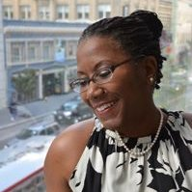
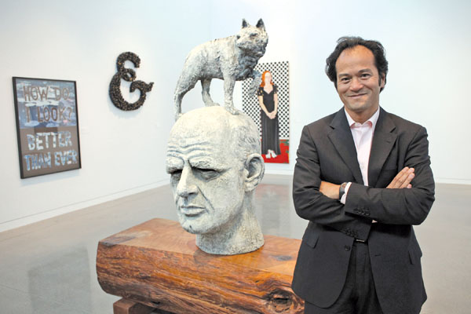
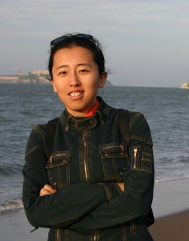
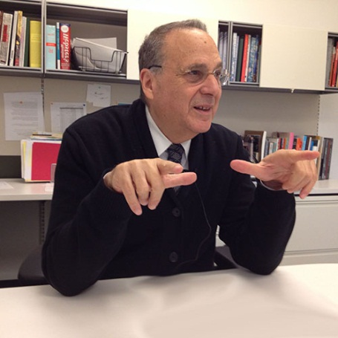
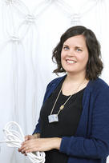
Step 1
Engage stakeholders and members of various sectors of our visual art community.

Slide 9
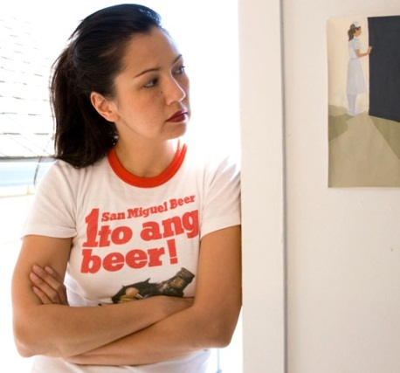
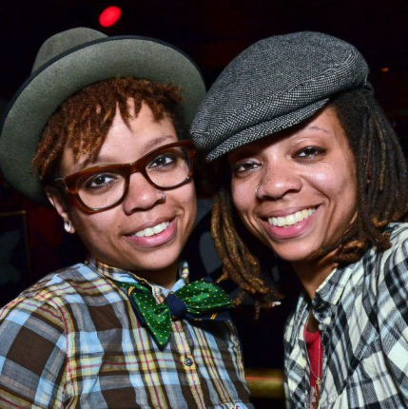
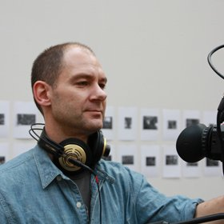
Two Stakeholder Meetings
In attendance:
Artists
Curators
Museum and alternative space staff
Art dealers
Funders
Commissioners
Advisory Board Members (past and present)
SFAC Staff
Individual Meetings (in progress)
Cultural Center directors and visual art staff.
Nonprofit arts org. directors

Slide 10
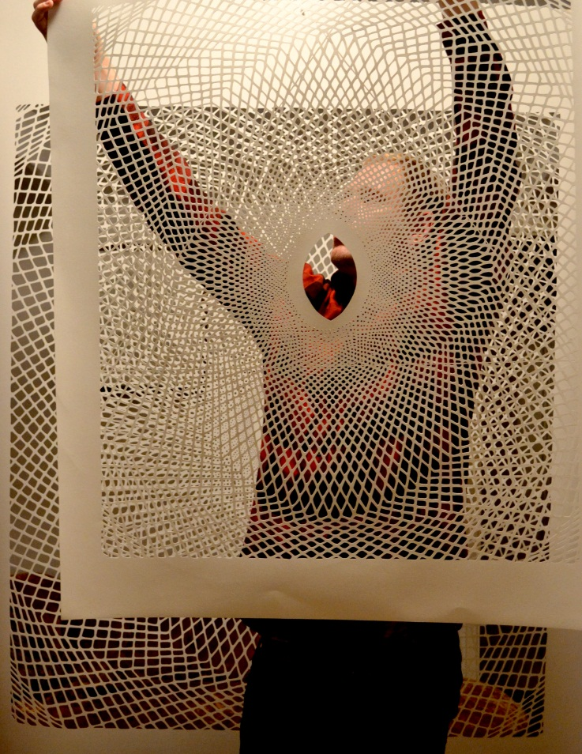
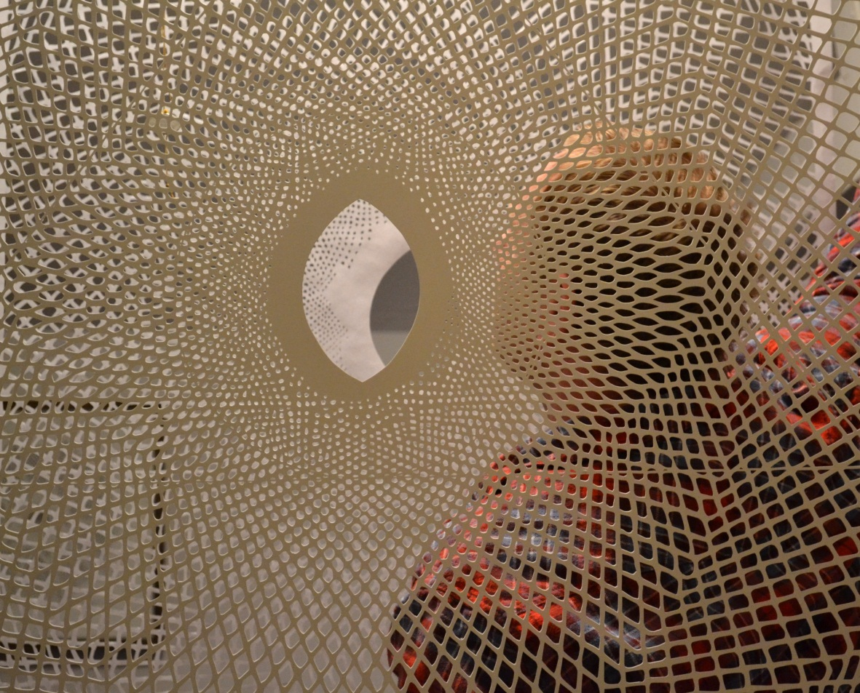
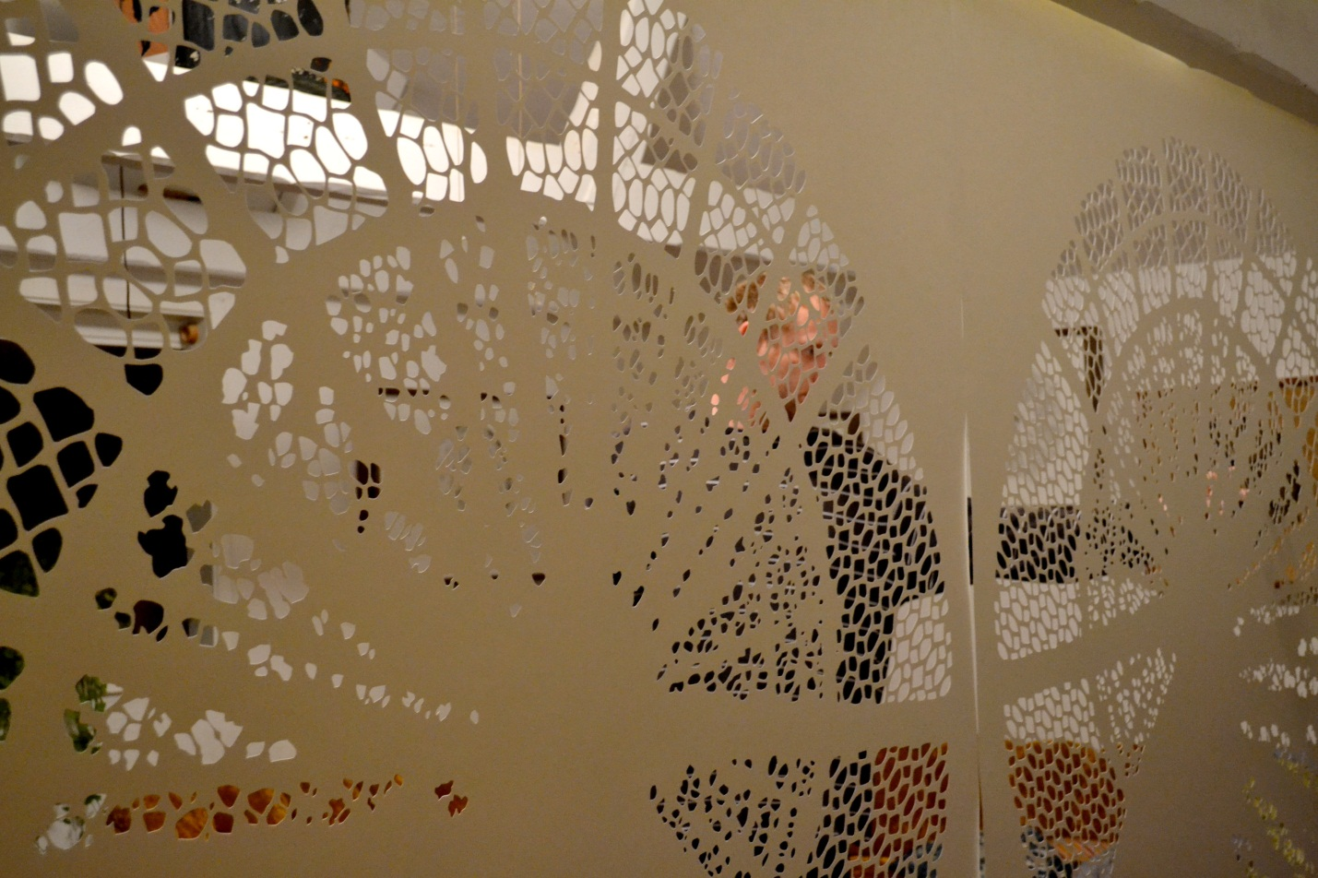
Step 2
Analysis of feedback and distill into a draft of programmatic objectives.

Slide 11
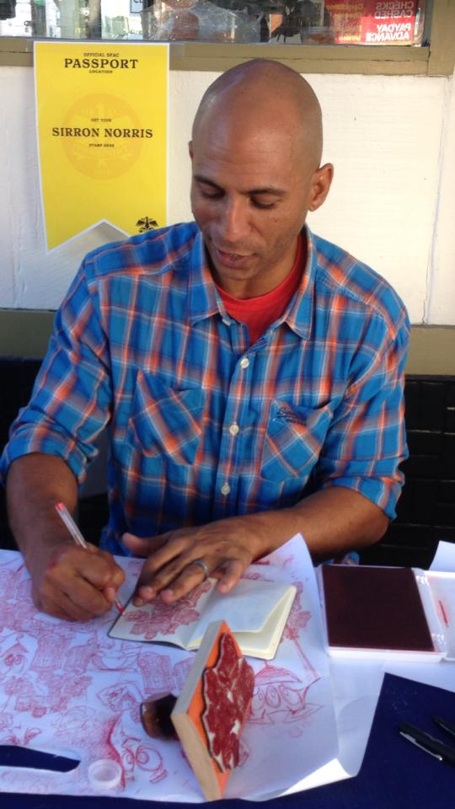
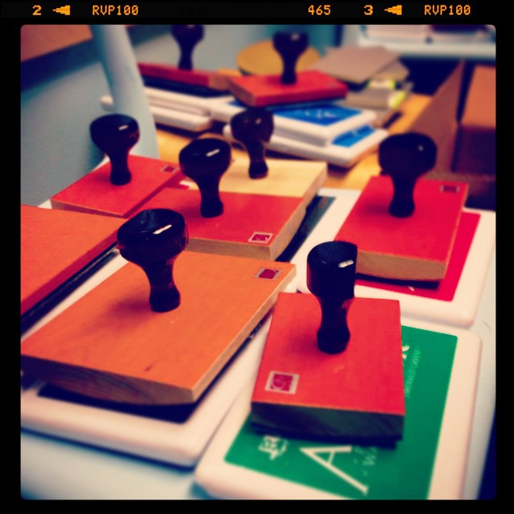
Objective 1: Exploit the unique civic nature of the SFAC Galleries program.
Engage a vast array of civic themes
Develop partnerships with other City Depts
Create programs for artists to interface with municipal entities
Feature SFAC grantees, public artists, street artists…

Slide 12
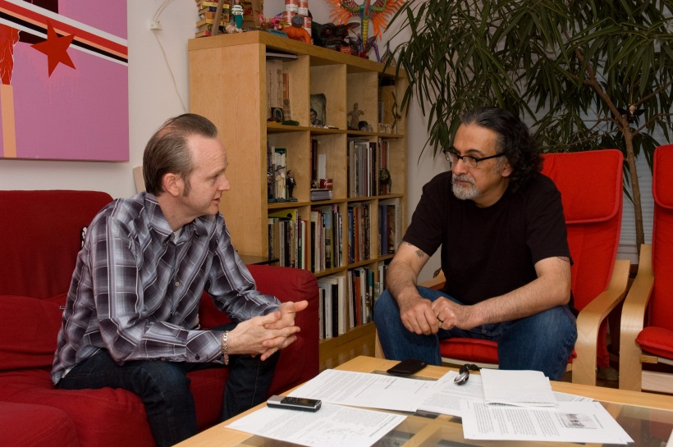
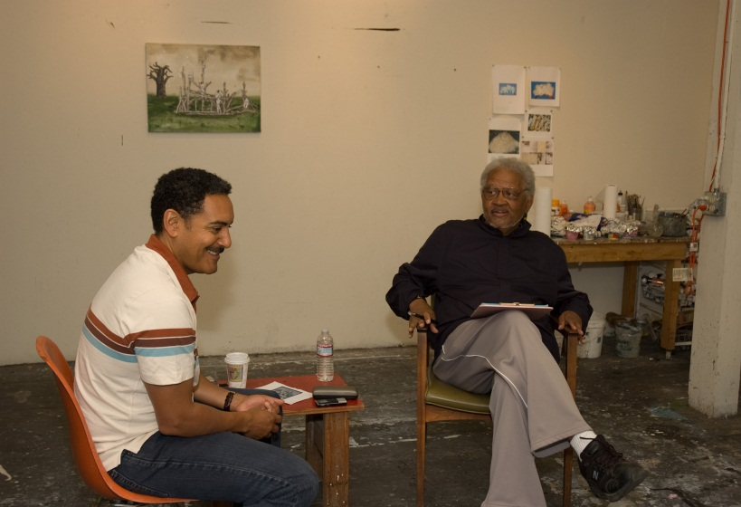
Objective 2: Represent the diversity of San Francisco.
Cultural, ethnic and gender diversity
Community diversity/neighborhood identities
Engage with various business sectors

Slide 13
Objective 3: Engage with artists in meaningful ways.
Empower local artists to address salient local topics
Show local, national and international artists
Commission new works/projects
Exhibit a high percentage of SF-based artists and SF-themed projects

Slide 14
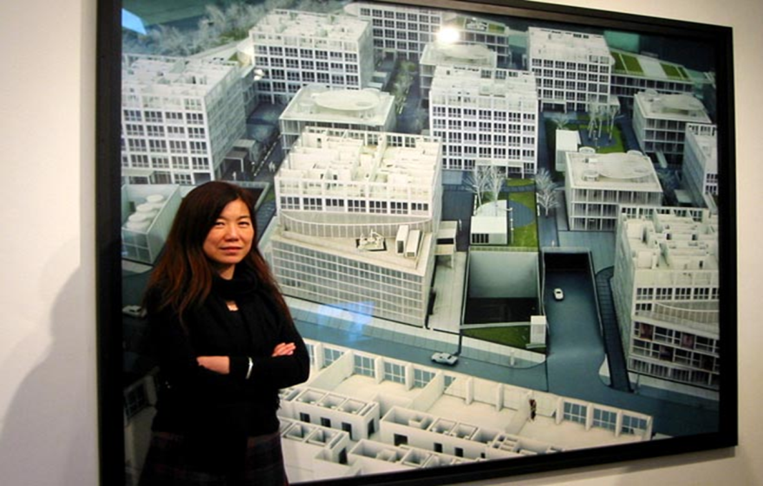
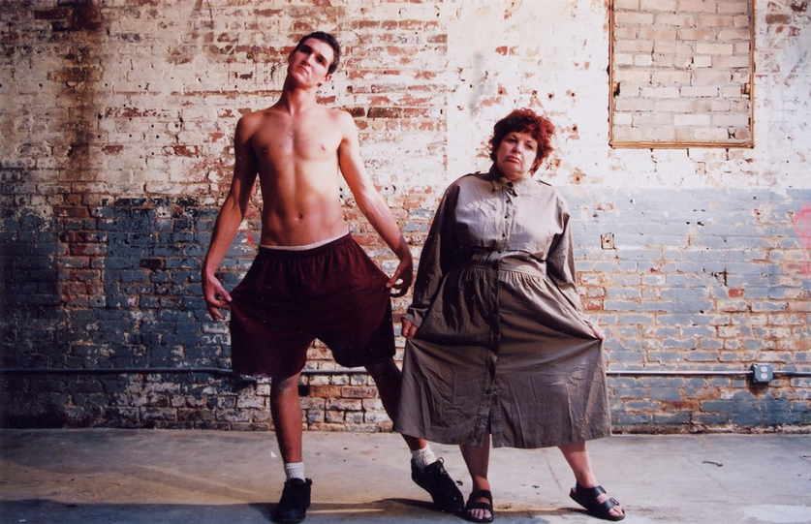
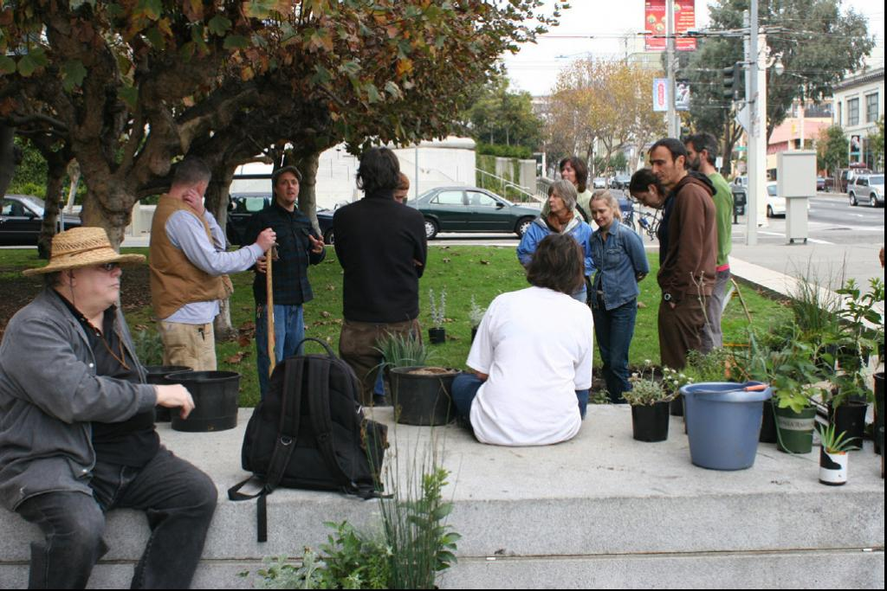
Objective 4: Develop unique and relevant exhibitions
Produce curated exhibitions and juried opportunities
Partner with arts and non-arts entities
Utilize guest curators
Commission artist-driven projects
Develop signature exhibitions and public programming
Use the gallery as a laboratory that fosters new ideas and practices
Travel exhibitions to promote a broader knowledge of our visual artists as well as the cultural values of the City of San Francisco

Slide 15
Objective 5: Expand free and accessible events that convene the community
Convene the community around timely topics (cultural policy making, artist and arts nonprofit displacement, burgeoning cultural districts, artist health care and housing, arts education legislation...)
Produce panel discussions and lectures. Also performances, readings, films and youth programming
Present workshops geared toward artist career development
Nurture signature public programming series like the Brown Bag Lunch Discussion and the Grove Street Artists Sidewalk Chat

Slide 16
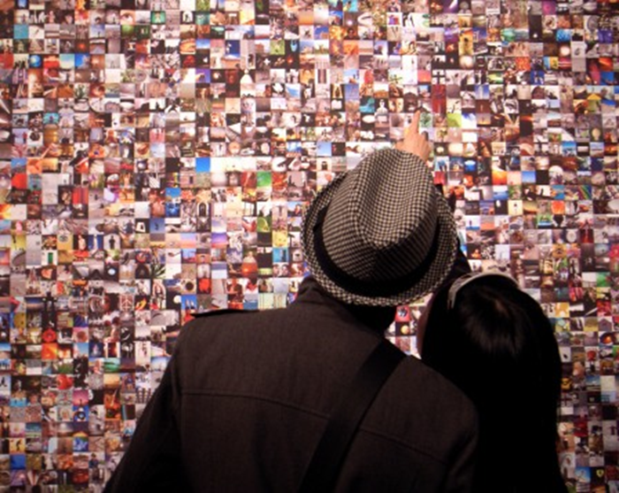
Step 3
Align programming with new objectives.

Slide 17
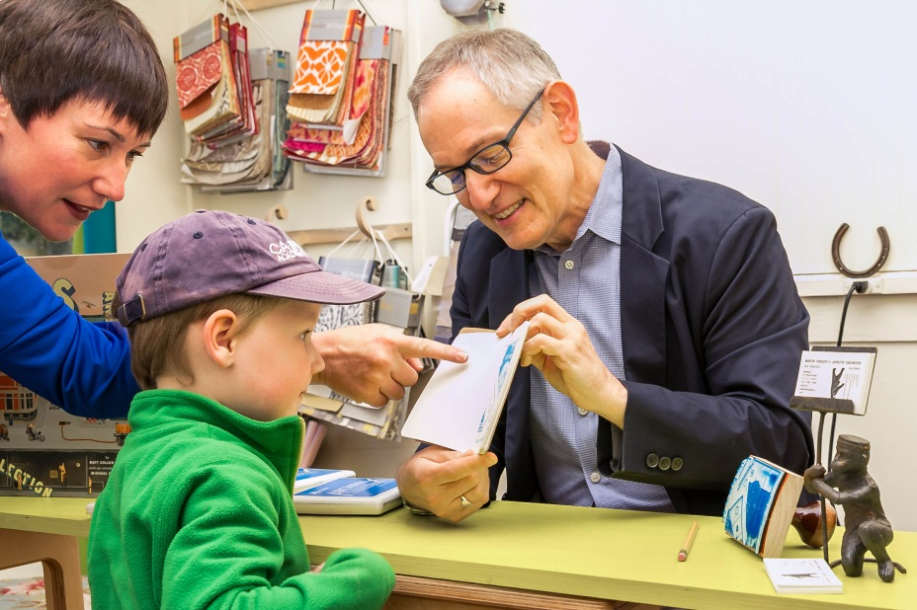
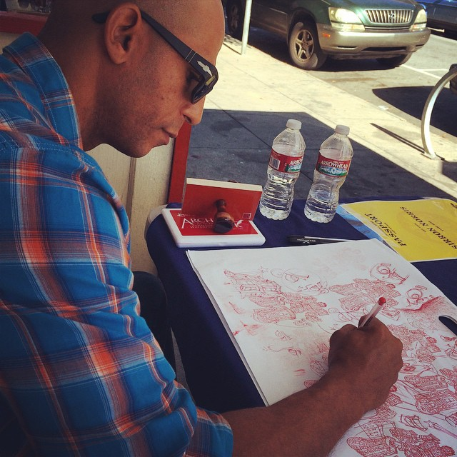
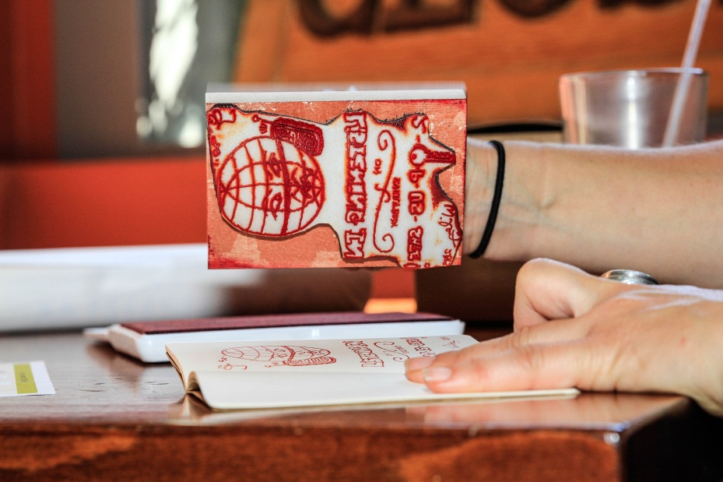
Ongoing partnership with OEWD’s Invest in Neighborhoods program (established 2014)
Program highlights the relationship between the arts and economic development.
Partners SFAC – OEWD – local artists – local businesses/merchants assocs. – 300 arts enthusiasts.
Previous neighborhoods: The Mission, Hayes Valley, North Beach, Divisadero Corridor, The Castro, Calle 24 Latino Cultural District
Passport 2015: Japantown

Slide 18
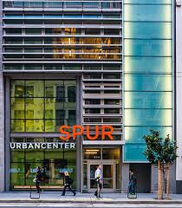
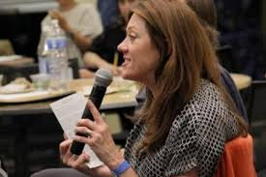
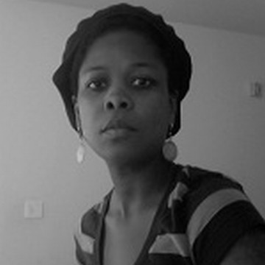
Potential public programming partners:
SPUR (intersection of urban planning and the arts)
Art Practical (public policy dialogues)
Congratulations Pine Tree (issues facing artists)
CIIS (intersection of civic/social issues and the arts)
Emerging Arts Professionals
Nia King (queer artists of color)
Ashara Ekundayo (diverse cultural communities)
SFAC Grantee Partners

Slide 19
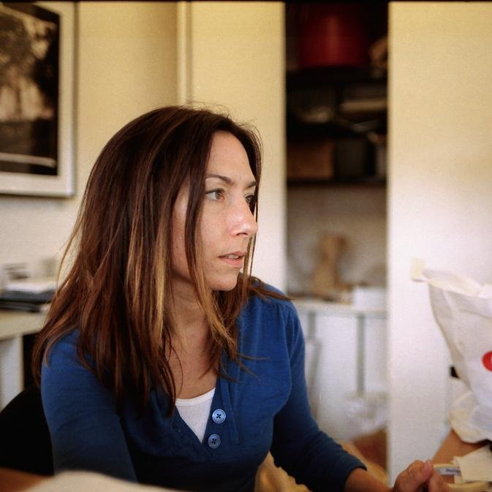
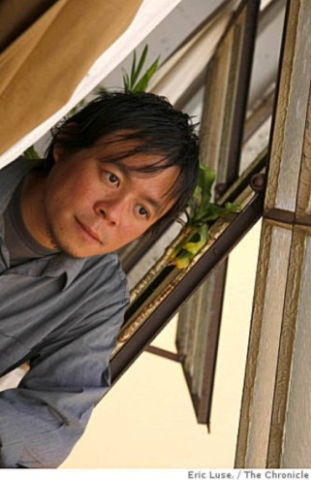
Expanding curatorial
Guest curators
Independent curator
Organizational curator
Artist curator
Varied Juries and opportunities
Broad community call, diverse jury
High level juried opportunity, mid-career survey
Nurturing new talent
Potential fellowship for emerging curators in partnership with CCA’s Curatorial Practice program

Slide 20
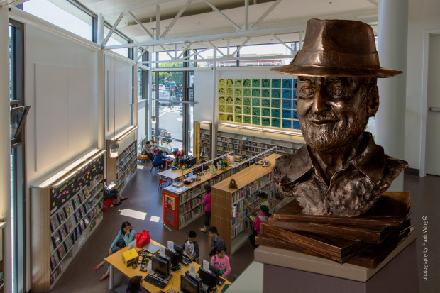
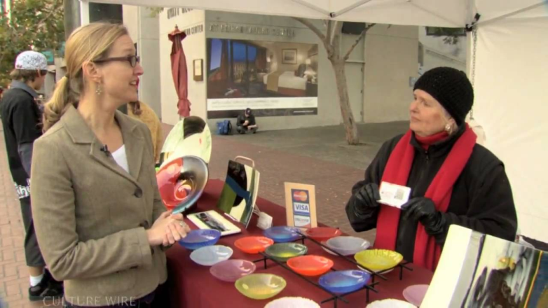
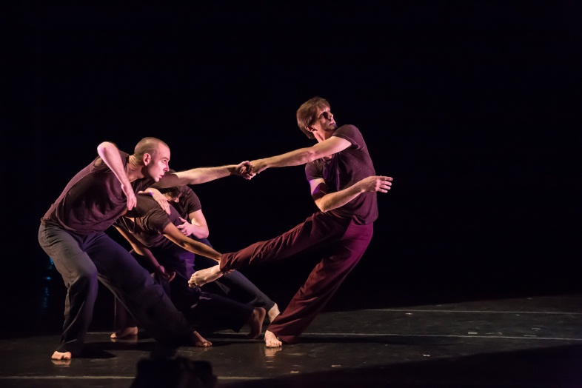
Featuring SFAC artists (early ideas)
Have artist products for sale in the lobby. Perhaps an annual featured Street Artist.
Have a monitor in lobby featuring DVD’s provided by performing arts grantees
Exhibitions. Civic Art Collection show in 2017. Public artist and grantee shows 2018-20.

Slide 21
Selected Upcoming Exhibitions
Veterans-themed exhibition (guest curator, arts and non-arts partners, local and national artists)
Chain Reaction 12 (signature program, artist curated, local artists)
Landmark: Contemporary Photography of Yellowstone (guest curator, travelling exhibition, municipal partners, California artists)
2017 Sister City Exhibition: Manila (guest curators, local & international artists, arts & municipal partners, travelling exhibition)
Mid-career survey for local artist (selected by a jury, significant local artist opportunity)
PhotoAlliance juried exhibition (open call for submissions, regional artists, arts organization partnership)
Roy De Forest & Friends (, Civic Art Collection focus, guest curator, partnership with Oakland Museum of California)

Slide 22
Questions for VAC…
Do you see a clear alignment of the program with the agency strategic plan?
Are there gaps or additional strategies that could advance the goals of the SFAC?
How would Commissioners like to be engaged in further strategic development and planning processes?

