Slide 1
PRELIMINARY RESEARCH & RECOMMENDATIONS
ON EMERGING MOBILITY SERVICES AND LABOR
University of San Francisco, Urban and Public Affairs - Research Methods Class

Slide 2
Labor/Political Economy Findings
Ben Peterson, Camila Mena, Grasielita Diaz, Josh Steinberger, Melissa Benik, Sergio Martinez, Zach James
Notes:
Good afternoon, commissioners. My name is Sergio Martinez. (pause)
We are excited to present to you the preliminary findings and recommendations made in regards to the emerging gig services and its potential effects on labor in the city of San Francisco.
The research was conducted by about 20 graduate students from the Urban and Public Affairs program from the University of San Francisco. Over the past 3 months, we prepared our research focus, conducted field research and compiled a final report of what we learned with recommendations for possible action. I don’t think that many of my research partners or I will ever be able to get into another Uber or Lyft without thinking about what we uncovered.
The research group itself was divided into the four smaller focus areas of labor/political economy, geography, politics and lobbying and best practices. Although, our research was confined by a limited scope, the sample reveals several findings that could be indicative of the larger picture and useful for the research that LAFco has to follow.
Today, we are at a moment where an increasing amount of people are working for and/or using the services of gig economy which due to their rapid rise have grown with little regulation. It is for that reason, that research like this is needed to expose the good, the bad, and the ugly around these gig economy services.
We are going to begin by talking about the population of drivers and their multiple relationship to their positions as drivers through the findings from the Labor/Political economy group. Our findings revolve around the research question:
What impact does the gig economy have on the livelihood of workers in San Francisco?

Slide 3
Methods
Survey
Demographics, Income/Expenses, Work/Life Balance, Career, Health, Externalities
Distributed the survey through “Uber and Lyft San Francisco” facebook page
Outreach at several gas stations & driver meetup spaces
Interviews
Notes:
We obtained our data by creating and distributing a survey. The survey is divided into two separate sections. The first section contains questions on demographics such as race, age, educational attainment, gender and residential zip code. The other demographic questions collect data on driver habits. The next section is 21 sliding scale questions that relate to our 5 subcategories of work/life balance, income/expenses, career, health and safety, and externalities. We chose these subcategories to best arrive at a measure of livelihood. The survey was created with the intention that it would take less than 10 minutes to complete, to incentivize drivers to respond.
We distributed this survey through the “sf uber/lyft drivers” facebook page, and participated in several outreach events at san francisco gas stations and received 36 total respondents.
Our last tool were in person interviews with drivers where we elaborated on the survey questions. There were 6 interviews total.

Slide 4
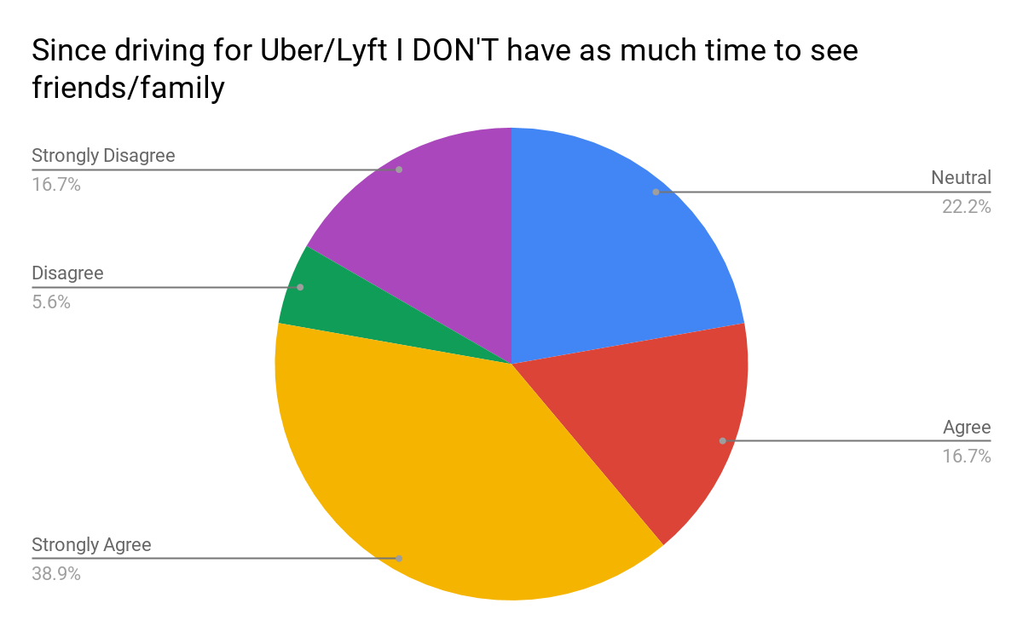
Work/Life Balance
“That’s the real heartbreak of the story - the loss of my children.”
Notes:
The work/life balance subcategory was used to determine how much the gig economy structure of work impedes on the life of drivers.
Over 2/3rds of respondents drive for both Uber and Lyft. This is troubling statistic because other results show that almost half of Uber drivers are driving more than 41 hours/week whereas a quarter of Lyft drivers drive more than 41 hours/week. With 2/3rds of drivers driving for both apps it is likely that many drivers are often working +40 hours per week.
Questions to ponder:
Why are people working this much?
How does Uber/Lyft incentivize drivers to keep working?
In addition to that finding, most respondents answered saying their schedule is more flexible since they’ve begun driving, but simultaneously answered that they have less time for hobbies and family. This clash may be due in part to Uber/Lyft’s “be your own boss” ideology. One driver described driving as.... “A trap.” The driver began working for Uber/Lyft after they were injured and could not continue at their original career. As time went on, it became harder and harder to get into another job because of their work gap. The driver explains that now they have to work 6 days a week to make ends meet. This only leaves a day for him to see his kids who do not live with him.

Slide 5
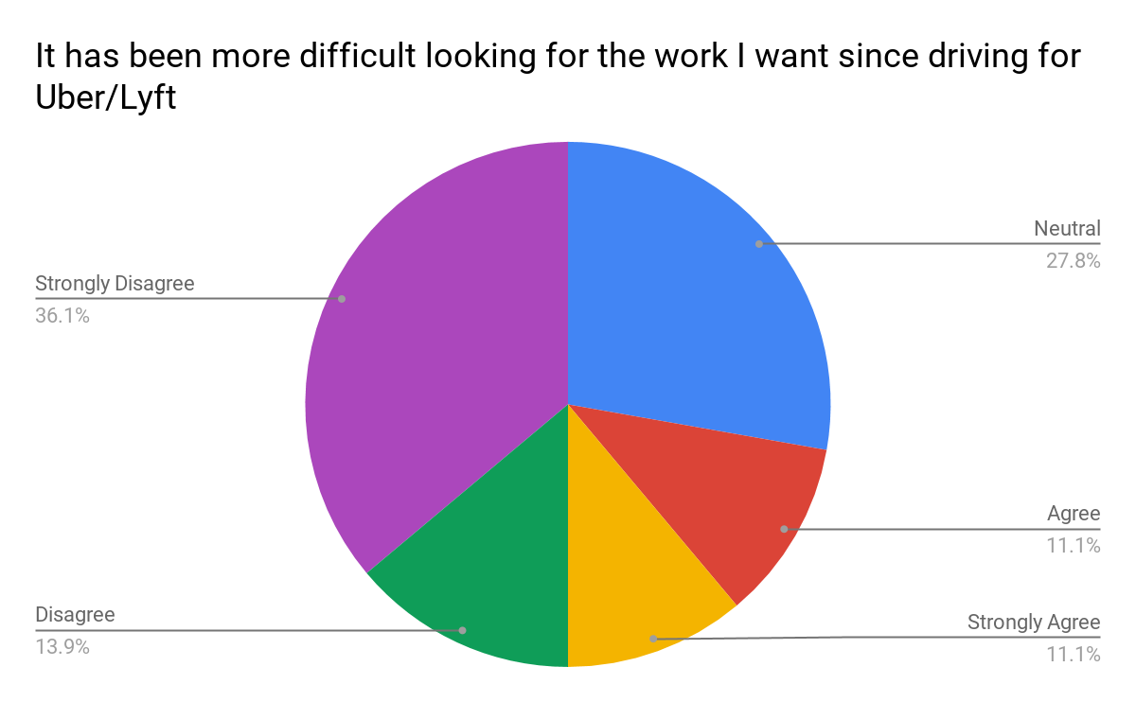
Career
“B: What were the circumstances around your decision to start driving for Uber?”
“K: Being a P.E. teacher, I had the summers off. So I thought I could do it on my time, my schedule... just make some extra money.”
Notes:
The career subcategory was used to measure the effect of driving on driver’s professional lives.
2/3rds of drivers indicated that driving was not their long term goal. 2/3rds of drivers were either working another job or looking for another job. This could mean that drivers are using TNCs as supplemental income.
As we know the costs of living in and around the Bay Area are increasing. Many families need to work 1.5-4 minimum wage jobs in order to afford a 2 bedroom apartment. These costs, along with, the higher than national average unemployment rate in the driver’s residential zip codes provides insight as to why people turn to gig work.
Of those who answered favorably, as seen in the quote, the respondents did not rely on the income. The quote on the screen describes the experience they had. As part of a household with two incomes this interviewee described driving money as their “golfing money.”

Slide 6
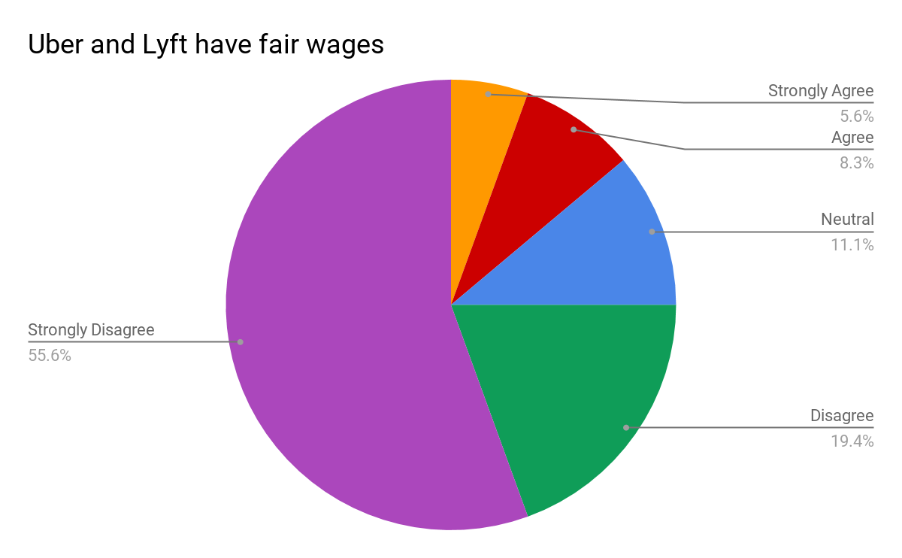
Income/Expenses
“Well at the moment it does (gas prices) affect when you’re pumping and stuff. I pump frequently like once a day, every time I’m going to drive I fill up, so it adds up. So let’s say it’s a random $120 on gas that I’ll spend on the weekend or something like that.”
Survey Response:
*75% of drivers responded that they believe the rate of pay Uber/Lyft provide is unfair, while only 14% believed they were earning fair wages
*
Notes:
The income/expenses subcategory was used to determine if driving for TNCs is economically profitable.
Of the four metrics we included in the survey, income/expenses received the lowest average score. Overall, 75% of respondents believe the rate of pay Uber/Lyft is unfair.
Questions included:
I have more income stability since driving for Uber/Lyft
I am not able to save money while driving for Uber/Lyft
The quote on the screen shows one driver who initially answered positively to the income questions but when probed about the expenses didn’t seem to know how much they would exactly goes into driving.

Slide 7
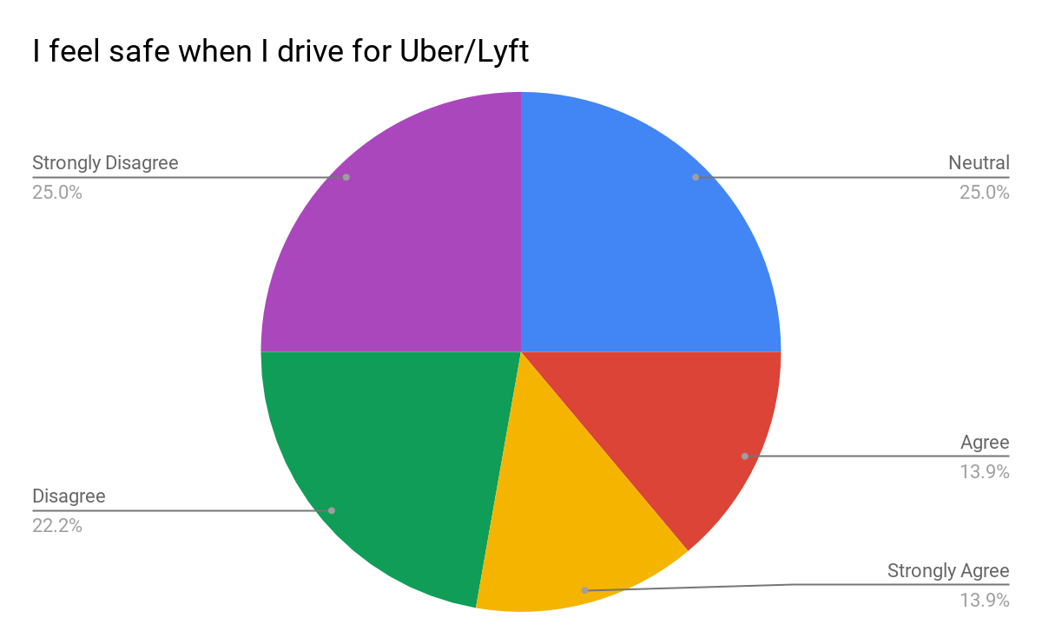
Health and Safety
DATA
“He got pissed off. He called me, you know, he said ‘f*** you, you piece of s**t... and then like he grabbed my water bottle and threw it at my face.”
Notes:
Quotations or things we picked out
Ben’s interview: Karen:”...I’ve never felt uncomfortable but I really only drive, you know, during the day”
Zach:
“In California I just don’t feel safe driving at night.”
“A lot of tourists are more happy, and you like, more relaxed” in Hawaii vs. California.
Zach:
“He got pissed off. He called me, you know, he said ‘fuck you, you piece of shit’ um and then like he grabbed my water bottle and threw it at my face.”
He has only been physically assaulted in California.
One interviewee has noticed that riders in California act much more entitled than in other places he has driven.

Slide 8
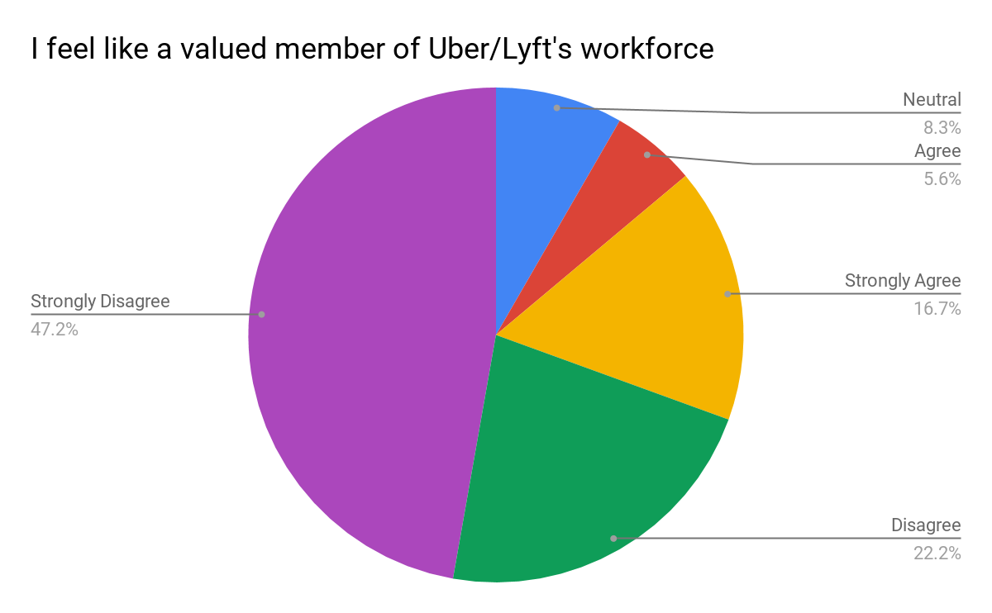
Externalities
“They are not taking a “normal capitalistic” responsibility for the overhead of their corporation. We are just pawns and numbers, and as long they keep us independent they don’t have any responsibility for us.”
Notes:
deactivations

Slide 9
Recommendations for Research:
Reach out to a wider set of organizations, continue outreach, and create survey link cards to gather more and diverse responses.
Focusing on:
Work/Life Balance
Create specificity in the survey to adequately distinguish between drivers who drive for one TNC or two to understand the impact of the “be your own boss” mentality
Income/Expenses
Is it common for drivers to take out debt in order to drive for the TNCs?
Are drivers aware of their income after their expenses? If they don’t track this, why not?

Slide 10
Recommendations Continued
Career
Track the reason why drivers begin driving and how long they remain driving
Health
Track medical visits/healthcare/employee Benefits
Explore the frequency of verbal, physical, and sexual assault experienced by drivers
Externalities
Explore the fear of deactivation
Investigate the Tech Support inefficiency in responding to driver’s needs

Slide 11
Geographical Dimensions of TNC Workers in the San Francisco Bay Area
Cara Annese, Anthony Caceres, Pierce Forgione, Luwam Kahassay, C.J. Olton Jr., Justin Pearson
Notes:
How the unique layout of the Bay Area affects TNC workers

Slide 12
Inquiries
Methods
In person interviews
Surveys
Data plotting, MapLine
What are the reasons TNC drivers come to San Francisco?
Why are they not working in their own city?
How long are they driving?
Notes:
Interviews were conducted with TNC Drivers while waiting for, or actually on a ride with them. Drivers tended to be more amenable to speaking in a ride. Surveys were conducted by the previous Labour group

Slide 13
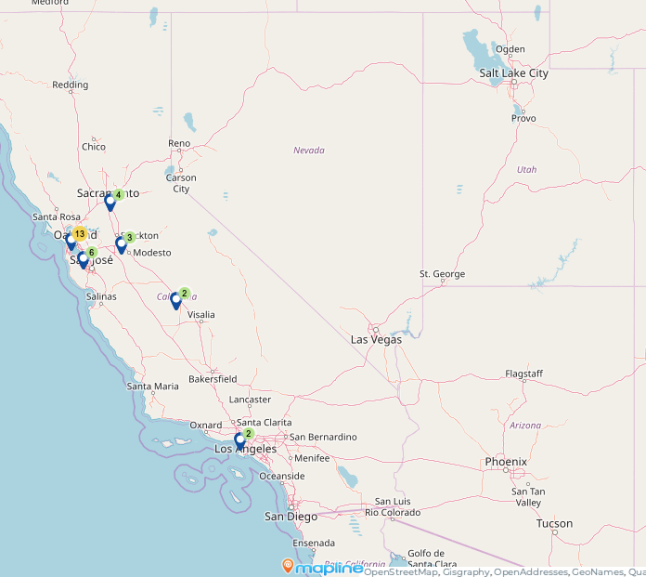
Map 1:
Representation from surveys of where drivers are coming from based on their zip codes.

Slide 14
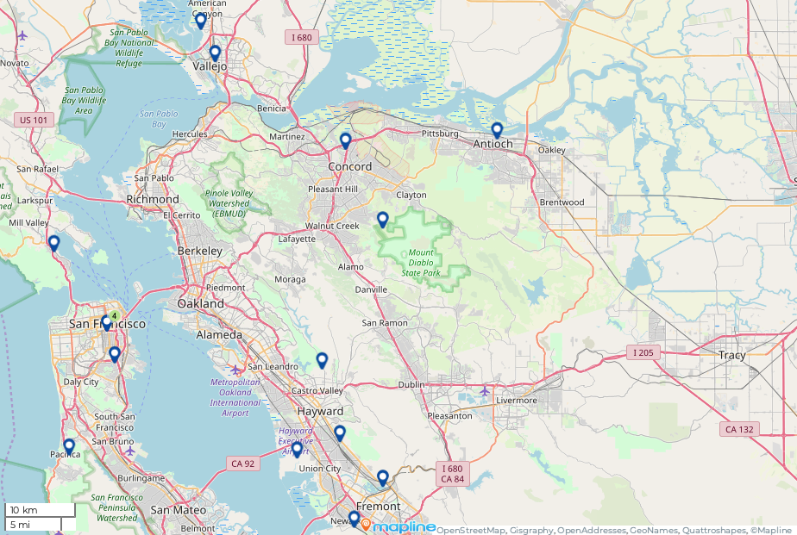
Maps Continued
(Based off interviews)
Notes:
Speak on interview with drivers who came from Anitoch, because it was cheaper to live there. The caveat was that there often were not rides on their way back home, and so that gas and time was on their own dollar. Linking to the points made by labour, we see the geography of the region playing out

Slide 15
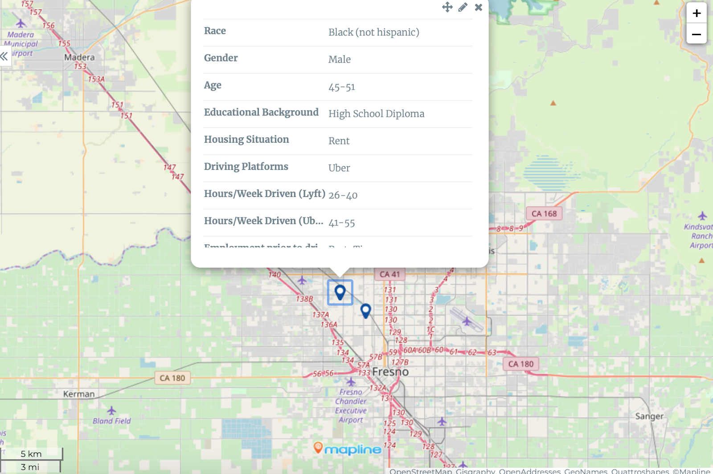
Maps Continued

Slide 16
Income Inequality
Bay Area Income Breakdown (2017 U.S Census)
 | Median Household Income | Per Capita Income | Population
Alameda | $96,265.00 | $41,363.00 | 1,666,753
Contra Costa | $88,456.00 | $42,898.00 | 1,150,215
Marin | $104,703.00 | $66,748.00 | 259,666
Napa | $79,637.00 | $40,632.00 | 139, 417
San Francisco | $96,265.00 | $59,508.00 | 884,363
Santa Clara | $106,761.00 | $48,689.00 | 1,937,570
Solano | $72,950.00 | $31,934.00 | 446,610
Sonoma | $71,691.00 | $37,767.00 | 499,942
U.S Census Bureau (2017). Median Household Income, Per Capita Income, 2013-2017 American Community Survey 5-year estimates.
Notes:
Place map showing Uber drivers’ routes coming into SF
Drivers take route to SF because the financial district during business hours is a hot market

Slide 17
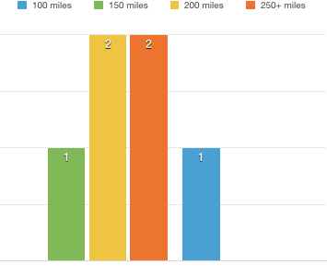
Miles Driven Per Shift

Slide 18
Through the data
It is important to think about why San Francisco is the central destination for so many drivers
This may stem from the city’s growth in jobs as well as the greater prospects for jobs in the thriving tech industry.
This must also be compared with the high cost of rent in San Francisco that has caused the wider Bay Area to exist as a super-city of sorts, in that, many people that may work in San Francisco must commute from outside the city.
Because of wealth and income disparities, many workers in general having to work multiple jobs in order to afford the cost of living in the Bay Area.
In the case of TNC drivers in San Francisco, they are being incentivized by higher earning potential to commute into the City, while living in lower cost areas on the outskirts
These commutes can be upwards of 100+ miles and over 2 hours.
The gig economy fills a gap in the hinterland-city connection that had existed prior in the Bay Area

Slide 19
Politics & Lobbying
Lydia Cho, Maria Amezcua, Karen Aceves, Juhi Khemani, Elijah Williams
Notes:
Maria
Hello I am Maria Amezcua and this is my partner Lydia Cho. Our group focused our research on Politics and Lobbying effort of Transportation Network Companies such as Uber and Lyft since they’ve entered San Francisco without clear regulations.

Slide 20
Inquiry Methods
How should city officials and community leaders factor in Transportation Network Companies when enacting policies and legislation to regulate TNC’s?
What are merchant groups and elected officials’ impressions of TNC’s lobbying efforts?
What can San Francisco do to mitigate impacts of TNC’s on the city?
Email communications
Interviews:
Legislative Aides (3)
Merchants Association (2)
Notes:
Maria
First, reiterate the questions again, read them in order
To answer these inquiries we began by reaching out to city officials we believed had the city and its constituents in mind when enacting policies, thus we chose the Board of Supervisors.
We began by drafting emails stating our purpose and who we were. And within a few days we received responses primarily from the Legislative Aides of the Supervisors, many responding positively to our inquiries.
We set a date with our first legislative aide for an in-person interview in city hall. While the other two interviews with the legislative aides were done over the phone.
At the same time, our team felt like we needed more than just responses from the legislative aides, and from a different perspective. So we looked into the community leaders and we ended up contacting various Merchants Association to contact. We were able to obtain two interviews with different merchant association and were conducted over the phone after the initial email.
These are a few of the questions asked ourselves when attempting to approach city officials and merchant groups...
By asking city officials and community leaders what San Francisco’s legislation would be when enacting policies and legislation for TNC’s.
For lobbying, we looked at the merchant groups in San Francisco and their impressions on Uber and Lyft’s lobbying efforts.
And our last general question is what can the city of San Francisco do to disarm Uber and Lyft?
We began by contacting individuals that were active in City Hall and had clear opinions on where they stand with TNC’s. We began by outreaching to the Board of Supervisors and drafting questions tailored to their stance on TNC’s, online comments, articles, etc. Our entire team began to craft an email stating our purpose and who we were. Within a few weeks we received responses primarily from the Legislative Aides of the Supervisors, many responding positively to our inquiries.
We set a date with our first legislative aide for an in-person interview in city hall. This lasted us at least 30 minutes worth of questions and answers. A few weeks later we received two more interviews with different legislative aides and both were over the phone for 20 minutes.
At the same time, our team felt like we needed more than just responses from the legislative aides, and from a different perspective. So we looked into the Merchants Association and found multiple associations and locations which we also initially emailed. We first distributed all the emails and contacts, but in the end only one group member received responses from multiple sources, some preferred their information to be omitted. All the merchant association interviews were done over the phone and via email.
Merchant’s Associations — the ones we initially contacted were the Greater Geary Merchants Association, Valencia Corridor Merchants Association, Marina Merchant’s Association, Presidio Heights Neighborhood Association, and the overall Council for District Merchants Association
Many of the responses we received were impressive and insightful.

Slide 21
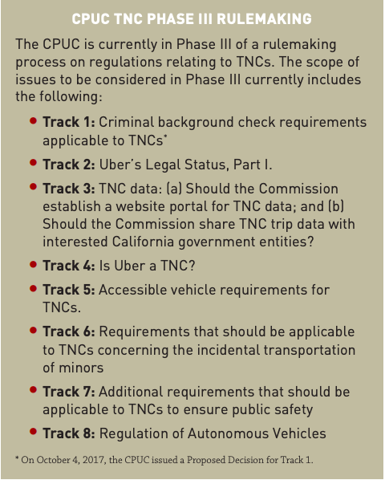
Findings: Legislative Aides
California Legislature: California Public Utilities Commision
Labor: Taxi industry and contractors
Environment: Congestion and emission
Safety: Double parking and vehicular housing
Notes:
Maria
*Do explain what the photo on the right hand side is.
*Try not to start each finding by saying “a lot of them said..”
*Do not introduce the next slide
We collected all the findings from the legislative aides and grouped them in categories where many of the responses overlapped.
The first category is jurisdiction: it was clear that San Francisco doesn’t have the ability to fully regulate TNC’s based on the California statewide policy of being regulated by the Public Utilities Commission.
What are the capabilities and even inabilities to regulate TNC’s on the side of city officials. Along with future possibilities of what the city would look like when there are regulations on TNC’s.
Constituents complaints and worries on safety such as vehicular housing
https://archive.sfcta.org/sites/default/files/content/Executive/Meetings/board/2018/01-Jan-23/DRAFT_TNC_Regulatory_Landscape_2017-Dec.pdf

Slide 22
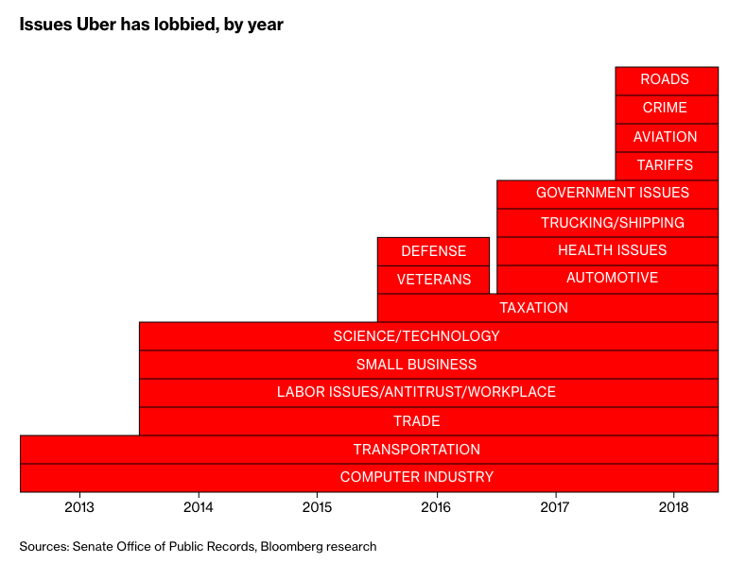
Findings: Lobbying Issues
Notes:
Lydia
Hello, my name is Lydia. So the second round of findings that the politics team would like to highlight is the merchants association.
After we’ve interviewed the few different supervisor offices, we started to think about -aside from the lawmakers and politicians, who are other key players that Uber and lyft are putting a lot of effort in to lobbying?
We came across this chart, on various issues that uber specifically focused on lobbying since 2013. This is something we found from bloomberg. As you can see, Uber started off with focusing on transportation and tech industry, but has expanded onto larger social issues as they’ve grown such as health, labor and even crime. By 2016, Uber and Lyft alone outnumbered the # of lobbyists compared to Amazon, Microsoft, and Walmart combined.
Among some of the more obvious ones, we thought it would be a good idea to dig a little deeper into how Uber/Lyft have advocated for their interests towards small businesses to gain public support here in san francisco.
So within the time capacity that we had, we were able to get ahold of 2 groups: one is Valencia Corridor merchants association and the other group wanted to stay anonymous while agreed to have their input reflected in our research.
Uber started lobbying efforts focused on transportation and the tech industry, however has moved onto larger social issues as they’ve grown such as health, labor, and even crime lobbying efforts. Based on this chart(?) from a research published by Bloomberg in April 2019, we were able to narrow down to some of the top issues that Uber has focused on lobbying since 2013. Within our research capacity, we decided to focus on and dig a little deeper into how TNCs may have advocated for their interests to small businesses in San Francisco.

Slide 23
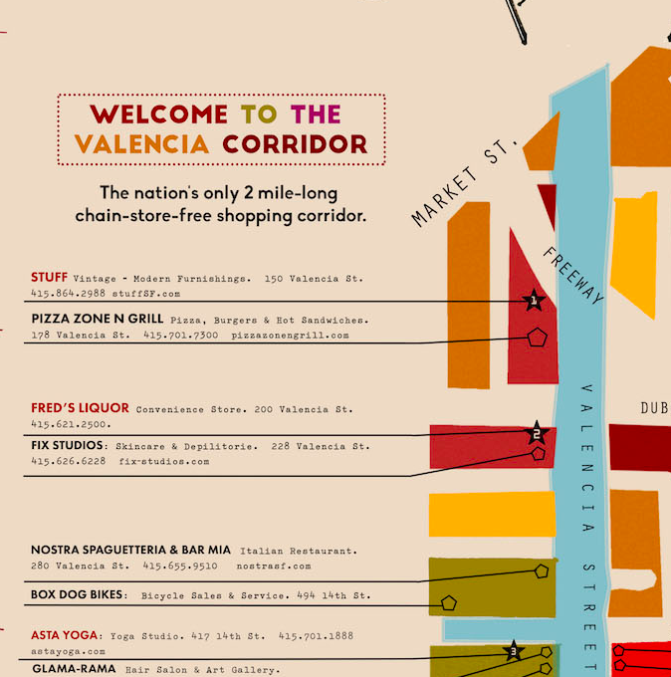
Findings: Merchants Association
Coalition Building community effort
Community Presence
Alliance/ Partnership
Sponsorship/ Investment
Providing support to local businesses that the city has not yet offered
Building connections with the
merchants in ways the city cannot
Notes:
So the main thing we found from the interviews is that both Uber and Lyft have in the past tried to make connections or at least communicate with these organizations.
For example, in 20xx, Lyft partnered with VCMA and funded to making of this map. Some of you may have already seen it, but it is a beautiful and well-designed map that features all the unique storefront on Valencia street, which is the only 2-mile long chain store free shopping corridor in our country. The map is a great project that helps the neighborhood
The map “ Welcome to the Valencia Corridor” has provided an emphasis on shopping by highlighting a “chain-store-free” corridor. LYFT has funded and helped the process of emphasizing the map’s importance for all; this includes the merchants/ visitor/ shoppers/ city/ residents. And in return, Lyft can generate more riders in and out of Valencia corridor.
The coalitions efforts and Lyft, use each others needs, as one needs customers and a flow of shoppers while the other provides the means of transportation and highlights locations like the Valencia Corridor. (This is the coalition effort, they feed off of each other lol)
Thus they create a relationship/alliance/partnership with each other
For example, Lyft/Uber sponsors events by giving grants and other financial means for the organization which also entails investment in the neighborhood where many of their targeted customers live and bring in more visitors that ride lyft/uber.
When we talk about the second bullet point, I think it’s important dilute the language we used in the preliminary report.
We do not want to call out Supervisor Ronen for not showing up for the merchants’ meetings.
Mention Merchant’s investment in street safety — how this directly affects their business and how double parking can affect their storefront.

Slide 24
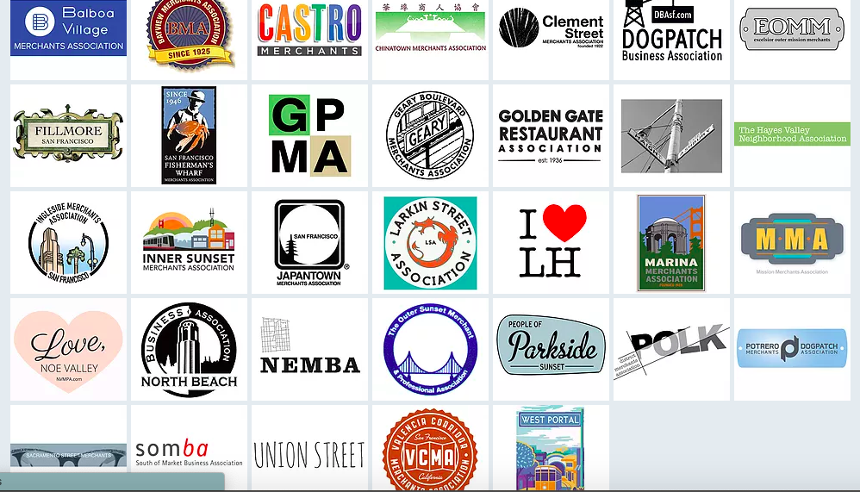
Noteworthy Stakeholders & Recommendations for Research:
Restaurant Associations; Golden Gate Restaurant Association
Bike Associations
Public Safety Coalitions
Neighborhood Associations
Merchants Associations
Notes:
Recommendation for research:
Due to our time constraints and long periods to reach out, wait for response, and choose a specific time for the interview; there were many associations, organizations, and groups we were unable to reach out to. As we found the Merchant’s Association as a great resource of information, we recommend for LAFCo to reach out to restaurant associations, Golden Gate Restaurant Association, along with other stakeholders such as the bike association, public safety coalition, neighborhood association, etc.

Slide 25
Best Practices
Eva Gaye, Preston Kilgore, Lindsay Miller, Winston Parsons, Gabriella Ruiz
Notes:
P: 1st Slide:
15 seconds
The best practices group built a suite of policy proposals for decision makers to utilize or apply based on the political climate, or the ability of local legislators to regulate the ride hail apps and to provide protections for drivers of these services.
We have six primary recommendations for SF policy makers to consider

Slide 26
Methods
Guiding Research Question: Specific to the gig economy, what are best practices that support San Francisco’s goal of “ensuring fairness in pay and labor policies and practices?”
Companies focused on: Uber, Lyft, UberEats, Doordash, and Postmates
Conversation with Gig Workers Rising
Performed research on cities currently working to regulate the above companies
Compiled policies and practices implemented
Categorized policy issues: Labor, Safety, and Geography
Interviewed Steve Smith, Communications Director at California Labor Federation
Consolidated our best practices
Notes:
P: Read directly from slides
Time: 45 seconds
The question that we used to guide our research was to look specifically at the gig economy and examine what are the best practices that support San Francisco’s goal of “ensuring fairness in pay and labor policies and practices?”
Our research included conversations with Gig Workers Rising, research on cities that are currently trying to regulate the companies above, and an interview with Steve Smith, The Communications Director at California Labor Federation.

Slide 27
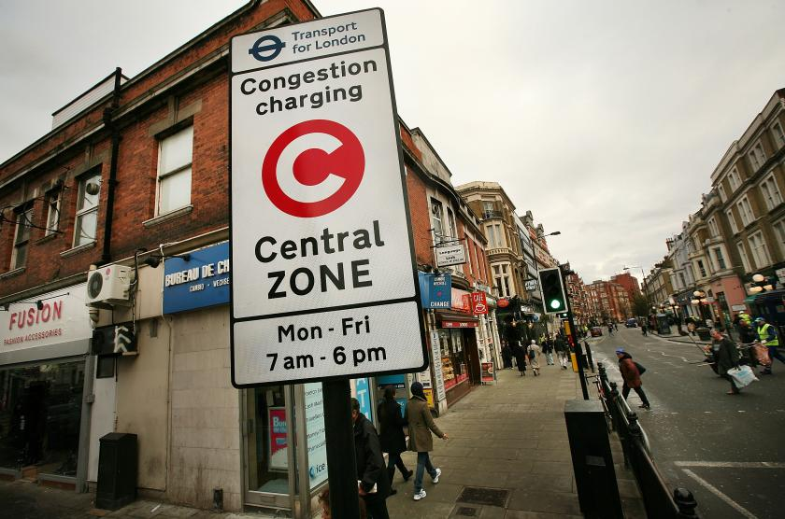
Congestion Pricing
Policy: A charge to enter high-traffic zones; funds other modes.
Rationale:
TNC’s make up the majority of new traffic (though auto use is on the rise, generally)
Consistently positive impacts on reducing congestion, pollution, GHG’s, raising funds for other modes
MUST be paired with prioritization for non-auto modes (dedicated right-of-way) and investment.
Notes:
W: Time: 3 minutes total congestion pricing, 1:20 this slide
First policy rec: implement congestion pricing, A charge to enter a designated zone of a city, with proceeds available to potentially fund transportation improvements.
While Ride-hail can play a useful role in our transpo “toolkit,” its current model has many adverse effects.
Cities that have implemented congestion pricing have seen consistent and significantly positive impacts on reducing traffic, pollution, GHG’s, while raising funds for investment in modes that alleviate congestion (transit, bicycling, pedestrian infrastructure)
Must be paired with major prioritization of transit and other modes (dedicated lanes) and significant investments locally and regionally.
Simply increasing funding for transit and other modes alone will likely not be enough to combat congestion from Uber/Lyft, or in general. A study from the University of Kentucky concluded that cities like San Francisco would need to increase bus service by roughly 25% to counteract the loss of bus ridership to TNCs over the preceding years. Pairing investments in transit with congestion pricing would be more efficient and fiscally responsible, and could potentially help the City get closer to achieving our Vision Zero goals of ending traffic fatalities by 2024.

Slide 28
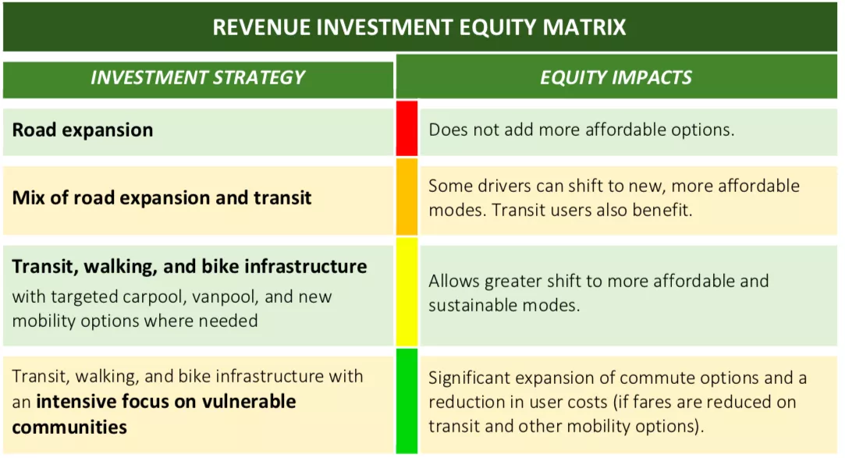
Congestion Pricing
Equity concerns:
Regional transit gaps
MUNI Equity Strategy
Taxi industry
TNC driver’s perspective
Requires political willpower
Transit = best defense/offense
Rising fares and poor service hinders success of transit.
TransForm, “Revenue Investment Equity Matrix”
Notes:
W: Time: 1:30 this slide
There are valid concerns, that if not implemented thoughtfully, congestion pricing could cause some real equity issues. Notably, the San Francisco Bay Area doesn’t have as robust of a regional transit network as London, Stockholm, and some other locales that chose to enact congestion pricing.
There are some measures to mitigate some of these issues, providing low income discounts, using congestion funds to provide debt relief for paid taxi medallion holders, and more, and we spell those out in further detail in our report.
We also think it is worth noting that Uber/Lyft are pro-congestion pricing in NYC and Seattle;
We feel that as the SFCTA re-explores congestion pricing for San Francisco, they would be wise to consult with TNC driver-leaders to make sure their insights are taken into account.
It will likely be met with significant public opposition, with more of the public being supportive after encountering reduced traffic and better transit service.
Transit could be one of the best potential tools S.F. has within its curent powers to respond to TNCs (and autonomous vehicles), and can provide better-paying jobs, however...
Rising fares make transit less competitive and SF should consider freezing, reducing, or eliminating MUNI fares.

Slide 29
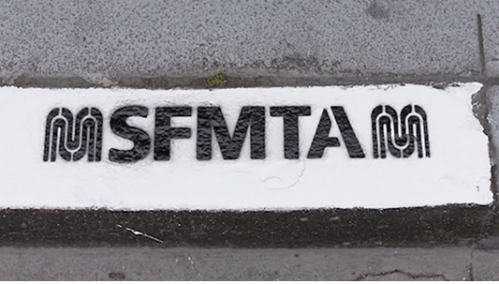
Curb Management
Policy: Develop a comprehensive curb management strategy to help mitigate illegal parking and traffic flow issues.
Rationale:
Increasing TNCs has come an increase in illegal parking, disrupting traffic flow and posing hazards to public safety.
Rising e-commerce, ADA needs, commercial uses at the curb.
Citations issued are borne by drivers, not Uber/Lyft, and it is unlikely that S.F. can ticket its way out of this issue.
SFMTA, “Color Curbs”
Notes:
W: Time: 2 min total curb mgmt, 0:40 this slide
Policy: Recommend that SF develop and implement a comprehensive curb management strategy to help mitigate illegal parking and traffic flow issues.
Another tangible impact of TNCs is felt at the curb.
Additionally, the growth of e-commerce and commercial needs, plus an aging population in SF should compel us re-evaluate how we allocate curb space.
It is unlikely that S.F. can “ticket” its way out of this issue. Citations issued are borne by solely by drivers, not Uber/Lyft.
Currently, San Francisco’s system for allocating curb space is antiquated and places the burdens on individuals and businesses to apply for loading zones, often with high fees.

Slide 30
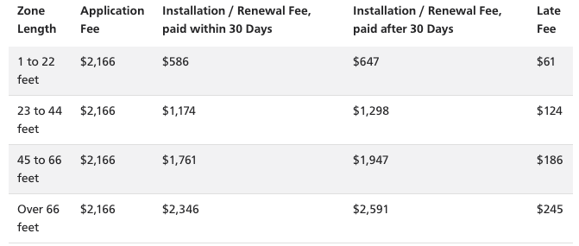
“White” Passenger Loading Zone Costs:
Notes:
W: Time: 0:24
This fee chart illustrates the costs an individual or merchant must incur in order to apply for a passenger loading zone.
Yellow and Blue zones have no charges, but again, the burden is on an individual or business to apply for loading needs.
Talk about what we should be doing on next slide!
A white zone is for passenger loading and unloading only, not exceeding 5 minutes. The effective time of white zones vary and are indicated by signs or by stencils on the curb. The driver must remain with the vehicle at all times (limited exceptions apply at preschools and hospitals).

Slide 31
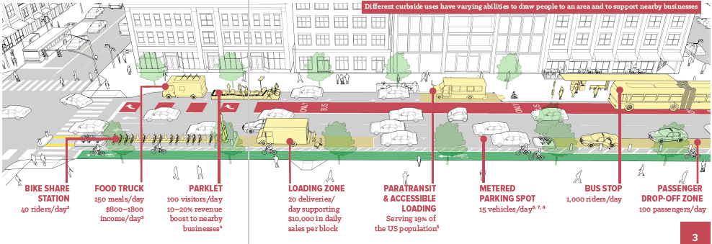
Notes:
W: Time: 0:52
Instead, SF should be allocating curb space to meet a variety of needs; that way our streets can be more organized and safer.
Image from the National Association of City Transportation Officials (NACTO)’s curb management guide, illustrates other types of curb uses and their benefits.
Other cities have developed or piloted other strategies for curb management, and this is something SF should consider as well. The City has done this on a project by project basis, but thus far there has not been a corridor-by-corridor review and re-allocation of curb needs.
What’s more, there could be benefits to TNC drivers themselves: more loading zones likely spares them from unnecessary tickets, could reallocate SFPD enforcement efforts to other tasks, and all road users would likely be better off.

Slide 32
Apps for Drivers
Policy: Creating an app for drivers of ride hail apps
Rationale:
Cities currently have very little data or access to measure the effects of ride hail services on local infrastructure and driver well being.
Issues with data and privacy: SharedStreets
Partnering with existing apps that already exist: Gridwise
Creating an infrastructure for alternatives transportation app: RideAustin a non profit and locally based non profit ride hail service.
Notes:
P:
Time 1:45
Cities currently have very little data or access to measure the effects of ride hail services on local infrastructure and driver well being. The reason this happens is because ride sharing apps consider their data private and proprietary.
So, As I mentioned , Data is hard to come by, however NYC has obtained data from ride hail companies which allows them to access transportation data, inform transportation planning and public safety efforts and learn what is happening on their streets.
An alternative recommendation because SF cant enforce the sharing of data iis for the SFMTA or the Office of Labor Standards and Enforcement to create their own app or collaborate on the development of an app for drivers to utilize. There are various ways to entice drivers to utilize the app that can be found in the report.
If the city decided against creating their own app then they could use an existing app such as gridwise to help track information. The benefit of apps like gridwise is that they are already capturing important data and because drivers are already using the service.
One criticism of cities using or collecting data is on how will they keep this data secure. ShareStreets is an initiative that is developing a third-party platform that serves as a data middleman between private companies and the public sector. Similar apps are taking what New York has learned around protecting data and making it replicable in a way that substantially reduces the risk from a data management and tech capacity perspective for local governments.
Another opportunity for the city of San Francisco is to offer an alternative to consumers who want to use a TNC. San Francisco could create an infrastructure for alternative transportation apps. One example where this exists is in Austin Texas, with the app called Ride Austin.
RideAustin was developed after Uber and Lyft briefly left the city once after choosing not to comply with Austin’s fingerprint requirement for drivers that was designed to keep passengers safe. Ride Austin is unique because it is a locally based non profit ride sharing service that pays their drivers sustainable wages and is currently the only rideshare to have 100% of their drivers fingerprinted.

Slide 33
Safe Food Delivery
Policy: Amend the CA Food Retail Code to include third-party food delivery companies in the definition of "food facilities"
Rationale:
Third-party food delivery companies are currently not regulated at any governmental level in California.
Growing concerns over consumer safety generally
Third party food vendor companies are not included in the definition of "food facility" in the CA Food Retail Code
This policy would require that third-party food-delivery services...
Educate their drivers about safe food handling
Require drivers to use temperature controlling gear
Notes:
P:
Time: 1:00
What our research on these delivery companies brought to light is that third party food delivery are not regulated at the federal state or local level.
In SF the City’s Department of Public Health issues permits to a variety of retail food operations,including farmers markets, caterers, and mobile food vendors, but does not appear to regulate third party food delivery companies.
We found that that the CPUC definition of “transportation network companies” does not include third party food delivery companies, which means there is a unique opportunity for the Department of Public Health to regulate them and require these companies to take on the burden of regulations rather than passing it on to their operator.
We found that there are some jurisdictions that regulate food delivery services at the local or state level.
Clark County, where Las Vegas is located requires drivers who work as independent contractors that transport goods to obtain a registration license.
In addition, many states require restaurant-affiliated delivery drivers to carry food handler permits, and this could be something that San Francisco looks to implement.
This is a concern for ppl in california because these companies do not follow safe food handling regulations and there was recently a report that a chinese food delivery based app had mishandled food to consumers and ultimately led to 20 students getting sick. The reason I mention this is that California and the city of San Francisco have a unique opportunity to get ahead of something like this happening here and ensure the burden does not fall on the operator but instead the company.

Slide 34
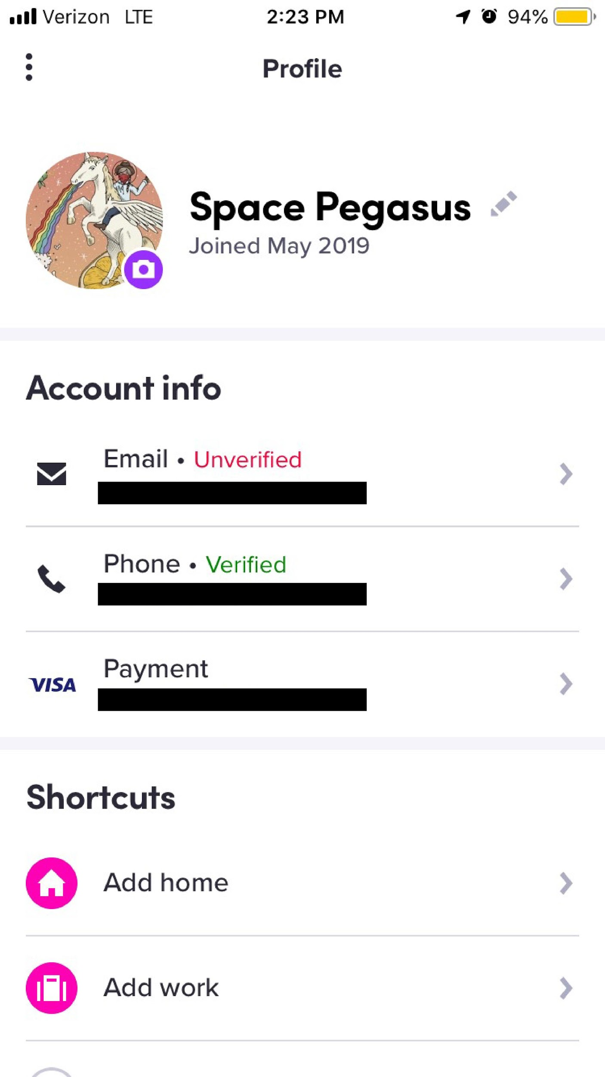
Driver Safety
Policy: TNCs should be required to provide: adequate safety training, cameras, and the sharing of information to police.
Rationale:
Existing regulation on TNCs by the CPUC primarily focuses on consumer safety and protections
According to online Uber and Lyft forums verbal and physical abuse by passengers are very common, especially against female drivers.
Uber and Lyft are not required to offer adequate safety trainings to drivers which both State and Federal laws mandate for “employees”
“Taxi drivers are over 20 times more likely to be murdered on the job than other workers”
“3,200 taxi drivers who were hurt or injured on the job, 180 sustained injuries caused by violent passengers”
Notes:
P: 1:15
Existing regulation on TNCs by the CPUC primarily focuses on consumer safety and protections but very little on driver safety.
As I mentioned earlier, TNCs offer very little public data, however we can find some comparable data that sheds light on the safety risks associated with being a TNC driver from OSHA and the Bureau of Labor Statistics where they found that Taxi drivers are over 20 times more likely to be murdered on the job than other workers and that 3,200 taxi drivers were either hurt or injured on the job, and 180 of them sustained these injuries caused by violent passengers.
Another example of the safety risks that exist can be found in the image to the right. The current app allows passengers to insert a fake name or profile photo and because uber and lyft can be somewhat resistant to sharing this information, this poses a safety risk for drivers that are attempting to identify or report a passenger after an incident.

Slide 35
Resolution supporting AB-5
Policy: Board of Supervisors Resolution in support of AB-5
Rationale:
Despite Dynamex decision, companies still classify workers as “independent contractors.”
Assemblywoman Lorena Gonzalez (District 80 - San Diego/Chula Vista) attempting to amend state labor code.
Use your “bully pulpit” power; draw media attention.
Notes:
W: Time: 1:00
Last recommendation is the easiest for San Francisco’s leaders to implement.
State Assemblywoman Lorena Gonzalez (District 80 - San Diego/Chula Vista) has introduced legislation to codify the “ABC” test established in the Dynamex decision into State law, thus enshrining a relatively simple means of determining whether a worker is an employee or contractor.
There are some exemptions for certain categories of workers, and leaders should make sure the language is finalized before authoring a resolution, though at the moment it appears that truck drivers and TNCs would still be covered.
Legislators should be aware that there is some disagreement amongst TNC drivers specifically about whether they want to be employees, depending upon how it ultimately impacts the flexibility to determine their own schedules. That said, the “contractor” status is currently being abused, and we think the City should consider supporting worker protections as soon as possible.
To our knowledge, no municipality or county in California has thus far filed formal support for Assembly Bill 5 (AB-5);
Passing a Resolution at the Board of Supervisors would formalize San Francisco’s support for this legislation, and elevating this action via media could increase public awareness of this issue, putting pressure on other State legislators to support it. This is an opportunity for officials in the public eye, such as some of yourselves, to exercise your bully pulpit power to enhance public awareness these issues.
The “ABC” test is as follows: “A person providing labor or services for remuneration shall be considered an employee unless the hiring entity satisfies all of the following conditions:
The person is free from the control and direction of the hiring entity in connection with the performance of the work, both under the contract for the performance of the work and in fact.
The person performs work that is outside the usual course of the hiring entity’s business.
The person is customarily engaged in an independently established trade, occupation, or business of the same nature as that involved in the work performed.”

Slide 36
Extended Recommendations
Seek data on more than transportation level data: also anonymized data on wages, demographics, zip codes/census tract, etc.
Local income and capital gains taxes, consider extending the sales tax to the service sector (possibly with reductions in sales tax on some or all goods) to fund transportation (and other) public investments.
Advocate for oversight of TNC deactivation process, establish an appeals process.
Prohibit forced arbitration in labor and consumer contracts.
General consumer feedback on TNCs via SFMTA App, 311 app with feature to forward TNC complaints to CPUC.
Notes:
W: Time: 1:00
Recommendations that were beyond the scope of our research
Advocate for local regulatory authority over TNCs, including oversight of driver deactivation process
Extend the tax umbrella locally to fund investments in transportation
Pursue a prohibition on forced arbitration clauses in labor and consumer contracts.
Route complaints concerns by workers and public via 311 and SFMTA apps to CPUC Consumer Intake Unit or other divisions. Perhaps if the CPUC started to more directly feel public and worker frustration with it, they will respond more or delegate responsibility to localities.
NEXT SLIDE

Slide 37
Conclusion
Current models and impacts of TNCs are likely unsustainable: from environmental, economic and social perspectives. Local and State response is necessary, and needs to happen soon.
Notes:
W: Time: 1:45
Lastly, we’d like to offer some concluding thoughts. That so many individuals are driving with TNCs and performing other “on-demand/” work, poses some serious questions. How much has our State economy really recovered from the 2001 and 2008 recessions when it appears that so many workers are willing (or needing) to work for longer hours and less pay or protections?
How economically and environmentally sustainable are TNC companies like Uber/Lyft, when both are still operating at significant losses and appear to be significant contributors to GHG emissions?
We feel that the policy recommendations we’ve presented could provide a way forward San Francisco’s leaders.
Beyond responding to the issues in front of us today, we need to be thinking of related policy and planning issues in the near future. We don’t know when autonomous vehicle technology will be commercially viable, but it is almost undoubtedly in our future: we need start preparing for how it will impact the future of work, our streets, our communities.
Lastly, our literature review revealed that in the United States, there seems to be a greater critique of on-demand labor from a consumer and public safety perspective, whereas internationally there appears to be a greater focus on the conditions that workers encounter. Local leaders can, and should, focus on elevating public awareness of the labor concerns that can come with on-demand work, especially as we sit on the precipice of a climate crisis and likely face another recession in the near future.
With that, we’d like to thank you for your time and consideration, and are open to answering any questions you may have.

Slide 38
Works Cited
Anonymous. Interview by Juhi Khemani. Merchant’s Association Interview. San Francisco, April 18, 2019.
Aide of Supervisor Fewer. Interview by Maria Amezcua. Legislative Aide Interview. San Francisco, April 18, 2019.
Aide of Supervisor Ronen. Interview by Lydia Cho. Legislative Aide Interview. San Francisco, April 25, 2019
Badger, Emily. “Is Uber Helping or Hurting Mass Transit?” The New York Times. October 16, 2017. https://www.nytimes.com/2017/10/16/upshot/is-uber-helping-or-hurting-mass-transit.html.
Baruchman, Michelle. “Ask An Expert: Congestion Pricing Is Coming to New York City. Could Seattle Be Next?” The Seattle Times. April 15, 2019. https://www.seattletimes.com/seattle-news/transportation/ask-an-expert-congestion-pricing-is-coming-to-new-york-city-could-seattle-be-next/.
Benito, Marcelino. "Food Delivery Apps Gaining Popularity but No Regulations in Place." KHOU. September 23, 2016. Accessed May 09, 2019. https://www.khou.com/article/news/food-delivery-apps-gaining-popularity-but-no-regulations-in-place/324087366.

Slide 39
Bliss, Laura. “The Policy That Will Make the Uber/Lyft IPO Pay Off.” CityLab, 2018. https://www.citylab.com/transportation/2018/12/uber-lyft-ipo-ride-hailing-congestion-pricing-new-york-city/578098/.
Buffa, Jonah. Interview by Juhi Khemani. Merchant’s Association Interview. San Francisco, April 11, 2019.
Buhl, Larry. “New Legislation Aims to Clarify Who Is an Employee.” The American Prospect. February 22, 2019.
Bureau of Labor Statistics. “Annual CPI-All Urban Consumers (Current Series) San Francisco-Oakland-Hayward, CA. 2011-2019.” Accessed May 8, 2019.
Cabanatuan, Michael. “SF to Experiment with Uber and Lyft Passenger Loading and Pick-up Zone.” SF Gate. November 7, 2017. https://www.sfgate.com/bayarea/article/SF-to-experiment-with-Uber-and-Lyft-passenger-12339573.php#item-85307-tbla-2.
California Department of Public Health, California Food Retail Code, sec. 113789, (b).
"Cities Need Data From Uber and Lyft." Bloomberg.com. July 5, 2017.
City of Toronto. “Curbside Management Strategy: Improving How Space Is Used.” Toronto, Ontario, Canada, November 14, 2017. https://www.toronto.ca/legdocs/mmis/2017/pw/bgrd/backgroundfile-109153.pdf.
Clark County, Nevada, Municipal Code 6.12.447.
“Emerging Mobility Labor Study,” Local Agency Formation Commission. City and County of San Francisco, 2019. https://sfgov.org/lafco/emerging-mobility-labor-study
“Flex Zone/Curb Use Priorities in Seattle.” Www.Seattle.Gov, 2019. https://www.seattle.gov/transportation/projects-and-programs/programs/parking-program/parking-regulations/flex-zone/curb-use-priorities-in-seattle.
Gao, Ceilidh, and Catherine Ruckelhaus. “Independent Contractor Misclassification Imposes Huge Costs on Workers and Federal and State Treasuries.” National Employment Law Project. New York, NY. Accessed April 2019. https://www.nelp.org/publication/independent-contractor-misclassification-imposes-huge-costs-on-workers-and-federal-and-state-treasuries-update-2017/.

Slide 40
“Geary Corridor Bus Rapid Transit Engineering and Environmental Analysis: Customer Intercept Survey Results.” San Francisco, CA, May 9, 2013. https://archive.sfcta.org/sites/default/files/content/Planning/GearyCorridorBusRapidTransit/gcac/GBRT%20CAC%20Intercept%20Survey%20Results.pdf.
Gonzalez, Lorena. AB-5 Worker status: employees and independent contractors., Pub. L. No. 5 (2019). https://leginfo.legislature.ca.gov/faces/billTextClient.xhtml?bill_id=201920200AB5.
Griswold, Alison. “Uber’s Success Is Far from Assured—Just Look at New York City.” Quartz. May 2, 2019. https://qz.com/1607604/uber-ipo-investors-should-pay-close-attention-to-new-york-city/
Graeheler, Michael, Richard Mucci, and Gregory Erhardt. “Understanding the Recent Transit Ridership Decline in Major US Cities: Service Cuts or &nbsp;Emerging Modes?” University of Kentucky. University of Kentucky, November 14, 2018. http://usa.streetsblog.org/wp-content/uploads/sites/5/2019/01/19-04931-Transit-Trends.pdf.
Institute of Transportation Engineers, The. “Curbside Management Practitioner’s Guide.” The Institute of Transportation Engineers. Washington, DC, 2019.
International Transport Forum, The. “The Shared-Use City: Managing the Curb.” The International Transport Forum, 2018. https://www.itf-oecd.org/sites/default/files/docs/shared-use-city-managing-curb_5.pdf.
JPMorgan Chase Institute. “The Online Platform Economy in 2018: Drivers, Workers, Sellers, and Lessors.” 2018. Accessed May 9, 2010. https://www.jpmorganchase.com/corporate/institute/report-ope-2018.htm
Kansal, Sachin. "Another Step to Prevent Drowsy Driving." Uber Newsroom. February 12, 2018. Accessed May 09, 2019. https://www.uber.com/newsroom/drowsydriving?utm_term=wH-UFOSSU0N-QETxEITLuSw1UkjxB0QVMRbX0M0&adg_id=218769&cid=10078&utm_campaign=affiliate-ir-Skimbit Ltd._1_-99_national_D_all_ACQ_cpa_en&utm_content=&utm_source=affiliate-ir.
Komanoff, Charles. “Why I Love Congestion Pricing but Hate the Taxi-Uber Surcharge.” Crain’s New York Business. January 15, 2019. https://www.crainsnewyork.com/op-ed/why-i-love-congestion-pricing-hate-taxi-uber-surcharge.

Slide 41
Lane, Megan. “Bill Analysis: AB-5 Worker Status: Employees and Independent Contractors.” California State Assembly. Sacramento, CA, April 3, 2019. https://leginfo.legislature.ca.gov/faces/billAnalysisClient.xhtml?bill_id=201920200AB5#.
Lyft, Inc. “Taking Breaks and Time Limits in Driver Mode.” Lyft Help. Accessed May 09, 2019. https://help.lyft.com/hc/en-us/articles/115012926787-Taking-breaks-and-time-limits-in-driver-mode.
Marshall, Aarian. "NYC Now Knows More Than Ever About Your Uber and Lyft Trips." Wired. February 01, 2019. Accessed May 09, 2019.
Molly Mchugh, “Uber and Lyft Drivers Work Dangerous Jobs- But They're On Their Own” Wired, March 10, 2016, https://www.wired.com/2016/03/uber-lyft-can-much-keep-drivers-safe/
“Muni Service Equity Strategy.” SFMTA.com. Accessed May 2019. https://www.sfmta.com/projects/muni-service-equity-strategy.
Nat. "Uber Peak Hours: When to Drive for Maximum Earnings." Ridester. October 12, 2018. Accessed May 09, 2019. https://www.ridester.com/uber-peak-hours/.
National Association of City Transportation Officials. “Curb Appeal: Curbside Management Strategies for Improving Transit Reliability,” November 2017. https://nacto.org/wp-content/uploads/2017/11/NACTO-Curb-Appeal-Curbside-Management.pdf.
National Low Income Housing Coalition. “Out of Reach: The High Cost of Housing.” National Low Income Housing Coalition. 2018. Accessed May 8, 2019. https://reports.nlihc.org/sites/default/files/oor/OOR_2018.pdf
Nickelsburg, Monica. “Uber and Lyft Push for Congestion Pricing as Seattle Considers Tax on Ride-Hailing Companies.” GeekWire. March 25, 2019. https://www.geekwire.com/2019/uber-lyft-push-congestion-pricing-seattle-considers-tax-ride-hailing-companies/.
Occupational Safety and Health Administration, Workers Rights, https://www.osha.gov/Publications/osha3021.pdf
Parsons, Winston. “Interview with Steve Smith, California Labor Federation,” April 30, 2019.
Poei, Hazel U., and Tulis, Benjamin A. “Assembly Bill Codifying Dynamex Moves Forward, with Notable Exemptions.” The National Law Review. March 29, 2019.
Ridester Staff. "Uber Deactivation: Why You Got Deactivated [ How to Get Reactivated]." Ridester. September 27, 2018.

Slide 42
Ridester Staff. “Uber Fees: How Much Does Uber Pay, Actually? (With Case Studies).” Ridester. April 30, 2019. Accessed May 09, 2019. https://www.ridester.com/uber-fees/.
San Francisco County Transportation Authority, TNCs Today: A Profile of San Francisco Transportation Network Company Activity, Joe Castiglione. Final Report, San Francisco: SFCTA, 2017. Accessed on May 9, 2019. https://www.sfcta.org/sites/default/files/2019-02/TNCs_Today_112917_0.pdf
Schaller, Bruce. “Making Congestion Pricing Work for Traffic and Transit in New York City.” Schaller Consulting. Brooklyn, NY, March 7, 2018. http://www.schallerconsult.com/rideservices/makingpricingwork.pdf.
Scheiber, Noam. “How Uber Uses Psychological Tricks to Push Its Drivers’ Buttons.” New York Times. April 2, 2017. Accessed May 8, 2019. https://www.nytimes.com/interactive/2017/04/02/technology/uber-drivers-psychological-tricks.html
Schmitt, Angie. “Congestion Pricing, Often Attacked as Inequitable, Is Actually the Cure for Inequitable Transportation.” Streetsblog. January 30, 2019. https://usa.streetsblog.org/2019/01/30/congestion-pricing-often-attacked-as-inequitable-is-actually-the-cure-for-inequitable-transportation/.
“San Francisco, Access, and Pricing Study.” San Francisco, CA: SFCTA, December 2010. https://www.sfcta.org/sites/default/files/2019-03/Downtown%20Congestion%20Pricing-%20MAPS%20study.pdf.
San Francisco County Transportation Authority. “TNCs Today:A Profile of San Francisco Transportation Network Company Activity.” San Francisco, CA, June 2017. https://www.sfcta.org/sites/default/files/2019-02/TNCs_Today_112917_0.pdf.
San Francisco Mayor’s Office of Public Policy and Finance, . “City and County of San Francisco, Proposed Budget, 2017-2019;” City and County of San Francisco. San Francisco, California, June 1, 2017.
San Francisco Municipal Transportation Agency. “New Color Curb.” Sfmta.Com. Accessed April 2019. https://www.sfmta.com/services/new-color-curb.
“San Francisco: Regulation For Curbside Supply and Demand/TNC and City Partnerships.” The Institute of Transportation Engineers. Washington, DC, 2019. https://www.ite.org/pub/?id=C2D66E96-FF01-0BA8-68C3-65CC9116A5AE.

Slide 43
Seattle Department of Transportation. “A Closer Look at Seattle’s Rising Transit Ridership.” Sdotblog.Seattle.Gov, January 3, 2018. https://sdotblog.seattle.gov/2018/01/03/a-closer-look-at-seattles-rising-transit-ridership/.
Selina Wang, “The Dark Realities Women Face Driving for Uber and Lyft”, Bloomberg, Dec 18,2019, https://www.bloomberg.com/news/articles/2018-12-18/the-dark-realities-women-face-driving-for-uber-and-lyft
Siddiqui, Faiz. “Falling Transit Ridership Poses an ‘Emergency’ for Cities, Experts Fear.” The Washington Post. March 24, 2018. https://www.washingtonpost.com/local/trafficandcommuting/falling-transit-ridership-poses-an-emergency-for-cities-experts-fear/2018/03/20/ffb67c28-2865-11e8-874b-d517e912f125_story.html?utm_term=.41f3763d06f6.
Smart Cities Dive. “Lyft Launches Geofencing Pilot in San Francisco.”. March 26, 2018. https://www.smartcitiesdive.com/news/ride-share-companies-geofencing-pilot-san-francisco/519898/.
State of California, Employment Development Department “Fraud Deterrence and Detection Activities: A Report to the California State Legislature.” State of California. Sacramento, CA, June 2018. https://edd.ca.gov/About_EDD/pdf/Fraud_Deterrence_and_Detection_Activities_2018.pdf.
Sun, Yushuang. "China Adopts Tightened Rules Governing Food Safety Online and Retail Food Sectors." Global Food Safety Forum. November 27, 2017. Accessed May 09, 2019. http://globalfoodsafetyforum.org/2017/11/china-adopts-tightened-rules-governing-food-safety-online-and-retail-food-sectors/.
Swan, Rachel. “Uber, Lyft Account for Two-Thirds of Traffic Increase in SF over Six Years, Study Shows.” San Francisco Chronicle. May 8, 2019. https://www.sfchronicle.com/bayarea/article/Uber-Lyft-account-for-of-traffic-increase-in-13830608.php?fbclid=IwAR3GEImWunq3ZZVx4UvM57yIHYZHBL7JhM1iVuFngVbZoXc0P-BimnPE_58.

Slide 44
“The New Automobility: Lyft, Uber and the Future of American Cities.” Schaller Consulting. Brooklyn, NY, July 25, 2018. http://www.schallerconsult.com/rideservices/automobility.htm.
“TNCs and Congestion.” sfcta.org, 2019. Accessed Mar 2019. https://www.sfcta.org/projects/tncs-and-congestion.
“Toronto Neighborhood Policy.” The Institute of Transportation Engineers. Washington, DC, 2019.
TransForm. “Pricing Roads, Advancing Equity.” TransForm. Oakland, CA, January 2019. http://www.transformca.org/sites/default/files/Pricing_Roads_Advancing_Equity_Combined_FINAL_190128_0.pdf.
TransitCenter. “There’s a Reason Transit Ridership Is Rising in These 7 Cities.” Transitcenter.Org, February 27, 2019. http://transitcenter.org/2019/02/27/theres-a-reason-transit-ridership-is-rising-in-these-7-cities/.
Transportation Network Companies. California Public Utilities Commission, 2019. http://www.cpuc.ca.gov/General.aspx?id=787
“Uber Community Guidelines.” Uber. Accessed May 09, 2019. https://www.uber.com/legal/community-guidelines/us-en/.
Uber Technologies, Inc. Uber Community Guidelines. Accessed May 08, 2019. https://www.uber.com/legal/community-guidelines/us-en/
Uber, “Safety Tips for drivers”,https://www.uber.com/drive/resources/safety-tips/
US Occupational Safety and Health Administration, Preventing Violence for Taxi and for-Hire Divers, https://www.osha.gov/Publications/taxi-driver-violence-factsheet.pdf
U.S Census Bureau (2017). Median Household Income, Per Capita Income, 2013-2017 American Community Survey 5-year estimates. Retrieved from: https://www.census.gov/quickfacts/geo/chart/contracostacountycalifornia,sonomacountycalifornia,solanocountycalifornia,napacountycalifornia,sanfranciscocitycalifornia,US/INC110217#INC110217
Wirtschafter, Eli. “San Francisco May Give Lyft and Uber More Curb Space to Unload Passengers.” KALW. March 15, 2018. https://www.kalw.org/post/san-francisco-may-give-lyft-and-uber-more-curb-space-unload-passengers#stream/0.

Slide 45
Wright, Edward. Interview by Karen Aceves. Legislative Aide Interview. San Francisco, April 4, 2019.
Zip codes and driver data [map]. California. San Francisco: Pierce Forgione, May 1, 2019. Created in: Mapline.

