Slide 1
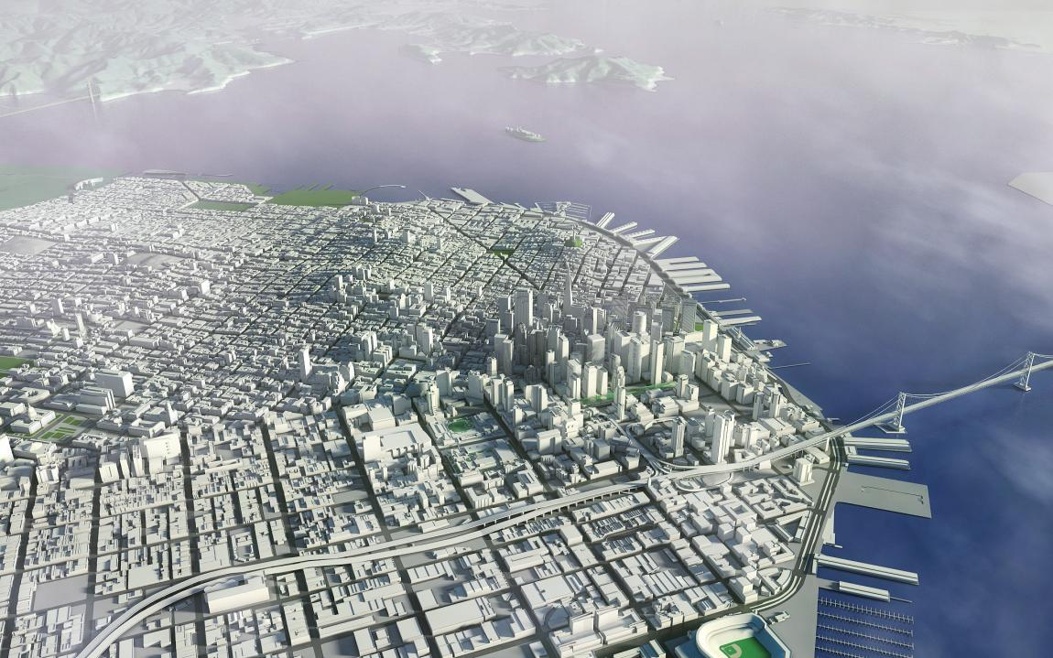
MOSCONE EXPANSION PROJECT
OCTOBER 21, 2013 Civic Design Review – Phase I

Slide 2
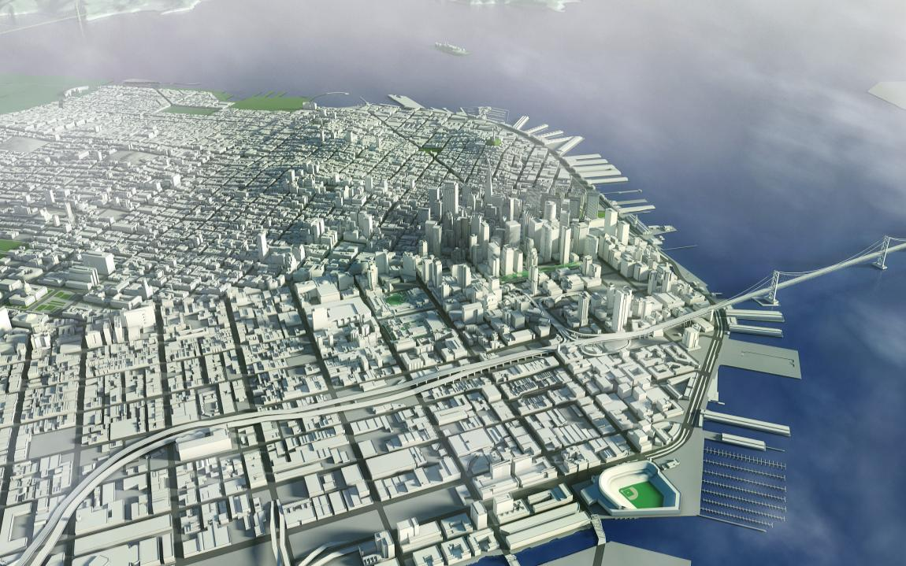
WHY EXPAND MOSCONE?
Moscone Center is at capacity Clients are demanding additional contiguous exhibition space The center is San Francisco’s Major economic engine: 21% of all tourism dollars and 27% hotel occupancy An independent study for 2010-2019 shows $2 billion loss in direct spending without expansion The proposed Moscone Expansion will recover $734 million
Notes:
Joe

Slide 3
MOSCONE EXPANSION PROJECT OBJECTIVES
Maximize economic impact by attracting new clients and maintain existing clients by creating contiguous exhibition spaces and increasing the quantity of flexible meeting and ballroom spaces. Maintain continuous operations and revenue during improvement and expansion. Capitalize on Moscone’s unique location in the city by improving its connections and relationship to the city’s fabric.

Slide 4
MOSCONE EXPANSION PROJECT URBAN DESIGN PRINCIPLES
Activate streets by redesigning or relocating vehicular and service functions to create uninterrupted pedestrian-favored sidewalks fronted by active uses wherever possible. Enhance pedestrian circulation and interest by reintroducing lost mid-block passageways and reducing the length of uninterrupted frontages. Create new and improved connections to the Yerba Buena Gardens. Maximize the value of the City’s infrastructure and urban planning investment by building at an appropriately high density. Improve Moscone’s civic presence on Howard Street by creating an iconic and architecturally significant arrival experience. PLANNING DOCUMENT REFERENCES: BETTER STREETS PLAN, SAN FRANCISCO PLANNING DEPARTMENT YERBA BUENA STREET LIFE PLAN, YERBA BUENA COMMUNITY BENEFIT DISTRICT CENTRAL CORRIDOR PLAN, SAN FRANCISCO PLANNING DEPARTMENT CENTRAL SUBWAY PLAN, SFMTA

Slide 5
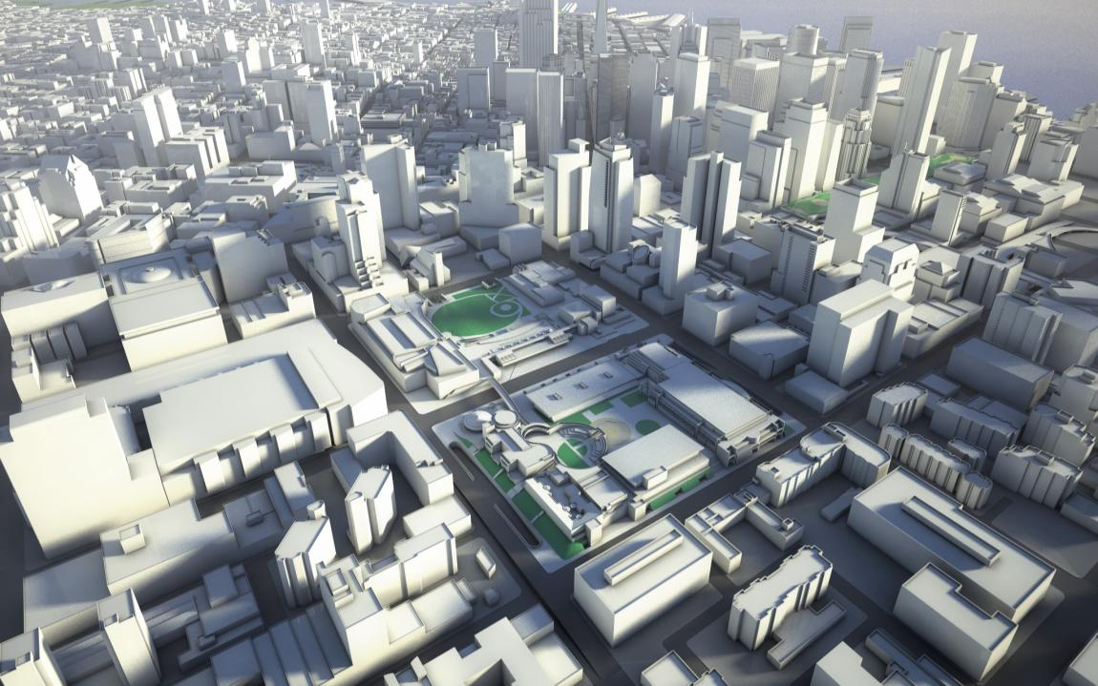
SITE CONTEXT

Slide 6
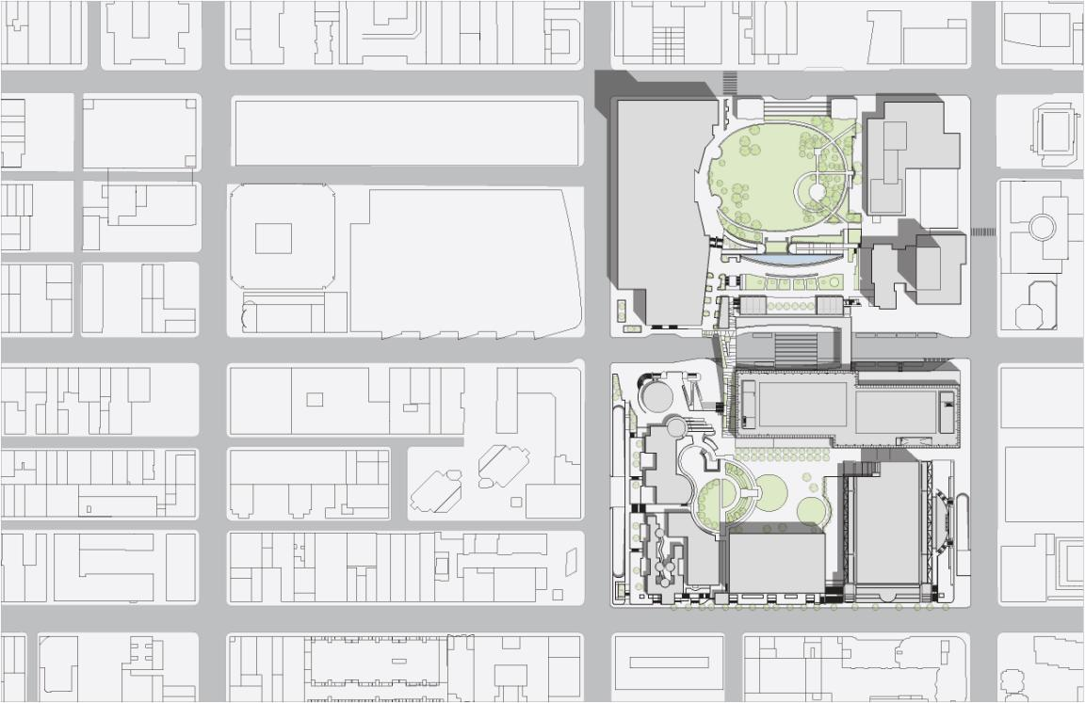
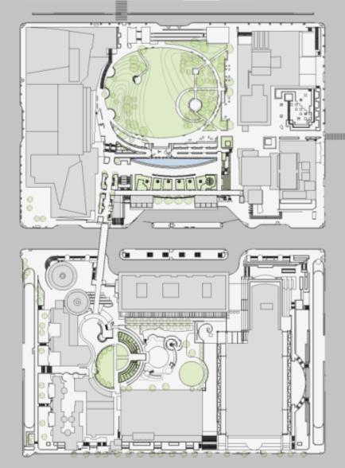
MISSION
FOURTH
THIRD
HOWARD
FOLSOM
N
EXISTING SITE PLAN

Slide 7
SITE CONTEXT PUBLIC REALM

Slide 8
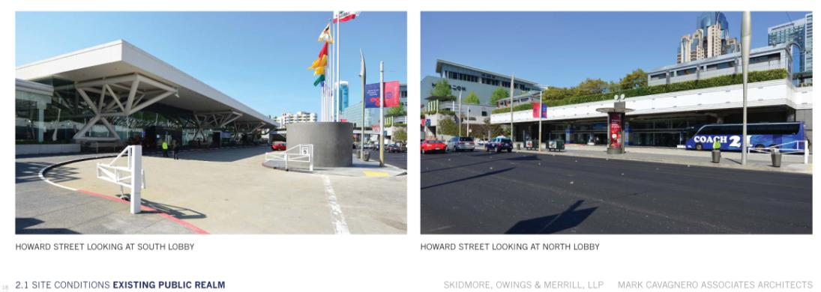
SITE CONTEXT PUBLIC REALM

Slide 9
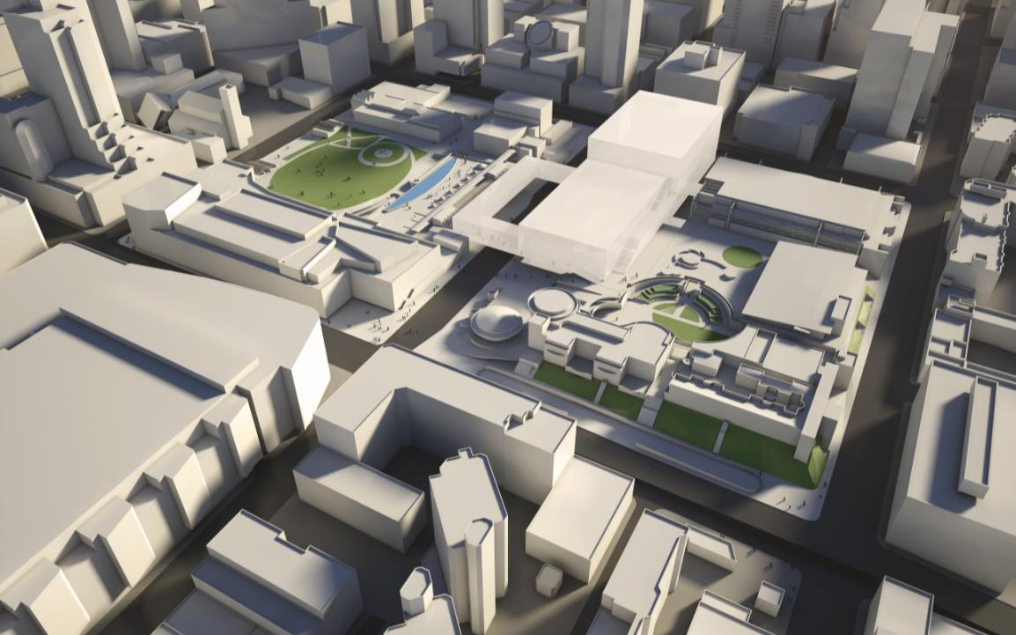
PRIOR CONCEPT AERIAL VIEW

Slide 10
SCHEMATIC PLANS AND STUDIES

Slide 11
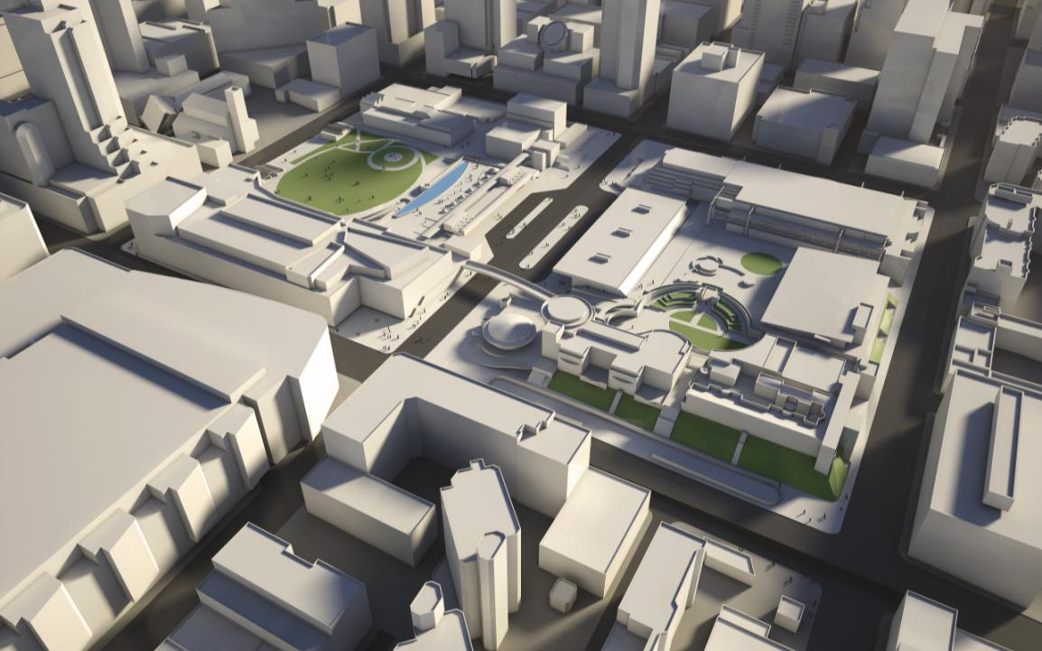
NORTH HALL
THIRD
SOUTH HALL
HOWARD
FOLSOM
EXISTING NORTH HALL: 180,000SF
EXISTING SOUTH HALL: 260,000SF
TOTAL EXHIBITION: 440,000 SF
FOURTH
EXISTING BELOW GRADE EXHIBITION HALLS

Slide 12
NORTH HALL
THIRD
SOUTH HALL
HOWARD
FOLSOM
540,000SF OF CONTIGUOUS EXHIBITION SPACE
FOURTH
EXISTING BELOW GRADE EXHIBITION HALLS

Slide 13
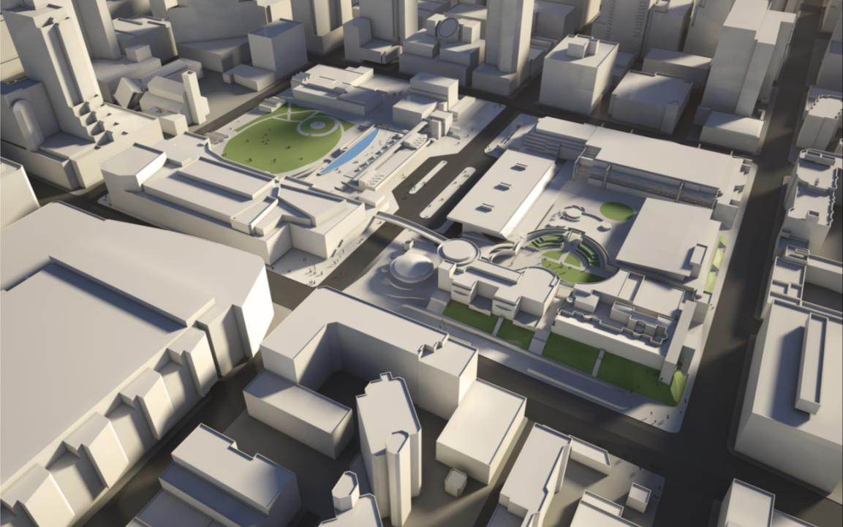
EXISTING AERIAL VIEW

Slide 14
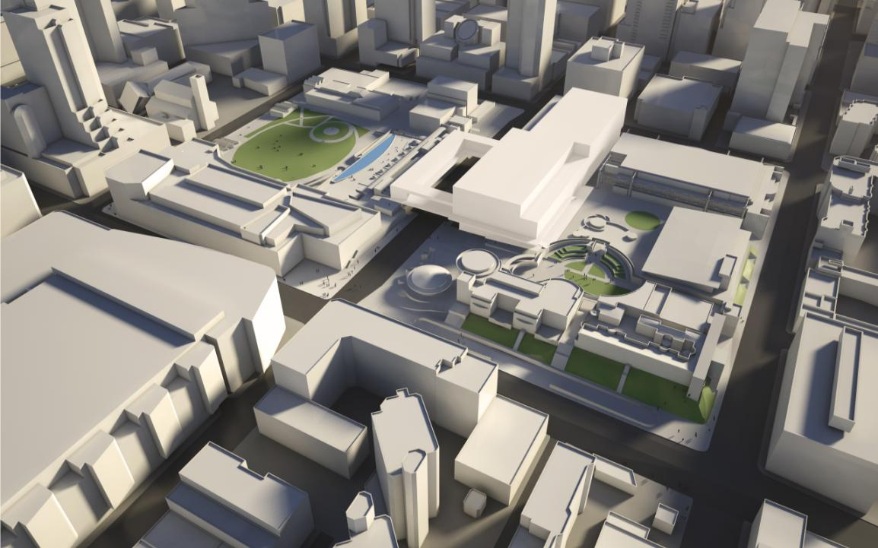
PROPOSED AERIAL VIEW

Slide 15
MISSION
FOURTH
THIRD
HOWARD
FOLSOM
N
PROPOSED SITE PLAN

Slide 16
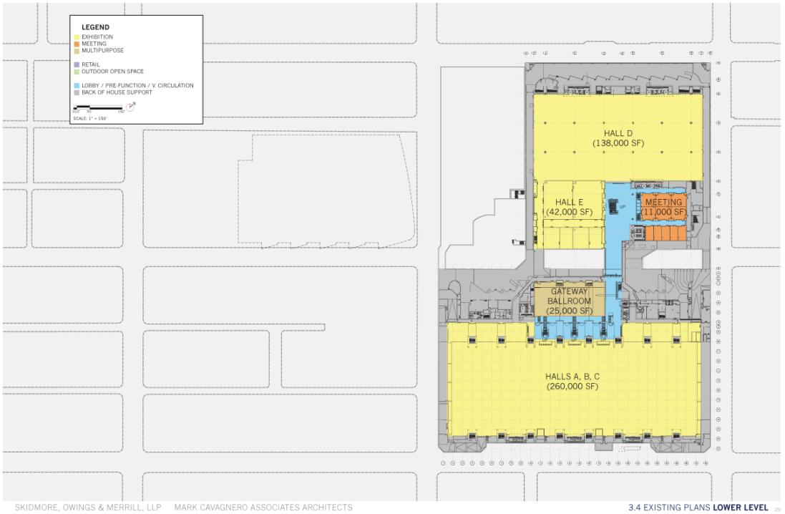
EXISTING CONDITIONS LOWER LEVEL DIAGRAM
Notes:
SOM

Slide 17
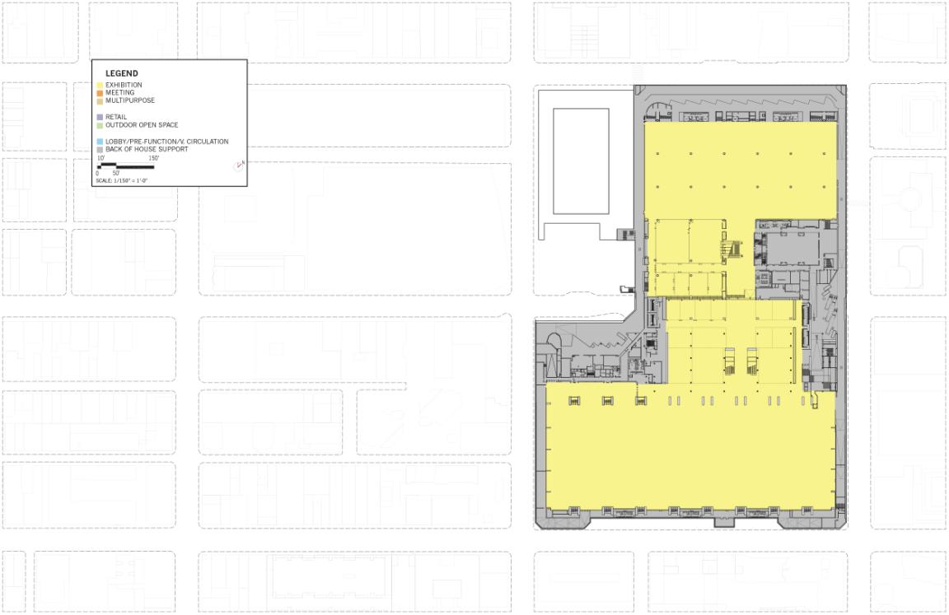
PROPOSED EXHIBITION LEVEL PLAN

Slide 18
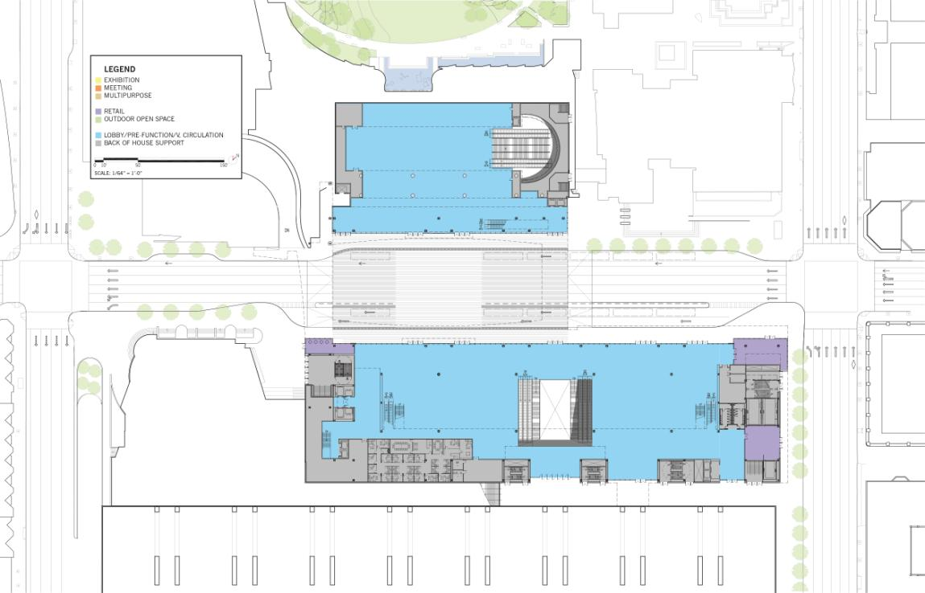
FOURTH
THIRD
LOBBY
HOWARD
LOBBY
LOBBY
PROPOSED FIRST LEVEL PLAN

Slide 19
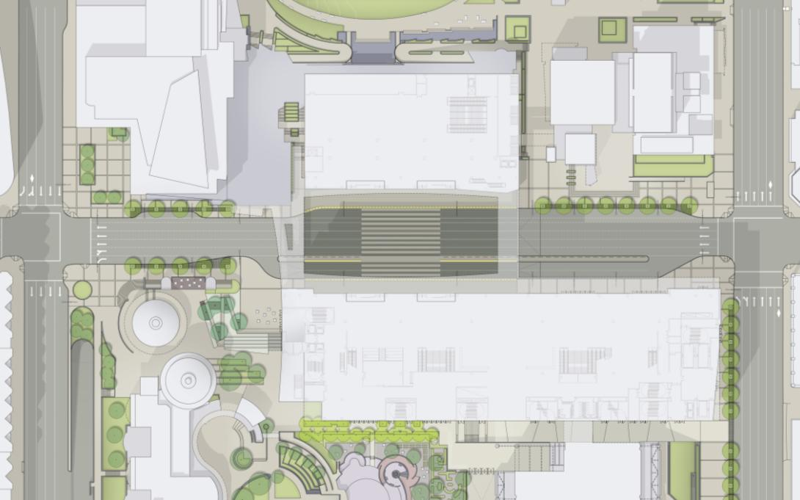
FOURTH
THIRD
LOBBY
HOWARD
LOBBY
LOBBY
PROPOSED FIRST LEVEL PLAN

Slide 20
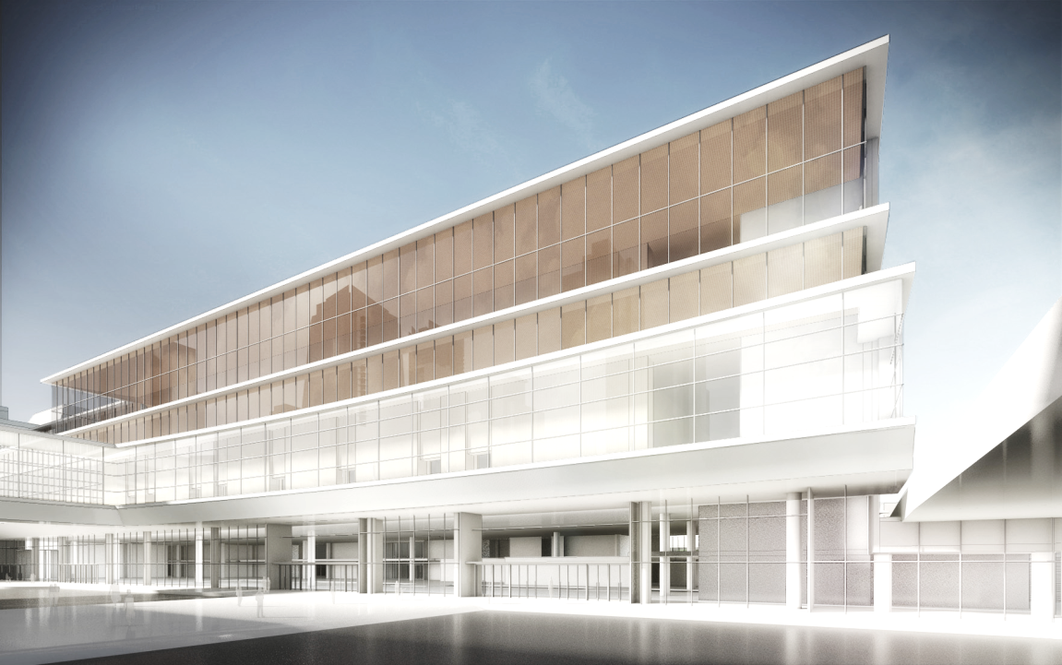
VIEW SOUTH FROM PORTICO

Slide 21
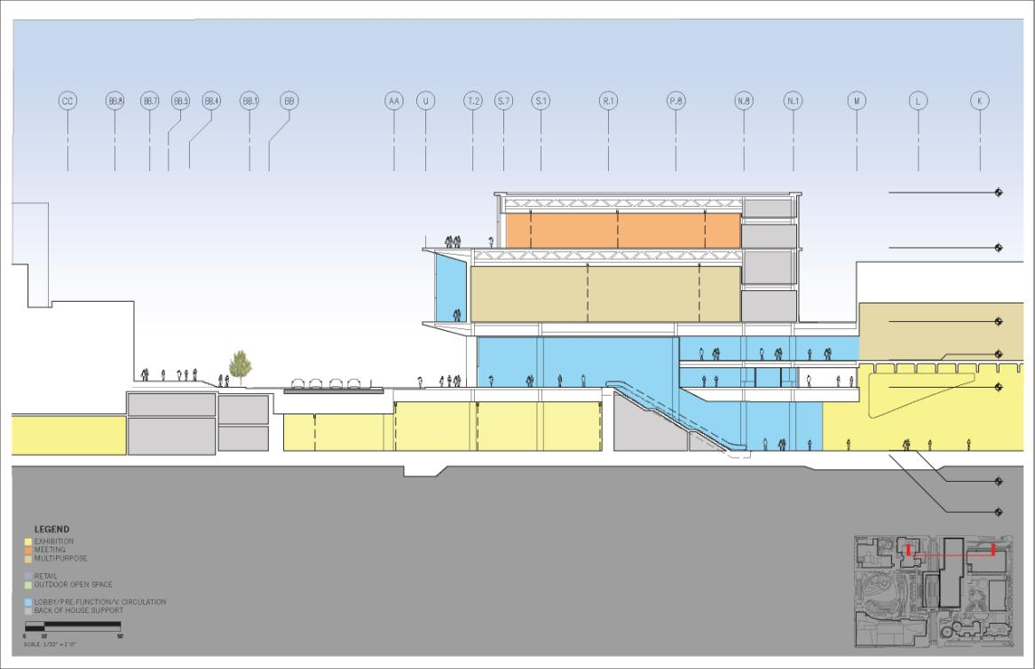
95’-0”
MEETING
68’-0”
BALLROOM
32’-0”
ESPLANADE BALLROOM
13’-2”
LOBBY
0’-0”
EXHIBITION
-31’-0”
-33’-0”
PROPOSED SECTION

Slide 22
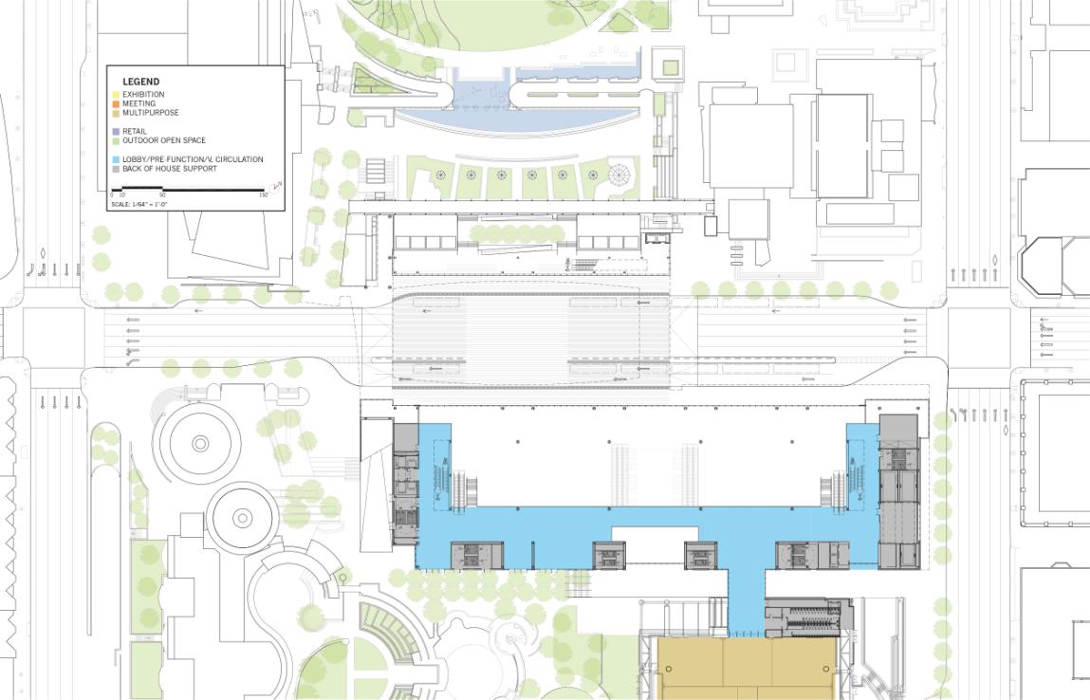
FOURTH
THIRD
HOWARD
PREFUNCTION
ESPLANADE BALLROOM
PROPOSED MEZZANINE LEVEL PLAN

Slide 23
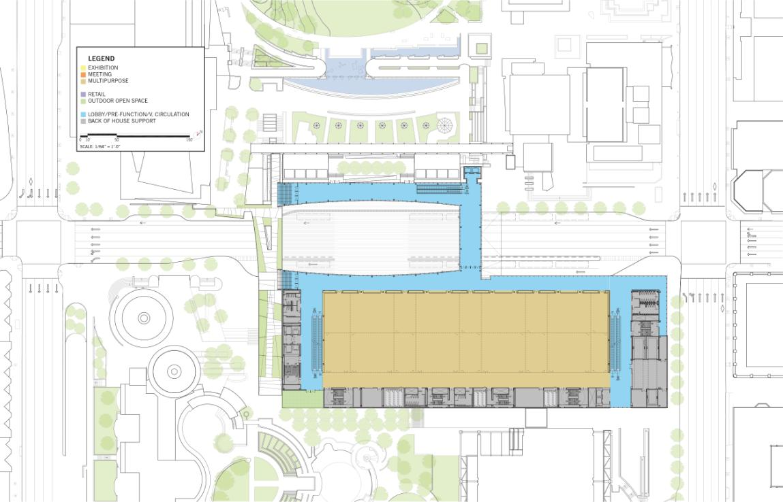
FOURTH
THIRD
PREFUNCTION
HOWARD
PREFUNCTION
BALLROOM 50,000SF (MEETING 40,000SF)
PROPOSED SECOND LEVEL PLAN

Slide 24
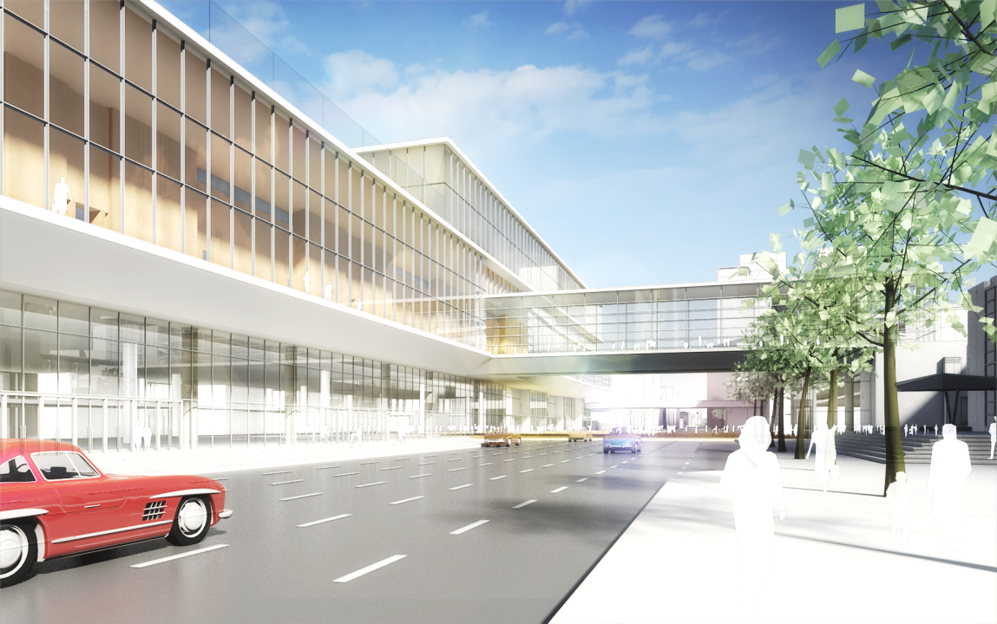
VIEW WEST FROM HOWARD STREET

Slide 25
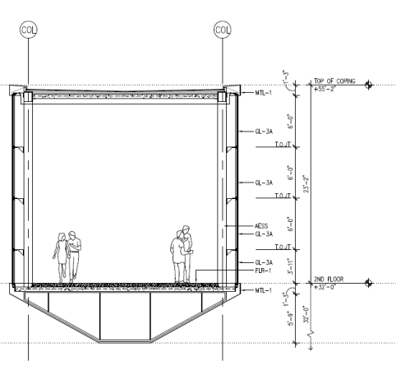
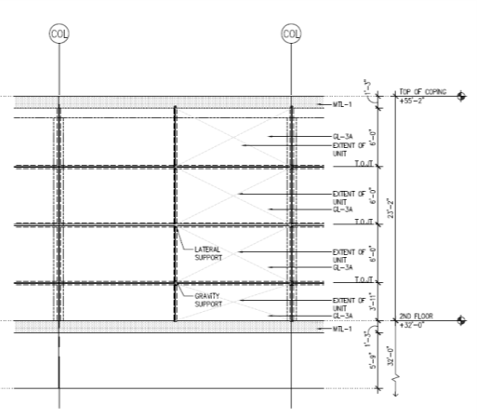
27 FEET
21 FEET
HOWARD STREET BRIDGE

Slide 26
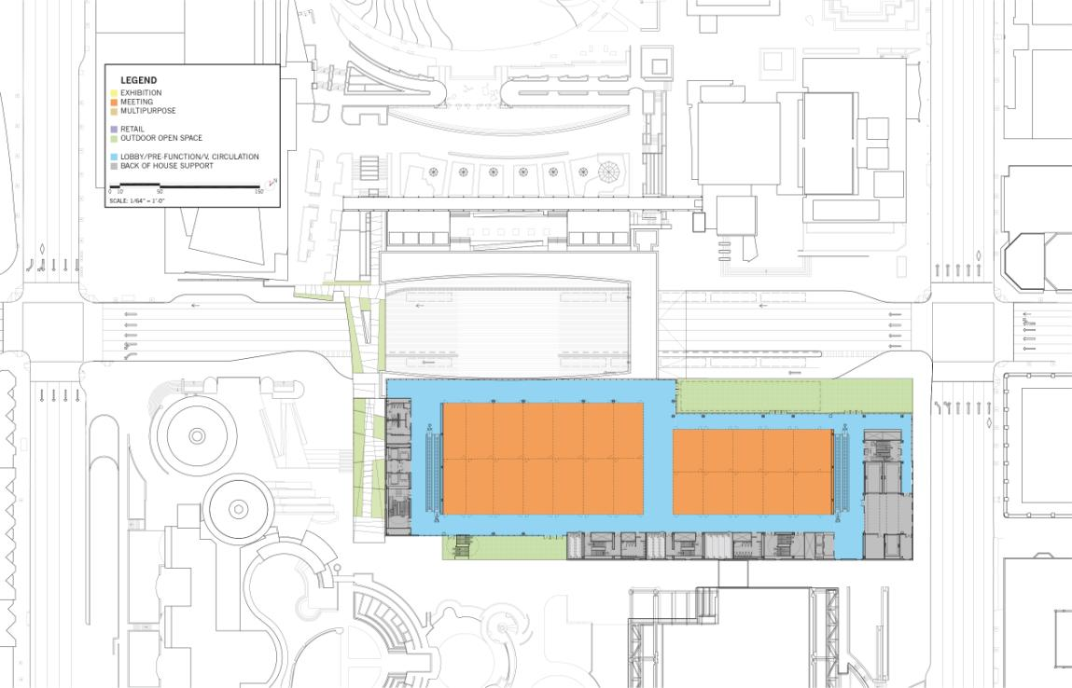
FOURTH
THIRD
HOWARD
PREFUNCTION
TERRACE
MEETING 22,000SF
MEETING 18,000SF
PROPOSED THIRD LEVEL PLAN

Slide 27
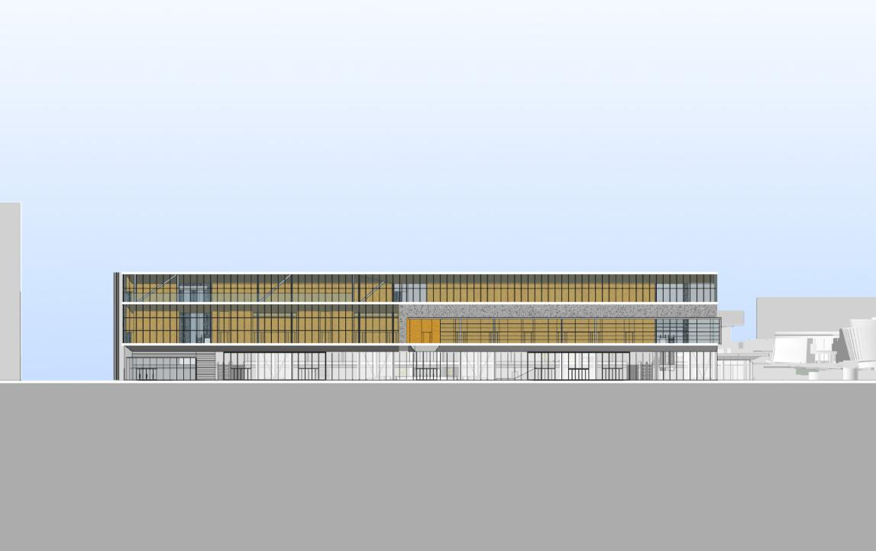
PROPOSED HOWARD STREET ELEVATION

Slide 28
ENHANCING THE PUBLIC REALM

Slide 29
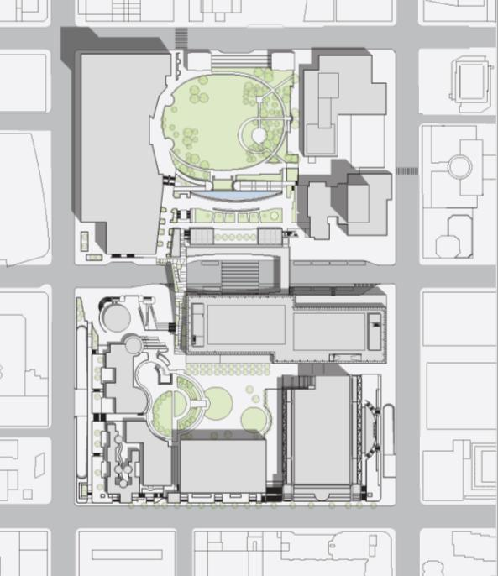
MISSION
THIRD STREET FRONTAGE
PARK BRIDGE
WEST PLAZA
YERBA BUENA PASEO
TERRACE GARDEN
HOWARD STREET PLAZA
FOURTH
THIRD
FOLSOM
PROPOSED SITE DIAGRAM

Slide 30
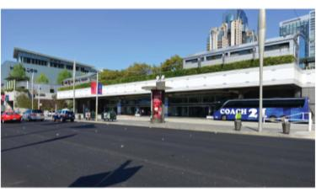
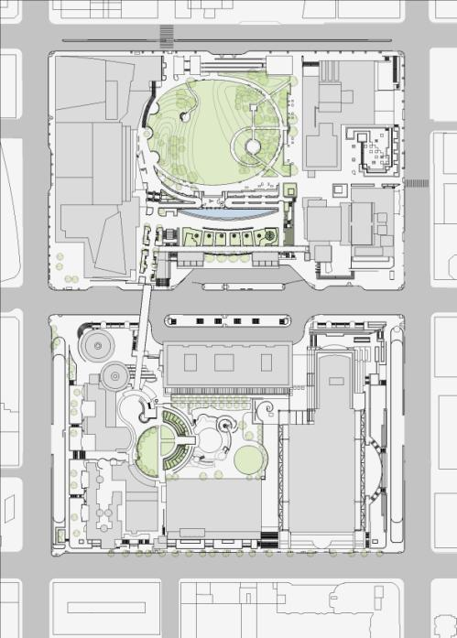
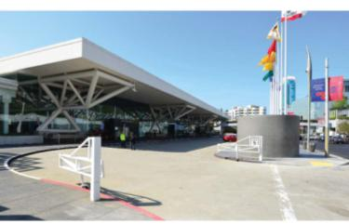
MISSION
FOURTH
THIRD
PEDESTRIAN
BUS LOADING
FOLSOM
EXISTING CONDITIONS SITE DIAGRAM
Notes:
SOM

Slide 31
MISSION
FOURTH
THIRD
PEDESTRIAN
TRUCK
BUS LOADING
FOLSOM
IMPROVED SITE DIAGRAM

Slide 32
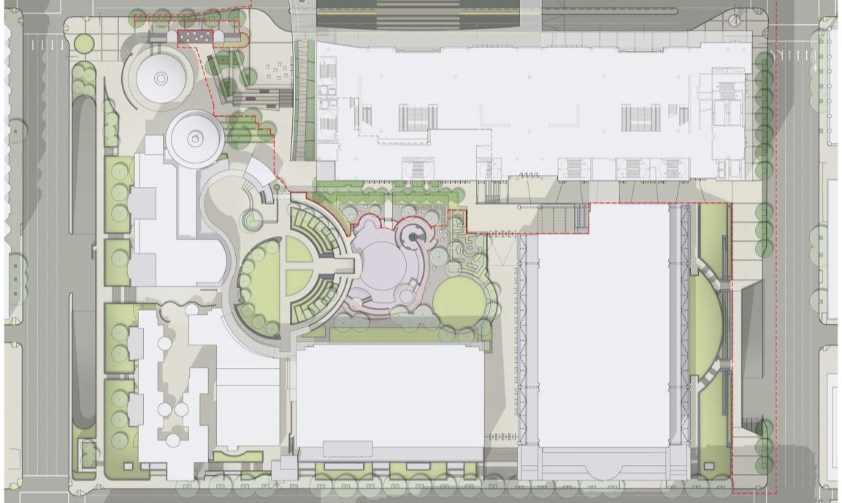
25’-0”
40’-0”
FOURTH
THIRD
40’-0”
IMPROVED THIRD STREET STREETSCAPE

Slide 33
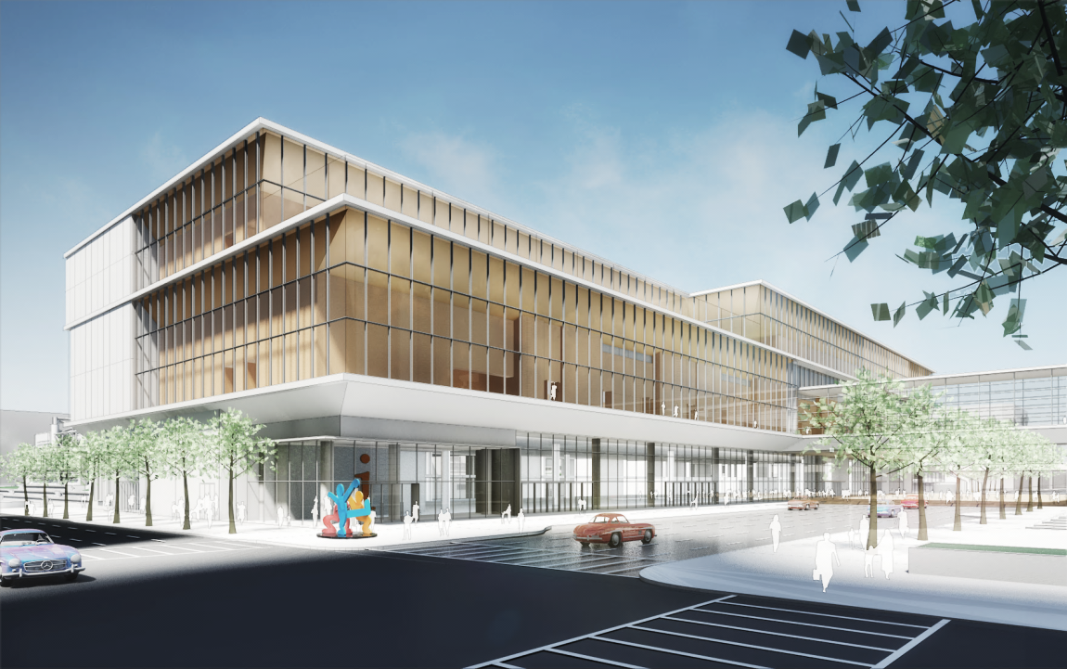
VIEW WEST FROM THIRD STREET

Slide 34
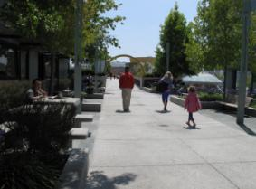
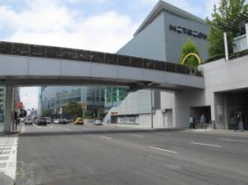
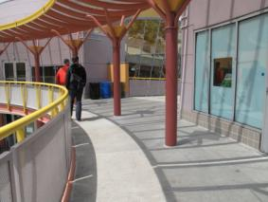
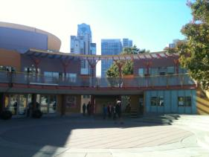
MISSION
FOURTH
THIRD
1
2
1
2
HOWARD
3
4
3
4
FOLSOM
EXISTING CONDITIONS ACCESSIBLE ROUTE DIAGRAM

Slide 35
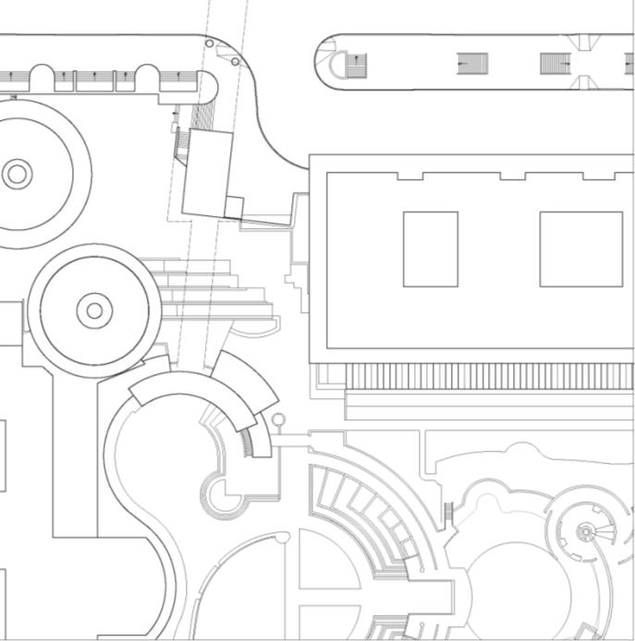
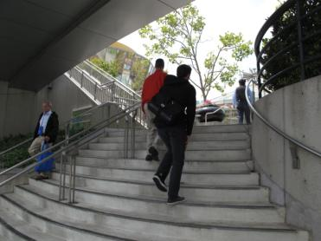
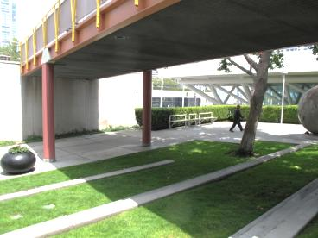
1
2
1
2
EXISTING CONDITION ENLARGED ROUTE DIAGRAM
Notes:
SOM

Slide 36
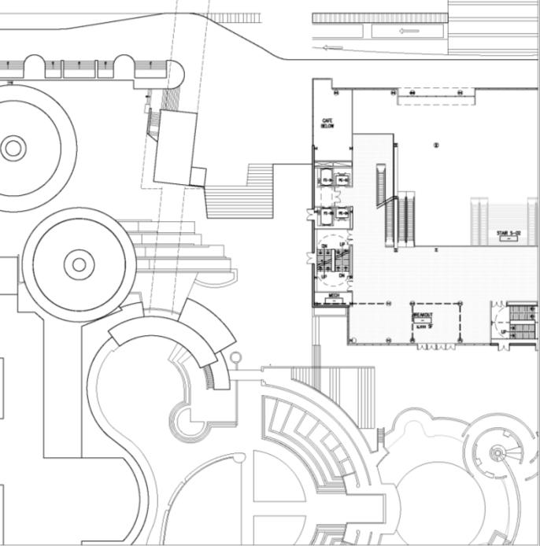
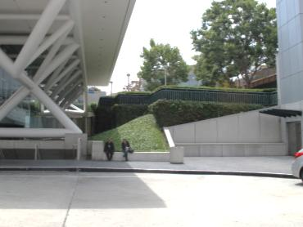
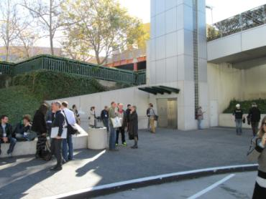
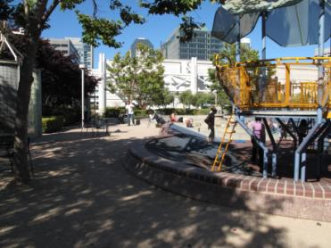
1
1
2
2
MODIFIED CONDITION ENLARGED ROUTE DIAGRAM
Notes:
SOM

Slide 37
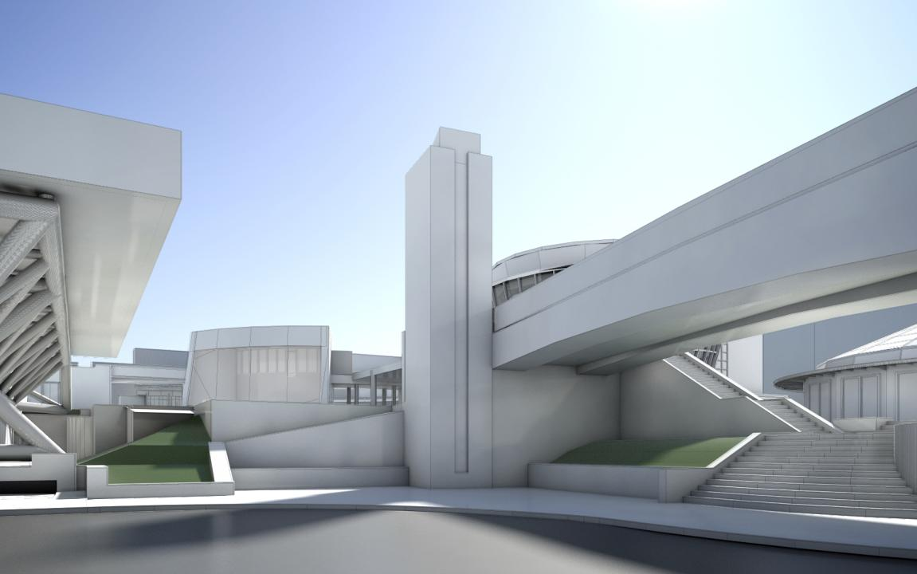
37
EXISTING VIEW FROM HOWARD TOWARDS CHILDREN’S CREATIVITY MUSEUM

Slide 38
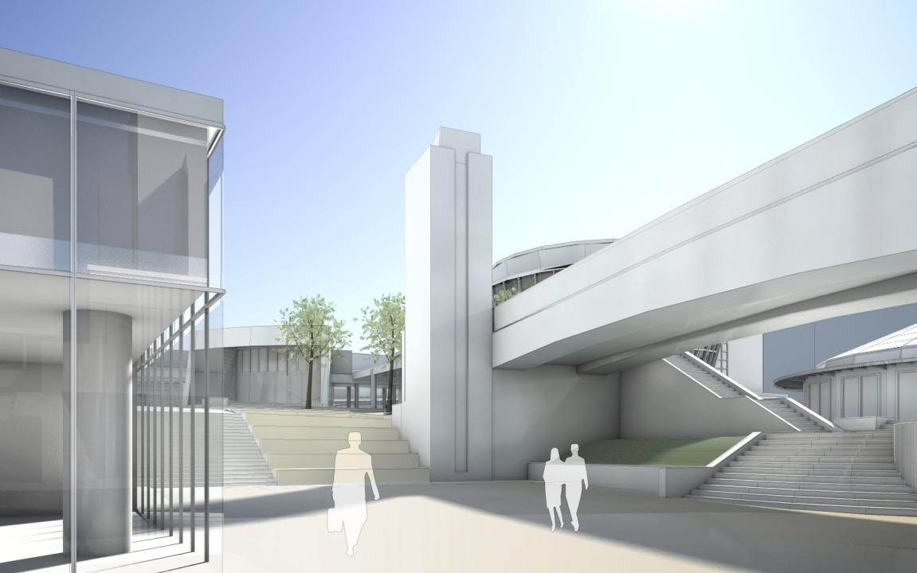
38
PROPOSED VIEW WITHOUT NEW PARK BRIDGE

Slide 39
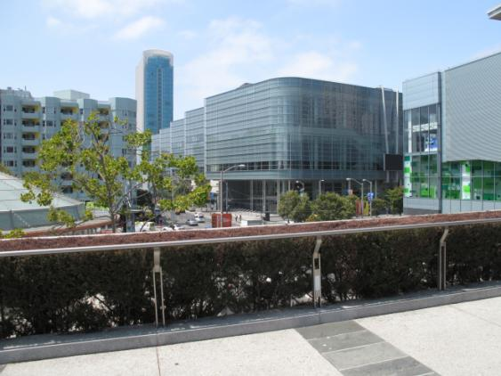
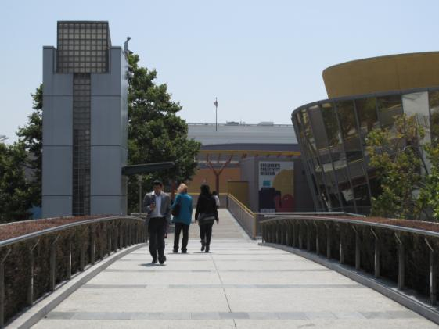
39
EXISTING CONDITIONS BRIDGE

Slide 40
PROPOSED BRIDGE ACCESSIBLE ROUTE DIAGRAM

Slide 41
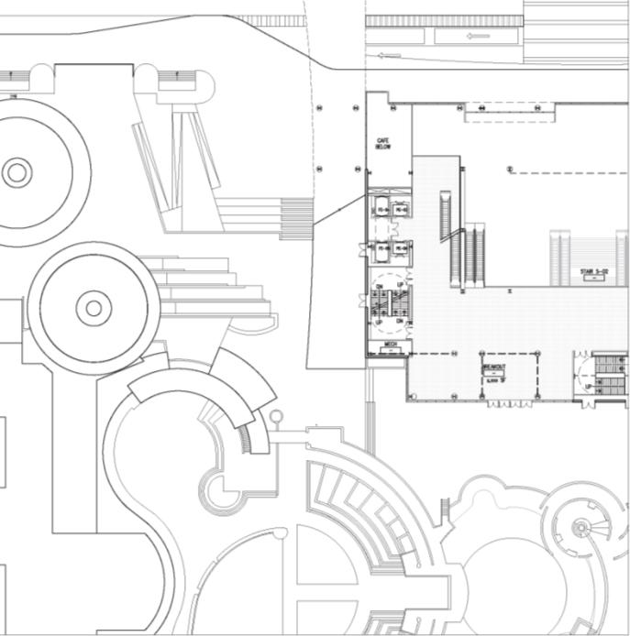
PROPOSED BRIDGE ENLARGED ROUTE DIAGRAM
Notes:
SOM

Slide 42
42

Slide 43
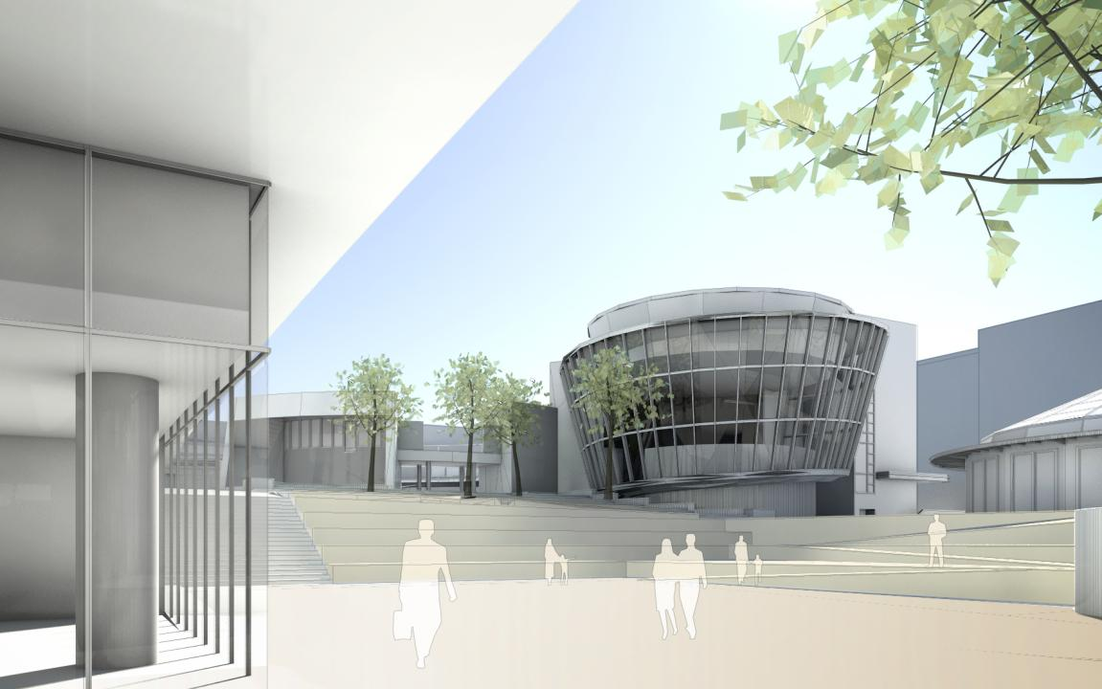
43
PROPOSED VIEW WITH NEW PARK BRIDGE AND WEST PLAZA

Slide 44
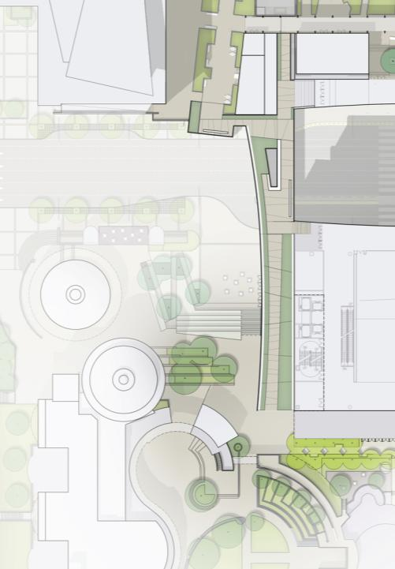
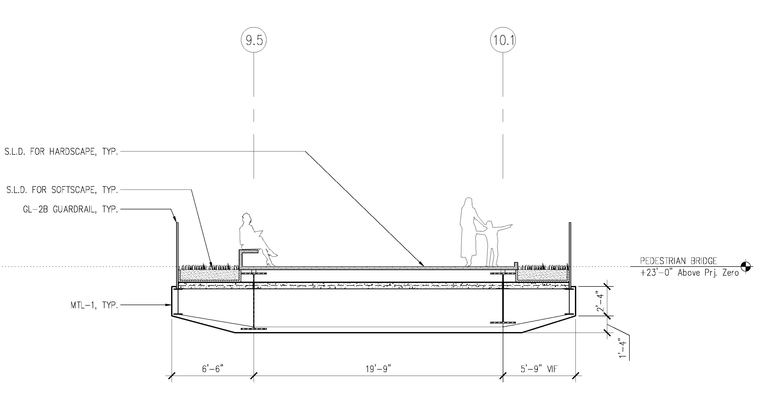
THIRD STREET
PROPOSED BRIDGE CROSS SECTIONS

Slide 45
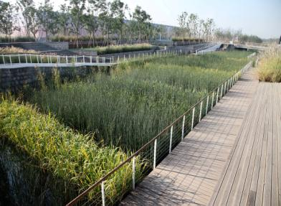
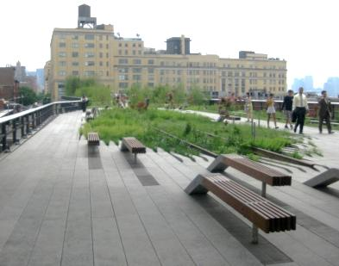
THIRD STREET
PROPOSED BRIDGE CROSS SECTIONS

Slide 46
82’-0”
55’-0”
19’-0”
0’-0”
PROPOSED SECTION

Slide 47
THIRD STREET
WEST PLAZA PRECEDENTS

Slide 48
THIRD STREET
WEST PLAZA STUDIES

Slide 49
FOURTH
FOURTH
THIRD
THIRD
HOWARD
HOWARD
PREFUNCTION
ESPLANADE BALLROOM
PROPOSED YERBA BUENA PASEO

Slide 50
IMPROVED CIRCULATION WITH NEW AND ENHANCED MIDBLOCK CROSSINGS

Slide 51
PROPOSED YERBA BUENA PASEO

Slide 52
YERBA BUENA PASEO PRECEDENTS

Slide 53
AERIAL VIEW FROM PLAYGROUND

Slide 54
82’-0”
55’-0”
48’-0”
19’-0”
35’-0”
AERIAL VIEW FROM PLAYGROUND

Slide 55
THIRD STREET
TERRACE GARDEN UPPER LEVEL SITE PLAN

Slide 56
PROPOSED TERRACE GARDEN

Slide 57
FOURTH
FOURTH
THIRD
THIRD
HOWARD
HOWARD
PREFUNCTION
ESPLANADE BALLROOM
PROPOSED STREETSCAPE AT HOWARD STREET PLAZA

Slide 58
UPDATE PLAN
PROPOSED STREETSCAPE AT HOWARD STREET PLAZA

Slide 59
HOWARD STREET PLAZA PRECEDENTS

Slide 60
82’-0”
MEETING
55’-0”
BALLROOM
19’-0”
0’-0”
LOBBY
LOBBY
EXHIBITION
PROPOSED SECTION

Slide 61
VIEW FROM PORTICO TO EAST

Slide 62
VIEW FROM PORTICO TO EAST

Slide 63
THANK YOU

