Slide 1
Excelsior Gateway Beautification Project: Ever Upward
Nicole Agbayani, Corridor Manager, Excelsior Action Group
Isis Rodriguez, Artist, sculpture design
Jason Gilmore, Artist, mosaic design
November 5, 2012

Slide 2
Excelsior Action Group, est. 2002
Our mission is to revitalize the San Francisco Excelsior Neighborhood’s Commercial Corridor by involving residents, merchants, neighborhood associations and city agencies through activities aimed to reinvigorate, green, beautify, strengthen and unify our diverse community.

Slide 3
Project Background

Slide 4
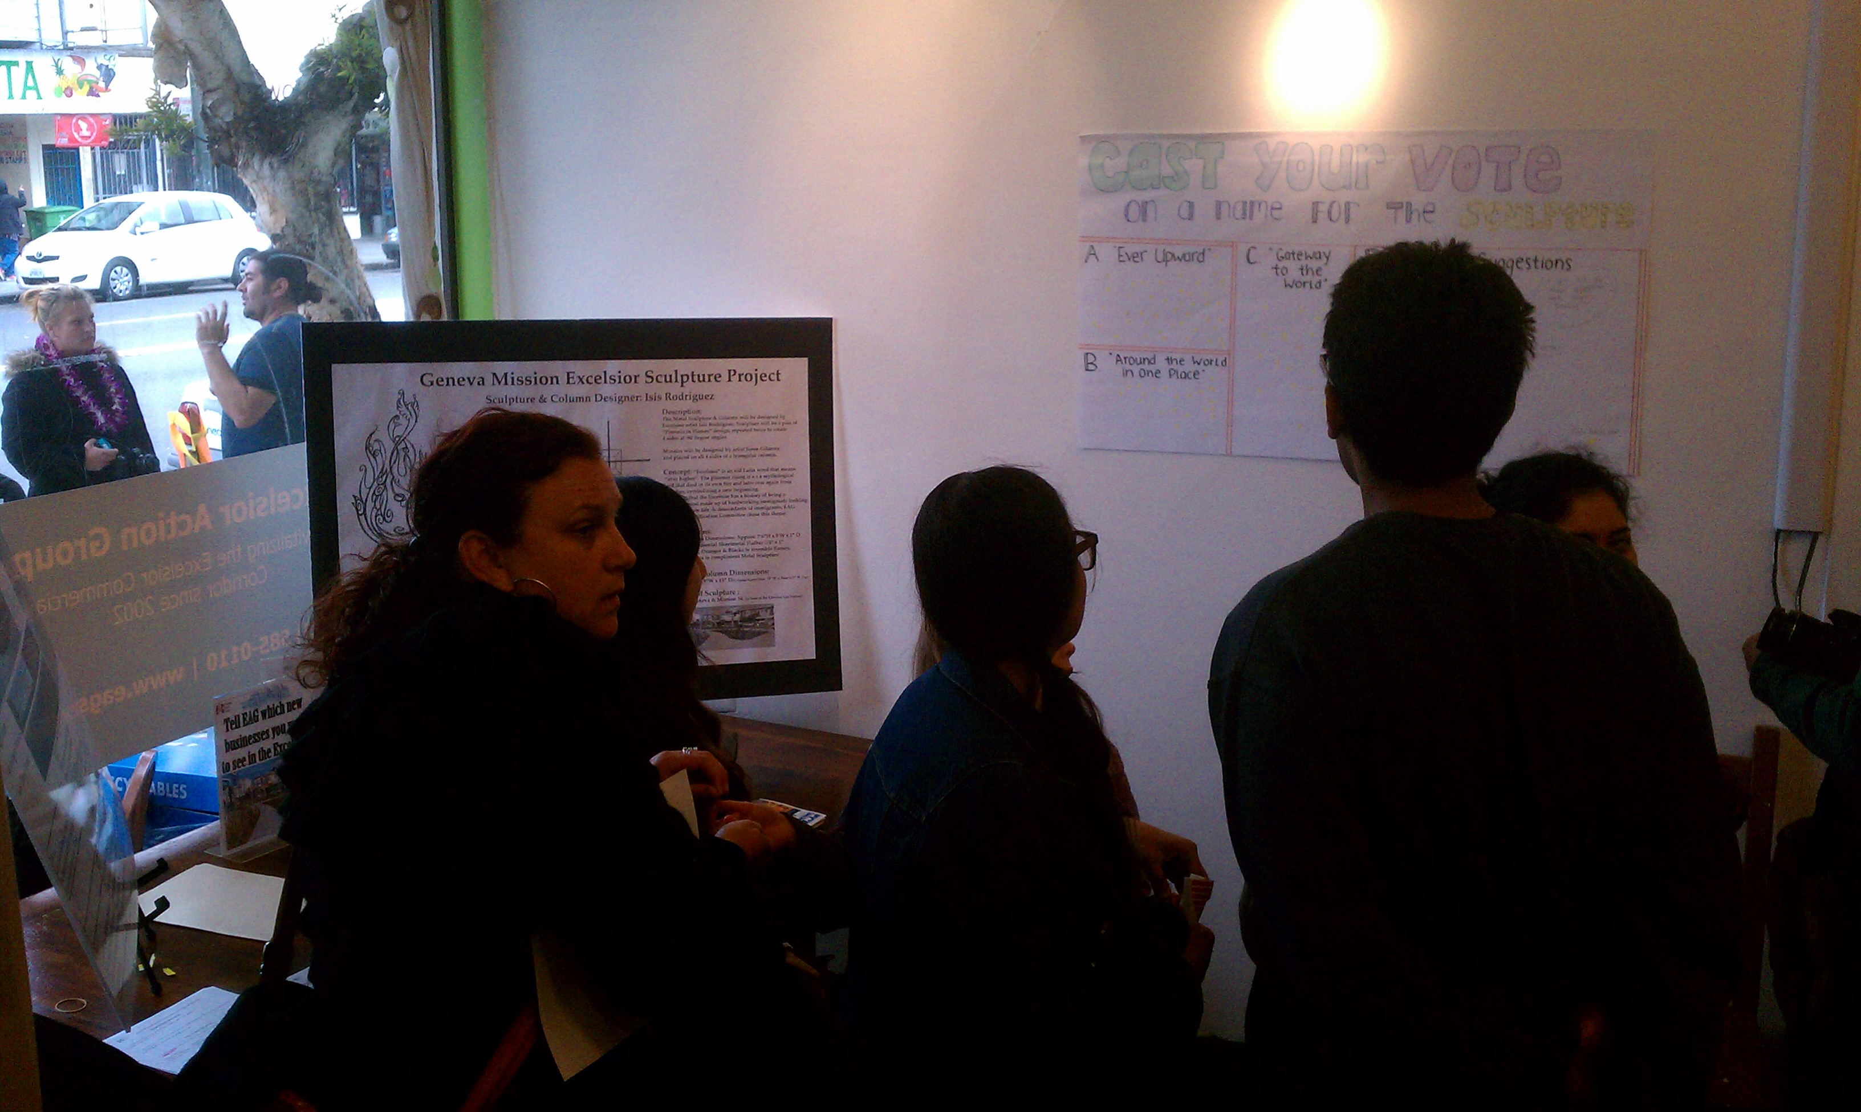
Community Design Process

Slide 5
Conceptual Design

Slide 6
Metal Sculpture

Slide 7
Mosaic Column

Slide 8
Project Workplan
Budget: $40,000
$30,000 Community Challenge Grant
$10,000 OEWD Capital Improvement Grant
In Kind support: Community volunteers mosaic
Timeline: February 2012 – September 2013
Design phase (Feb 2012 – Oct 2012)
Approval phase (Oct 2012 – May 2013)
Fabrication & Installation phase (Jun 2013 – Sep 2013)
Ever Upward Project Budget Detail
Description Amount
a. Design Fee - Isis Rodriguez $3,000.00
b. Design Fee - Jason Gilmore $700.00
c. Engineering Fee - SDE $4,000.00
d. Metalwork fabrication $13,000.00
includes painting ($1,600.00)
c. Column $6,500.00
fabrication
transport
footing
foundation
installation
d. Permits $1,500.00
e. Mosaic tiles $2,000.00
f. Materials for mosaic $300.00
g. Fiscal sponsorship $6,000.00
h. Contingency $3,000.00
TOTAL $40,000.00

Slide 9
Thank You!
Nicole Agbayani, LEED AP BD+C
Corridor Manager, Excelsior Action Group
(415) 585-0110
nagbayani@eagsf.org

