Slide 1
FAX Special Projects

Slide 2
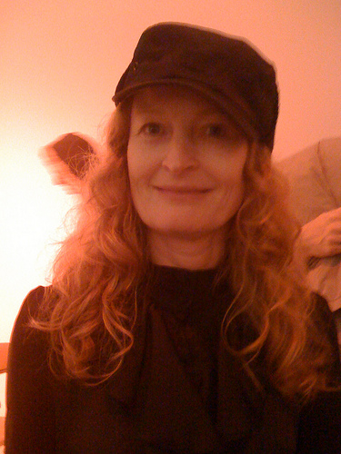
Anne Colvin Attn: Miss Calpurnia
A film, an artist’s video, stills, faxes, plotter print, copies, publication...

Slide 3
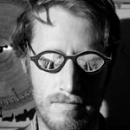
Colter Jacobsen
Mysterious Object at Noon
(Oh Distance Has A Way of Making Love Understandable)
A noontime exquisite corpse event at the Gallery. Incomplete drawings will be faxed into the Gallery, and the public will be invited to finish them at the event.

Slide 4
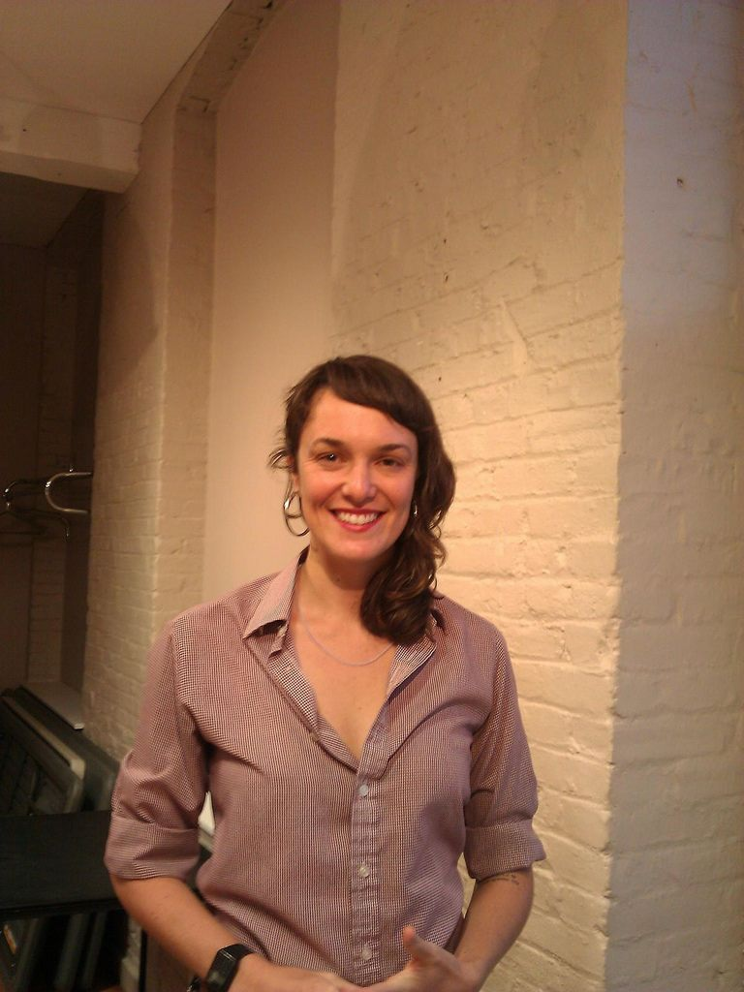
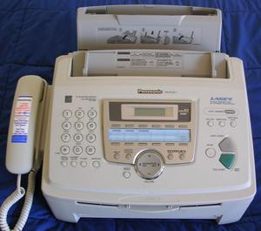
Adrienne Skye Roberts
FAX(FACTS)BOMB
A presentation and workshop that traces the evolution of technology and its effect on protest tactics and privacy.

Slide 5
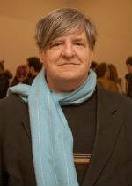
Kevin Killian
Box of Rain
A play by Kevin Killian, designed by Matt Gordon
When a San Francisco gallery installs a new fax machine, astounded staff is confronted with the possibility of regular communication between the living and the dead. "Walk into splintered sunlight, inch your way through dead dreams, to another land."

Slide 6
Visible Horizon SFAC Main Gallery August 10 – October 6, 2012

Slide 7
Chris Duncan
Oakland based artist Chris Duncan mines questions of optics, geometric abstraction, color theory, and dynamic patterning – and as of late, sound. Working in painting and mixed media, Duncan likes to surround and suspend the viewer – creating dizzying mirrored images and horizon lines that stretch into infinity.

Slide 8
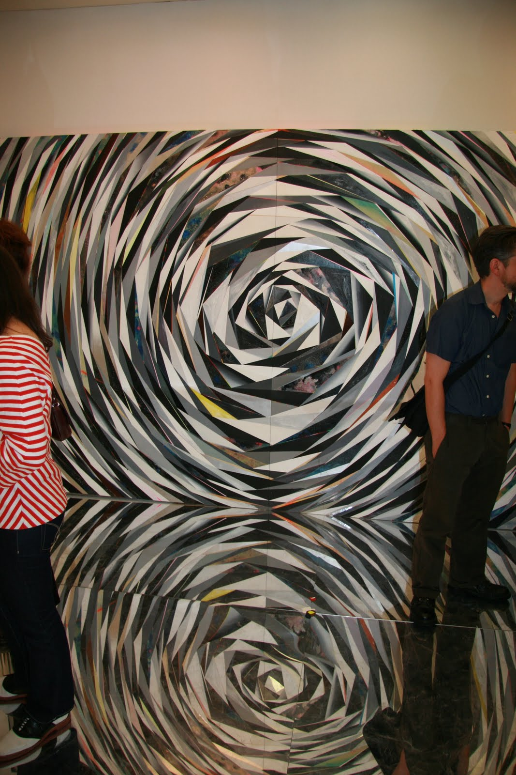
Eye vs. I
at Baer Ridgeway, 2011

Slide 9
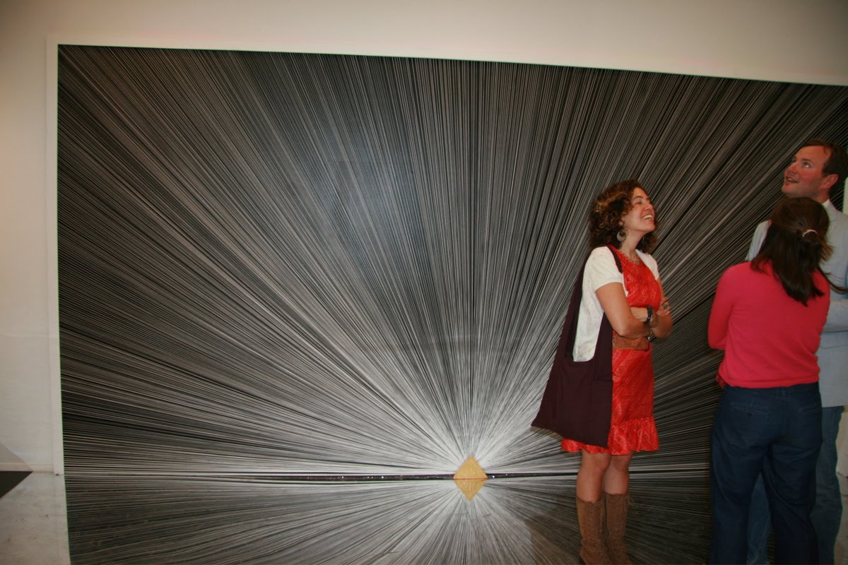

Slide 10
Rhonda Holberton
Rhonda Holberton is an interdisciplinary artist whose interests lead her to meld mythology, science and pop culture into works ranging from video to photography to sculpture. She is as included to dig a hole in the dirt outside a nuclear power plant, as she is to source and deconstruct found video. Although her work rarely features people, her practice is deeply rooted in the relationship between humankind and the world we explore and intervene with.

Slide 11
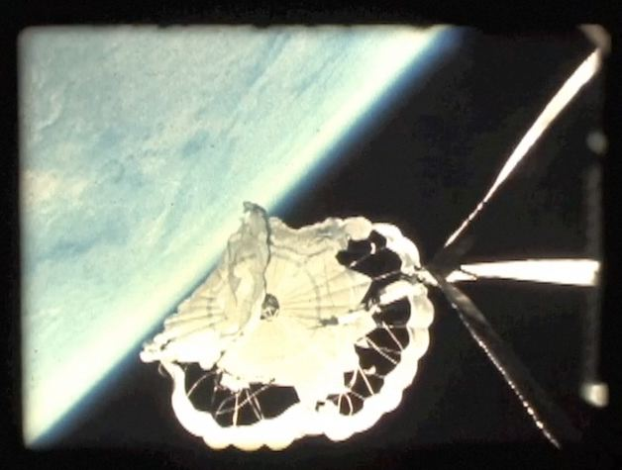
Parachute Fail, video

Slide 12
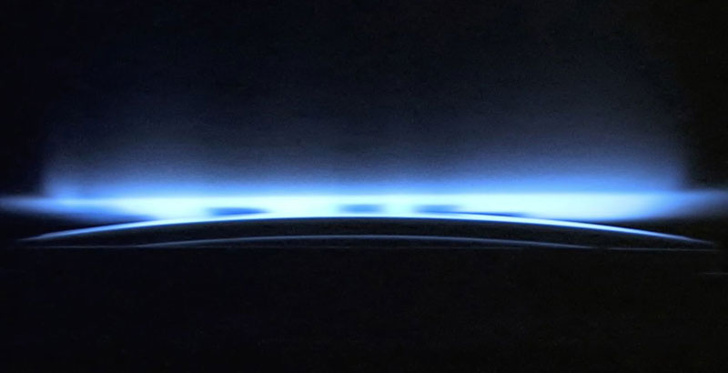
All Tomorrows, Video

Slide 13
Andrew Chapman
Andrew Chapman's work examines the significance of two dimensional image making in the age of digital production and hybridized modes of image distribution. Through an emphasis on painting, he seeks to investigate perceptual decision making and visual understanding, and the ways in which two-dimensional information indexes a multi-dimensional reality.

Slide 14
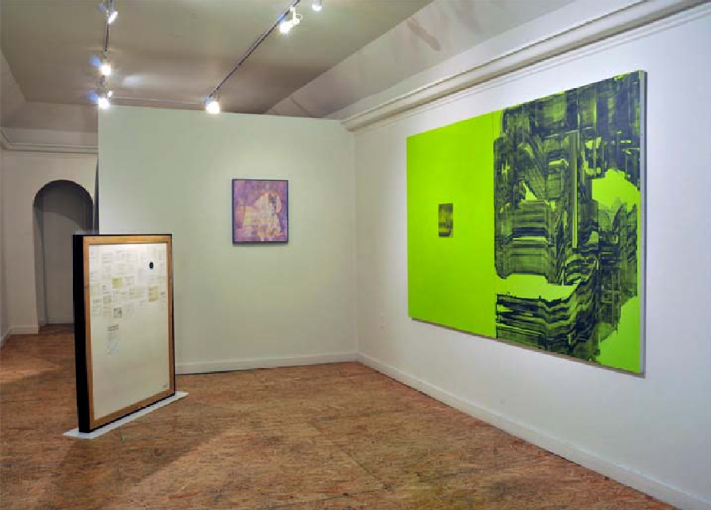

Slide 15
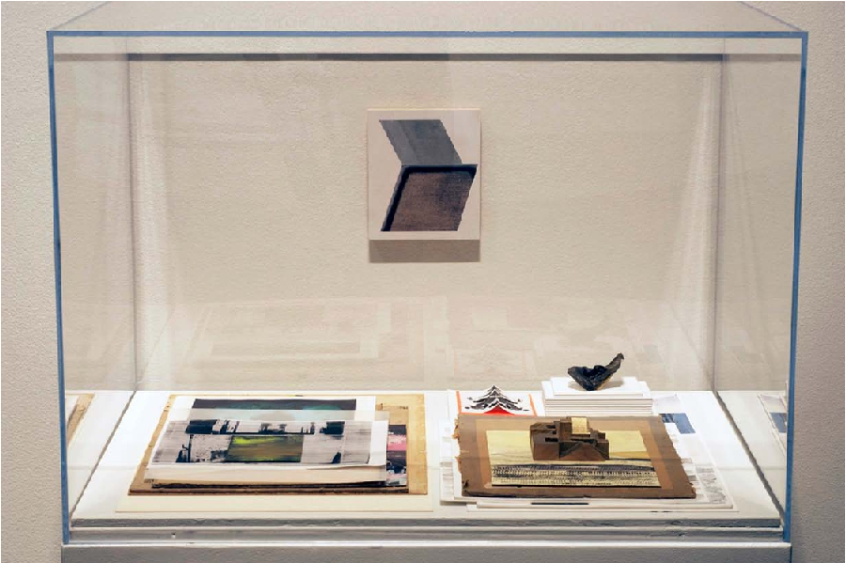
Psycho-Cartography Display, 2011

