Slide 1
SFAC Galleries
The Golden Capricorn 50th Anniversary Season

Slide 2
The Capricorn Chronicles
SFAC Main Gallery
February 12 – March 28
Winter Gallery Hours:
Wednesday – Saturday
Noon – 5pm
Saturday Time Warp events
Public access to exhibition archive and media
Partnerships with other archives
Community archive days
Outreach to educators to bring classes
Gallery staff in the gallery
Artists waiting in line for an annual juried show, 1970s

Slide 3
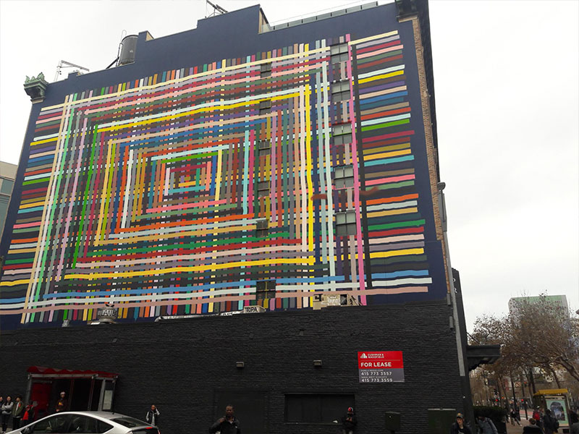
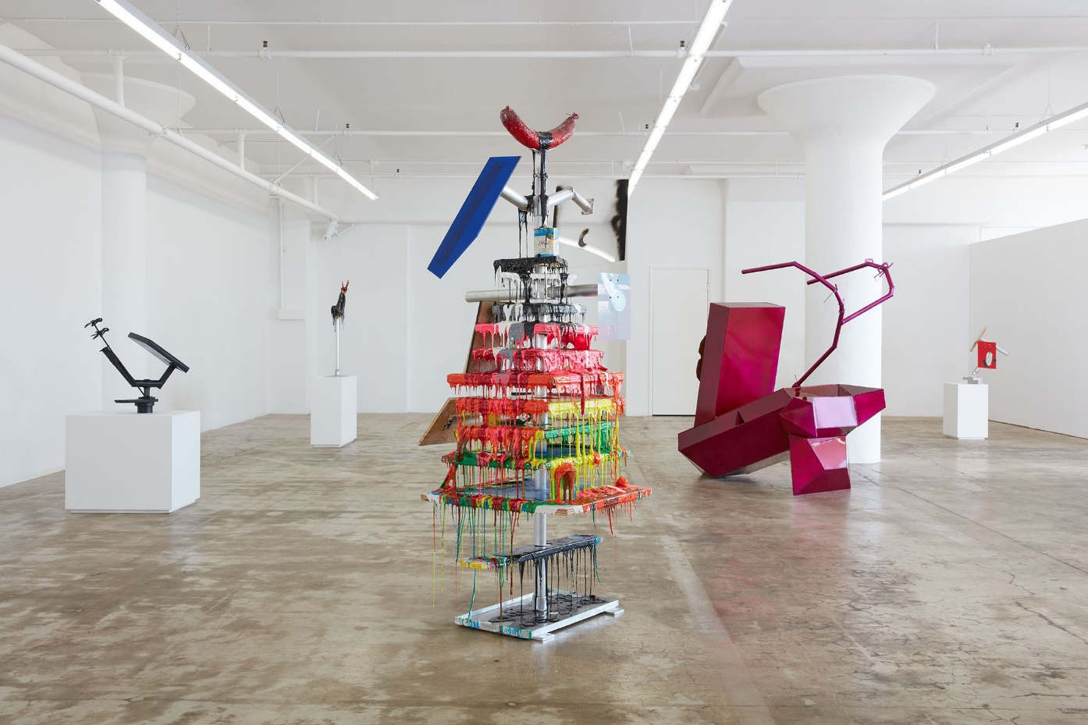
Conversation 8: Harry Dodge & Alicia McCarthy
Curated by Nancy Lim
SFAC Main Gallery
April 17 – June 20
Alicia McCarthy
Harry Dodge

Slide 4
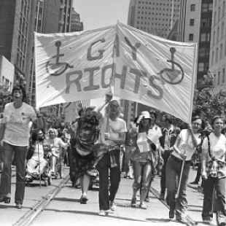
50th Year of Pride
Curated by Lenore Chinn & Pam Peniston
City Hall
May 7, 2020 – April 16, 2021

Slide 5
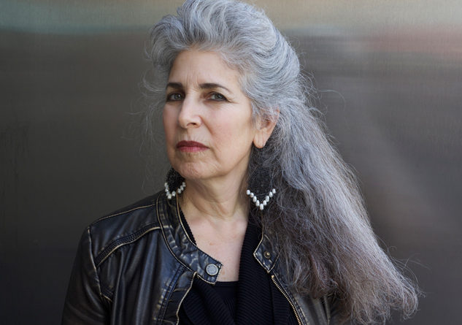
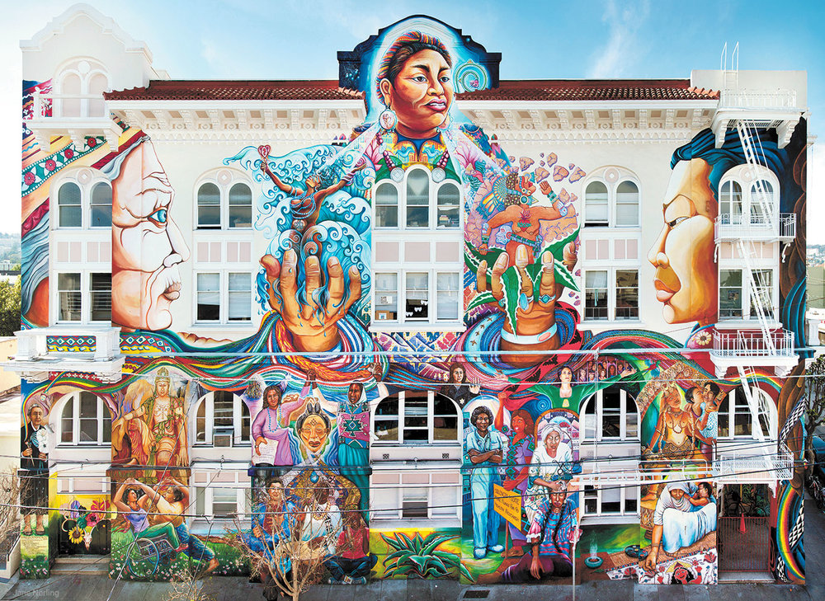
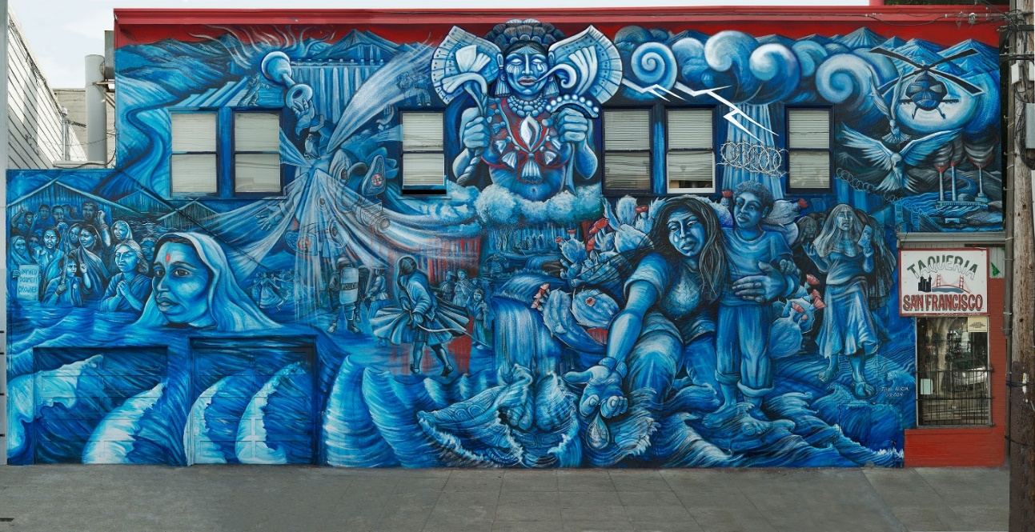
Juana Alicia
Golden Capricorn Award Exhibition
Curated by Meg Shiffler
SFAC Main Gallery
July 10 – September 12

Slide 6
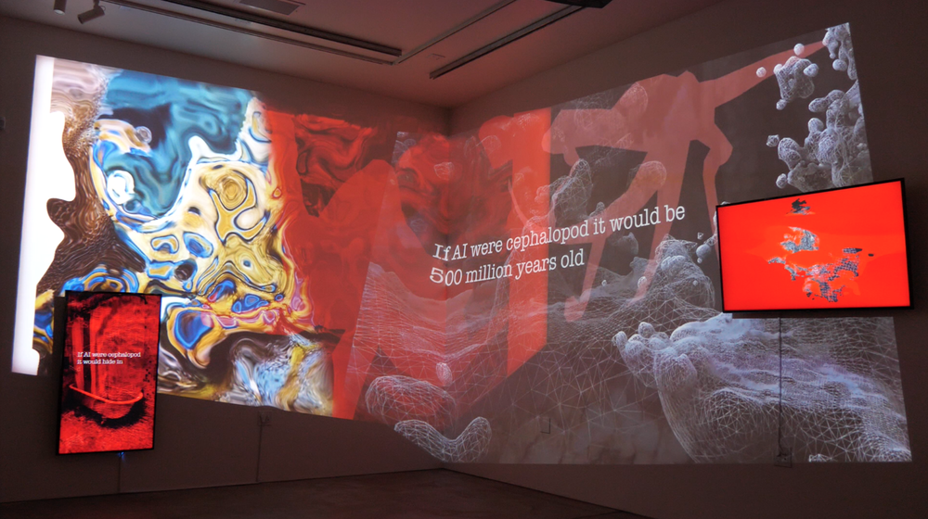
This is not the only possible world
Curated by Jackie Im
SFAC Main Gallery
October 2 – December 12
Ranu Mukherjee

Slide 7
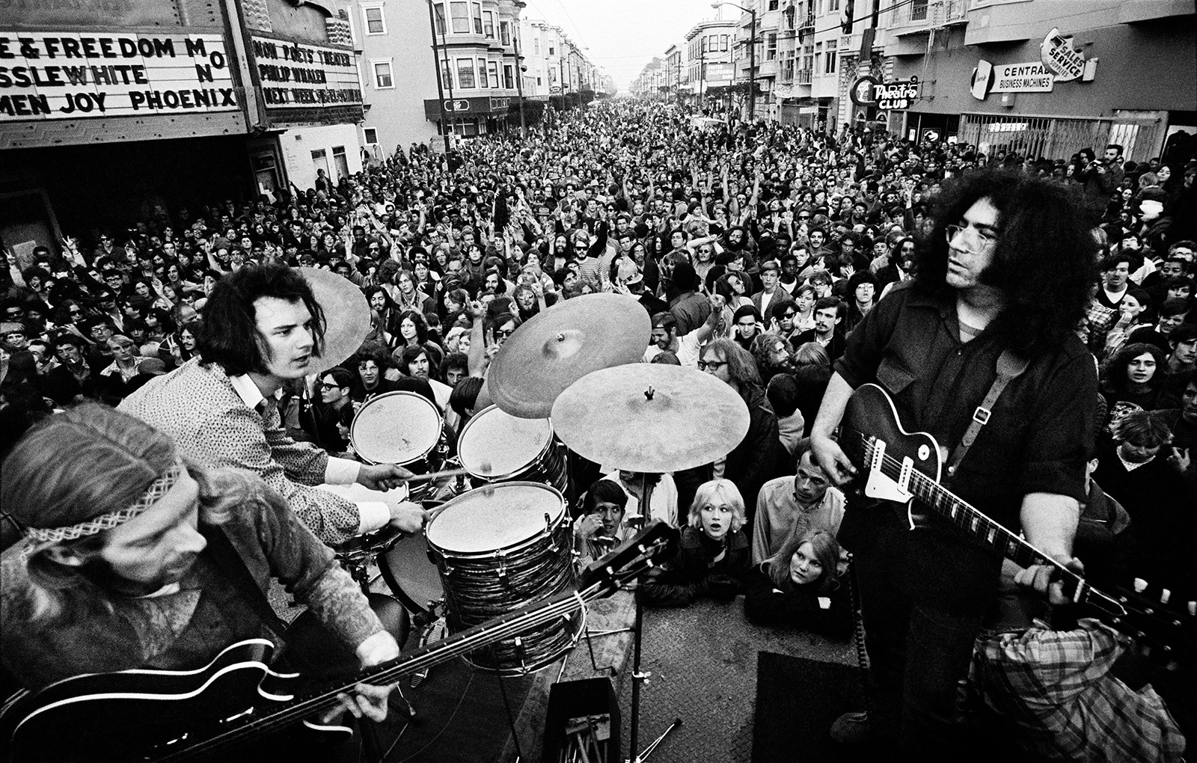
Traveling Exhibition
Jim Marshall’s 1967
Curated by Amelia Davis &
Meg Shiffler
Stadtgalerie Kiel
Kiel, Germany (Sister City)
June 13 – September 6

Slide 8
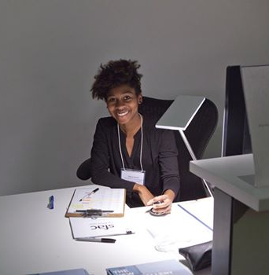
Also in 2020…
50th Anniversary public program series
Artist in Residence at SF Planning Department – Mansur Nurullah
Continuing programming at Café Valor
Development and release of publicly searchable 50 year exhibition history database on our web site (pulling data from Salesforce)
Physical and digital archive work
Internship program in partnership with Opportunities for All, and CCA Fellow.
Former SFAC Galleries CCA Fellow, Elena Gross

