Slide 1
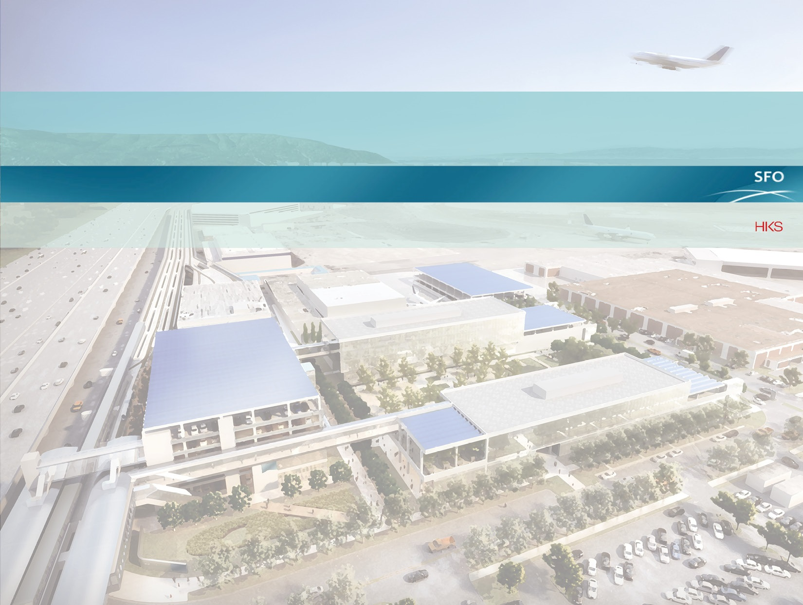
SFAC Civic Design Review – Informational Overview
February 8, 2016
SAN FRANCISCO INTERNATIONAL AIRPORT
CONSOLIDATED ADMINISTRATION CAMPUS

Slide 2
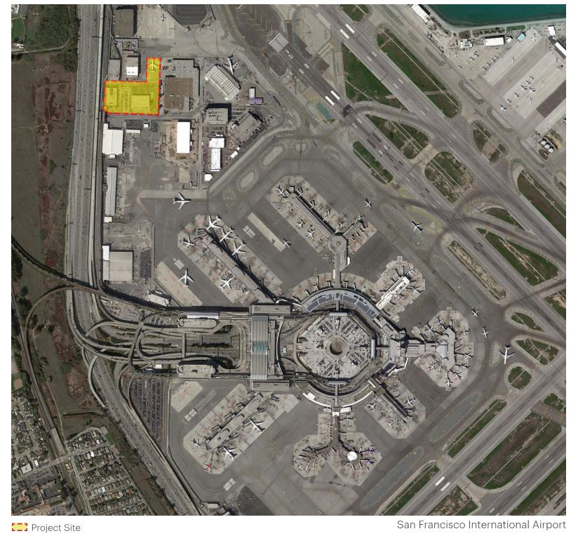
Site Context

Slide 3
Site
West Field cargo building
USPS facility
Airport Maintenance
Museum curatorial facility
APM service facility
Cargo building
Building 676
AirTrain station
Hwy 101
Exit ramp

Slide 4
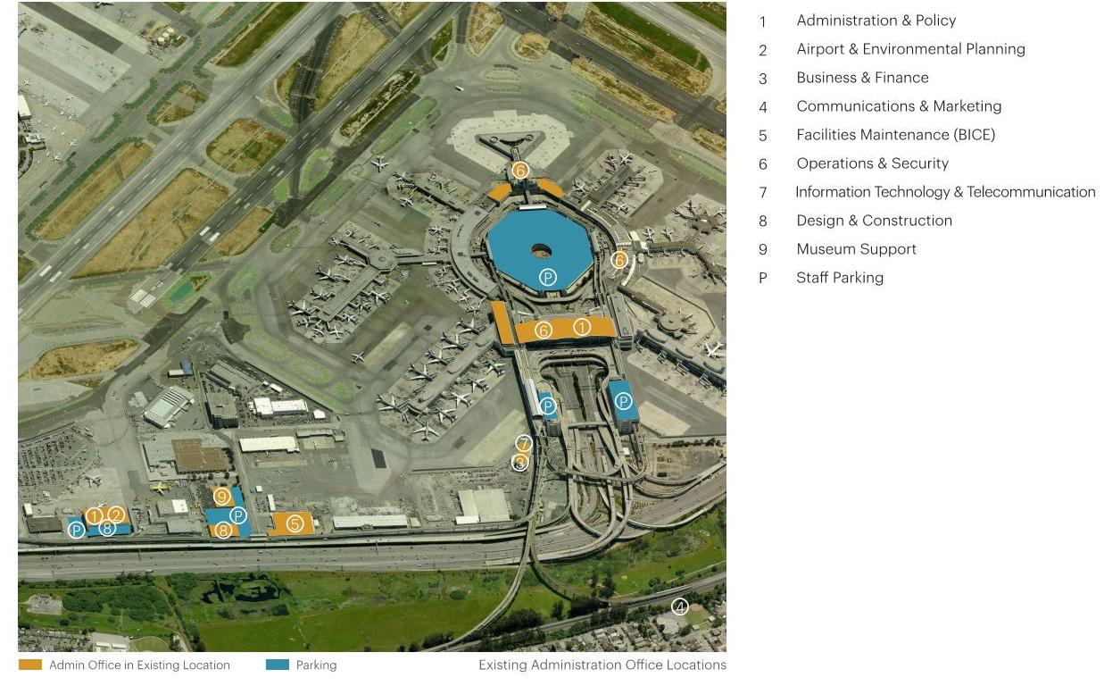
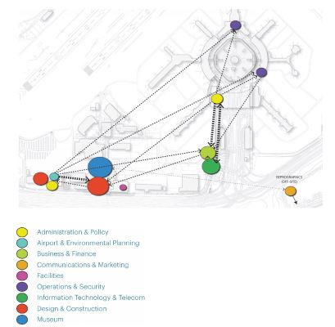
Space Program
SHOULD BE
ADJACENCY DIAGRAM
Similar base

Slide 5
Campus Vision

Slide 6
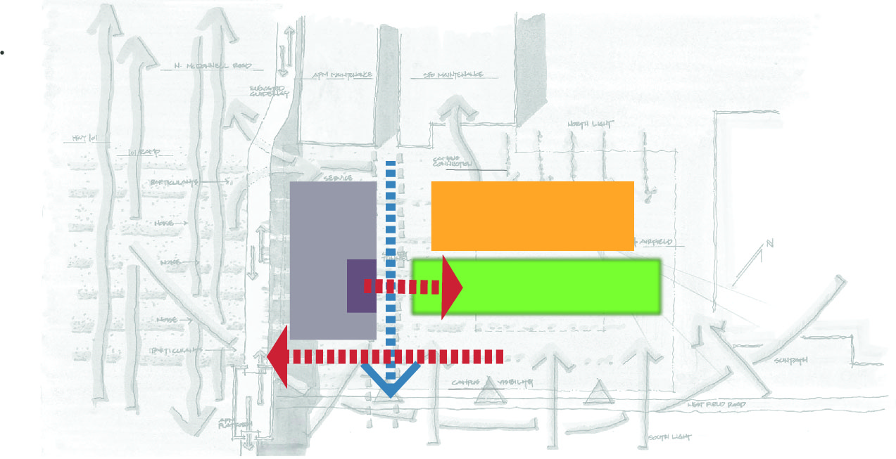
Macro Site Organization
Characteristics:
Garage as noise buffer
Garage pedestrian access to center of site
Separate garage for maintenance staff
Open site access to AirTrain station
Museum access to service area
Open area between Museum & Garage (connection to Maintenance Facility)
Site open to favorable sun angles
Maintenance Garage
Secondary Site Access
Garage
Museum
Program in Garage
Central Green
AirTrain access

Slide 7
Campus Overview
Campus Program
Site: 8 acres
Admin. Buildings: 200,000 gsf
Employees: 585 staff
Parking: 925 stalls
Sustainability Goals
Net Zero Energy Capable Design
LEED Gold without Renewable Source
LEEDv4 Certification
Campus Structures
2 Administration Buildings
2 Parking Structures
2 Campus Roads
AirTrain Station Improvements
MAINTENANCE DEPT. PARKING
NORTH CAMPUS RD
N MCDONNELL ROAD
ADMIN BLDG 1
CAMPUS PARKING STRUCTURE
EAST CAMPUS RD
AIRTRAIN STATION
ADMIN BLDG 2
WEST FIELD ROAD

Slide 8
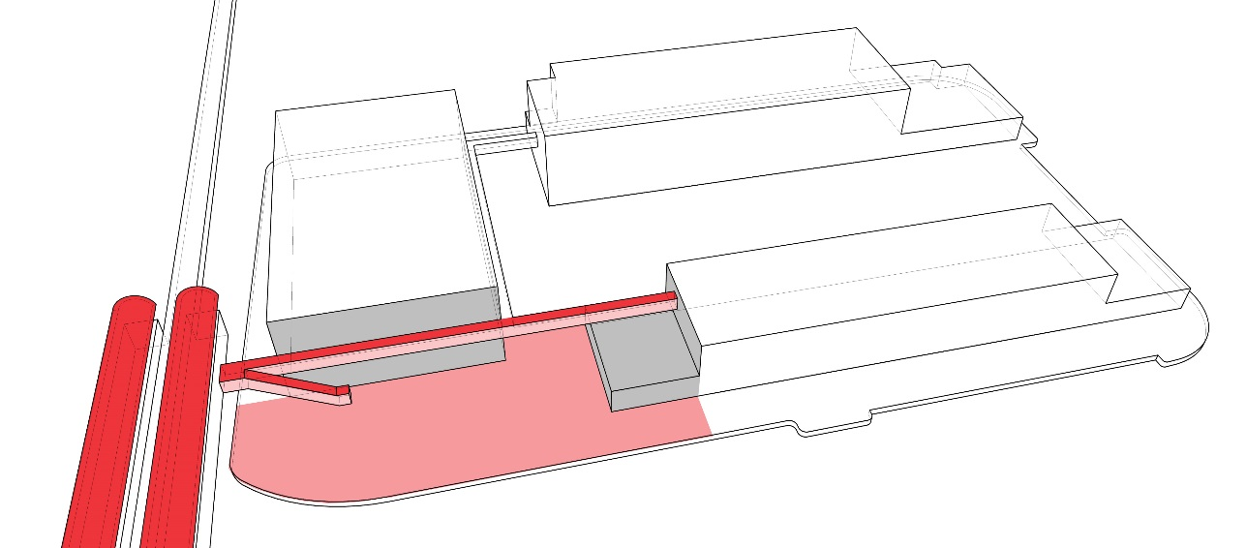
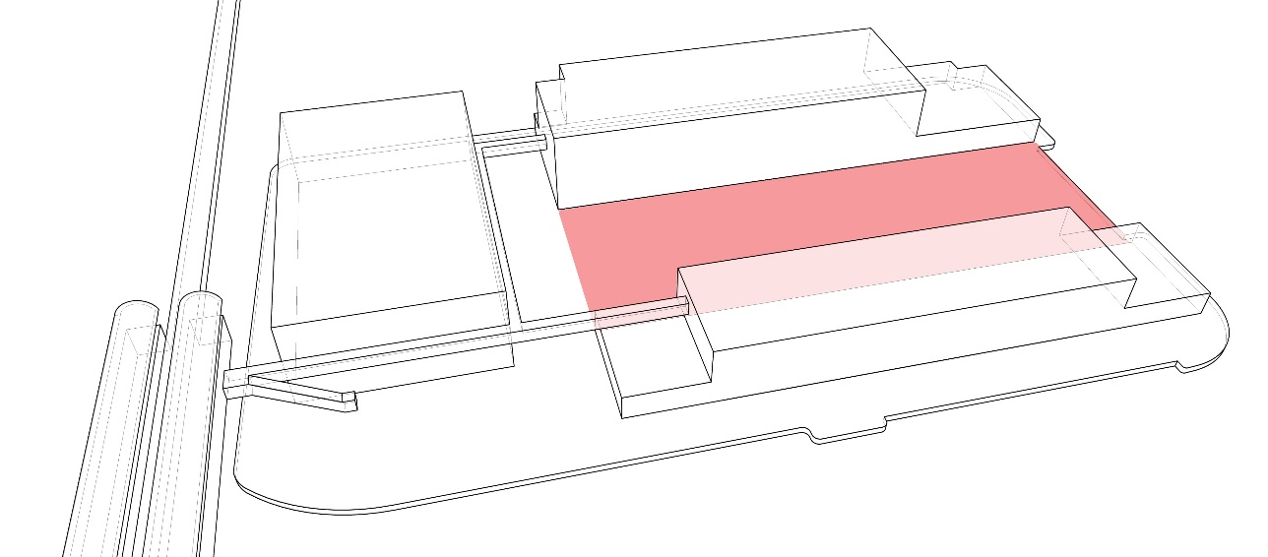
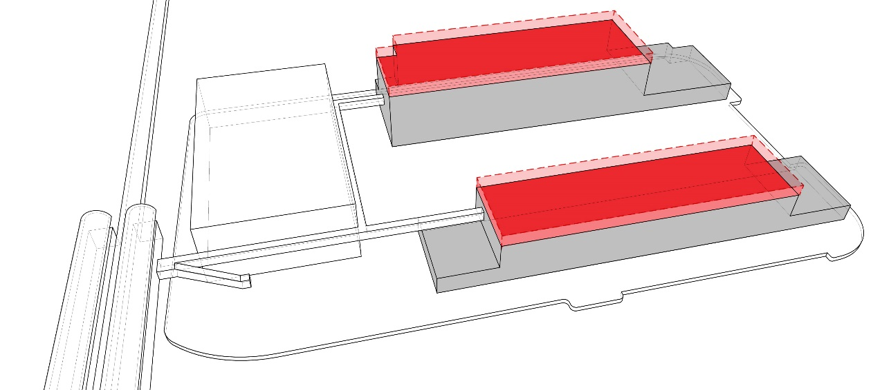
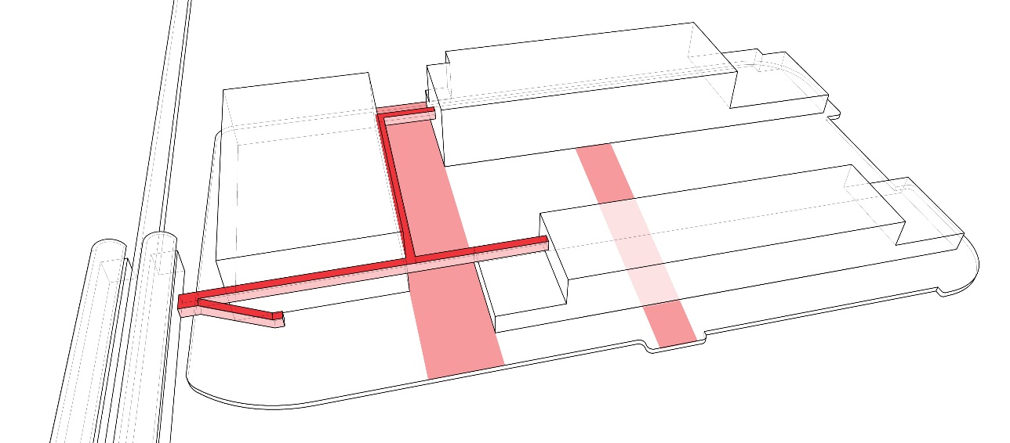
Campus Urban Design Factors
PUBLIC ARRIVAL
CENTRAL GREEN
Open multi-level arrival area for safety and wayfinding.
Central access point for train, bus, bicycle, and car.
Landscaped for wellness and improved pedestrian ways.
Creates a pedestrian-only, multi-use outdoor area with sustainable landscaping.
Provides first usable landscaped area on entire airport property.
Allows quiet, secure, community setting for large gatherings and individual respite
PLAN CONFIGURATION
CONNECTIVITY
Floor Plate size is optimized for program growth and adjacency needs of all SFO Departments
Building Placement allows adding floors for program changes with minimal solar and viewshed impacts.
Orientation provides optimum solar, wind and views, while buffering noise and traffic issues.
Campus open space and key pedestrian ways connect directly to adjacent administrative facilities
Potential expansion of campus program with key pedestrian and utilities corridors in 3 directions
Direct pedestrian connections to the AirTrain Station, SamTrans stops, and FlyCycle bicycle facilities

Slide 9
Campus Phasing Plan
Phase 1A
Construct New Perimeter Roads + Utilities
Construct Admin. Bldg. 1
Phase 1B
Demolish Existing Museum
Demolish Existing A+E Bldg.
Construct Surface Parking
Phase 2A
Construct Campus Garage
Construct Maint. Dept. Garage
Phase 2B
Construct Admin. Bldg. 2
Construct Campus Site + Landscape
Construct AirTrain Connections

Slide 10
Campus Sustainability
ACOUSTIC BUFFER
Strategically locate parking structure as a buffer to protect campus from freeway noise
RENEWABLE ENERGY
Harvest solar energy to provide electricity for the net-zero capable campus
BUILDING ORIENTATION
Orient office buildings and glazing to minimize SW-facing surfaces and preference SE/NW facades
NARROW FLOORPLATES
Enable access to daylight and views
RECYCLED WATER USE
Recycled water to be used for irrigation and flushing with potential usage for heat sink to reduce building energy use and eliminate water-intensive cooling towers
RECYCLED WATER LINE
TRANSIT CONNECTION
Improved access to AirTrain-BART, bus
STORMWATER MITIGATION
Use bioretention areas and permeable paving to clean and slow flow of rainwater onsite and minimize peak demand on centralized SFO infrastructure
BICYCLE
On-site bike share, parking & showers, bike paths encourage low carbon commuting for employees
USABLE OUTDOOR SPACE
Use building massing and trees for acoustic mitigation, protection from winds, and solar shading
HEALTH & WELLNESS
Daycare, fitness center

Slide 11
Phase 1 - Project Schedule
 | 2015 |  |  |  | 2016 |  |  |  | 2017 |  |  |  | 2018
 | 1Q | 2Q | 3Q | 4Q | 1Q | 2Q | 3Q | 4Q | 1Q | 2Q | 3Q | 4Q | 1Q
EIR Approved
Design-Build RFP
Enabling Projects
Phase 1A Design + Construction
Phase 1B Demo + Site Parking
Art Program Plan CDR Review
SEPT 2015 INITIATE DB
ENABLING PROJECTS
PROGRAM
PHASE
DESIGN PHASE
15 mo.
NOV 2017
MOVE - IN
CONSTRUCTION PHASE
4 mo.
JUNE
OCT
MAR
APR
JUN

Slide 12
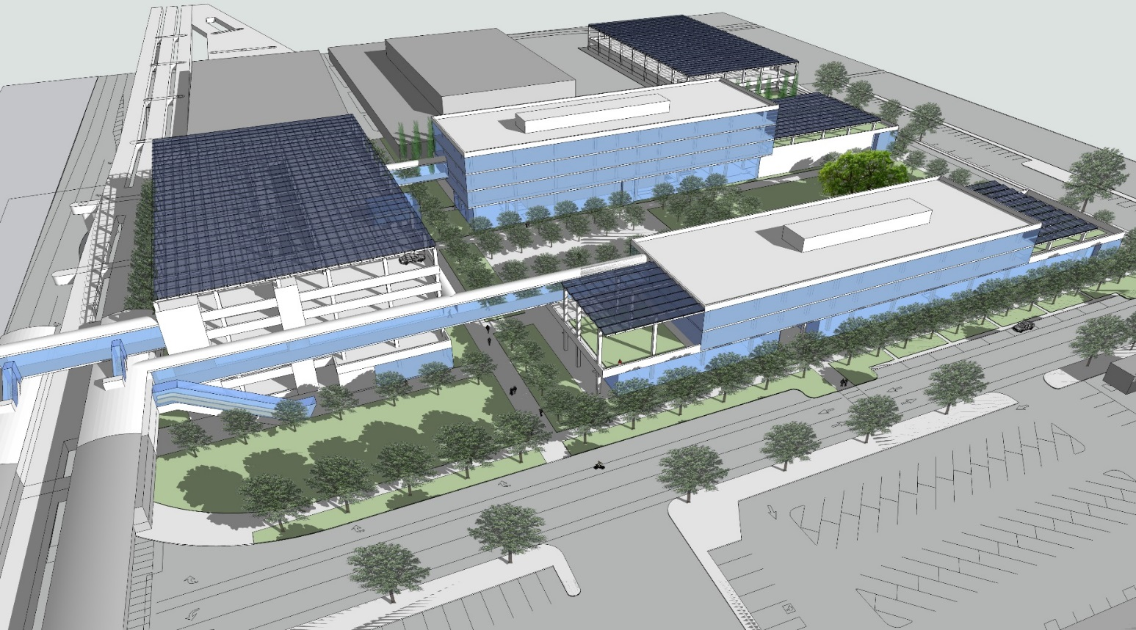
Campus Development

Slide 13
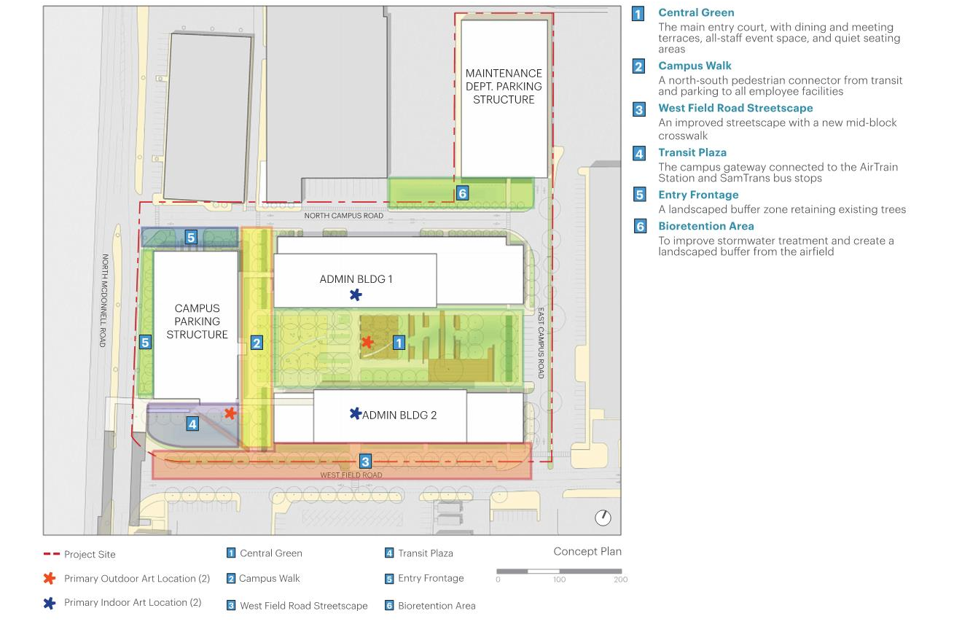
Public Art Locations

