Slide 1
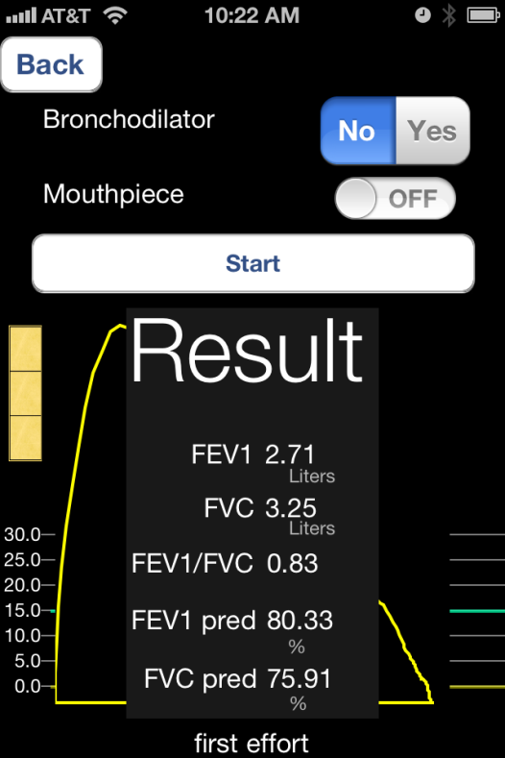
SpiroSmart: Development of a mobile phone-based spirometer with feedback capability
J. Stout, S. Patel, EC Larson, M. Goel,
D. Burges, M. Rosenfeld
.

Slide 2
Disclosure Slide
Project implementation was funded through the
Coulter Family Foundation.
I have no financial conflicts of interest.

Slide 3
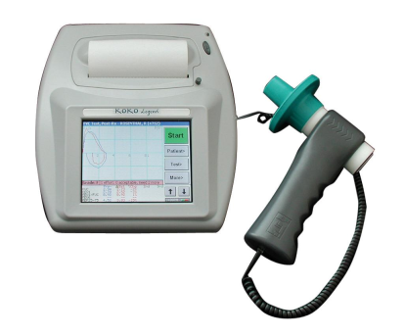
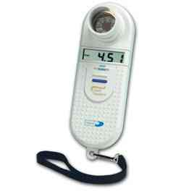
The Current Scenario
Diagnostic spirometry is generally only done in the clinical setting. Though home devices exist, they often lack complete platforms.
Spirometers are relatively expensive, & have minimal coaching capability.
No mobile apps currently measure spirometry
Clinical Spirometer Home Spirometer

Slide 4
Our Proposed Solution
SpiroSmart: Mobile phone spirometry application
Uses built-in microphone
No additional hardware needed
Built-in automatic feedback software (FRS-based)
Capable of 1-on-1 remote coaching (in progress)
Automatic over-reads (in progress)
Notes:
Screen sharing. 1 on 1 person.
Customized feedback.
Only show our solution
JS Bottom line now reads: Automatic over-reads (proposed for Year 2)

Slide 5
dataset
flow features
measures
regression
curve
regression
lung function
Notes:
to evaluate the curves we created a survey

Slide 6
Flow features

Slide 7
Auto-regressive estimate
envelope detection

Slide 8
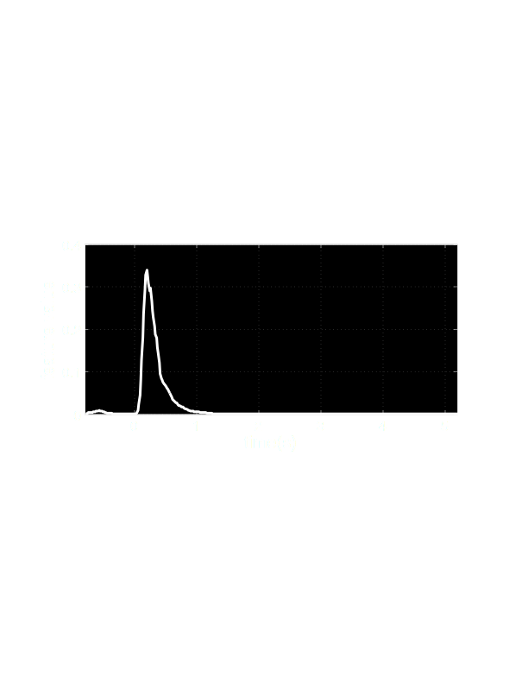
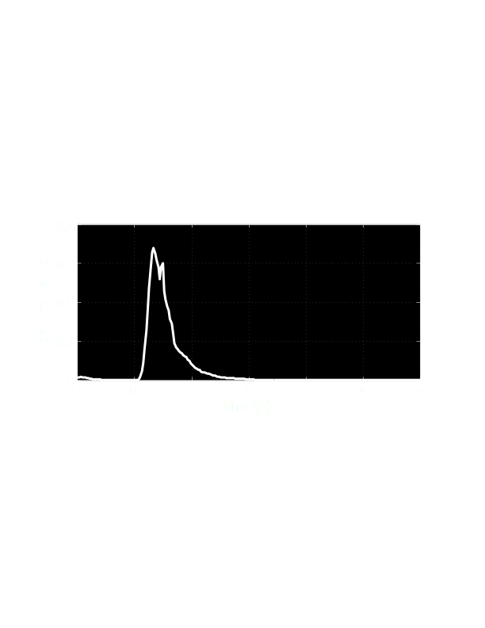
ground truth
spirometer
flow features
feature 1
feature 2
Notes:
To use machine learning we need a ground truth estimate of the flow rate over time. However, recall we couldn't collect data on spirosmart and the spirometer at the same time. so we have to randomly assign a ground truth curve from the clinical spirometer in the same session where the given audio file was recorded. Here are two example features and the ground truth. We align the signals according to their maximum value. now we can build our machine learning model.

Slide 9
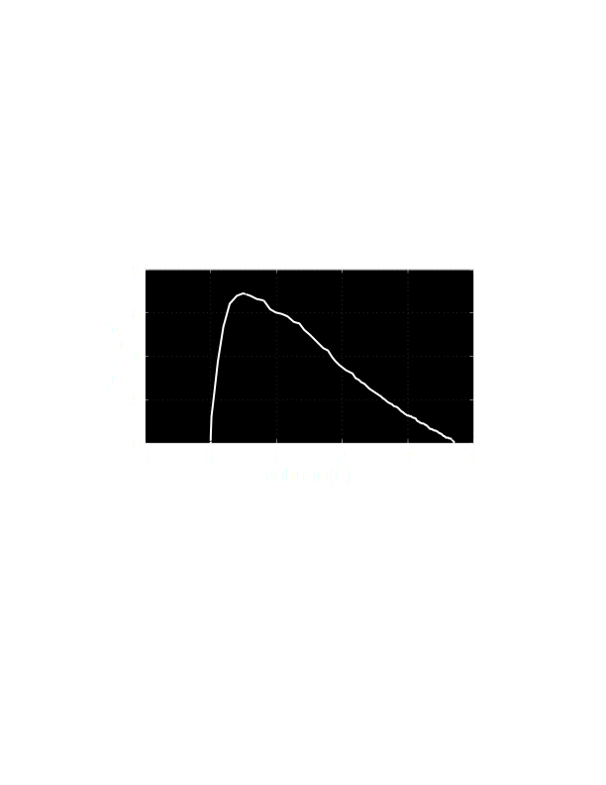
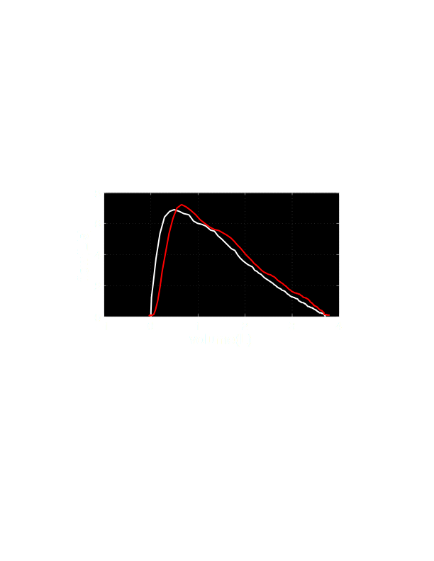
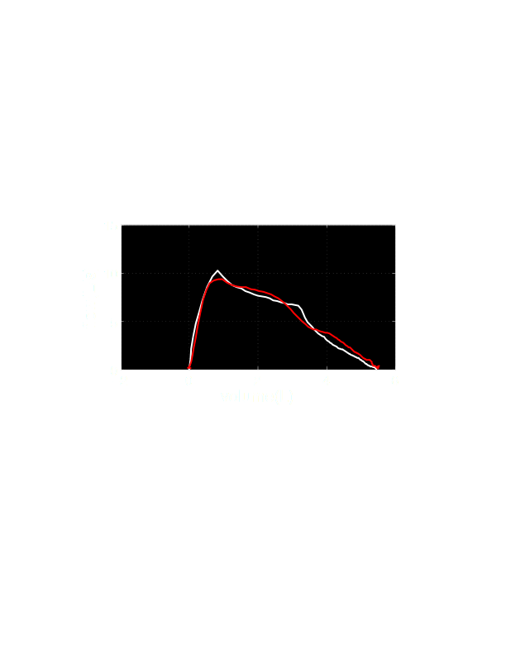
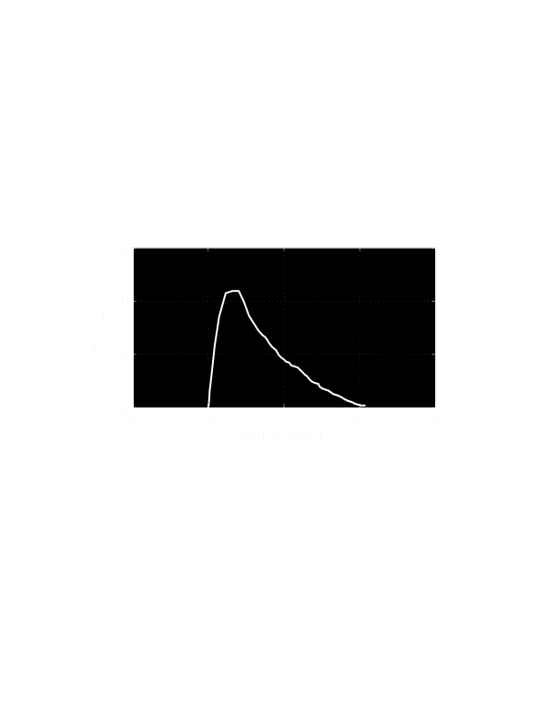
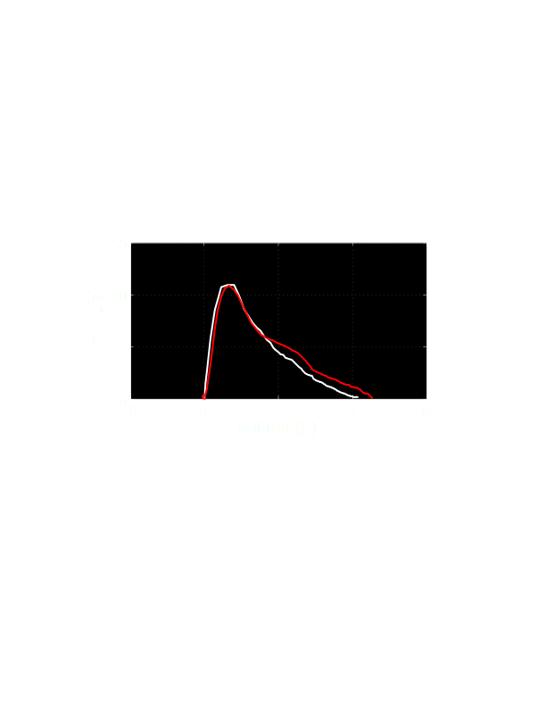
example curves
curve
regression
Notes:
So lets look at some of the example outputs. here we see two flow volume curves from a clinical spirometer in white and the spirosmart output in red. These subjects are considered to have normal lung function. Here is an example of an obstructed curve and the spirosmart output. They all appear to be good estimates, but what we are really interested in is can a pulmonologist look at these curves and make a diagnosis?

Slide 10
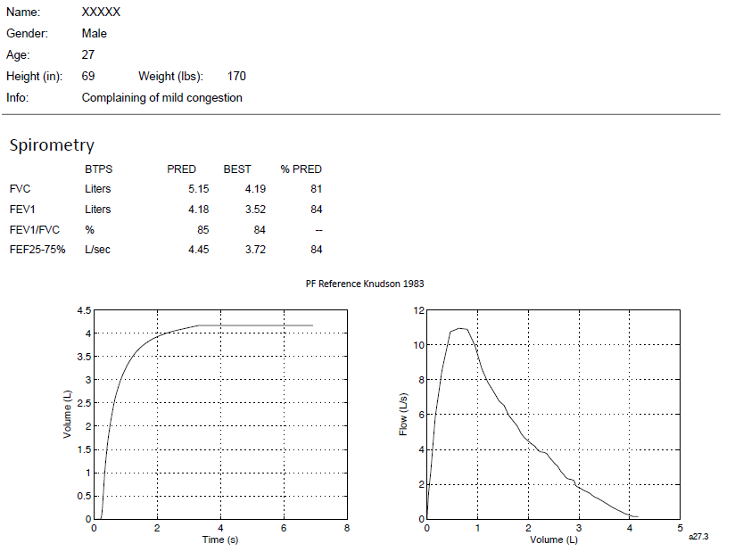
Initial Validation
Have a working initial prototype (patent app filed)
Evaluated in 52 “healthy” subjects
Accuracy within 5% when compared to a clinical spirometer
Clinically acceptable variance (within FDA accuracy)
Output similar measures to clinical spirometers
FEV1, FEV6, FVC, PEF (Not FEF 25-75)
Example report generated for doctor
Notes:
Rachael’s notes:
Maybe you will speak to this – the picture shows an additional mouth piece. Is this needed? If not, maybe you should leave it out.
The within 5% accuracy rate. Within known variance, FDA
FEV1
FEV/FVC
510k performance requirements
Diseased individuals
IP position – filed

Slide 11
Current Status
First iteration of infrastructure complete
Interface on phone
Physician interface in the cloud
Integrate with feedback reporting system (FRS)
Head-to-head trial with obstructed patients and children underway
All were able to successfully conduct test
Creating new machine learning methods for highly obstructed patients
FDA
Risk management completed
Software development procedure in place
Notes:
Not sure pharma companies are a major customer.
Different levels of service
Mobisante, numera
Hospitalizations and er visits are the real costs
JS 4th bullet down, I changed intergrated to intergrate, since it’s still in process.

Slide 12
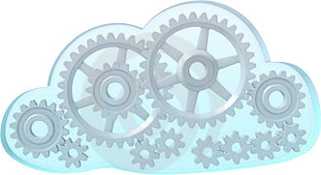
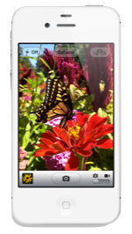
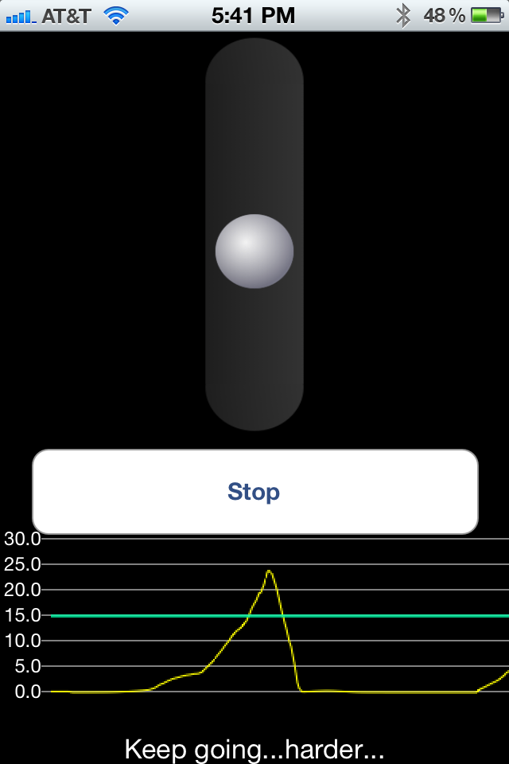
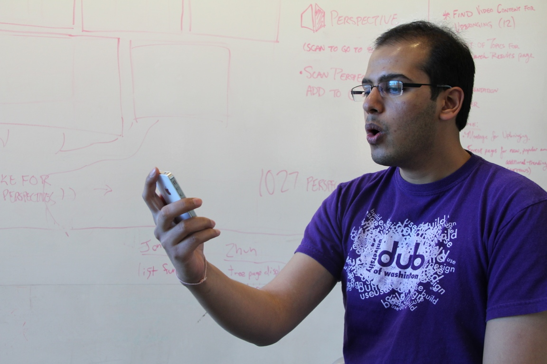
limitations
no inhalation
quiet surroundings
coaching
Smartphone*
Notes:
All in all we were happy with the results but we also want to try and put these results in perspective. In the current form of spirosmart, we really see this as a replacement for people already doing home spirometry, not as a replacement for all clinical spirometers. we draw this conclusion based on several current limitations.
the first limitation is that we are doing audible sensing, so we need relatively quiet surroundings--this is easy to do if you are at home. Second we cannot measure quantities from the subject inhaling. These are almost never used in diagnosis but they are helpful when teaching someone how to use a spirometer.
And coaching someone in general with this device is something we didn't address in the current study. Its unclear how easy it will be to coach someone when the technician can't say things like keep going and really push out! Although our community might be uniquely skilled to create interfaces and incentive graphics for coaching on spirosmart.
Another limitation is that we currently require a smart phone with an internet connection because the computation just can't yet be done on a phone in real time. The audio must be sent to a server, processed, and then results sent back down.
Finally, in the current study, no participants lung function changed drastically during the study so we don't' know if spirosmart can track trends over time.

Slide 13
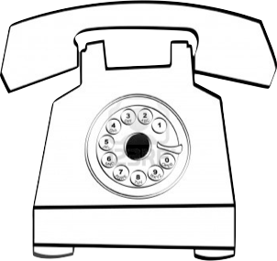
call in service
Notes:
(maybe all you need is a phone like this). This could really lower the access barriers of spirometry, for instance in developing world, telemedicine, and in general to people that do not own a smart phone.

Slide 14
Initial Interest in SpiroSmart
Scientific community
Effectiveness of new/existing treatments (e.g., Pharma)
Health services research (e.g., NIH, AHRQ)
Prevalence, morbidity, service delivery (e.g., IPCRG, Gates Foundation)
Evidence first, then health care diffusion in developed countries
Notes:
JS See what you think of this

Slide 15
Spirometry 360: Training through Feedback Reporting System Cycle

Slide 16
Next Steps
Complete model development for obstruction
Complete model development for children
Complete integration with FRS
Complete home monitoring trial
Evaluate patient and physician user interfaces
Develop comprehensive automatic results analyses

Slide 17
Comprehensive results analysis
Use of 20,000 tests in Spirometry 360 FRS database for “ground truth” machine learning.
Will include all error patterns as we’ve defined them.
Notes:
JS See what you think of this

Slide 18
Early Termination
FV Curve
VT Curve

Slide 19
Variable Flow
FV Curve
VT Curve

Slide 20
Cough
FV Curve
VT Curve

Slide 21
In Summary
Initial results for “normal” lung function promising
Iterative “machine learning” algorithms will enable model development for obstruction, children, and error patterns
May lead to greater understanding of lung function in diverse and remote settings
Notes:
JS See what you think of this

