Slide 1
Pulmonary Hypertension:
The Asthma Masquerader
Sachin Gupta, MD

Slide 2
Live Audience Polling: Poll Everywhere App
Please download from the Apple AppStore
Free, fast install, anonymous polling
Username: KPSF

Slide 4
About the Presenter
No financial disclosures or conflicts of interest

Slide 5
Outline
Background
Diagnosis
Management
Questions

Slide 6
Abbreviations
PH – Pulmonary Hypertension
PVH – Pulmonary Venous Hypertension
PAH – Pulmonary Arterial Hypertension
IPAH – Idiopathic PAH
CTEPH – Chronic Thromboembolic Pulmonary Hypertension
HFpEF – Heart Failure with preserved EF
HFrEF – Heart Failure with reduced EF
PVR – Pulmonary Vascular Resistance
CHD – Congenital Heart Disease
ILD – Interstitial Lung Disease
PoPH – Portopulmonary Hypertension
WHO FC – World Health Organization Functional Class

Slide 7
Case Vignette
HOPI-
34 y/o W with no significant PMHx presents with a chest tightness and dyspnea on exertion for 10 months. Referred from Primary care for refractory symptoms.
Chest tightness noted with heavy exertion, at times associated with light-headedness.

Slide 8
Case continued
The patient denies wheezing. No skin rashes. Denies allergic rhinitis type symptoms.
She frequently travels to Lake Tahoe and feels her symptoms are worse, particularly on exertion such as hiking.
Given a trial of Albuterol and QVAR by her PCP, with a spacer. Initial improvement, however afterwards no change in symptoms with usage.

Slide 9
Case continued
Peak flow measurements in primary care clinic around 350.
Patient does not have a Peak flow meter at home.
Extensive history in relation to triggers not helpful.

Slide 10
Case continued
PMHx: Asthma
PSHx: None
Allergies: NKDA
Family History: Mother with SLE, Father with CAD
Social Hx: No tobacco, drug abuse. Occasional etOH use.
Lives by herself in San Leandro, works in retail

Slide 11
Exam:
BP 126/68, HR 72, T 36.7, RR 18, Peak flow 340, FENO 17
Height 5’2”, 61 kg
General: NAD, full sentences
Lungs: CTAB
CV: RRR, S1S2, no m/r/g
Ext: no c/c/e
Skin: tightening of skin over fingers
http://sclerodermainfo.org/Images/Telangiectasia-1.jpg

Slide 12
Labs/imaging:
CBC – no peripheral eos
Chem 7 – normal
Basic spirometry – normal, no BD response
EKG (3 months prior at an ER visit): RVH, rightward axis
By Stillwaterising - Own work, CC0, https://commons.wikimedia.org/w/index.php?curid=9686540

Slide 13
Notes:
Poll Title: What is the next best step in management? https://www.polleverywhere.com/multiple_choice_polls/ocNP2MP5tcaKu2V

Slide 16
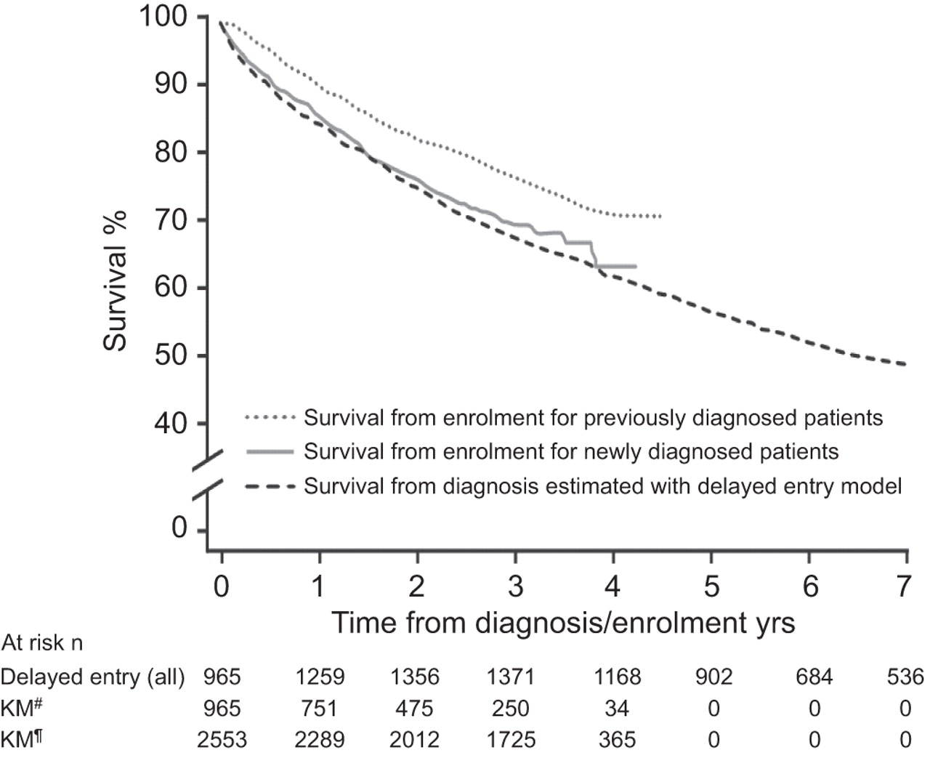
Survival estimates of patients in REVEAL using Kaplan–Meier estimates stratified by newly versus previously diagnosed patients and survival estimated by a delayed entry model accounting for truncation.
M.D. McGoon, and D.P. Miller Eur Respir Rev 2012;21:8-18
©2012 by European Respiratory Society
Notes:
Survival estimates of patients in REVEAL using Kaplan–Meier estimates stratified by newly versus previously diagnosed patients and survival estimated by a delayed entry model accounting for truncation. The model includes all REVEAL patients but the number of patients at risk is limited to the time period during which they were followed in the study. Therefore, the first 3 months is estimated exclusively based on newly diagnosed patients and thereafter combined data from previously diagnosed patients and long-term follow-up of newly diagnosed patients. #: newly diagnosed; ¶: previously diagnosed.

Slide 17
What is Pulmonary Hypertension?
A progressive condition caused by disease at the level of the pulmonary arteries.

Slide 18
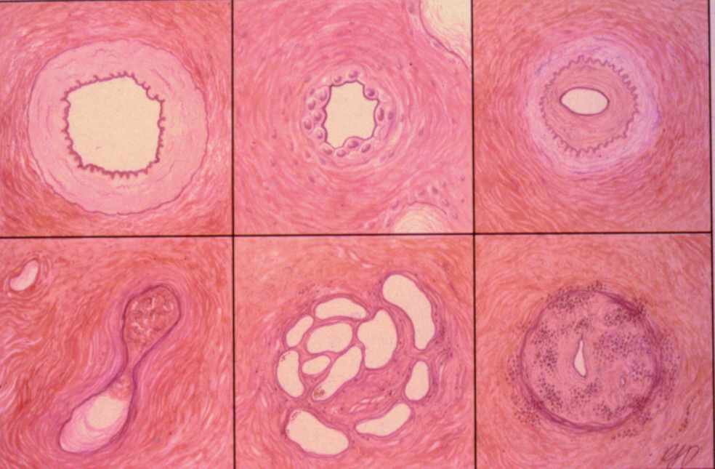
Notes:
Normal
Smooth muscle hypertrophy
Intimal hyperplasia
In situ thrombosis
Plexogenic lesion

Slide 20
Pulmonary Hypertension Physiology
Complex, multi-factorial condition
Endothelial dysfunction occurs early in disease pathogenesis and leads to:
endothelial and smooth muscle proliferation
remodelling of the vessel wall
impaired production of vasodilators (NO, prostacyclin)
overexpression of vasoconstrictors (endothelin-1)
Notes:
The exact causes of the development of PAH remain unknown. However, research has led to a better understanding of underlying pathological mechanisms.
PAH is recognised as a complex, multi-factorial condition involving numerous biochemical pathways and different cell types.^{1,2} Endothelial dysfunction, an abnormality of the inner lining of blood vessels, is believed to occur early in disease pathogenesis, and this leads to endothelial and smooth muscle cell proliferation followed by structural changes (remodelling) of the pulmonary vascular bed, which in turn results in an increase in pulmonary vascular resistance. Vascular remodelling itself involves every layer of the vessel wall and is characterised by proliferative and obstructive changes involving many cell types; including endothelial cells, smooth muscle cells, and fibroblasts.¹ Inflammatory cells and platelets may also play a significant role in PAH.
Endothelial dysfunction results in chronically impaired production of vasodilatory mediators, such as nitric oxide (NO) and prostacyclin, along with prolonged overexpression of vasoconstrictors, such as endothelin-1 (ET-1), which not only affect vascular tone but also promote vascular remodelling. These substances are important therapeutic targets for new treatment options in PAH.^{1,3}
Galiè N, et al. Eur Heart J 2009;30:2493–537;
McLaughlin VV, et al. Circulation 2009;119:2250–94;
Humbert M, et al. N Engl J Med 2004;351:1425–36.

Slide 21
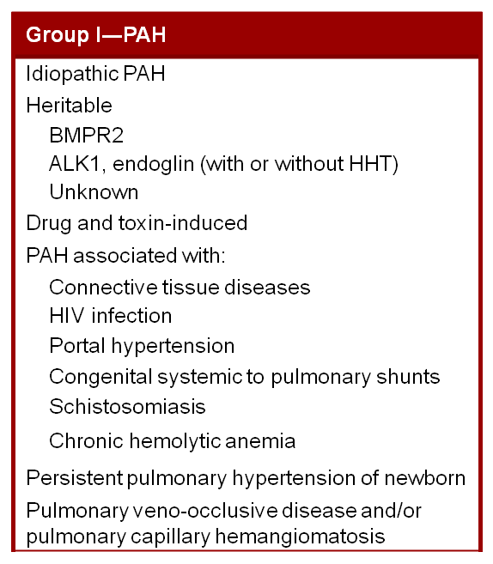
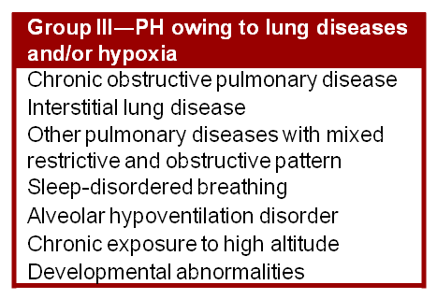
Where is the Lesion?
VC
RA
RV
PA
PC
PV
LA
LV
Ao
ALK-1, activin receptor-like kinase 1; Ao, aorta; BMPR2, bone morphogenetic receptor type 2; HHT, hereditary hemorrhagic telangiectasia; HIV, human immunodeficiency virus; LA, left atrium; LV, left ventricle; PA, pulmonary artery; PC, pulmonary capillary bed; PV, pulmonary vein; RA, right atrium; RV, right ventricle; VC, vena cava.
Graphic adapted from http://cme.medscape.com/viewarticle/530730.
Notes:
Simonneau et al. J Am Coll Cardiol. 2009;54(1 suppl S):S43-S54.

Slide 22
Epidemiology
PAH is uncommon
estimated prevalence of 15–50 cases per million
Idiopathic PAH
annual incidence of 1–2 cases per million people in the US and Europe
2-4 times as common in women as men
Prevalence is higher in at risk groups:
Systemic sclerosis (~7–12%)
HIV infection (0.5%)
Sickle cell disease (2–3.75%)
Schistosomiasis (4.6%)
Notes:
1.Peacock AJ et al. Eur Respir J 2007; 2. Gaine SP, Rubin LJ. Lancet 1998; 3. Badesch DB et al. Chest 2010; 4. Hachulla E et al. Arthritis Rheum 2005; 5. Mukerjee D et al. Ann Rheum Dis 2003; 6. Sitbon O et al. Am J Respir Crit Care Med 2008; 7. Machado RF, Gladwin MT. Chest 2010; 8.Fonseca GH, et al. Eur Respir J 2011; 9. Lapa M et al. Circulation 2009

Slide 23
Epidemiology of PAH
Prevalence of PAH in associated conditions:
CTDª: 8%-12%
CHD: 15%-30%
PoPH: 2%-6%
HIV: 0.5%
Distribution of PAH in French Registry
Appetite suppressant
>1 Risk factor
IPAH
HIV
PoPH
CHD
FPAH
ª Systemic sclerosis.
CTD
CHD, congenital heart disease; CTD, connective tissue disease; FPAH, familial pulmonary arterial hypertension; HIV, human immunodeficiency virus; IPAH, idiopathic pulmonary arterial hypertension; PoPH, portopulmonary hypertension.
.
Notes:
1. Simonneau et al. J Am Coll Cardiol. 2009;54(1 suppl S):S43-S54. 2. Hachulla et al. Arthritis Rheum. 2009;60:1831-1839. 3. Mukerjee et al. Ann Rheum Dis. 2003;62:1088-1093. 4. Landzberg. Clin Chest Med. 2007;28:243-253. 5. Hadengue et al. Gastroenterology. 1991;100:520-528. 6. Krowka et al. Hepatology. 2006;44:1502-1510. 7. Sitbon et al. Am J Respir Crit Care Med. 2008;177:108-113. 8. Humbert et al. Am J Respir Crit Care Med. 2006;173:1023-1030

Slide 24
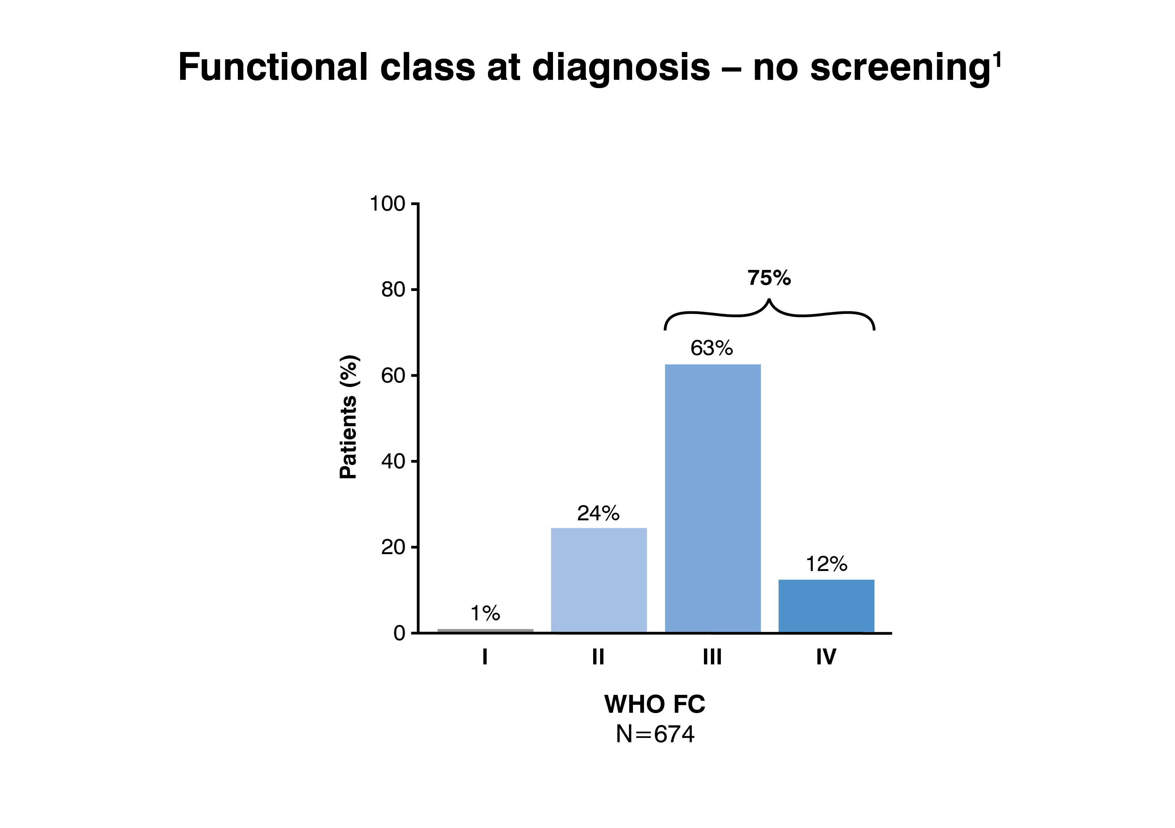
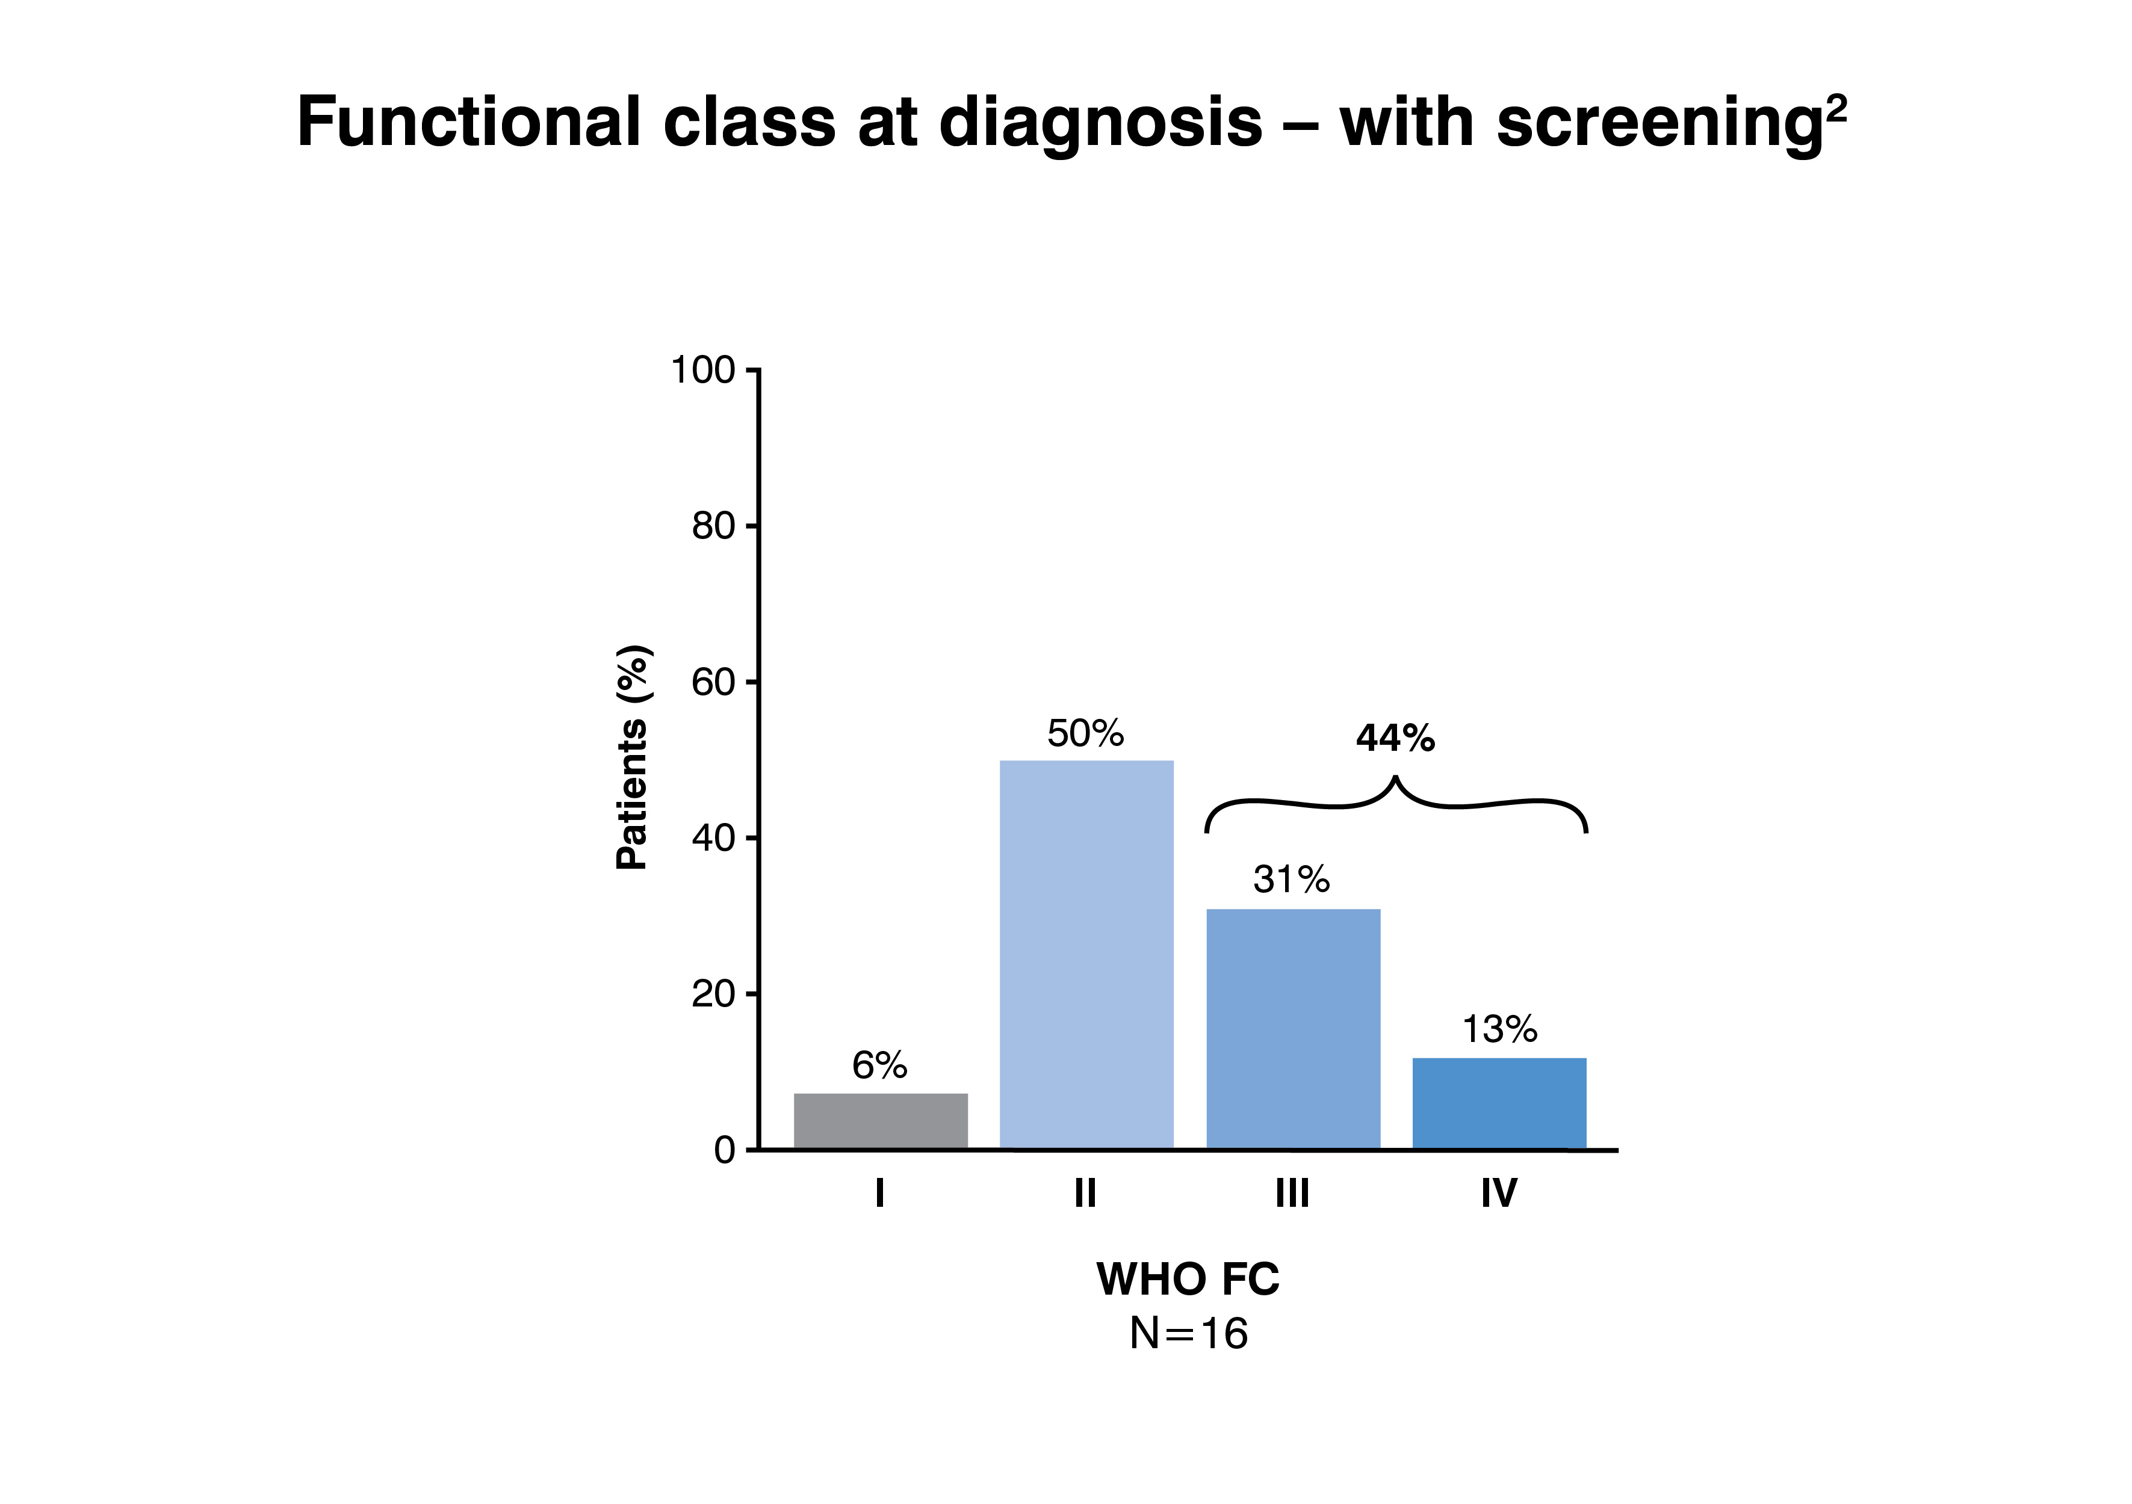
Screening high risk populations
Results of a disease registry in France
Without screening, the majority of patients were diagnosed in WHO FC III or FC IV and only 24% of patients were in WHO FC II at diagnosis
With screening, PAH was detected at earlier stage
1. Humbert M et al. Am J Respir Crit Care Med 2006; 2. Hachulla E et al. Arthritis Rheum 2005
Notes:
Results from a PAH registry in France, for example, showed that without screening the majority of patients were diagnosed in WHO FC III or IV, and only 24% of patients were in the less severe WHO FC II.¹ In the US, over 60% of newly diagnosed patients with PAH enrolled in the REVEAL registry were in functional class III.² However, PAH was detected at an earlier stage during a national screening programme in a high-risk population, demonstrating the potential value of a screening strategy.³
Humbert M, et al. Am J Respir Crit Care Med 2006;173:1023–30;
Benza RL, et al. Chest 2011 Jun 16. [Epub ahead of print];
Hachulla E, et al. Arthritis Rheum 2005;52:3792-800.
24

Slide 25
Outline
Background
Diagnosis
Management
Questions

Slide 26
Notes:
Poll Title: You suspect PAH in a 32 y/o W with history of cocaine use. Which symptom pairs coincide with that suspicion? https://www.polleverywhere.com/multiple_choice_polls/ecgqVRR0wPf669E

Slide 27
Poll – sx of pah
Cough, wheeze
DOE, CP
Fatigue, pre-syncope
Edema, palpitations
1&3
2, 3, 4
All of the above

Slide 28
Symptoms
DOE - 2 Years - 70%
CP - RV ischemia - 30%
Raynaud’s phenomenon- 10%
Early Satiety – 50%
Syncope / near syncope – 30%
Fatigue- 90%
Peripheral Edema – 10%
Hoarseness- 10%
Ascites- 20%
Notes:
Early symptoms mild and non-specific
Commonly attributed to other conditions
Over time, symptoms become more severe and limit normal daily activities
Delayed diagnosis common:
symptom onset to disease diagnosis > 2 years^{1,2,3}
frequently not recognised until the disease is relatively advanced^{1,3}

Slide 29
Evaluation
History & Physical
Labs- CBC, BMP, LFT, TSH, ANA, CCP, CRP, ESR, HIV, Anticardiolipin Ab, BNP, TnI
EKG, CXR
PFT – Spiro, Lung volumes, DLCO
Echocardiogram

Slide 30
Notes:
Poll Title: Which of the following exposures place a patient at risk of developing PAH? https://www.polleverywhere.com/multiple_choice_polls/2O8lPbj1d6l05m0

Slide 31
Poll
Which of the following are exposures that place patients at risk of developing PAH?
SSRI
Bactrim
Methamphetamines
Phen-fen
PPI
4&5
2&3
3&4

Slide 32
Approach to Diagnosis
Clinical suspicion of PH
Symptoms, known risk factors
Exclusion of Group 2 (left heart disease) and Group 3 (lung disease) PH
ECG, chest radiograph, echocardiography, PFTs
PH specialist evaluation
V/Q scan, Polysomnogram, 6MWT, cardiac MRI, Right heart catheterization
Galiè N et al. Eur Heart J 2009
Notes:
The diagnosis process can be summarised in four general stages, although the type of tests used may vary between centres, depending on the individual circumstances and the needs of the patient.
1. Clinical suspicion of PAH: Symptoms such as exertional dyspnoea, syncope, angina, and/or progressive limitation of exercise capacity without apparent risk factors, symptoms, or signs of common cardiovascular and respiratory disorders, or patients with associated conditions and/or risk factors (e.g. family history, connective tissue diseases, HIV)
2. Exclusion of Group 2 and Group 3 PH: Clinical history, electrocardiogram (ECG), chest radiograph, transthoracic echocardiogram, pulmonary function tests (PFTs), and high-resolution computed tomography (HRCT) of the chest are requested in order to identify the presence of Group 2 (left heart disease) or Group 3 (lung diseases)
3. Exclusion of Group 4 PH: If PH Groups 2 or 3 are not found, less common causes of PH should be looked for. For example, ventilation/perfusion lung scan is used to exclude Group 4 chronic thromboembolic pulmonary hypertension (CTEPH)
4. PAH evaluation and characterisation: A range of other tests can be performed to refine the final diagnosis, including CT pulmonary angiography, cardiac magnetic resonance imaging (CMRI), haematology, biochemistry, immunology, serology, and ultrasonography. The degree of limitation to the patient caused by PAH is assessed by determining functional class and by exercise tests such as the six-minute walk test (6MWT). However, the diagnostic gold standard for the confirmation of a diagnosis of PAH is right heart catheterisation (RHC).
Galiè N, et al. Eur Heart J 2009;30:2493–537.
32

Slide 33
Notes:
Poll Title: Name 4 markers of PAH on an Echocardiogram: https://www.polleverywhere.com/multiple_choice_polls/gkJa2Ng5H856mAl

Slide 34
Poll – TTE relevant findings
Name 4 markers of PAH on an echocardiogram:
a) LA dilatation, LV wall thickening, PASP 45, Moderate mitral regurgitation
b) RA dilatation, RV dysfunction, PASP 40, Mild tricuspid regurgitation
c) LA dilatation, RA dilatation, PASP 60, Severe aortic regurgitation
d) RA dilatation, LV dilatation, PASP 35, Mild aortic stenosis

Slide 35
Outline
Background
Diagnosis
Management
Questions

Slide 36
Management

Slide 37
Functional class
Functional Class | Symptomatic profile
I | Patients with pulmonary hypertension but without resulting limitation of physical activity. Ordinary physical activity does not cause dyspnoea or fatigue, chest pain, or near syncope
II | Patients with pulmonary hypertension resulting in slight limitation of physical activity. They are comfortable at rest. Ordinary physical activity causes undue dyspnoea or fatigue, chest pain, or near syncope
III | Patients with pulmonary hypertension resulting in marked limitation of physical activity. They are comfortable at rest. Less than ordinary activity causes undue dyspnoea or fatigue, chest pain, or near syncope.
IV | Patients with pulmonary hypertension with inability to carry out any physical activity without symptoms. These patients manifest signs of right heart failure. Dyspnoea and/or fatigue may even be present at rest. Discomfort is increased by any physical activity
Notes:
The clinical severity of PAH is classified according to a system originally developed for heart failure by the New York Heart Association (NYHA) and then modified by the World Health Organisation (WHO) for patients with PAH. This system grades PAH severity according to the functional status of the patient, linking symptoms with activity limitations, and allows clinicians to quickly and accurately predict disease progression and prognosis, as well as the need for specific treatment regimens, irrespective of the underlying aetiology of PAH .
Galiè N, et al. Eur Heart J 2009;30:2493–537.
37

Slide 38
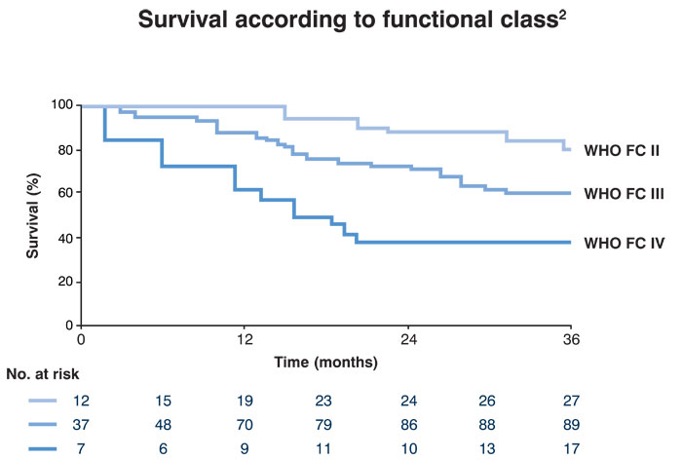
¹
Humbert M et al. Circulation 2010
Notes:
WHO FC is a powerful predictor of survival in patients with PAH. In a recent French study, lower functional class (I/II) was found to be positively and significantly associated with survival (Figure);¹ while data from the US REVEAL registry showed that functional class IV was independently associated with increased mortality.²
Given this link with prognosis, improvement from WHO FC III/IV to WHO FC II and improvement or maintenance of patients with early signs at WHO FC I/II are very important goals of therapy.³
Humbert M, et al. Circulation 2010;122:156–63;
Benza RL, et al. Circulation 2010;122:164–72;
Barst RJ, et al. J Am Coll Cardiol 2009;54:S78–84.
38

Slide 39
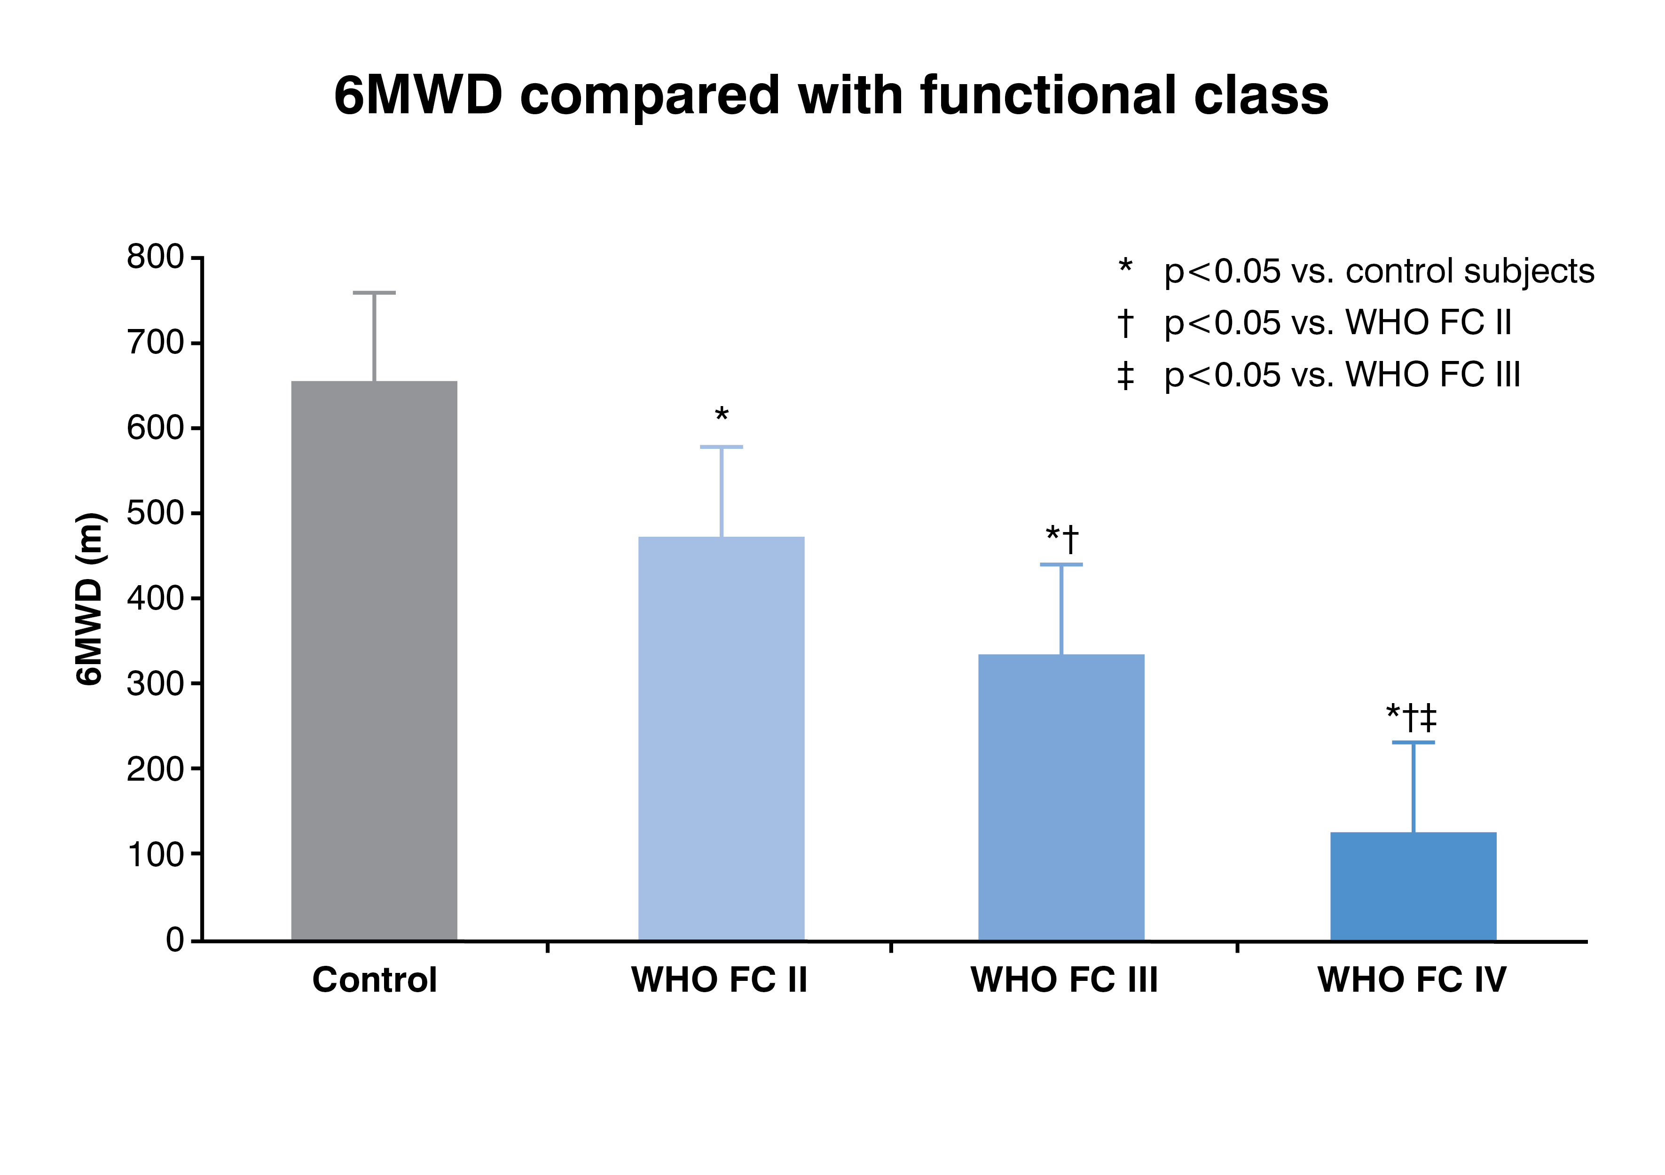
6 minute walk test (6MWT)
Measure of patients’ functional limitations
Simple, inexpensive, convenient
Notes:
The six-minute walk test (6MWT) is a key test in PAH management because it is a measure of the patient’s functional limitation and correlates with peak aerobic capacity.¹ It is also a simple test to perform, which is inexpensive and convenient. In addition to distance walked, dyspnoea on exertion, and O₂ saturation can also be recorded, which can provide further information regarding the patient’s condition.
Results of the 6MWT have been shown to correlate with functional class and the distance walked significantly decreases in proportion to the severity of NYHA FC.²
It should be noted that, despite these advantages, the 6MWT is only properly validated for patients with IPAH. It is not yet clear whether it is appropriate for the assessment of treatment success in patients with, for example, PAH-SSc where accompanying conditions can make the 6MWT difficult. It also has not been standardised for all populations, and it is important that the test is performed under supervision according to a standardised protocol in order to allow meaningful comparisons.³
Ross RM, et al. BMC Pulm Med 2010;10:31;
Miyamoto S, et al. Am J Respir Crit Care Med 2000;161(2 Pt 1):487–92;
ATS statement: guidelines for the 6-minute walk test. Am J Crit Care Med 2002;166:111–7.
39

Slide 40
Right heart cath
Notes:
Right heart catheterisation (RHC) is required for a definitive diagnosis of PAH,^{1,2} to assess the severity of haemodynamic impairment, and to test the vasoreactivity of the pulmonary circulation. PAH is defined as a sustained elevation of mean pulmonary arterial pressure (mPAP) to ≥25 mmHg at rest, and a mean pulmonary capillary wedge pressure (PCWP) of ≤15 mmHg.^{1,3}
Galiè N, et al. Eur Heart J 2009;30:2493–537;
Habib G, Horbicki A. Eur Respir Rev 2010;19:1–12;
Badesch DB, et al. J Am Coll Cardiol 2009;54:S55–66.
40

Slide 41
RHC Interpretation
Defined by:
Mean PA pressure > 25 mmHg
PCWP < 15mmHg
PVR > 2.5 / 3.0
mPAP by Severity:
26-35 Mild
36-45 Moderate
46-55 Severe
> 55 Systemic

Slide 42
Hemodynamic Progression of PAH
Symptomatic/ Decompensating
Declining/ Decompensated
Pre-symptomatic/ Compensated
CO
Symptom Threshold
Right Heart Dysfunction
PAP
Symptoms
PVR
RAP
Time
CO, cardiac output; PAP, pulmonary arterial pressure; PVR, pulmonary vascular resistance; RAP, right atrial pressure.
Notes:
42
The symptoms of PAH may not be obvious at first and are often attributed to more common conditions. Over time, however, they can become more severe and begin to limit normal activities. As the disease progresses, some patients may experience constant dyspnoea and fatigue so that even simple tasks, such as getting dressed and walking short distances, become difficult.
As the early symptoms of PAH are often mild, time from symptom onset to disease diagnosis is, on average, more than 2 years.^{1,2} This means that PAH is frequently not recognised until the disease is relatively advanced.^{1,3}
Humbert M, et al. Am J Respir Crit Care Med 2006;173:1023–30;
Badesch DB, et al. Chest 2011;137:376–87;
Gaine SP, Rubin LJ. Lancet 1998;352:719–25.

Slide 43
General measures
General measures
Limit effects of external circumstances
avoid pregnancy
prevention and prompt treatment of chest infections
awareness of the potential effects of altitude
Conventional or supportive therapy
Provide symptomatic benefit
supplemental oxygen
oral anticoagulants
diuretics
Notes:
General measures aim to limit any potentially deleterious effects of the patient’s external circumstances on their PAH disease, and include avoiding pregnancy, prevention and prompt treatment of chest infections, and awareness of the potential effects of altitude.^{1,2}
Conventional or supportive therapy aims to provide symptomatic benefit. Such measures include supplemental oxygen, oral anticoagulants, diuretics, and calcium channel blockers.
1. Galiè N, et al. Eur Heart J 2009;30:2493–537;
2. McLaughlin VV, et al. Circulation 2009;119:2250–94;
3. Badesch DB, et al. Chest 2004;126(1 Suppl):35S–62S.
43

Slide 44
Advanced (PAH-specific) therapy
Endothelin receptor antagonists (ERAs)
Synthetic prostacyclins and prostacyclin analogues
Phosphodiesterase-5 (PDE-5) inhibitors
Guanylate cyclase stimulator
Notes:
Advanced therapy (also termed ‘PAH-specific therapy’)
PAH-specific therapies have been developed to target one of three major pathways known to be involved in the development of PAH and have, to varying degrees, been shown to affect the disease process.
Endothelin receptor antagonists (ERAs) are oral treatments that act by blocking the binding of endothelin, which is implicated in the pathogenesis of PAH through its actions on the pulmonary vasculature, to either one (single antagonist) or both (dual antagonist) of its receptors. Clinical trials have shown that treatment with ERAs has a beneficial effect on exercise capacity, WHO Functional Class (FC), haemodynamics and time to clinical worsening in patients with PAH.¹⁻⁶
Synthetic prostacyclins and prostacyclin analogues act by helping to correct the deficiency of endogenous prostacyclin seen in patients with PAH. The clinical use of prostacyclins in patients with PAH has been extended by the synthesis of more stable analogues for intravenous infusion,⁷ as well as those that can be given by subcutaneous infusion,^{8,9} or by inhalation.¹⁰
Phosphodiesterase-5 (PDE-5) inhibitors are oral agents which act on the nitric oxide (NO) pathway to induce vasodilation and also have antiproliferative effects on vascular smooth muscle cells. Clinical trials have shown that treatment with PDE-5 inhibitors has a beneficial effect on exercise capacity, haemodynamic parameters, and symptoms in patients with PAH.^{11,12}
Humbert M, et al. N Engl J Med 2004;351:1425–36;
Channick RN, et al. Lancet 2001;358:119–23;
Rubin LJ, et al. N Engl J Med 2002;346:896–903;
Galiè N, et al. Lancet 2008;371:2093–100;
Galiè N, et al. Circulation 2006;114:48–54;
Galiè N, et al. Circulation 2008;117:3010–9;
Nicolas LB, et al. Am J Respir Crit Care Med 2011;183:A5902;
Simonneau G, et al. Am J Respir Crit Care Med 2002;165:800–4;
Barst RJ, et al. Eur Respir J 2006;28:1195–203;
Olschewski H, et al. N Eng J Med 2002;347:322-9;
Galiè N, et al. N Engl J Med 2005;353:2148–57;
Galiè N, et al. Circulation 2009;119:2894–903.
44

Slide 45
SILDENAFIL (Revatio) / TADALAFIL (Adcirca)
PDE – 5 Inhibitor
Found abundantly in pulmonary vasculature
Inhibits proliferation
Potent pulmonary vasodilation
Increased epistaxis and GI bleed
Can’t prescribe nitrates

Slide 46
BOSENTAN (Tracleer) / AMBRISENTAN (Letairis) / MACITENTAN (Opsumit)
ET – 1 antagonist
Binds ET_{A} – ET_{B} receptors in endothelium and vascular smooth muscle
Oral agents
Caution in pregnancy
Caution hepatotoxicity

Slide 47
RIOCIGUAT (Adempas)
Oral agent
Approved for CTEPH and IPAH
Contraindicated in pregnancy
Cannot be combined with PDE5 inh
Variable plasma concentrations
Notes:
Off label sickle cell dz usage

Slide 48
ILOPROST (Ventavis)
Inhaled prostacyclin derivative
6-9 treatments/day
10-15 minutes/treatment
Demonstrated benefit in FC 4 patients

Slide 49
EPOPROSTENOL (Flolan, Veletri)
Prostacyclin, IV
75% sustained ↓ in PVR
10% are non responders
Improved FC and mortality
Requires continuous infusion

Slide 50
TREPROSTINIL (Remodulin)
Prostacyclin analogue
SQ or IV infusion
Modified insulin pump – SQ

Slide 51
SELEXIPAG (Uptravi)
Oral prostacyclin receptor agonist
BID dosing
Indicated for FC 2 and 3 patients
Reduced disease progression and hospitalization
Similar side effects as prostacyclins

Slide 52
Has Survival Meaningfully Improved With Modern Therapies?
IPAH, HPAH, and anorexigen-associated PAH
After 2000 (current therapies)
100
1992-1999 (only IV PGI₂)
Before 1992 (no specific Tx)
75
n=269
NS
Survival (%)
n=260
50
25
n=118
P<0.05, log-rank test
0
0
12
24
36
48
60
Months
HPAH, hereditary pulmonary arterial hypertension; IPAH, idiopathic pulmonary arterial hypertension; IV, intravenous; NS, not significant; PGI₂, prostacyclin; Tx, treatment.
Notes:
Sitbon et al. Slides presented at European Respiratory Society; September 16-18, 2007; Stockholm, Sweden.

Slide 53
PAH Treatment – Bottom Line
Currently no cure for PAH
PAH therapies can markedly improve a patient’s symptoms and slow the rate of clinical deterioration
Management is complex, involving use of a range of treatment options:
general measures
conventional or supportive therapy
advanced therapy (PAH-specific therapy)
surgical intervention
lung transplantation
Notes:
While there is currently no cure for the disease, modern advanced PAH therapies can markedly improve a patient’s symptoms and slow the rate of clinical deterioration.^{1,2} The management of PAH is complex and involves the use of a range of treatment options, which can be broadly broken down into four main categories:
1. General measures
2. Conventional or supportive therapy
3. Advanced therapy (also called PAH-specific therapy)
4. Surgical intervention
1. Galiè N, et al. Eur Heart J 2009;30:2493–537;
2. Humbert M, et al. Circulation 2010;122:156–63.
53

Slide 55
Notes:
Poll Title: Who manages Pulmonary Hypertension? https://www.polleverywhere.com/multiple_choice_polls/vSHhmrWS10hmnFg

Slide 56
Poll
PH is managed by:
Cardiologists
Pulmonologists
Neither
Both

Slide 57
Who you gonna call?
Cardiology
Anne Goh, MD
Pulmonary
Sachin Gupta, MD
Cardiology
Dana McGlothlin, MD

Slide 58
Notes:
Poll Title: Any questions? https://www.polleverywhere.com/free_text_polls/jaeY3RHGMFiKy5u

Slide 59
Questions?

Slide 60
Thank you for the invitation!!!

Slide 62
Appendix

Slide 63
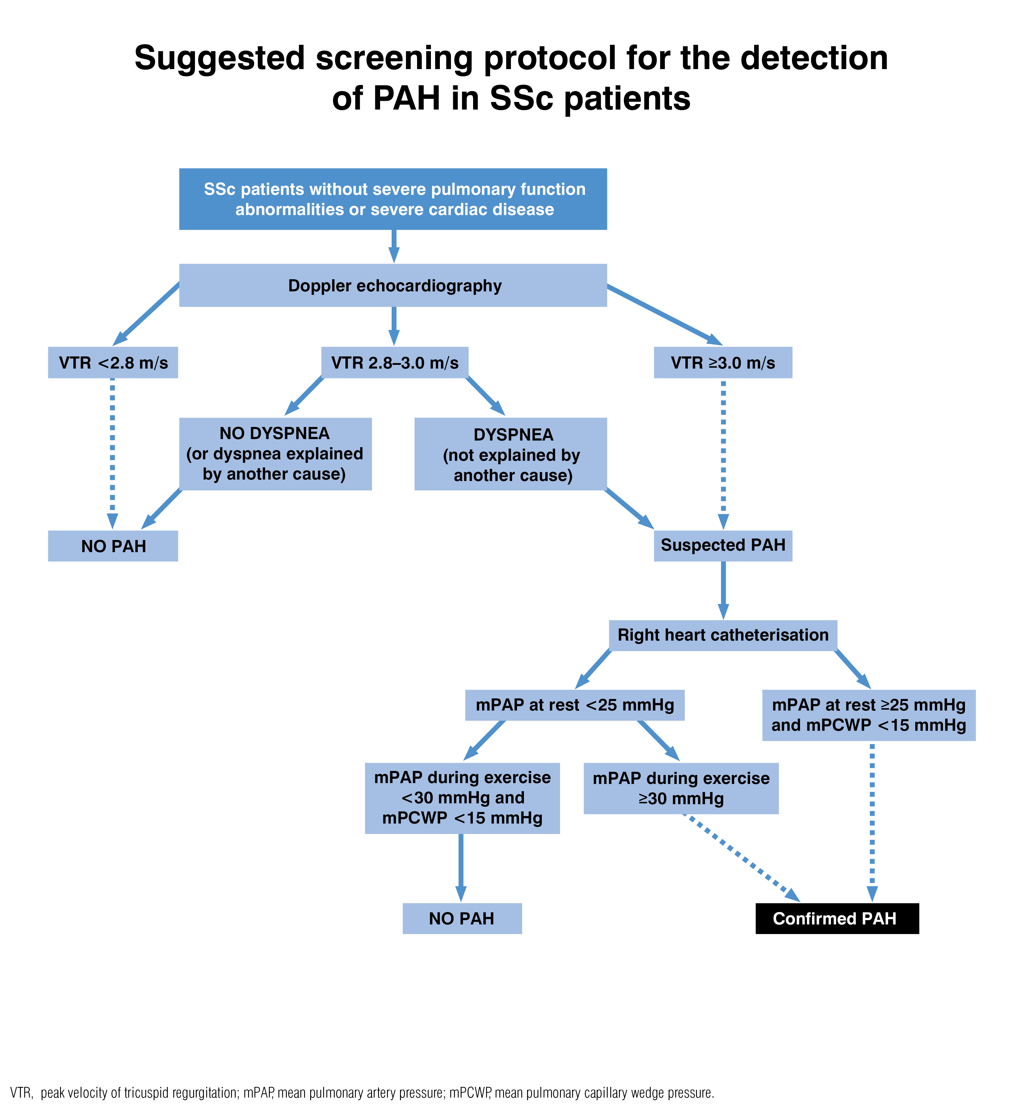
Screening for PAH in SSc: suggested screening protocol for the detection of PAH in SSc patients
Figure adapted from: The three-year incidence of pulmonary arterial hypertension associated with systemic sclerosis in a multicentre nationwide longitudinal study in France¹. Hachulla E, de Groote P, Gressin V, et al. Copyright © 2009, John Wiley and Sons, Inc. Reproduced with permission of John Wiley and Sons, Inc.
1. Hachulla E et al. Arthritis Rheum 2009
Notes:
In this example of a screening algorithm, it is recommended that patients with SSc are regularly assessed using Doppler echocardiography.
The parameter assessed is peak velocity of tricuspid regurgitation (VTR); patients with low VTR (<2.8 m/s) do not have PAH, whereas a high (>3.0 m/s) VTR, or moderate VTR (2.8–3.0 m/s) together with dyspnoea, raises the suspicion of PAH. To confirm the diagnosis, patients must then undergo right heart catheterisation (RHC)
Hachulla E, et al. Arthritis Rheum 2009;60:1831–9.
63

Slide 64
What is the role of exercise?
Exercise improves exercise capacity and QOL
Important adjunct to medical therapy
Avoids deconditioning from being sedentary
PH isn’t a contraindication to judicious exercise
Encourage patients to remain active within symptom limits
Mild breathlessness is acceptable
Avoid severe breathlessness, exertional dizziness, near syncope, or chest pain
Isometric exercises discouraged due to exertional syncope
Notes:
It is important to avoid and to the extent possible reverse the deconditioning that may occur in patients with exercise limitation who become sedentary. Pulmonary hypertension is not a contraindication to judicious exercise, and patients should be encouraged to remain active within acceptable symptom limits. Mild breathlessness is acceptable, but patients should avoid exertion that leads to severe breathlessness, exertional dizziness, near syncope, or chest pain. Isometric exercises (straining against a fixed resistance) are discouraged because they can cause exertional syncope (2, 9). Patients with PH due to heart failure or advanced lung disease can participate in a structured rehabilitation program. Monitored exercise programs for patients with stable PAH have demonstrated improvements in exercise capacity and quality of life and can serve as an important adjunct to medical therapy (59, 60).

