Slide 1
Asthma Phenotypes
Neeta Thakur MD, MPH and George Su MD
Zuckerberg San Francisco General
University of California, San Francisco
September 30,20116

Slide 2
Disclosures
Spouse employee of Roche/Genentech

Slide 3
Learning Objectives
Evaluate the concept that asthma is not a single disease
Identify asthma phenotypes
Develop a treatment approach based on the different phenotypes of asthma

Slide 4
Living with asthma
Photo Credit: Sam Oh
Notes:
Bringing it back to the patient, the individual with asthma.
Why does this matter?
This is ‘Yana Hill, she lives in the Bayview, a community in San Francisco built over industrialized land, outlined by freeways, and riddled by violence and poverty. Due to historical events, this neighborhood is the home to one of the highest percentage of Blacks in San Francisco. Another descriptor for this neighborhood is that there is a lack of opportunity.
She has had asthma since childhood with intermittent control. When she was 18 years old, and almost 9 months pregnant, she had a severe asthma attack. Standing in the halls of her school, she took her albuterol inhaler with no effect. She prayed as she waited for the paramedics to arrive. She was hospitalized for a week and shortly after her son was born.
Take a step back –
Why does Ms. Hill have asthma
RF AA, lives in poor neighborhood, family history of asthma, obese, pregnant
How do you decide, as her medical provider, what the next best management step is?
This is relevant for a large proportion of individuals with asthma

Slide 5
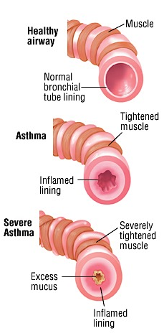
What is asthma?
Tightening of Airways
Airway Remodeling
Thick Mucous Production
Acute and Chronic Phases
Wheezing
Coughing
Shortness of Breath
What causes asthma?
Notes:
Talking Points:
Asthma is the most common chronic disease of childhood.
Asthma consequences
• Asthma affects a person’s ability to sleep and learn
• $56 billion in lost costs due to asthma
 Unnecessary missed days of school and
work
 Unnecessary hospitalizations

Slide 6
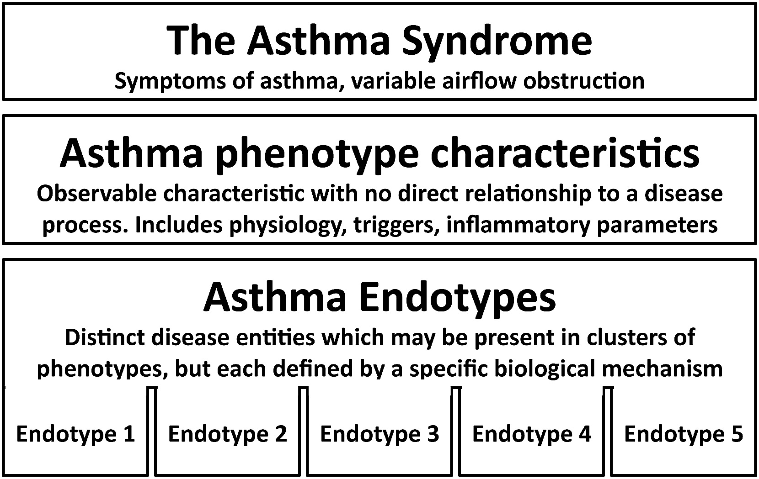

Slide 7
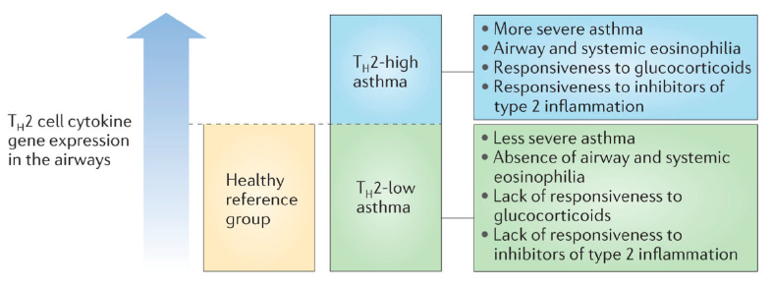
Asthma Phenotypes
ALLERGIC
Non-ALLERGIC
Notes:
Traditionally thought of as an atopic disease that activates Th2 pathways, however, this is only accounts for 40-50% of asthma, depending on what metrics are used to define Th2 asthma
- Woodruff - 50% of bronchs from asthmatics have POSTN, which encodes periostin; CLCA1, which encodes calcium-activated chloride channel regulator 1; and SERPINB2
- McGrath 36% with sputum eosinophilia
Caveat: Most of this work does not take the environment into account and is in predominantly White populations

Slide 8
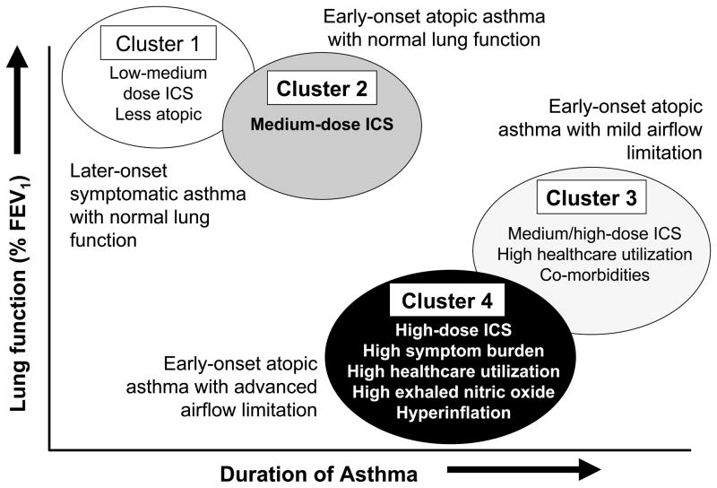

Slide 9
Asthma Phenotypes
Non-eosinophilic
Childhood
Adult
Eosinophilic

Slide 10
Eosinophils
Elevated in bronchial bx, induced sputum or peripheral blood
Corticosteroid naïve ≥2.7% (blood)
I: concordance between symptoms and airway eos
“Childhood-onset” and allergy to airborne allergens
II: discordance, fewer symptoms
“Late-onset” non-atopic disease
Persistence on high-dose ICS or PO steroids associated with symptomatic and exacerbation-prone disease
Dust mites
Pollens

Slide 11
Asthma Phenotypes
Non-eosinophilic
Childhood
Adult
Intrinsic
Allergic
Eosinophilic

Slide 12
How do you identify this group? Total IgE
Sum of total IgE
Sometimes reported as %total IgG (0.05% normal)
60% of allergic asthma (includes HMW OA)
Poor PPV and NPV compared to allergen-specific IgE
Dust mites
Pollens

Slide 13
How do you identify this group? Radioallergosorbant IgE (RAST)
Allergen-specific IgE
More expensive than skin-prick
Less sensitive and specific
Rational starting point:
Specific HMW candidate antigen(s) (some LMW antigens)
Determine positive aeroallergen
Grasses, weeds, dust mites, molds
Low predictive value for food allergies
Dust mites
Pollens

Slide 14
How do you identify this group? Skin prick allergy testing
More sensitive and specific than RAST
False negatives:
OTC antihistamines (48 hours)
Allegra, Clarinex, Zyrtec and Astelin (Azelastin) nasal spray (5 days)
PO steroids (25 mg prednisone) (3 weeks)
High dose topical steroids (3 weeks)
Dust mites
Pollens

Slide 15
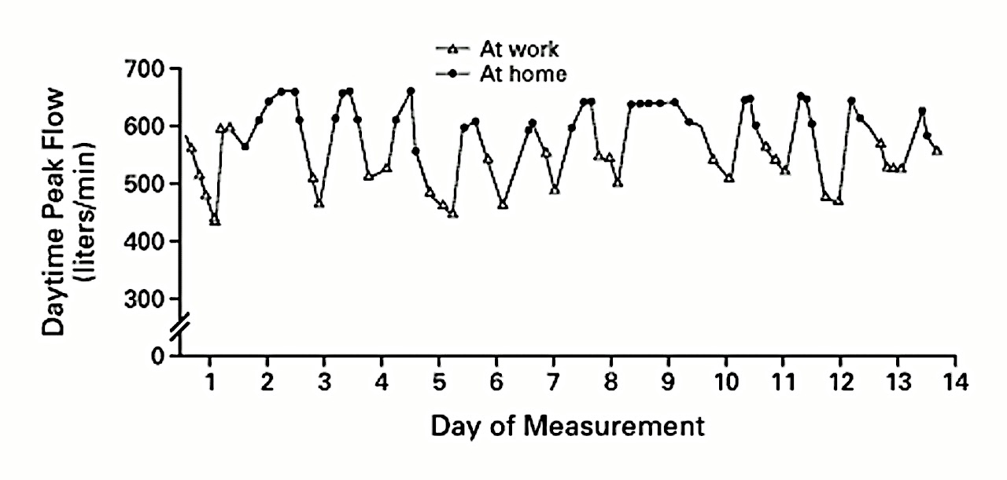
What’s the Asthma Phenotype? Occupational Asthma
Beckett W., et al., NEJM 2000
Notes:
Audience Response, this individual measured peak flows at different times of day. Does anyone know why the measurements vary so much? Raise of hands, which measurements are at home, which are at work?
What type of asthma does the individual have?

Slide 16
Occupational Asthma
“Work-sensitized” (high MW >5000 daltons)
IgE-mediated “asthma with latency”
“Irritant-induced” (low MW <5000 daltons)
Non IgE-mediated “asthma without latency”
Irritant asthma
Reactive airways dysfunction syndrome (RADS)
“Low-dose RADS”
“Work-exacerbated” (aggravated)
> 250 workplace culprit substances
Estimated 16% of all adult onset asthma
Toren and Blanc 2009

Slide 17
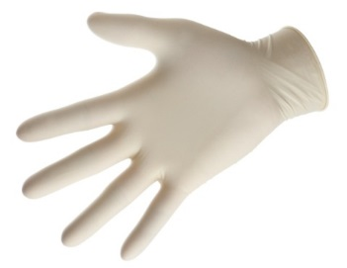
What do these have in common?

Slide 18
When to do obstruction testing for Occupational Asthma?
Preferably performed toward the end of a typical work week and within 24 hr of the occurrence of symptoms

Slide 19
Active panel patients with DM
Asthma Phenotypes
Non-eosinophilic
Occupational (non-sensitized)
Childhood
Adult
Intrinsic
Allergic
Occupational (sensitized)
Eosinophilic

Slide 20
What’s the Asthma Phenotype?
34 year old man
Persistent rhinitis at age 30, watery rhinorrhea
Cough, wheeze
Sudden acute event requiring ED visit
No previous history of asthma

Slide 21
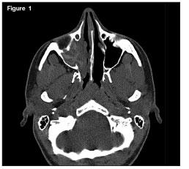
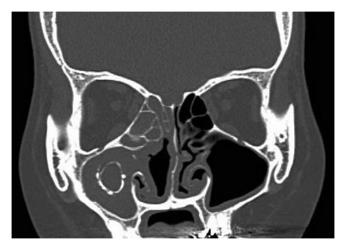

Slide 22
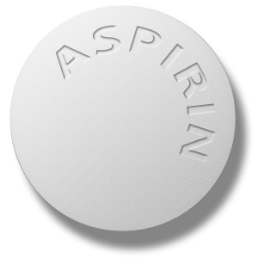

Slide 23
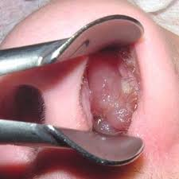
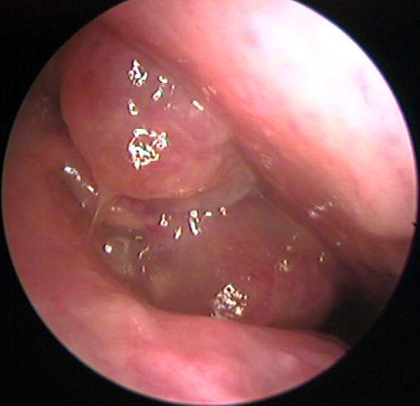
B. Ghorayeb, MD

Slide 24
Case: Diagnosis
Exacerbation after ingestion of aspirin or other non-NSAIDs
Starts with intractable nasal congestion and watery rhinorrhea
Refractory to pharmacologic Treatment
Progressive, may become associated with anosmia
Specific IgE tests negative
Nasal polyposis
Total or near-total opacification of the sinus cavities (on CT)
An individual with rapid onset of a severe attack with no previous insult who necessitates acute emergency care, intensive care unit admission, or endotracheal intubation

Slide 25
Asthma-Exacerbated Asthma

Slide 26
Aspirin-Exacerbated Asthma: diagnosis
Sample oral challenge protocol
Starting dose of 40.5 mg
Doses given at 3 hour intervals, up to a maximum dose of 325 mg
Time interval between doses can be shortened to 90 minutes unless the patient specifically reports that symptoms began within 90 minutes
Protocols are carried out over one to two consecutive days
Observation and spirometry

Slide 27
Active panel patients with DM
Asthma Phenotypes
Non-eosinophilic
Occupational (non-sensitized)
EIA
Air pollution
Cigarette
Childhood
Adult
Intrinsic
Allergic
Occupational (sensitized)
Cough variant
Aspirin
Eosinophilic

Slide 28
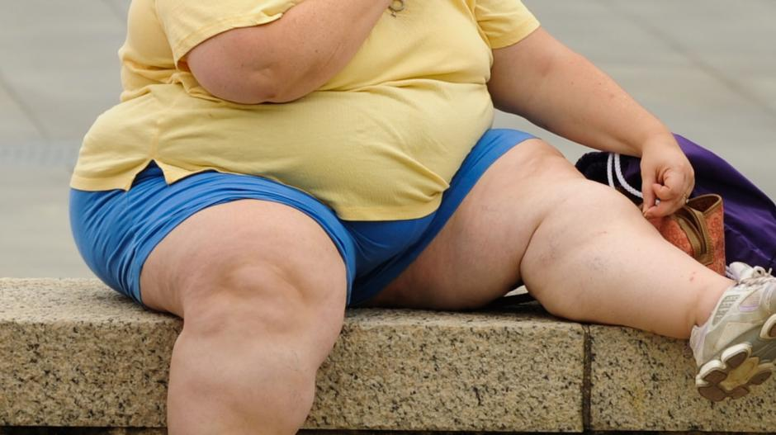

Slide 29
Obese Asthma Phenotype
Leiria, 2014

Slide 30
Asthma Phenotypes
Active panel patients with DM
Non-eosinophilic
Occupational (non-sensitized)
Obesity
EIA
Air pollution
Cigarette
Childhood
Adult
Intrinsic
Allergic
Occupational (sensitized)
Cough variant
Aspirin
Eosinophilic

Slide 32
Asthma Phenotypes
Active panel patients with DM
Non-eosinophilic
Infection-related
Occupational (non-sensitized)
Obesity
EIA
Air pollution
Cigarette
Childhood
Adult
Intrinsic
Allergic
Occupational (sensitized)
Cough variant
Aspirin
Eosinophilic

Slide 33
Severe/refractory asthma (ATS workshop)
Major
(≥1)
Continuous or near-continuous oral steroids
High-dose ICS
Additional daily controller
Use of SABA on a near-daily basis
Persistent airway obstruction
FEV1 < 80%
Diurnal variation in PF ≥ 25%
≥ 1 urgent care visit per year
≥3 or more steroid bursts per year
Prompt deterioration with 25% reduction in steroid dose
Episode of near-fatal asthma
Minor
(2)

Slide 34
Asthma Phenotypes
Active panel patients with DM
Non-eosinophilic
Infection-related
Occupational (non-sensitized)
Obesity
EIA
Air pollution
Cigarette
Exacerbation-prone
Childhood
Adult
Intrinsic
Allergic
Occupational (sensitized)
Cough variant
Aspirin
Eosinophilic

Slide 35
Emerging Treatment Options Based on Phenotypes
TARGETED AT Th2 (ALLERGIC) ASTHMA

Slide 36
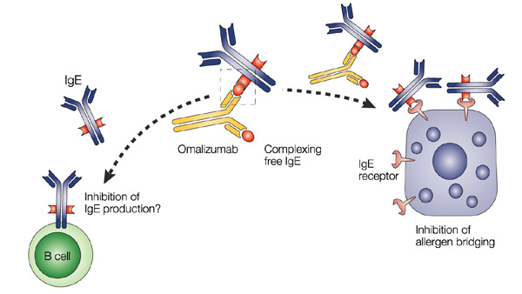
Treatments based on Phenotypes - Omalizumab
Best Candidates:
High IgE
Known Allergen
BMI

Slide 37
Treatments based on Phenotypes - Omalizumab
Asthma Exacerbations
Hanania Ann Intern Med 2011, Busse NEJM 2011
Notes:
The protocol-defined asthma exacerbation rate during the 48-week treatment period was significantly lower in the omalizumab group than in the placebo group (incidence rate, 0.66 vs. 0.88; P = 0.006) (Table 2). This corresponds to a 25% relative reduction in the asthma exacerbation rate for patients who received omalizumab compared with placebo (IRR, 0.75 [95% CI, 0.61 to 0.92]). In addition, omalizumab increased the time to first asthma exacerbation (hazard ratio, 0.74 [CI, 0.60 to 0.93]; P = 0.008)

Slide 38
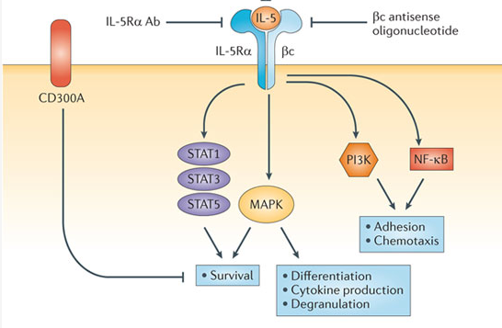
Treatments based on Phenotypes - Mepolizumab
IL-5: Key cytokine in eosinophil
Differentiation
Recruitment
Activation
Survival
Best Candidates:
- High Eosinophils
- 2 or greater exacerbations/yr
- On high dose ICS
Fulkerson Nature Review Drug Discovery 2013

Slide 39
Treatments based on Phenotypes - Mepolizumab
MENSA trial (RCT), selected for high eosinophils, mod-high dose ICS
Asthma Exacerbations and FEV₁ at 32 Weeks.
Ortega NEJM 2014 (Sponsored by Glaxo-Smith Kline)
Notes:
Figure 2. Asthma Exacerbations and FEV₁ at 32 Weeks. Panel A shows the numbers of asthma exacerbations in patients receiving either intravenous or subcutaneous mepolizumab or placebo. The rate of exacerbations was reduced by 47% (95% confidence interval [CI], 28 to 60) among patients receiving intravenous mepolizumab and by 53% (95% CI, 36 to 65) among those receiving subcutaneous mepolizumab, as compared with those receiving placebo (P<0.001 for both comparisons). Panel B shows the mean forced expiratory volume in 1 second (FEV₁) as a percentage of the predicted value. At week 32, there was greater improvement from baseline in the two mepolizumab groups than in the placebo group — a 100-ml greater increase in the intravenous-mepolizumab group than in the placebo group (P=0.02) and a 98-ml greater increase in the subcutaneous-mepolizumab group than in the placebo group (P=0.03). The I bars indicate 95% confidence intervals.

Slide 40
Side Effects and Adverse Reactions
Omalizumab
Anaphylaxis (must have epi-pen)
0.1-0.2%
Can occur as late as 1 year
? Malignancy (0.5 vs. 0.2% in RCT)
Longer observation trials underway
Pain and arthralgia
Injection site bruising/pain
Mepolizumab
No observed risk of anaphylaxis
Muscle pain
Fatigue
Injection site bruising/pain

Slide 41
In Summary
ASTHMA IS COMPLEX!!!
Look at multiple data points, including
Age
Patient specific data: BMI, occupation
Triggers
Disease course
Biomarkers

