Slide 1
What’s New (and What Isn’t) in Asthma Management
San Francisco Asthma Network Forum 2016
Andi Marmor, MD, MSEd
Professor of Pediatrics, UCSF
Zuckerberg San Francisco General Hospital
Sept 21, 2016

Slide 2
Questions for this talk
How should asthma be classified at acute and preventive visits?
Do inhaled steroids make kids short?
Can inhaled steroids be used intermittently?
Are long-acting β-agonists safe?
Can ICS/LABA be used for rescue?
Does acetaminophen lead to asthma?

Slide 3
Case Presentation: Camellia
5 yo girl here for her an asthma follow-up visit, 1 month after her first hospitalization
Mom is very concerned that she got “steroids” and does not want her to get all of the problems she’s heard about on the news
You note that Camellia got PO dexamethasone X2 in the hospital, and was D/C’d on (QVAR) 40, 1 puff BID

Slide 4
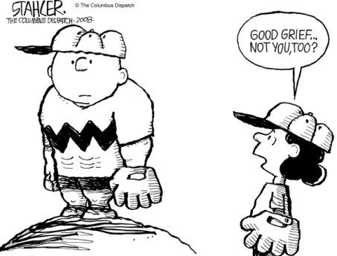
What about side effects?

Slide 5
What is an advantage of dexamethasone over prednisone?
Dexamethasone is more effective for lower airway inflammation
Dexamethasone has a longer half-life than prednisone
Dexamethasone can be given IM or IV if the child can’t take it PO
Dexamethasone syrup tastes better than prednisone syrup

Slide 6
Dexamethasone vs prednisone
Prednisone
Dexamethasone
Half-life: 12-24 hours
Total dose studied: 6mg/kg over 5 days
  2mg/ kg x 1, 1 mg/kg x 4 days
PO syrup: 15 mg/5ml
Bitter taste in some formulations
Half-life: 36-72 hrs
Equivalent dose: 1.2 mg over 5 days
  0.6mg/kg x 2 doses
IV formulation: 4mg/ml
IV form well-tolerated when given PO
Better compliance with 2 doses, and equal efficacy

Slide 7
What is an advantage of dexamethasone over prednisone?
Dexamethasone is more effective for lower airway inflammation
Dexamethasone has a longer half-life than prednisone
Dexamethasone can be given IM or IV if the child can’t take it PO
Dexamethasone syrup tastes better than prednisone syrup

Slide 8
Camellia’s Asthma Visit Continues
Daytime/exercise:
  Using albuterol 2-3x/week during PE
Nighttime:
  Wakes up at night 2x/per week, uses albuterol
ED/hosp:
  1 hosp and 1 exacerbation requiring PO steroids
Meds:
  Using her Qvar daily, as prescribed
  40 mcg BID = low dose

Slide 9
Without looking at the guidelines, how would you classify Camellia’s asthma?
Moderate persistent asthma
Severe persistent asthma
Not well-controlled asthma
Mild intermittent asthma
Pneumonoultramicroscopicsilicovolcanoconiosis
Notes:
the longest word ever to appear in an English language dictionary., factitious name for silicosis

Slide 10
NHLBI Asthma Classification
Assess SEVERITY in patient not currently on controller medication
Assess CONTROL in patients currently on controller medication
Treatment is based on classification of severity or control
  Initiate therapy based on severity
  Modify therapy based on control

Slide 12
Simplified version: Rule of 2’s
≥ 2 daytime /exercise symptoms/ week or
≥ 2 episodes of SABA use/week or
≥ 2 nighttime awakenings/month or
≥ 2 systemic corticosteroids or hospitalizations in last year
_____________________________________
= PERSISTENT OR NOT WELL-CONTROLLED ASTHMA

Slide 13
Simplified version: Rule of 2’s
≥ 2 daytime /exercise symptoms/ week or
≥ 2 episodes of SABA use/week or
≥ 2 nighttime awakenings/month or
≥ 2 systemic corticosteroids or hospitalizations in last year
_____________________________________
= PERSISTENT OR NOT WELL-CONTROLLED ASTHMA
Step up to next level of care

Slide 14
EPR-3 (8/28/07): p296-304, 306

Slide 15
What about side effects?

Slide 16
Inhaled Corticosteroids: Effective?
YES

Slide 17
Inhaled Corticosteroids: Safe?
Daily use of ICS in kids associated with a small but statistically significant decrease in growth velocity in the 1st year of treatment
  Systemic effects related to absorption through lung epithelium not GI tract
Growth effects seen in long-term trials are
  Mild (<1cm height loss) but permanent
  Dose-dependent
  Steroid-dependent (in some studies)
  Delivery device-dependent (smaller molecules = increased risk)
Zhang 2014, Pruteanu 2013, Loke 2015, Wolfgram 2015

Slide 18
Principles for safe use of ICS
Use lowest dose to achieve control
Choose most effective molecule with least bioavailability
  fluticasone, mometasone, flunisolide > budesonide or beclomethasone
The Next Generation: Ciclesonide
  Pro-drug activated in lung epithelium
  Preliminary studies confirm safety and efficacy
  Dosing for pediatric patients not yet established
Kramer 2013
Notes:
Zhang 2014

Slide 19
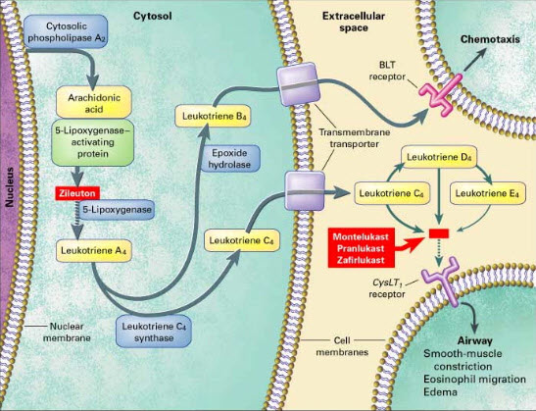
What about leukotriene receptor antagonists??

Slide 20
LTRA’s: Recommendations
Inhaled corticosteroids are the preferred therapy (most effective, and cost-effective) for adult and pediatric persistent asthma
Consider LTRA only for patients with mild persistent asthma in whom poor adherence or concern for side effects preclude the use of ICS.
My consider as a 2nd-line adjunct to daily ICS in patients with mild breakthrough symptoms
Chauhan 2014, Wang, 2011

Slide 21
Case Continued
You decide to switch Camellia to Fluticasone, and increase her to a moderate dose (110mcg, 1 puff BID)
You explain the risks and benefits of ICS and the importance of asthma control
As you are finishing up the visit, mom asks “Why can’t she just take her inhaled steroid when she gets sick?”

Slide 22
Which of these regimens would be appropriate for this child?
Use of ICS during exacerbations only
Increasing dose of ICS during exacerbations
Increasing frequency of ICS during exacerbations
None of the above

Slide 23
Summary of evidence: intermittent ICS (during exacerbations only)
Intermittent ICS superior to placebo
  Including preschoolers with intermittent wheeze
  Growth suppression similar to placebo
Daily ICS superior to intermittent
  Increased risk of growth suppression in kids
Chong, 2013; Kaiser 2016, Chauhan 2013

Slide 24
A few notes of caution…
Patients enrolled generally had mild persistent or “episodic” asthma
All of these trials included a run-in period of daily ICS
The “rescue” dose was 2-3 times higher than daily dose

Slide 25
What about increasing DOSE of ICS during exacerbations?
Adults:
  Meta-analysis showed no benefit to adding extra doses to daily ICS (Kew, 2016)
Kids:
  One RCT: No advantage to adding rescue dose over daily dose (Martinez ,2011)

Slide 26
Martinez, 2011
Daily
Combined
Rescue
Placebo

Slide 27
Which of these regimens would be appropriate for this child?
Use of ICS during exacerbations only
Increasing dose of ICS during exacerbations
Increasing frequency of ICS during exacerbations
None of the above
Why?
Notes:
She doesn’t have episodic or mild persistent asthma

Slide 28
Recommendations for “Rescue” ICS:
Consider when asthma is mild persistent or well-controlled on low-dose ICS and:
  Infrequent, mild exacerbations with viral prodrome
  Documented ability to take meds as instructed
  Reason not to stay on daily ICS (eg: growth concerns)
  “Rescue” dose should be moderate or high-dose
There is no evidence for benefit of adding extra doses of ICS to daily ICS during exacerbations
Notes:
Also talk about other ways to reduce side effects from steroids: lowest effective dose, use of spacer, ciclesonide, etc

Slide 29
Camellia’s Follow-up Visit
Camellia goes home on moderate-dose fluticasone after discussion of risks/benefits
3 mo later she comes to urgent care with an exacerbation requiring PO steroids
Since her last visit:
  She is using her fluticasone reliably and correctly
  Still using her albuterol 3x/week during PE
  Wakes up at night twice per week
  = NOT well-controlled

Slide 30
EPR-3 (8/28/07): p296-304, 306

Slide 31
Wait a minute…
Apparently adding a long-acting bronchodilator (LABA) is the next step
But what about the
BLACK BOX WARNING?

Slide 32
Rationale for FDA Warning
Black box warning issued by FDA on all preparations containing LABA in May, 2006
SMART study:
  Clinical trial in adults, most on LABA ALONE
  Increased risk asthma-related death (13/13,176 vs 3/13,179)
Recent meta-analyses (Salpeter, 2006; Rodrigo, 2009) found differences smaller but still statistically significant in kids
Most recent review: Peters 2016

Slide 33
Are LABA’s effective?
Studies in adults consistently show better asthma control with lower total steroid dose when LABA added
  Previous studies in kids showed benefit, but a recent meta-analysis failed to show benefit
Recommendations:
  Adults: first line adjunct to ICS in patients poorly controlled on low-dose ICS
  Children
    <5: Off-label use only
    5-12: consider in patients poorly controlled on mod dose ICS
  Open discussion with family about risks/benefits
Chauhan, 2015

Slide 34
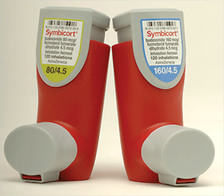
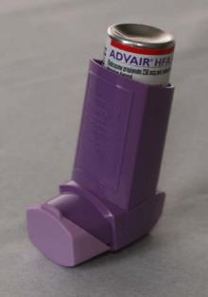
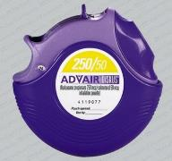
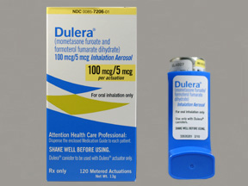
ICS/LABA combination inhalers
Symbicort
Budesonide/formoterol
Advair:
Fluticasone/salmeterol
Dulera
Mometasone/formoterol

Slide 35
Case Continued
You start Camellia on the ICS/LABA combo covered by her insurance plan, with a plan to step back down to ICS
One month later, she remains well-controlled
However, her mother wonders if she can use her combo inhaler for rescue rather than also carrying her albuterol around

Slide 36
Using extra doses of a combination ICS/LABA for rescue is
Supported by evidence from RCT’s
Currently FDA approved for children
FDA approved for adults but not for kids
Totally nuts

Slide 37
Rationale: Combination ICS/LABA Inhalers for Rescue
Formoterol (not salmeterol) has an onset of action (~5 min) similar to albuterol, with longer duration
Benefits might include
  Ability to titrate ICS dose up during exacerbation
  Single inhaler for control and rescue
  Potential for better control with less total ICS

Slide 38
Evidence: ICS/LABA Inhalers for Control + Rescue
Adults:
  Several recent trials (Rabe 2006, Bousquet 2007, Papi 2015) and 2 meta-analyses (Cates 2013, Kew 2013)
  ICS/LABA for rescue -> decreased use of SABA, fewer exacerbations compared to ICS alone or ICS/LABA control only
  Lower total ICS dose when compared to high daily dose ICS

Slide 39
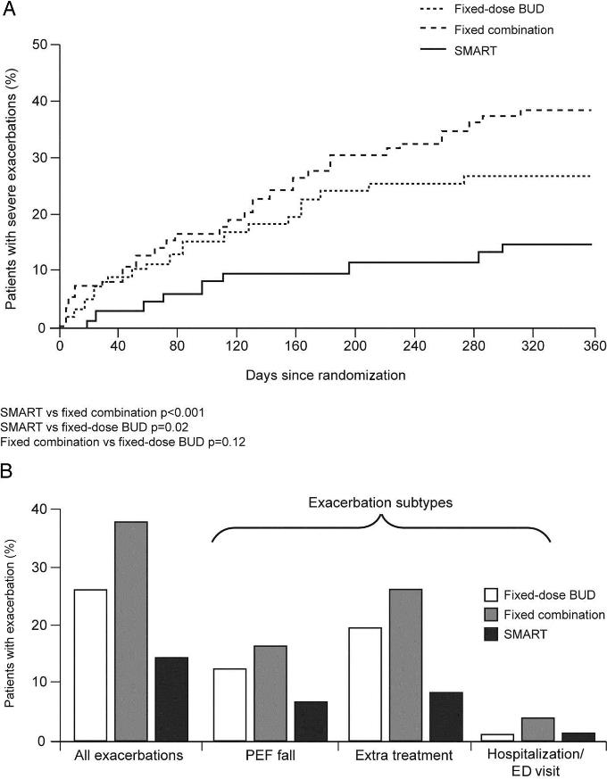
Evidence in Kids: ICS/LABA for Control + Rescue
  RCT of 341 kids poorly controlled on ICS alone
High-dose budesonide
Bud/form + SABA rescue
Bud/form control and rescue
  (Bisgaard, 2006)

Slide 40
Using extra doses of a combination ICS/LABA for rescue is
Supported by evidence from RCT’s
Currently recommended for children
Recommended for adults but not for kids
Totally nuts
So, why aren’t we all doing this?
Notes:
Not an FDA-approved indication

Slide 41
Recommendations
ICS/LABA inhalers are not currently licensed for rescue use in either children or adults…
Benefits include better control with less ICS when compared to higher dose ICS

Slide 42
Questions for this talk
How should asthma be classified at acute and preventive visits?
  SEVERITY in patients not on controller, CONTROL in patients on controller
Do inhaled steroids make kids short?
  Yes, but not by much
Can inhaled steroids be used intermittently?
    Yes, in select patient, at 3x normal doses
Are long-acting β-agonists safe?
  Probably, but they should be used with caution
Can ICS/LABA be used for rescue?
  Formoterol/ICS combo effective, but not approved for this indication

Slide 43
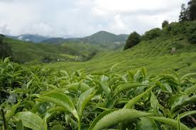
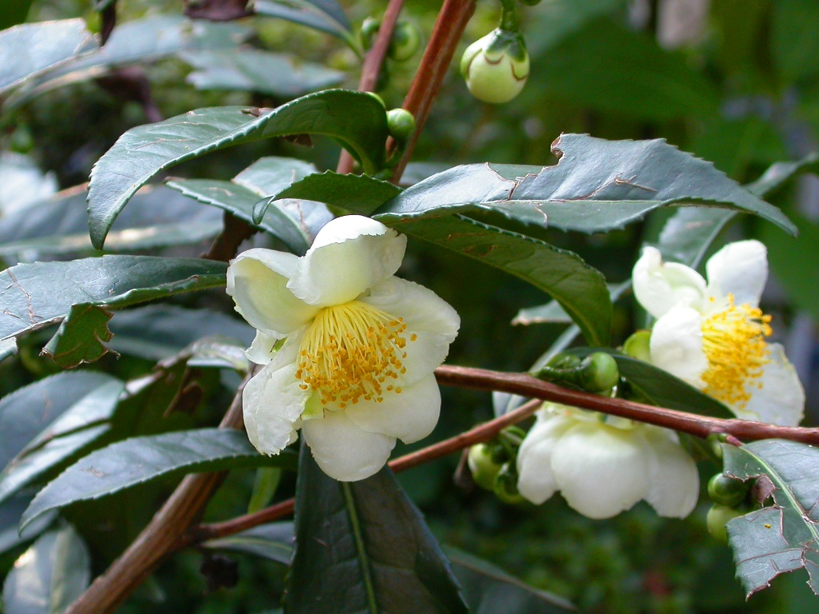
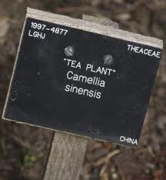
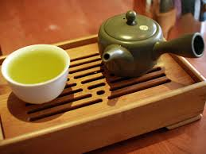
Camellia
Camellia sinensis = “tea plant”
Evergreen shrub originating in Asia
Produces black, green oolong and white teas
Ancient physicians in India and China used it as a treatment for asthma
The bronchodilator theophylline was derived from C. sinensis in 1888

