Slide 1

Providing Care to LGBTQ Patients
Erica M. Metz, MD
Regional Medical Director for Transgender Health, Kaiser Permanente NCAL
San Francisco Asthma Network Forum
September 30, 2016

Slide 2
Disclosures
No financial relationships
Will discuss FDA off-label treatments

Slide 3
Objectives
1. Become familiar with definitions and terminology related to sexual orientation and gender identity.
2. Examine health care disparities that may affect LGBTQ patients and strategies to reduce them .
3. Develop skills to provide sensitive and respectful care to LGBTQ patients.
4. Learn the basics of hormonal, surgical and preventive care for transgender patients.
Fifth Agenda

Slide 4
Objectives
1. Become familiar with definitions and terminology related to sexual orientation and gender identity.
2. Examine health care disparities that may affect LGBTQ patients and strategies to reduce them .
3. Develop skills to provide sensitive and respectful care to LGBTQ patients.
4. Learn the basics of hormonal, surgical and preventive care for transgender patients.
Fifth Agenda

Slide 5
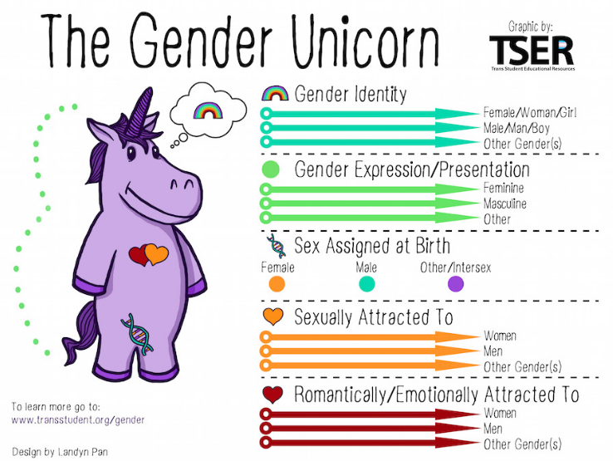
Key Terms & Concepts| The Gender Unicorn Construct
Notes:
Please remove animation

Slide 6

Key Terms & Concepts| What is the “Q”?
Lesbian
Gay
Bisexual
Transgender
Queer or Questioning
Lesbian
Gay
Bisexual
Transgender
Queer or Questioning
Notes:
Please remove animation

Slide 7
Key Terms & Concepts| Definitions
  Gender Identity
  A person’s innate perception (or sense) of their own gender; a person’s gender identity may or may not be the same as that person’s sex assigned at birth
  Transgender
Describes an individual whose gender identity differs in some way from the sex they were assigned at birth
  Transman (Female to Male) Assigned female at birth, has a male gender identity, may seek treatment to masculinize
Transwoman (Male to Female) Assigned male at birth, has a female gender identity, may seek treatment to feminize
  Gender Non-Conforming
  Gender Non-Binary
  To present, dress or act differently from what society expects of a person of a specific gender
Identity does not conform to a binary understanding of gender as limited to male and female
  Gender Dysphoria
  Transition
  The discomfort or distress that is caused by a discrepancy between a person’s gender identity and that person’s sex assigned at birth…that can in large part be alleviated by treatment.
The process an individual takes to improve congruence between their outward appearance and their gender identity; which may including changing their gender expression, taking hormone therapy, and/or having surgery.
Notes:
Please remove animation

Slide 8
Transgender Terms & Concepts | Terms to Use & Avoid
Appropriate Terms | Inappropriate Terms (Avoid Use)
Transgender individual / person Trans* community | Transvestite Transsexual Transgendered
Transgender Woman Transwoman Woman | Male to Female/MTF (refers to treatments, not individuals)
Transgender Man Transman Man | Female to Male/FTM (refers to treatments, not individuals)
Transition | Sex Change
Gender Affirming Surgery Lower Body Surgery | Sex Change Operation Sexual Reassignment Surgery (SRS) Bottom Surgery
Assigned Female at Birth / Natal Female / Born Female Assigned Male at Birth / Natal Male / Born Male Cis-gender | “Normal” Female, “Real” Female “Normal” Male, “Real” Male

Slide 9
Objectives
1. Become familiar with definitions and terminology related to sexual orientation and gender identity.
2. Examine health care disparities that may affect LGBTQ patients and strategies to reduce them .
3. Develop skills to provide sensitive and respectful care to LGBTQ patients.
4. Learn the basics of hormonal, surgical and preventive care for transgender patients.
Fifth Agenda

Slide 10

How many LGBT people are there?
Gallup Daily tracking survey: “Do you, personally, identify as lesbian, gay, bisexual, or transgender?”
US: 3.8% are LGBT, 29% are raising children
5.56 same sex couples per 1k households
CA: 4.6%, 30% raising children, 7.8 couples/1k households
Same-sex Couple and LGBT Demographic Data Interactive. (May 2016).
Los Angeles, CA: The Williams Institute, UCLA School of Law.
Link: http://williamsinstitute.law.ucla.edu/visualization/lgbt-stats

Slide 11

How Many Transgender People Are There?
UCLA’s William Institute estimate: 0.6% of US population (1.4 million)
May 2015 Census Bureau’s analysis of name change since 1936
  135,367 people changed name to opposite gender
  30,006 also changed their sex
  65% transgender men, 35% transgender women
  Surgery no longer required for legal gender change as of 2013
Kaiser Permanente NCAL employee survey: 2% self-identify as transgender
Link: http://www.nytimes.com/2016/07/01/health/transgender-population.html
Notes:
UCLA’s William Institute estimate: 0.6% of US population (1.4 million people)
This is an update to The Williams Institute’s widely accepted estimate five years ago (0.3%)—new estimate drawn from a 2014 CDC telephone health survey
A 2015 NYT article, cited the May 2015 Census Bureau’s analysis of people who changed name and sex with the Social Security Administration since 1936
135,367 people have changed their name to one of the opposite gender
30,006 also changed their sex
65% transgender men, 35% transgender women
Surgery no longer required for legal gender change as of 2013
www.ustranssurvey.org launched August, 2015 with over 20,000 respondents; findings will be available in late 2016

Slide 12




Effects of Stigma
Interpersonal Stigma
Structural Stigma
Intrapersonal Stigma
Stress
Inequities and Health Disparities
Hatzenbeuler, ML, Link BG. Introduction to the special issue on structural stigma and health. Soc Sci Med 2014; Feb 103: 1-6.

Slide 13

Intersectionality
Race
Class
Gender Identity
Sexual Orientation
Age
Religious background
Level of education
Culture
Housing
Legal status
Mental and physical health
Native language

Slide 14
Why Focus on this Population?
Increased visibility and awareness, more patients “out”
Medically underserved and at risk
  19% report being refused care; high levels of postponing care due to fear of discrimination or inability to pay (less likely to be insured)
  Highest rates of tobacco, alcohol and drug use
  MSM and transwomen at high risk of HIV infection, particularly people of color
  High rates of homelessness (20-40% of homeless youth are LGBT)
  Nearly 50% of transwomen in one study reported using hormones not prescribed by a physician
  50% of transgender people report needing to educate their doctor about how to care for them
  Elderly LGBT patients have more isolation, fewer family supports and a lack of social services

Slide 15
Why Focus on this Population?
High rates of suicidality and mental health disparities
  LGBT youth 2-3x more likely to commit suicide
  Dane County Survey: 17% of transgender teens with h/o suicide attempt vs 3% of non-trans
  National Transgender Discrimination Survey found 41% of respondents had attempted suicide
  54% of transgender people reported having depression symptoms; LGB people 13%, significantly higher than the general population (6.6%)
www.ustranssurvey.org launched Aug, 2015 -- 20,000 respondents
  Treatment leading to increased gender congruency results in reduction of medical and psychiatric comorbidities and improvements in well-being and social functioning

Slide 16


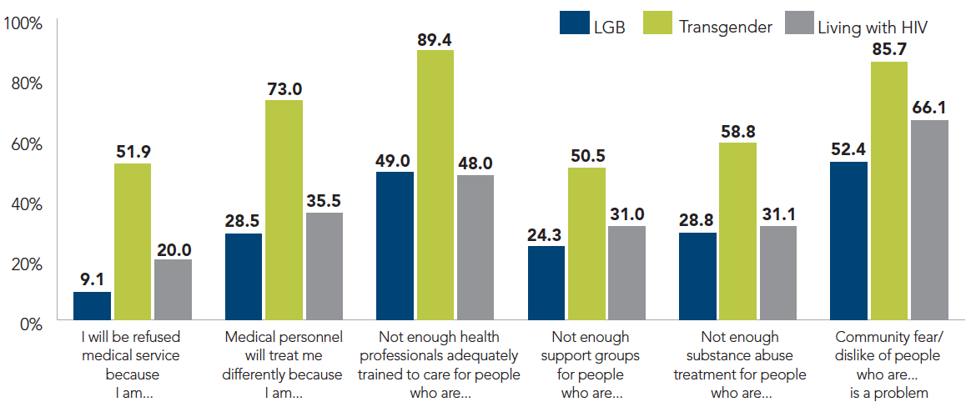
^{Lambda Legal, 2010,} ^{New York. Available at} www.lambdalegal.org/health-care-report

Slide 17
Smoking
2004 California tobacco use survey:
  lesbian women 70% more likely to smoke than other women
  gay men were 50% more likely to smoke than other men
The LGBT National Tobacco Control Network estimates that the LGBT community is 50% to 200% more likely than others to be addicted to tobacco
Bisexuals with highest rates on state surveys (>30%)
LGBT adolescents: 47% of females and 36.7% of males reporting same-sex attraction or behavior smoked (compared to 29%)

Slide 18

Factors affecting tobacco use
High stress related to stigma and discrimination
Bar culture (social bonding, safe spaces)
Lack of access to health care and treatment
Tobacco industry targeting, “normalizing” in ads

Slide 19
Objectives
1. Become familiar with definitions and terminology related to sexual orientation and gender identity.
2. Examine health care disparities that may affect LGBTQ patients and strategies to reduce them .
3. Develop skills to provide sensitive and respectful care to LGBTQ patients.
4. Learn the basics of hormonal, surgical and preventive care for transgender patients.
Fifth Agenda

Slide 20
Build Trust| Key Principles
Understand Self-Designation & Use Inclusive Language
Avoid assumptions about sexual orientation and gender identity based on appearance
Use preferred name (regardless of legal name on medical record)
If you are unsure how to address ask, “How would you like to be called?” or “What are your pronouns?”
If you make a mistake, apologize and correct yourself promptly, and refrain from making an excuse
Be Respectful
Not all gender non-conforming people are transgender
Ask relevant questions only
Provide warm handoffs
Alert staff about discrepancies in legal and preferred name and gender marker
Only disclose sexual orientation or transgender status if necessary for care
Keep conversations with colleagues professional (avoid gossip or jokes)

Slide 21
Taking a Sexual History| Best Practices & Examples
“Ironically, it may require greater intimacy to discuss sex than to engage in it.”
The Hidden Epidemic, Institute of Medicine 1997
Instead of… | Ask…
Do you have a wife/husband or boyfriend/girlfriend? | Do you have a partner? Are you in a relationship?
Do you have sex with men, women or both? | What is(are) the gender(s) of your sexual partners?
Do you use birth control? | Do you have sex that could result in pregnancy? What are your future plans/wishes for fertility?
Make it routine, “normalize,” practice!
Get to know your patient as a person
Ask about behaviors to assess risk (focus on body parts)
Protect confidentiality
Notes:
Metz

Slide 22
Addressing transgender patients| Best Practices & Examples
Best Practices | Examples
When addressing patients, avoid using gendered terms like “sir” or “ma’am” | “How may I help you today?”
When talking about patients, avoid pronouns and other gender terms, or use gender neutral words such as “they.” Never refer to someone as “it”. | “Your patient is here in the waiting room” “They are here for their 3 o’clock appointment”
Politely ask if you are unsure about a patient's preferred name | “What name would you like us to use?” “I would like to be respectful—how would you like to be addressed?”
Ask respectfully about names if they do not match what is in your records. | “Could your chart be under another name?” “What is the name on your insurance?”
Only ask information that is required. | Ask yourself: What do I know? What do I need to know? How can I ask in a sensitive way?
We all make mistakes. If you do make a mistake: Apologize and correct yourself promptly Once you apologize, do not continue to tell the person how bad you feel—it puts them in a position of needing to comfort you Refrain from giving reasons or excuses for the mistake Do not continue to make the same mistake | “I apologize for using the wrong pronoun.” “I am sorry I used the wrong name, Sarah” “I meant she. I am sorry”
Notes:
Metz

Slide 23
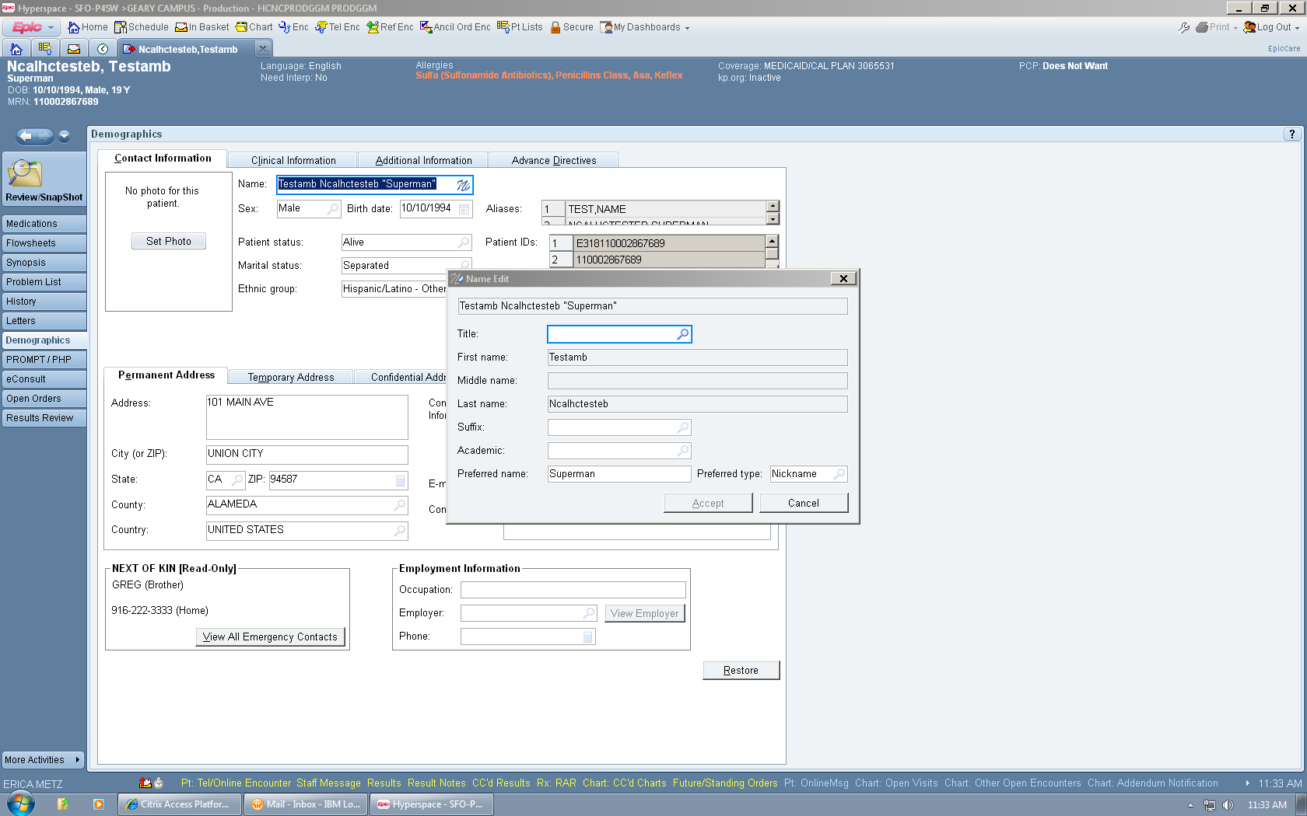
Document| Preferred Name

Slide 24
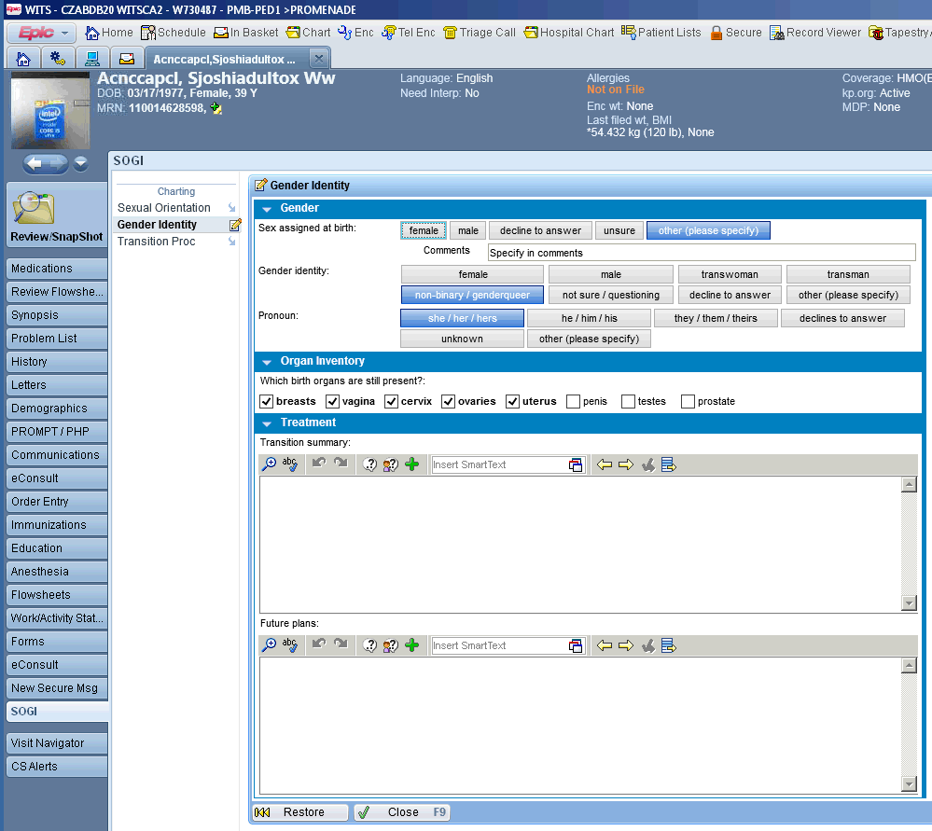
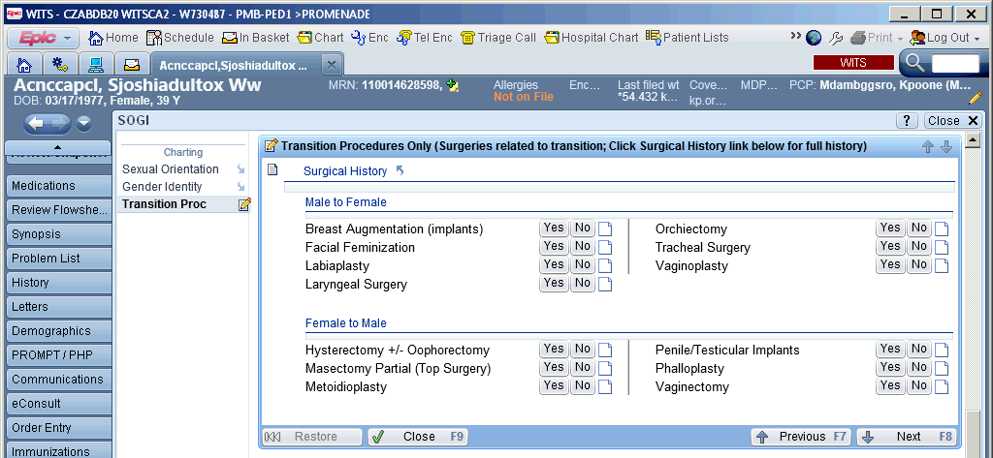

Document| Gender Identity
New Sexual Orientation & Gender Identity SmartForm to document sex assigned at birth, gender identity, pronouns, organ inventory, transition treatment/plans and surgical history
If the SOGI tab is not present, click More Activities and add it

Slide 25
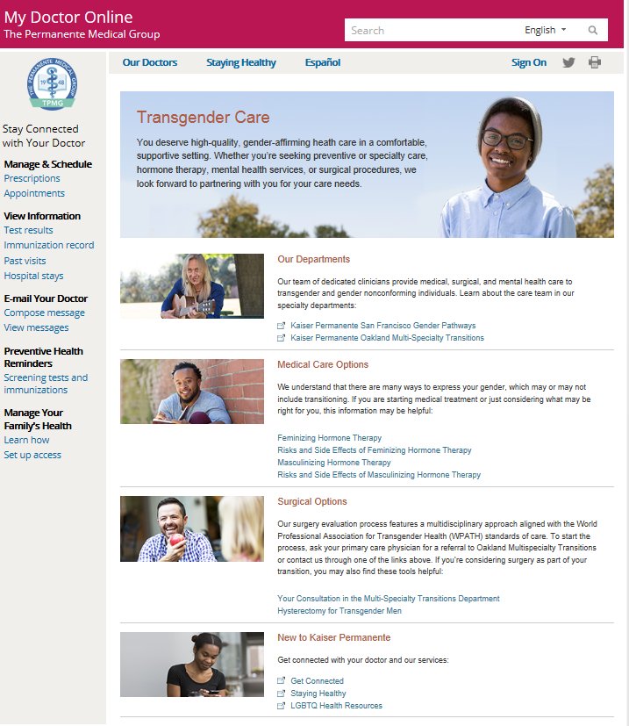
Online Resources| Information for patients
KP My Doctor Online
Transgender Care
kp.org/mydoctor/transgendercare
Multi-Specialty Transitions Clinic
Oakland Medical Center
www.kp.org/eastbay/transgender
Gender Pathways Clinic
San Francisco Medical Center
www.kp.org/sanfrancisco/transgender
Notes:
Weiss

Slide 26
Objectives
1. Become familiar with definitions and terminology related to sexual orientation and gender identity.
2. Examine health care disparities that may affect LGBTQ patients and strategies to reduce them .
3. Develop skills to provide sensitive and respectful care to LGBTQ patients.
4. Learn the basics of hormonal, surgical and preventive care for transgender patients.
Fifth Agenda

Slide 27
Evolving Health Care Environment
DMHC: Insurers Cannot Deny Care to Transgender Patients
Friday, April 12, 2013 The California Department of Managed Health Care this week issued guidance reminding health plans that discrimination against transgender individuals violates anti-discrimination laws. DMHC urged insurers to review health plan documents -- including coverage limitations based on gender -- to ensure they are in compliance with the laws.
Kaiser Transgender Benefits
Medical care, hormones and mental heath all covered
Gender affirming surgery (lower body surgery) and male chest reconstruction (upper body surgery) covered by all commercial plans, the ACA and MediCal
Medicare has removed coverage exclusion, but payment infrastructure remains undeveloped and few surgeons are certified
Reconstructive evaluations to determine medical necessity of other procedures
Federal health board rules Medicare can pay for transgender recipients' sex-change surgeries
Friday, May 30, 2014 SAN FRANCISCO (AP) Medicare can no longer automatically deny coverage requests for sex reassignment surgeries, a federal board ruled Friday in a groundbreaking decision that recognizes the procedures are medically necessary for some people who don't identify with their biological sex.

Slide 28
Transgender Care| Multidisciplinary Clinic Services
Mental Health
Medicine
Support for patients who are questioning or who have mental health needs related to their gender identity or transition
Mental health evaluation for readiness to start hormones (optional in informed consent model)
Mental health evaluation for readiness for gender affirming surgeries
Group therapy, support groups and patient education sessions
Hormone initiation and management
Follow-up and assistance with any medical issues related to transition, including lab monitoring and appropriate health care maintenance screenings
Medical case consultations and pre-operative assessments
Social Work & Nursing
Gynecology
Case management and care coordination
Pre- and post-operative planning
Addressing insurance, social and financial concerns and arranging for assistance
Education about treatment options
Referrals to trans* knowledgeable providers
Cervical cancer screening and routine gynecologic care for transmen in a gender neutral setting
Counseling on fertility preservation
Consultations for hysterectomy/oophorectomy for gender transition

Slide 29
Transgender Care| Surgical Services
 | Transwomen | Transmen
Gender Affirming (Lower Body) Surgery | Vaginoplasty Labiaplasty Orchiectomy Revision procedures and/or treatment of post-operative complications | Metoidioplasty (with or without urethral lengthening) Phalloplasty (free flap) Hysterectomy / Oophorectomy Revision procedures and/or treatment of post-operative complications
Upper Body Surgery | Feminizing mammoplasty (breast augmentation)* | Bilateral mastectomy with chest reconstruction (top surgery)
Other Procedures | Chondrolaryngoplasty (tracheal shave)* Facial feminization procedures* Speech therapy Voice surgery* Facial hair removal* | Speech therapy
*medical necessity determined based on reconstructive surgery statute

Slide 30
Clinical Criteria for Transgender Surgery
Persistent, well-documented gender dysphoria
  Two mental health evaluations by therapists trained in gender evaluation (one for chest surgery and other feminizing procedures)
Capacity to make a fully informed decision and to consent for treatment
Age of a majority in a given country
Well-controlled medical or mental health concerns, if present
12 continuous months of hormone therapy (not a prerequisite for male chest reconstruction)
12 continuous months of living in a gender role that is congruent with the patient’s identity for gender affirming surgery
From WPATH Standards of Care, 7th version

Slide 31
Prescribe Hormones| Goals of Medical Therapy
Give cross-sex hormones to induce physical changes more congruent with a patient’s gender identity
  Gradual physical and psychological process taking approximately 5 years to complete (most changes occur 3 mos-2 yrs)
Provide patient education regarding options, benefits and risks
  Expectation setting
  Fertility goals
  Importance of monitoring/follow up
Individualize treatment to patient’s goals
Use the lowest effective dose to minimize risk of side effects
Consider harm reduction (TD estrogen for smokers, encourage cessation)
Continue appropriate primary care preventative screenings for organs present

Slide 32
Prescribe Hormones| Testosterone options
IM injections
SC injections
Topical
Testosterone cypionate 200mg/mL, 100-200mg every 2 weeks
    Start low dose and increase for desired effect and physiologic level (300-1000ng/dL)
Weekly dosing common, reduces fluctuations in energy
Generally ½ of IM dose (50mg weekly)
Much smaller needle so easier to self inject
Pilot studies and clinician experience suggest equivalent to IM shots
Can form inflamed nodules under the skin
  Gel 12.5mg/pump, 2-8 pumps to skin daily
    Can transfer to partners
    Slower, subtle
Transdermal patch 2-4mg/24 hour, applied weekly
  Limited by rash, rotate sites

Slide 33
Hormones in Primary Care| Follow Up for Transmen
Refill stable testosterone prescriptions
Check testosterone level (treatment monitoring), lipids, FBS, ALT/AST, CBC every 6 months; HIV/STD screening as appropriate
  Total testosterone level at midway point between injections more useful than peak or trough (goal 300-1000ng/dl)
Encourage smoking cessation
Ask about sexual practices; advise pregnancy prevention if at risk
Continue routine breast and cervical cancer screening if not surgically removed (some breast tissue remains after top surgery – consider screening if high risk)
Bone density screening at age 60 or earlier if risk factors or inconsistent testosterone use after oopherectomy

Slide 34
Prescribe Hormones| Estrogen Options
Estradiol tablets
Topical Estradiol
Estrogen injections
2-6mg daily
Dividing dose bid can reduce nausea
Take sublingually instead of swallowing
Weekly transdermal patch 0.1-0.4mg/day
Preferred for patients over 40, who smoke, or who have medical comorbidities
Non-formulary bi-weekly patch (better adhesive)
Estradiol valerate 20-40mg/mL
Dose 20-60mg IM every 2 weeks
Non-formulary
Variable levels
Estradiol cypionate 5mg/mL alternative
Any of above with Anti-androgen Spironolactone
25-100mg bid, titrate as tolerated until testosterone suppressed to <50ng/dL or patient’s goal is met

Slide 35
Hormones in Primary Care| Follow Up for Transwomen
Refill stable estrogen and spironolactone prescriptions
Check lipids, glucose or A1C, Cr/K, ALT, estradiol (goal 50-200pg/mL), total testosterone (suppression monitoring, goal <50) every 6 months; HIV/STD screening as applicable
Encourage smoking cessation
Ask about sexual practices; consider PrEP if at risk
Mammograms recommended starting at age 50 for patients on estrogen for 5 years or more
Remove cervical cancer screening prompt: click “No Cervix” button in PROMPT tab
Bone density screening at age 60, consider sooner if risk factors or inconsistently on estrogen (encourage Vitamin D supplements)
Prostate cancer screening controversial (PSA typically suppressed)

Slide 36
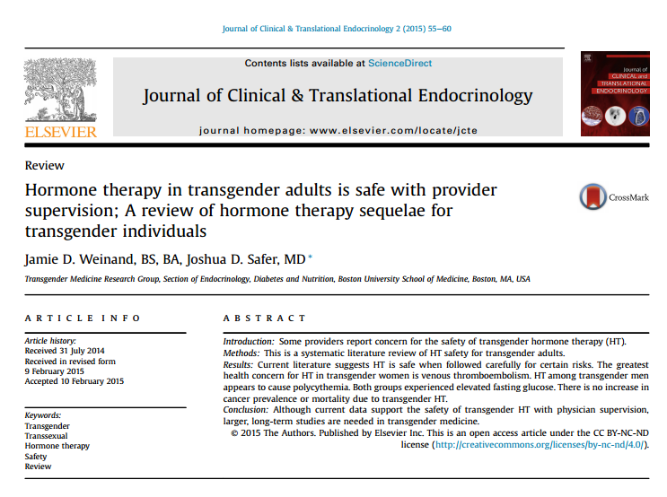
Prescribe Hormones| Literature Review
Notes:
Please put graphic from this journal/article on this slide

Slide 37
Outcomes in Transwomen on Estrogen
Venous Thromboembolism
  Driven by hypercoagulable risk factors and type of estrogen
  Gooren, et al, 2008:
    NO increase in clot in 2,236 MTF patients on HT from 1976-2006 compared to controls
    Except for ethinyl estradiol 6-8%
  Asscheman, et al, 2014: 1% in 1,076 MTF patients over average 5.4 years
  Wierckx, et al, 2013: 5% of 214 pts in 1st 3 years, but 10/11 had at least one VTE risk factor (smoking, surgery, hypercoaguable disorder)
  Ott, et al, 2010: no clot in 162 transwomen followed for mean 64.2 months on TD estrogen
Cardiovascular risk similar or slightly higher compared to male controls (higher than female controls), also closely tied to smoking
One study (Asscheman, et al, 2011) showed increased mortality of 51%, but secondary to substance use, HIV and suicide

Slide 38
Outcomes in Transwomen on Estrogen
Increased insulin resistance and type 2 diabetes
No clear increase in cancer
  possible prostate cancer incidence 0.04% (Gooren, et al, 2013)
  no change in breast cancer risk compared to male breast cancer incidence (10 case reports since 1968)
Bone density:
  Wierckx, et al, 2010: 25% of 100 transwomen had osteoporosis after 10 years of hormone therapy
    Treated with anti-androgens for 1 year prior to starting estrogen
    Estrogen non-adherence
  Mueller, et al, 2011, no osteoporosis in 84 transwomen
  European data suggests transwomen have lower bone density than male controls at baseline

Slide 39
Outcomes in Transmen on Testosterone
Polycythemia (no adverse outcomes)
Increased incidence of type 2 diabetes
No increased cardiovascular events
No increased thromboembolism
No proven increase in cancer incidence
  Gooren, et al, 2013 breast cancer incidence 5.9 per 100,000 person years
  ?slight increase in ovarian cancer but rates still very low
No decrease in bone density (may rise)
No increased mortality

Slide 40
Special considerations for asthma care
PFTs in transgender patients
  Need to know birth gender to accurately interpret results
  Reference values may be inaccurate if affirmed gender is on medical record
  Requires sensitivity to explain discrepancy to patients
Chest binding for transmen
  May affect comfort/compliance with spirometry assessments
  Can affect asthma symptoms
  No published studies

Slide 41
References
American Lung Association, The LGBT Community: A Priority Population for Tobacco Control, www.lung.org
de Haan Gene, Santos Glenn-Milo, Arayasirikul Sean, and Raymond Henry F. Non-Prescribed Hormone Use and Barriers to Care for Transgender Women in San Francisco. LGBT Health. December 2015, 2(4): 313-323. doi:10.1089/lgbt.2014.0128.
Dejun Su, et al. Mental Health Disparities Within the LGBT Population: A Comparison Between Transgender and Nontransgender Individuals. Transgender Health. Volume 1.1, 2016. DOI: 10.1089/trgh.2015.0001
Erickson, Doug, “New transgender research filling in gaps,” Wisconsin State Journal, January 26, 2014
Gooren, Louis J, Care of Transsexual Persons, NEJM 2011; 364:1251-7
Gorton, R. Nick, Medical Therapy & Health Maintenance for Transgender Men: a Guide for Health Care Providers, 2005
Healthy People 2020 Topics and Objectives: Lesbian, Gay, Bisexual and Transgender Health, www.healthypeople.gov
Hembree, Wylie C., et al, Endocrine Treatment of Transsexual Persons: an Endocrine Society Clinical Practice Guideline, J Clin Endocrinol Metab, September 2009; 94(9):3132-3154
Makadon, Harvey J, Achieving Health Equity for Lesbian, Gay, Bisexual and Transgender People, presentation from National LGBT Education Center, a program of Fenway Health
Murad, MH, et al, Hormonal therapy and sex reassignment: a systematic review and meta-analysis of quality of life and psychosocial outcomes, Clin Endocrinol (Oxf). 2010;72(2):214.
NCAL Transgender Benefit Clinician Advisory Group, Kaiser Permanente Transgender Hormone Therapy Practice Resource, September 2012
Tang H, Greenwood GL, Cowling, DW, Lloyd, JC, Roeseler AG, Bal, DG. Cigarette Smoking among lesbians, gays, and bisexuals: how serious a problem? (2004) Cancer Causes and Control. Vol. 15, Number 8. Pages 797-803.
UCSF Primary Care Protocol for Transgender Patient Care (http://transhealth.ucsf.edu)
Weinand, JD, Safer, JD, Hormone therapy in transgender adults is safe with provider supervision; A review of hormone therapy sequelae for transgender individuals, J Clin & Translational Endo, June 2015; 2(2):55-60.
World Professional Association for Transgender Health (WPATH) Standards of Care for the Health of Transsexual, Transgender, and Gender Nonconforming People, 7th version, 2011

