Slide 1

Interstitial Lung Disease:
An Asthma Masquerader
Sachin Gupta MD, FCCP
Division of Pulmonary and Critical Care Medicine
November 2nd, 2018
@Doctorsachin

Slide 2
Relevant Financial Disclosures
None

Slide 3
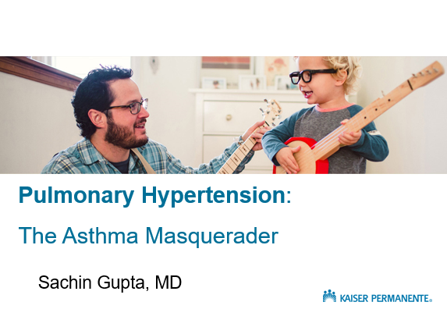
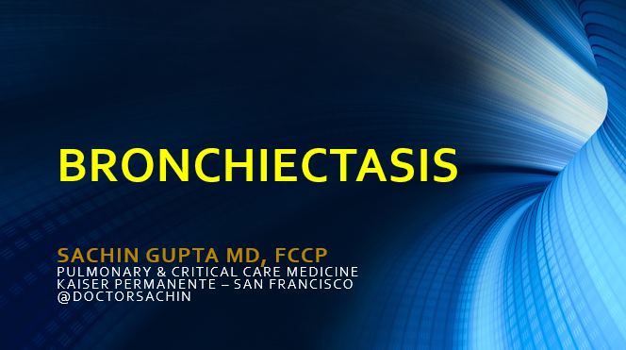
Asthma Network Lecture Series:
2016
2017

Slide 4
Abbreviations
CTD – Connective tissue disease
UCTD – Undifferentiated CTD
NSIP – Non-specific Interstitial Pneumonitis
HP – Hypersensitivity pneumonitis
ILD – Interstitial lung disease
IIP – Idiopathic interstitial pneumonia
IPF – Idiopathic pulmonary fibrosis
IPAF – Interstitial pneumonia with autoimmune features

Slide 5
Goals
1) Background of Interstitial Lung Disease
2) Compare/Contrast the 3 most prominent types of lung fibrosis
3) Discuss the multidisciplinary approach to the care of patients with pulmonary fibrosis

Slide 6
Outline
1) Background of Interstitial Lung Disease
2) ILD Diagnostic Pearls
3) Continuum of ILD Care

Slide 7
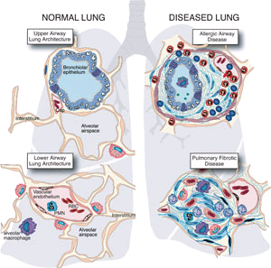
Asthma
ILD

Slide 8

Notes:
ILD is uncommon compared to other pulmonary problems seen in general practice. The prevalence of ILD has been estimated as 81/100,000 in males and 67/100,000 in females.

Slide 9
Interstitial Lung Diseases
Definition: A heterogeneous group of non-infectious, non-malignant processes of the lower respiratory tract that commonly result in:
Symptoms: Dyspnea and cough
Signs: Crackles on lung exam, sometimes clubbing of fingers
PFTs: Restrictive ventilatory impairment
Chest imaging: Diffuse parenchymal opacities
Lung biopsy: Granulomatous, or interstitial, inflammation and fibrosis
Outcome: Typically progressive and fatal

Slide 10
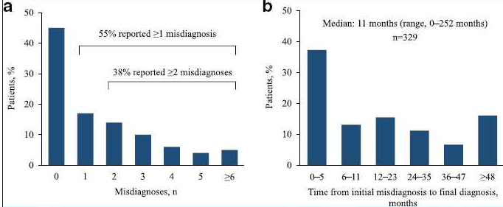
Time to Diagnosis
1/3 never smokers, 2/3 current or former smokers
13-25% had Obstructive lung disease (13-15% asthma, 19-25% COPD)
40-52% consulted for cough
18-26% of patients received >1 prescription for SABA in the year preceding IPF diagnosis

Slide 11
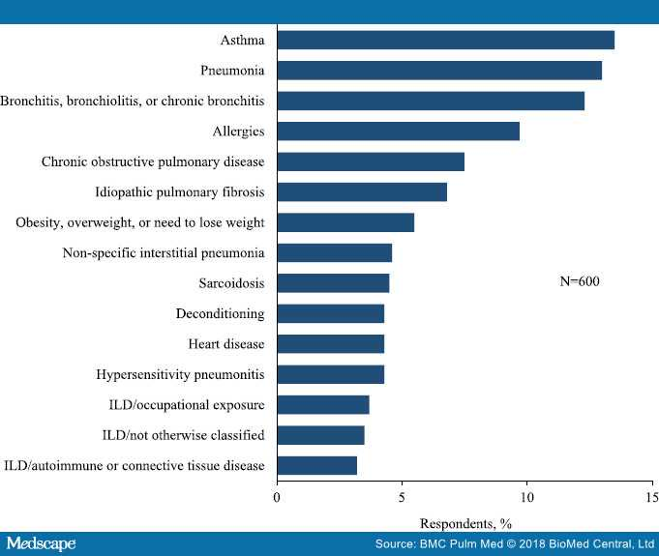
Notes:
The majority of respondents (75%) consulted at least three physicians prior to receiving their current diagnosis.
Systemic corticosteroids were prescribed to 21.8% of survey participants during the diagnostic evaluation. Among those with a self-reported diagnosis of IPF, 21.1% reported prior treatment with systemic corticosteroids. Other commonly prescribed medications during the interval between initial medical consultation and the current diagnosis were antibiotics (32.0%), salmeterol/fluticasone (17.8%), N-acetylcysteine (13.5%), omeprazole (11.8%), and albuterol (11.6%).

Slide 12
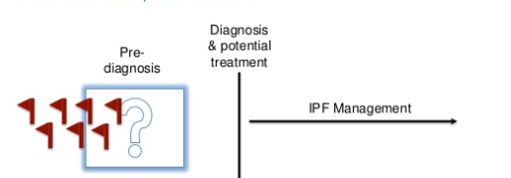
Notes:
Several studies have shown that reductions in forced vital capacity as small as 5–10% over 6 months are associated with a significant increase in the risk of death,^{[14–19]} and delayed referral to subspecialty care has been shown to confer an increased risk of death in patients with IPF.
Patients presenting with a history of ⩾6 months’ breathlessness on exertion with no evidence of obstruction should be assessed for conditions that may cause breathlessness, such as chronic heart failure, asthma, COPD, bronchiectasis, pleural effusion, abdominal splinting and anaemia

Slide 13
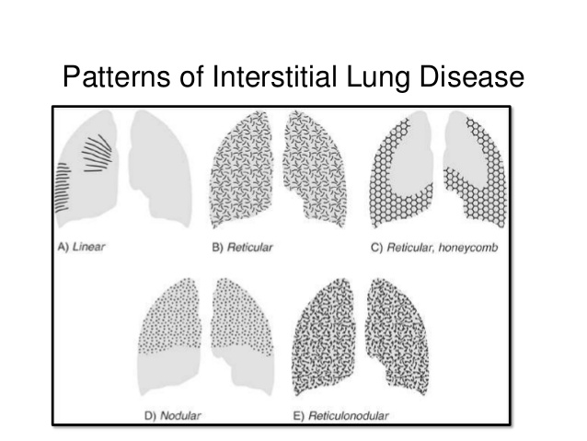

Slide 14
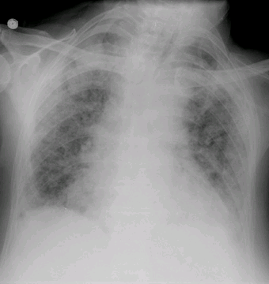

Slide 15
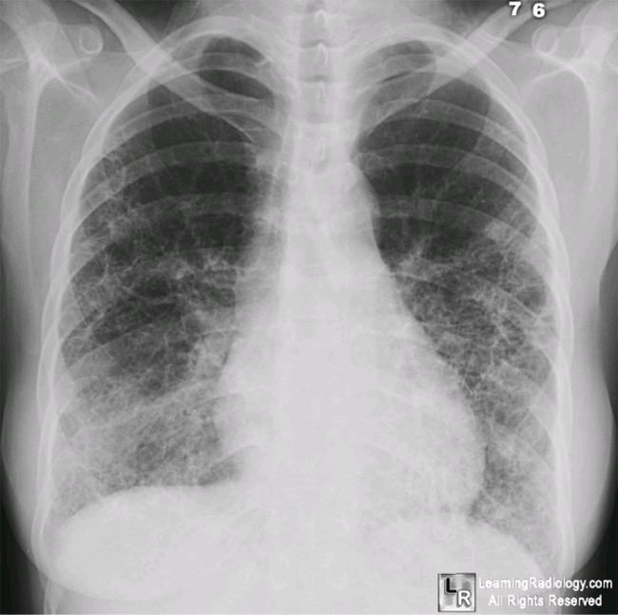

Slide 16
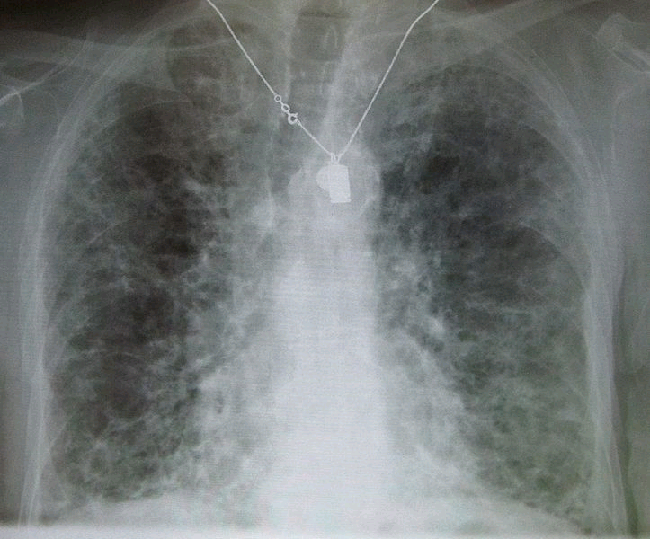

Slide 17
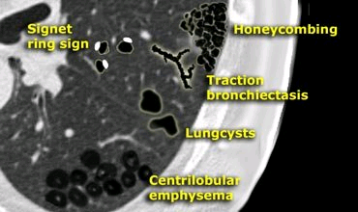
Notes:
A signet-ring sign represents an axial cut of a dilated bronchus (ring) with its accompanying small artery (signet).

Slide 18
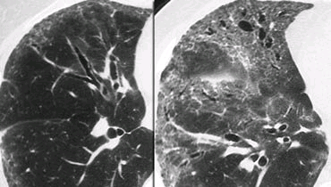

Slide 19
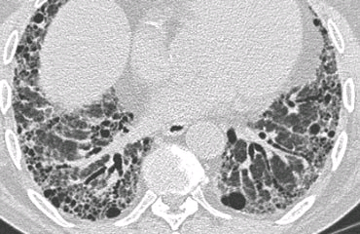

Slide 20
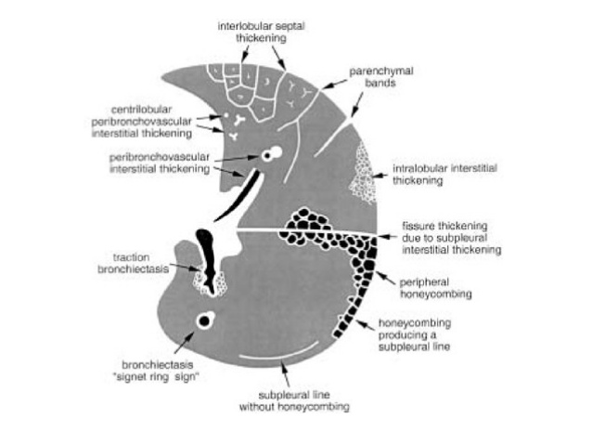

Slide 21
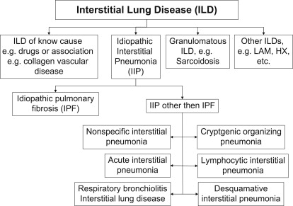

Slide 22
Differential Diagnosis
Collagen Vascular Disease/Autoimmune
  Rheumatoid Arthritis
  Systemic Sclerosis
  Mixed Connective Tissue Disease
  Sjogren’s
  Antisynthetase Syndrome
  Vasculitidies
Idiopathic
  IPF, NSIP, COP, AIP, RBILD, DIP, etc
Environmental
  Hypersensitivity pneumonitis (avian, molds, isocyanates, other organic dusts)
  Pneumoconiosis (silicosis, asbestosis, berryliosis, coal miner’s lung)
Medication
  TNF-alpha inhibitors
  Chemotherapy
  Amiodarone
  MTX
  NSAIDS/Antiobiotics
Notes:
Causes of hypersensitivity pneumonitis:
(1) Microbial agents
(2) Fungi, for example, Aspergillus, Penicillium,
Cladosporium, Trichosporon, Aureobasidium
(3) Bacteria, for example, thermophilic actinomyces,
Bacillus subtilis, Klebsiella, Epicoccum nigrum
(4) Mycobacteria, for example,Mycobacteriumavium,
M. immunogen
(5) Amoebae
(6) Animal proteins
(a) Common – avian
(b) Rare – fish meal, rat urine, silkworm larvae
(7) Chemical sensitizers
(8) Isocyanates, anhydrides, pyrethrum, sodium
diazobenzene sulfate, copper sulfate

Slide 23
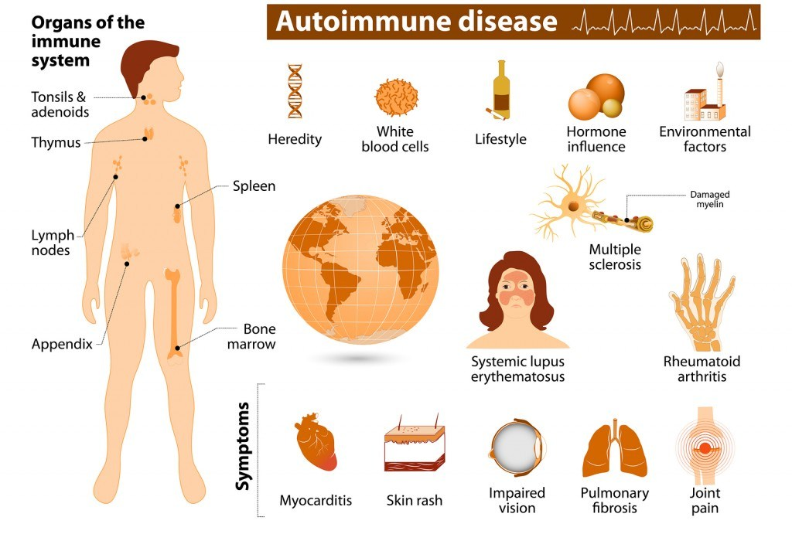

Slide 24
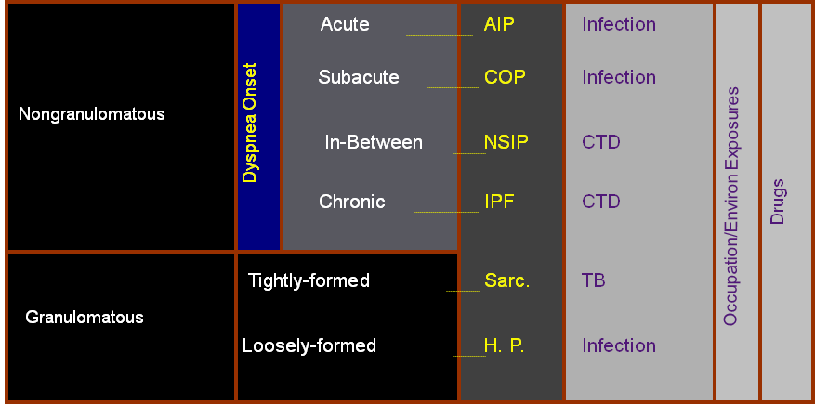
Courtesy Dr. Vincent Valentine

Slide 25
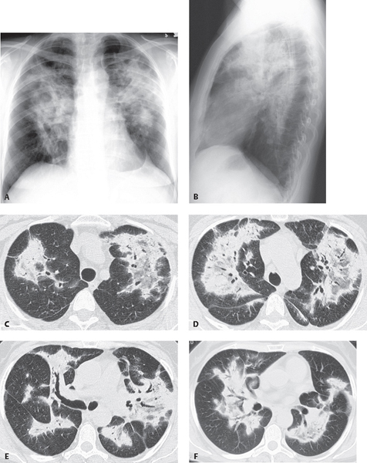
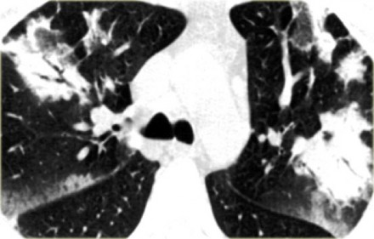
Notes:
COP

Slide 26
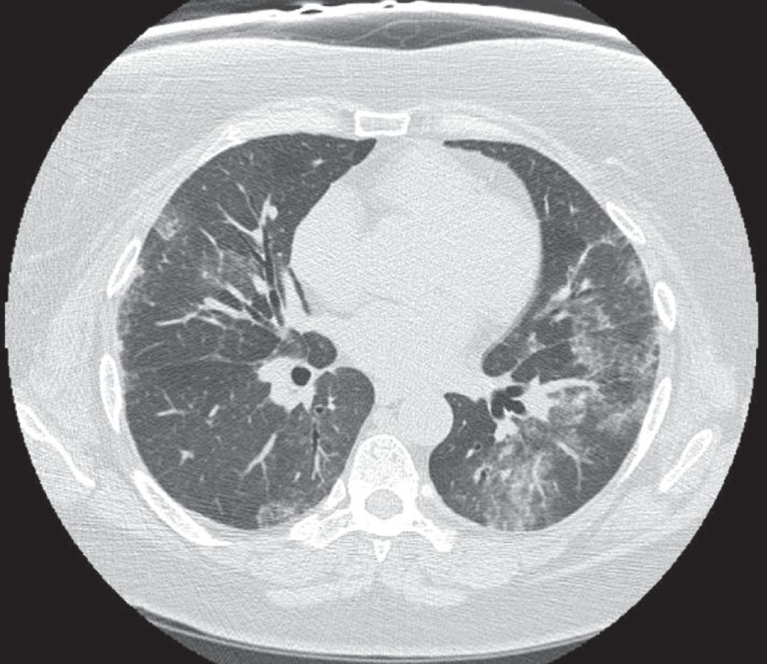
Notes:
NSIP

Slide 27
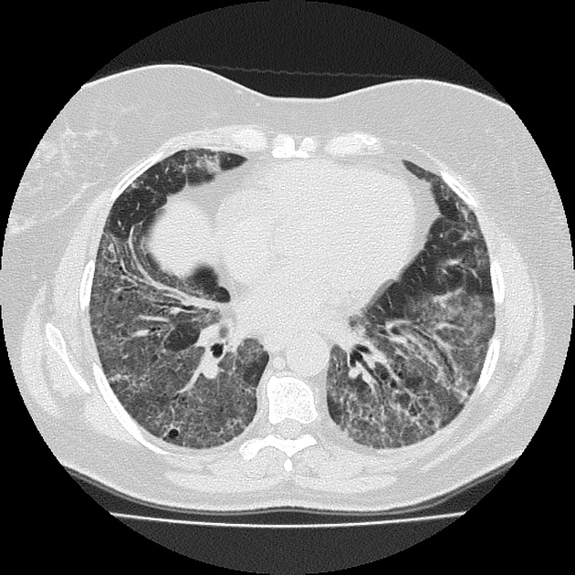
Notes:
NSIP

Slide 28
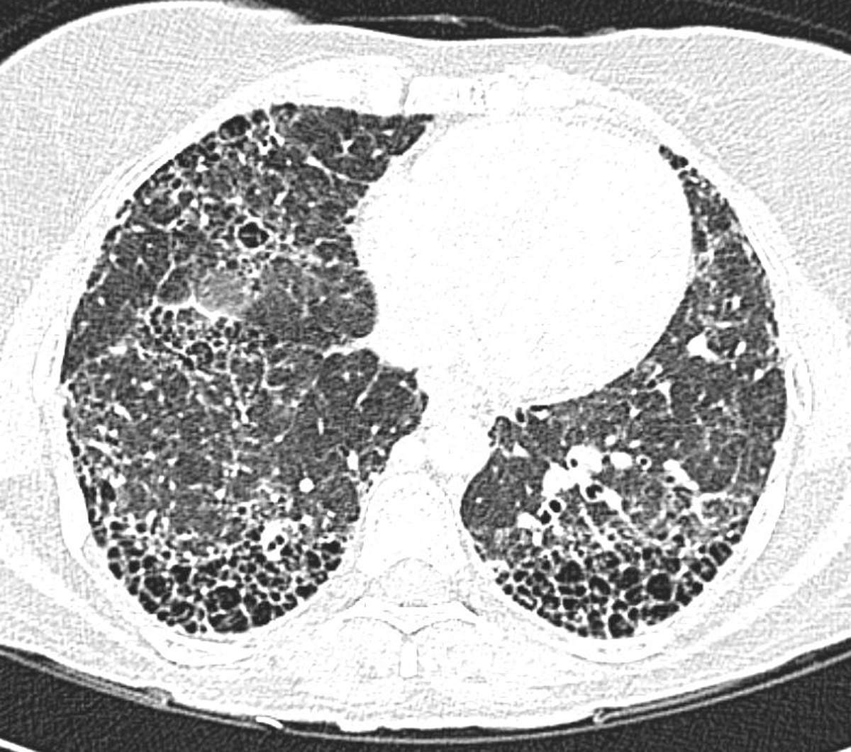
Notes:
IPF

Slide 29
Park JH, Kim DS, Park IN, Jang SJ, Kitaichi M, Nicholson AG, et al. Prognosis of fibrotic interstitial pneumonia: idiopathic versus collagen vascular disease-related subtypes. Am J Respir Crit Care Med. 2007;175(7):705-11.

Slide 30
Outline
1) Background of Interstitial Lung Disease
2) ILD Diagnostic Pearls
3) Continuum of ILD Care

Slide 31
Vignette #1
31 y/o W is referred for evaluation of dyspnea in October 2016.
Pt reports symptoms started in August with progressive dyspnea. Sx did not improve and as she worsened she was able to do less and less of her ADLs and IADLs.
No wheeze and rare cough. No hemoptysis. No f/c/ns, no weight changes. Denies CP, palpitations, orthopnea, PND.

Slide 32
No pets, lives in a duplex and other folks have 2 dogs. She reports some plumbing issues time to time in her building but tub has not overflowed and no mold in the house that she has seen on the floors or ceilings. Non linoleum surface in the bathroom, possibly stone floor. Been there since 2011 and carpet throughout; feels it is very old carpet.
From Nigeria, no pets there, was from a larger city and home did not have cooking over an open fire. No hobbies -- her time is between taking care of her daughter and hanging out w/ her parents in Oakland. Parents do not have pets.
Works for a med technology company, office work and no obvious mold there. Been there for a year. Assembles stethoscopes.
No VDGF exposures as far as she knows.
Came to the ER in February (6 mos ago) for a pneumonia (sx for 2d PTA) and did not have any exposures then. Got abx and felt better. Had no issues w/ breathing between February to August.
Occ pains in calves, sporadic. No skin rashes, tightening. Always a little dry mouth. No vision changes. No arthritis/arthralgias. No weakness.
One child, 9 y/o who is healthy.

Slide 33
Came to the ER, c/o severe dyspnea. Reports feeling a lot better when placed on O2.
Bronchoscopy completed as an inpatient and CTD labs sent as well.
Given 1g/d of Medrol x3 (1 dose inpt, 2 doses outpt), home O2 and sent out.

Slide 35
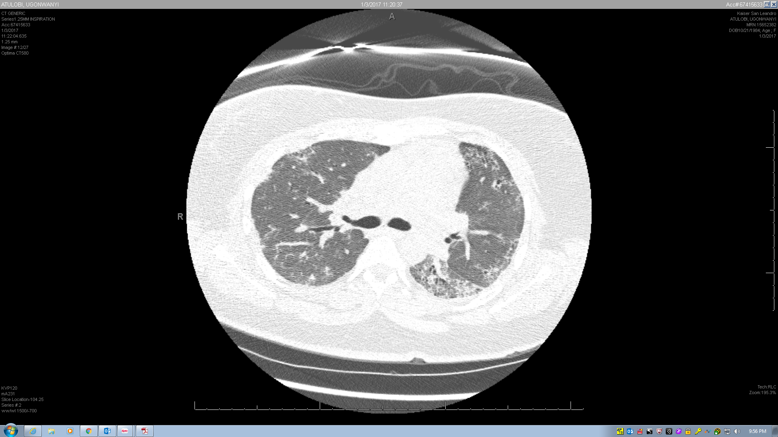

Slide 36
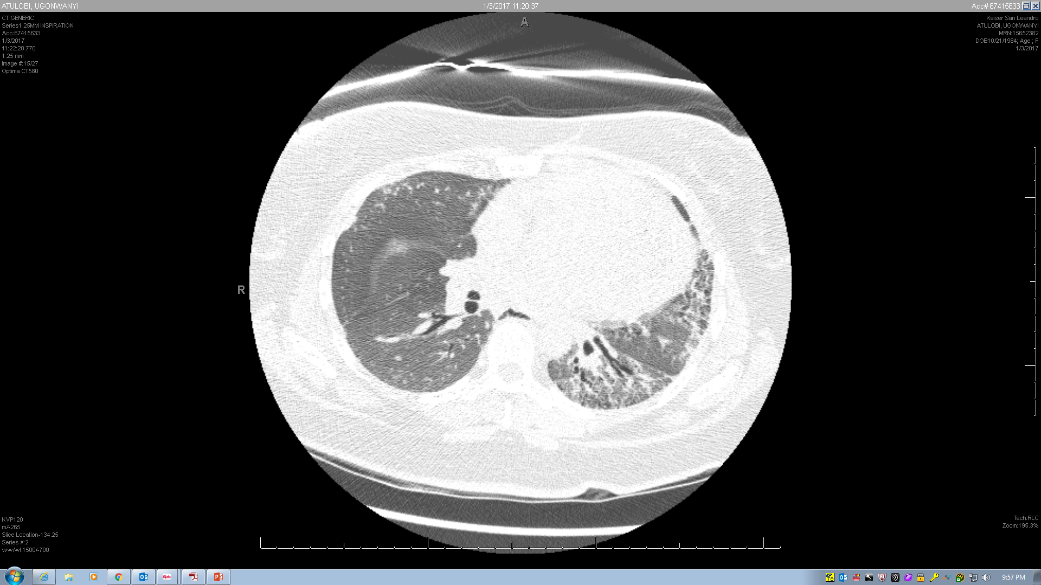

Slide 37
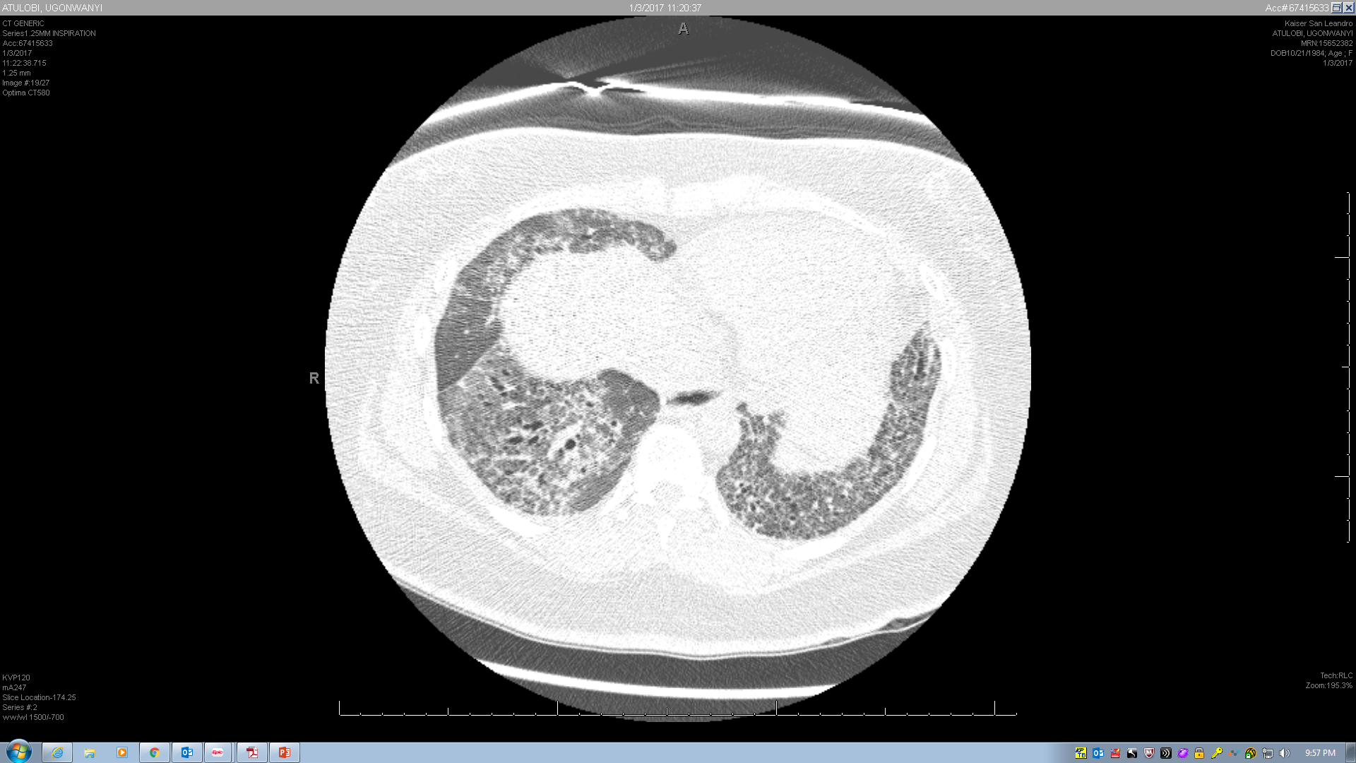

Slide 38
Differential Diagnosis:

Slide 39

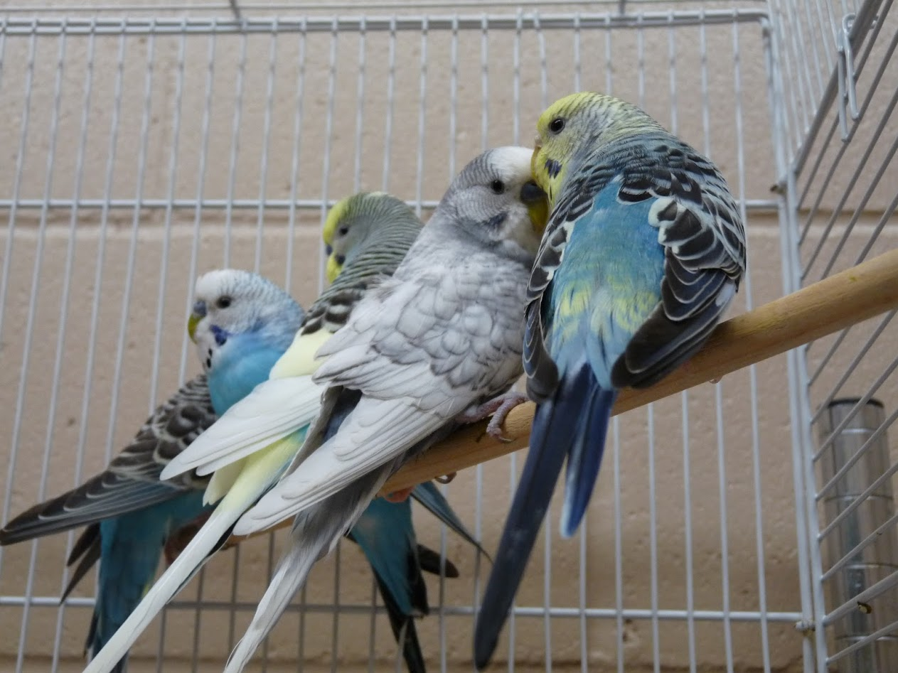
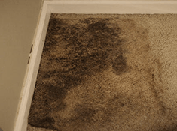

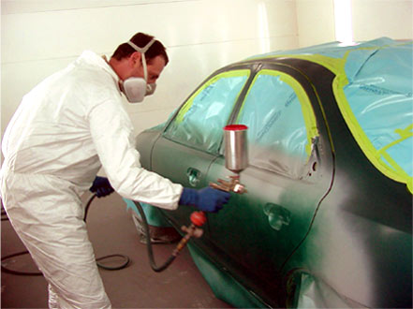

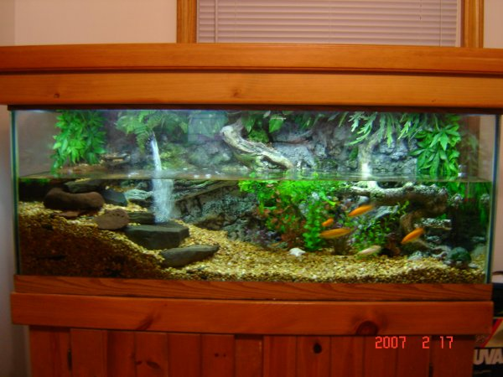
Notes:
Causes of hypersensitivity pneumonitis:
(1) Microbial agents
(2) Fungi, for example, Aspergillus, Penicillium,
Cladosporium, Trichosporon, Aureobasidium
(3) Bacteria, for example, thermophilic actinomyces,
Bacillus subtilis, Klebsiella, Epicoccum nigrum
(4) Mycobacteria, for example,Mycobacteriumavium,
M. immunogen
(5) Amoebae
(6) Animal proteins
(a) Common – avian
(b) Rare – fish meal, rat urine, silkworm larvae
(7) Chemical sensitizers
(8) Isocyanates, anhydrides, pyrethrum, sodium
diazobenzene sulfate, copper sulfate

Slide 40
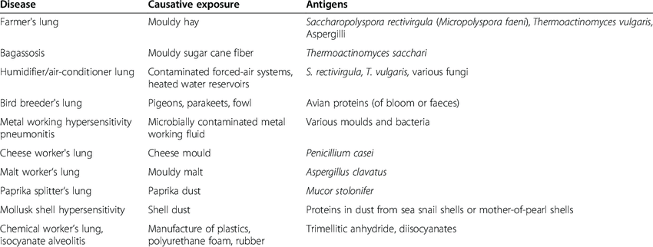
Extrinsic Allergic Alveolitis– AKA: Hypersensitivity Pneumonitis:

Slide 41
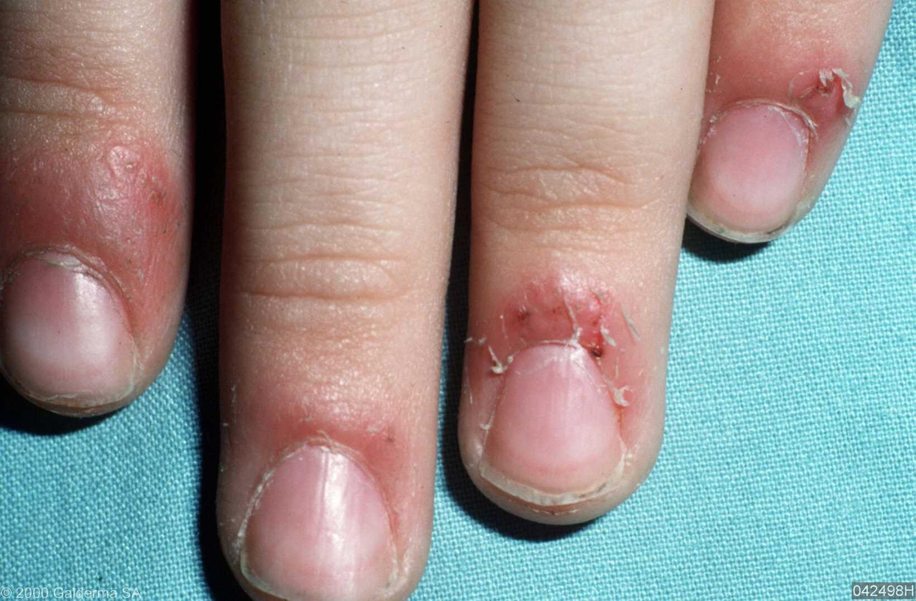
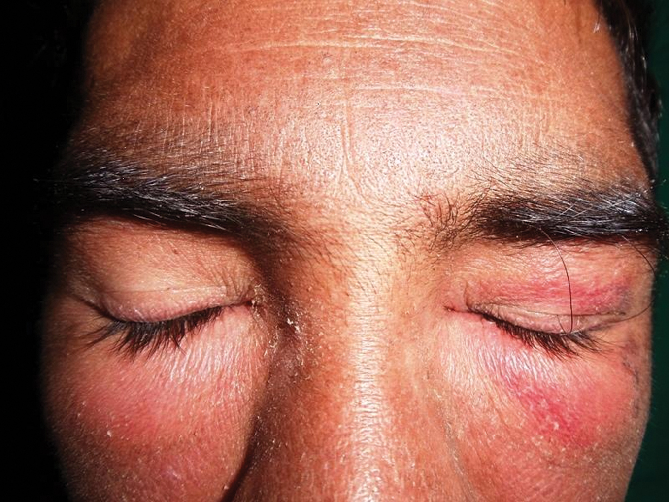
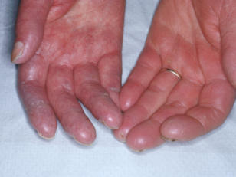
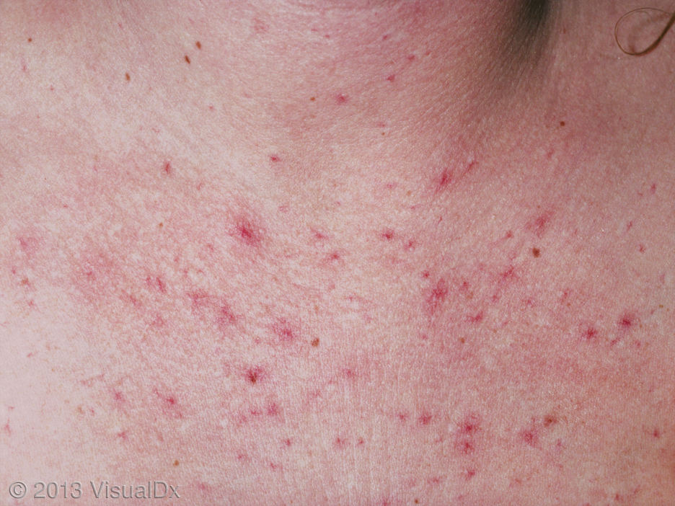
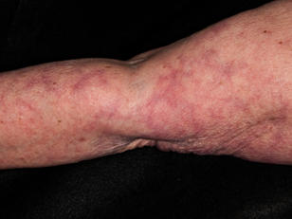
Notes:
Periungal erythema

Slide 42

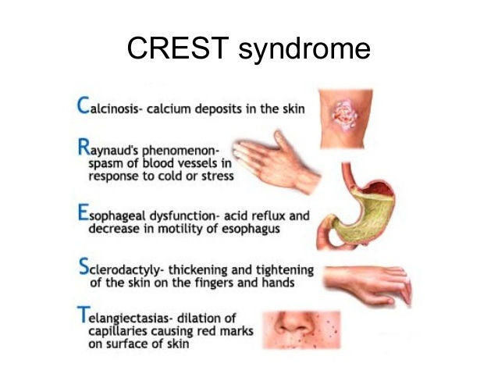
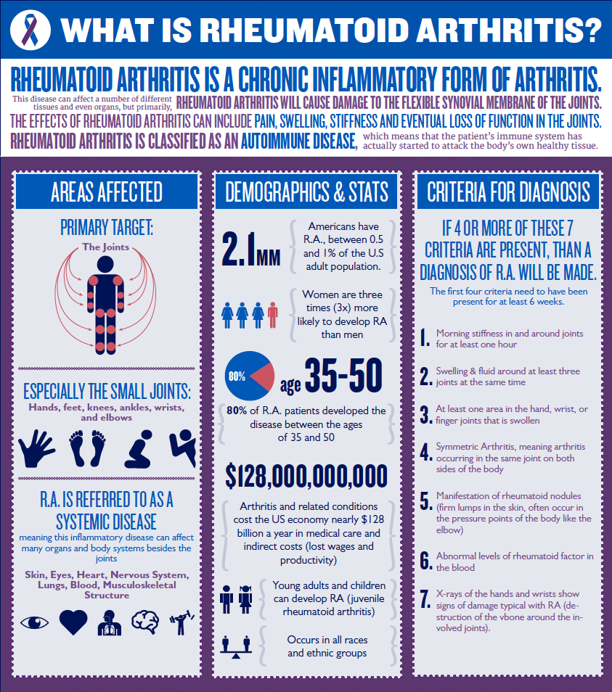
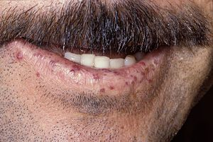
NSIP:

Slide 43
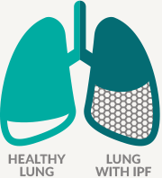

Slide 44
Outline
1) Background of Interstitial Lung Disease
2) ILD Diagnostic Pearls
3) Continuum of ILD Care

Slide 45
Role of an ILD Center
Diagnosis
  Multidisciplinary approach with a standardized assessment
  Management
  Choice of appropriate therapy
  Patient education and Psychosocial support
  Oxygen therapy as appropriate
  Pulmonary rehabilitation
  Management of co-morbidities (ie Allergies, GERD, Obesity, Sarcopenia/Frailty, CAD, Pulmonary Hypertension)
  Enrollment in a clinical trial
  Transplant evaluation

Slide 46
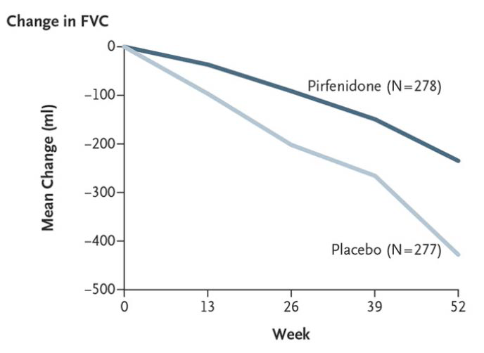
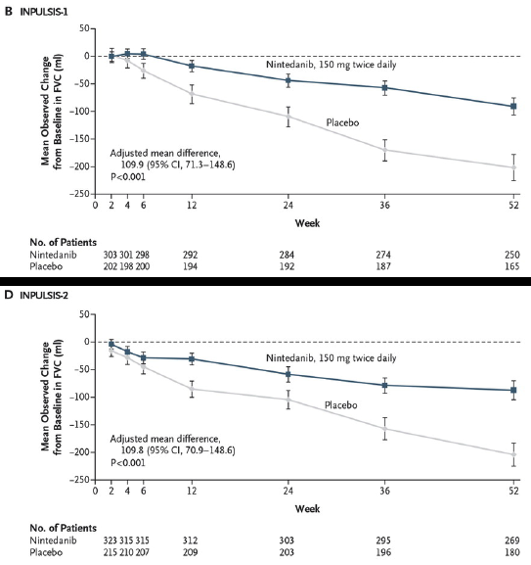
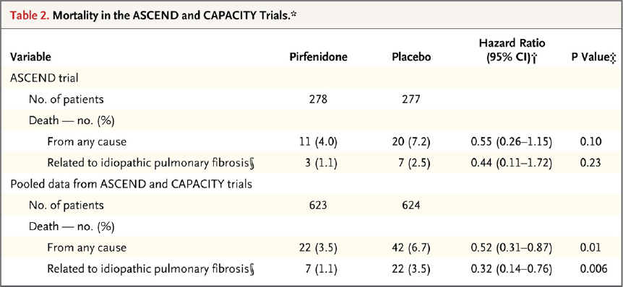
Agents for the Treatment of IPF
Pirfenidone
Nintedanib
King TE, Jr. et al. N Engl J Med. 2014;370:2083-2092.
Richeldi L et al. N Engl J Med. 2014;370:2071-2082.

Slide 47
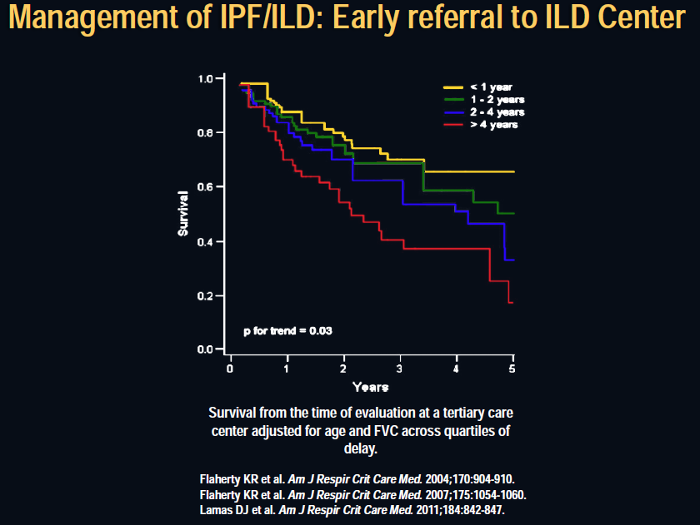

Slide 48
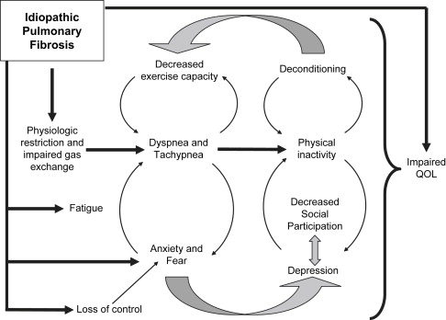

Slide 49
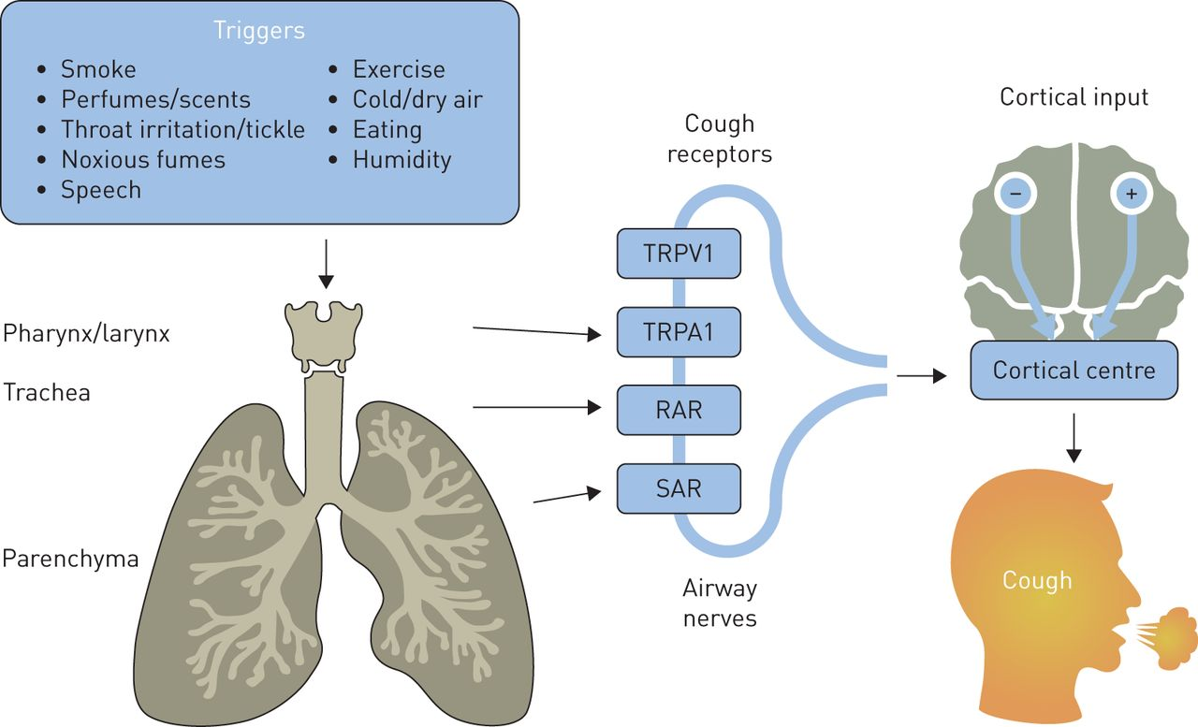
Notes:
Ambulatory cough recordings were manually counted and reported as number of coughs per hour.
Results
The 24hr cough rates were high (median 9.4, range 1.5-39.4), with day time rates much higher than night time (median 14.6, range 1.9-56.6 compared to 1.9, range 0-19.2, p = 0.003). Strong correlations were found between objective cough frequency and both the VAS (day r = 0.80, p < 0.001, night r = 0.71, p = 0.001) and LCQ (r = -0.80, p < 0.001), but not with measures of pulmonary function. Cough rates in IPF were higher than healthy subjects (p < 0.001) and asthma patients (p < 0.001) but similar to patients with chronic cough (p = 0.33).

Slide 50
Overall Summary:
Interstitial Lung Disease is not common, but frequently deadly.
PFTs and Imaging are needed early for those who do not fit in the box.
“Normal” X-ray does not rule out ILD.
Chronic cough may persist despite ILD treatment and often requires multispecialty care.
Notes:
Age<50, women, and/or NSIP on imaging
12-21% of cases with ILD prior to CTD

Slide 51
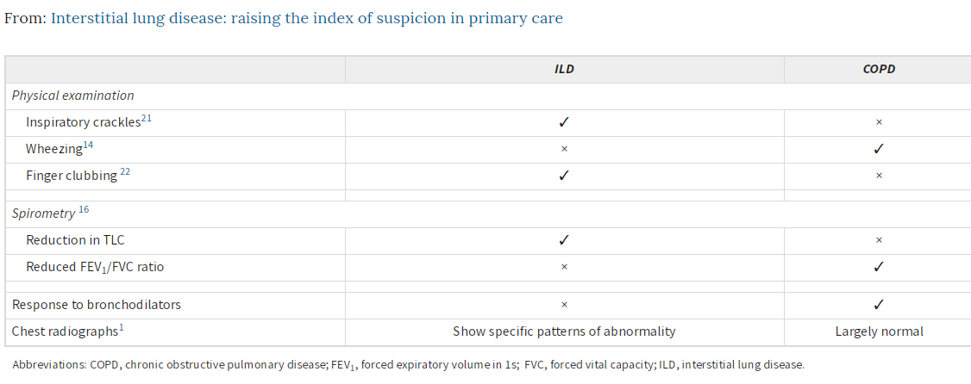

Slide 52
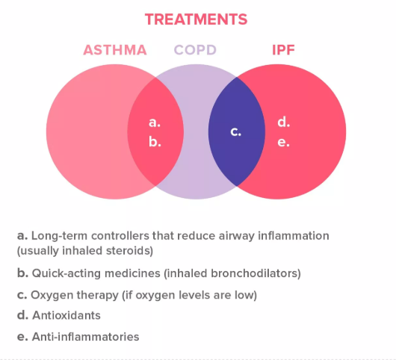

Slide 53

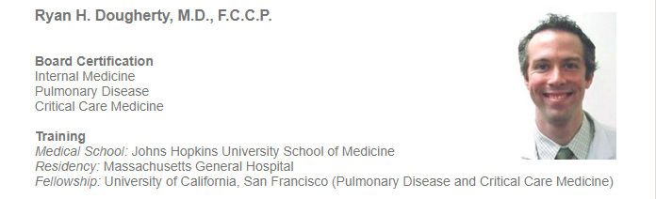

San Francisco Critical Care Medical Group
Office # 415-923-3421

Slide 54
References
Cosgrove, Gregory P., et al. "Barriers to timely diagnosis of interstitial lung disease in the real world: the INTENSITY survey." BMC pulmonary medicine 18.1 (2018): 9.Ferri C, et al, Interstitial pneumonia with autoimmune features and undifferentiated connective tissue disease, Autoimmun Rev (2015), http://dx.doi.org/10.1016/j.autrev.2015.09.003.
Fischer A, Donnelly SC. Pulmonary fibrosis in connective tissue disease (CTD): urgent challenges and opportunities. QJM: An International Journal of Medicine. 2017 Aug 1;110(8):475-6.
Zibrak, Joseph D., and David Price. "Interstitial lung disease: raising the index of suspicion in primary care." NPJ primary care respiratory medicine 24 (2014): 14054.Mohning M, Yunt Z, Keith RC, Olson A, Fernandez Perez E, Huie T, Demoruelle MK, Goldstein B, Swigris JJ, Solomon J. Duration Of Rheumatoid Arthritis And The Risk Of Developing Interstitial Lung Disease. InD104. ADVANCES IN INTERSTITIAL LUNG DISEASE 2017 May (pp. A7409-A7409). American Thoracic Society.
Kim EJ, Collard HR, King TE. Rheumatoid Arthritis-Associated Interstitial Lung Disease: The Relevance of Histopathologic and Radiographic Pattern. Chest. 2009;136(5):1397-1405. doi:10.1378/chest.09-0444.
Graney BA, Fischer A. Advocating for early interstitial lung disease detection in mixed connective tissue disease ILD detection in mixed connective tissue disease. Rheumatology. 2017 Jul 18.
Paija X, Bosch JA, Pallisa E, Martinez-Valle F, Ramentol M, Bujan S, Solans-Laqué R. AB0548 Interstitial Lung Disease (ILD) in Primary SjÖGren Syndrome: Clinical, Immunological and Radiological Features and Outcome. Annals of the Rheumatic Diseases. 2014 Jun 1;73(Suppl 2):987-.
Bhatti H, Girdhar A, Usman F, Cury J, Bajwa A. Approach to acute exacerbation of idiopathic pulmonary fibrosis. Annals of thoracic medicine. 2013 Apr;8(2):71.

Slide 56
Extra Slides:

Slide 57
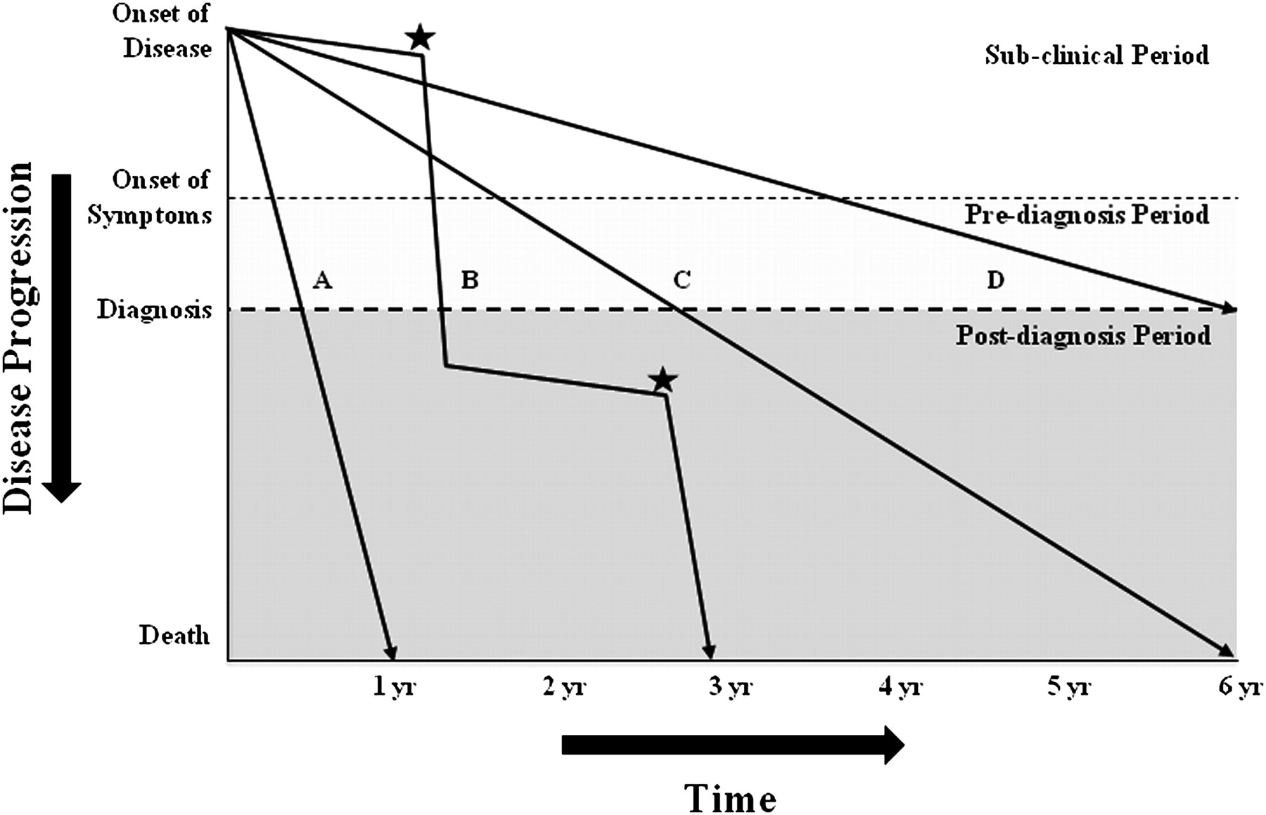
IPF Prognosis
Notes:
Median Ipf survival 2-3 years

Slide 58
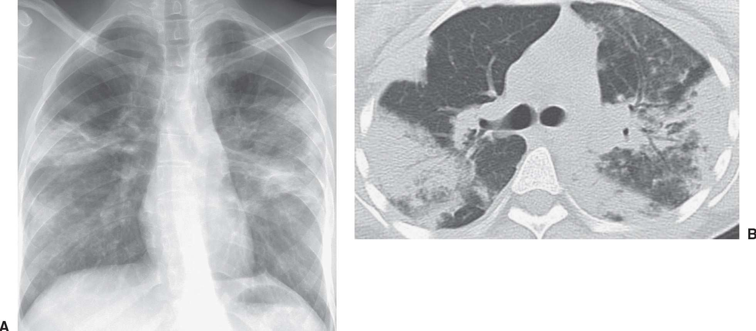
Acute Eosinophilic Pneumonia
Acute febrile illness
Diffuse pulmonary infiltrates
Increased BAL eosinophils
Peripheral eosinophilia can be seen but not required
Drug/toxins or infections can be a trigger

Slide 59


Slide 60


Slide 61


