Slide 1

Work-related Asthma:
The more you look the more you find
Work
-related Asthma
Jennifer Flattery, M.P.H.
Research Scientist
Jennifer.flattery@cdph.ca.gov
510-620-5765

Slide 2
Work-related Asthma Prevention Program (WRAPP)
Within the Occupational Health Branch,
California Department of Public Health
Robert Harrison, Principal Investigator
Justine Weinberg, Industrial Hygienist
Debbie Shrem, Health Educator
Carolina Espineli, Research Assistant
Eleana Martysh, Research Assistant

Slide 3
Disclosures
I have no relevant financial relationships with commercial interests to disclose

Slide 4
Learning objectives
At the conclusion of the presentation, participants will be able to:
Describe the extent and nature of work-related asthma in the California population.
Discuss key risk factors for work-related asthma and how to screen adult patients at risk.
Access and use resources for the diagnosis, management, and prevention of work-related asthma.

Slide 5

Pediatric asthma

Slide 6


Adult asthma

Slide 7
Current Asthma (2014)
Age group | Statewide | San Francisco County
Children (<18 yrs) | 851,000 | 9,000
Adults (>=18 yrs) | 2,303,000 | 33,000
California Health Interview Survey, 2014

Slide 8
Burden
Asthma is the leading cause of work absenteeism and loss of productivity
  >14 million work days lost each year
  approximately $2 billion of asthma indirect costs.
92% of asthma deaths in California are adults, > half of adult deaths are 18-64 years old (working age)
Barnett S (2007).
CDC NCEH (2014)

Slide 9

Adult Access to Care
Adults less likely than kids to receive care when cost is an issue
>1 in 4 Black adults can’t afford their asthma medicines or routine doctor visits

Slide 10
Case Management for Adults
Children more likely than adults to learn how to manage asthma.
<1 in 2 children get an asthma action plan.
<1 in 3 adults get an asthma action plan.
BRFSS Asthma Call-back Survey 2006-2010;

Slide 11
Disparities –
Adult Current Asthma Prevalence
Lower income adults
have higher asthma prevalence.
Adults with less education
have higher asthma prevalence.
NHIS 2013

Slide 12
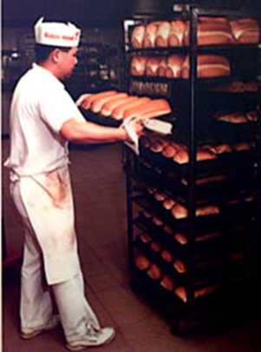


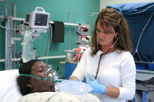
Adults are also Workers
Same adults at high risk for asthma are also often in high risk jobs
  At least half of waking hours at work
  Workplace exposures as important as household exposures, often more preventable
  Not just ‘dirty industry’ jobs that are high risk for WRA
Seen in primary care, family practice, ER

Slide 13
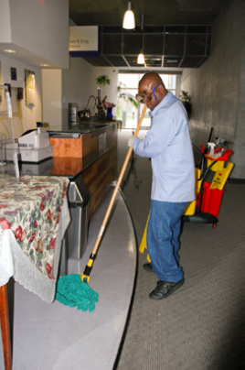
Case Report – high school custodian
41 year old custodian, worked at a public high school for 4 years, no asthma hx
Cleaned small bathroom, graffiti removal
No safety training
Developed difficulty breathing and coughing, > 12 ER visits, dx’d with bronchitis
Symptoms improved when out
Transferred to elementary school

Slide 14

Clinicians don’t ask about work
Milton (1998), Sama (2003), Walters (2012) – Only 2-19% of charts documented occupation or work exposures, even for WRA cases

Slide 15
No discussion about work
Mazurek (2014) – Of employed adults with asthma, 46% had asthma that was reportedly work-related, but only 15% discussed work factors with their health care provider
BRFSS ACBS 2006 to 2010

Slide 16
Lost opportunity
Not commonly part of clinician-patient dialogue, yet may represent an important opportunity for prevention in adult asthma
The longer the time from symptoms to diagnosis, the poorer the outcome (Holness 2013)

Slide 17

Case Report - carpenter
37 year old carpenter, built houses and buildings. No asthma hx
Original doctor visit for nail gun injury. Doctor heard wheezing, asked about work. Only used painter’s dust mask, bought on his own
Wood dust in air at work, couldn’t breathe
Dx’d with asthma, reported 5/20 co-workers had similar breathing problems. Changes at work

Slide 18
Definition of Work-related Asthma (WRA)
Health care professional’s diagnosis of asthma AND temporal relationship between symptoms and work exposures
New onset and work-aggravated
Many examples of mild intermittent asthma that is now severe and constant due to work exposures

Slide 19
Case report – teacher
54 year old special ed teacher, long hx of mild asthma
Returned from spring break, carpets cleaned, lingering strong chemical odor, immediate breathing problems
Left work, out x 1 week
2 years later, still many meds and reacts to many triggers daily
Now carpets cleaned with water

Slide 20
Population data on WRA
Population-based survey data show an estimated 1,210,487 adults >=18 yrs have asthma that has been caused or made worse by work
This represents nearly half of all adults with current asthma
WRA is not rare
2012 BRFSS ACBS

Slide 21
Surveillance
Data from 4 sources, use interviews and med recs to characterize risk factors, identify prevent strategies
Doesn’t capture everybody
Much more detail than population surveys
Risk factors – who’s getting it and how
Rates can be calculated
Case reports

Slide 22
WRAPP Surveillance Data, confirmed cases 1993-2011

Slide 23
WRAPP Surveillance Data, confirmed cases 1993-2011

Slide 24
WRAPP Surveillance Data, confirmed cases 1993-2011

Slide 25
Exposure
Self-reported
Association of Occupational and Environmental Clinics (AOEC) list of exposures
Standardized coding for all kinds of exposures
Protocol with strict criteria for determining if a substance is an ‘asthmagen’ –capable of causing new asthma (Rosenman 2015)
327 substances designated as asthmagens

Slide 26
15 Most Common Exposures Reported by Cases
Dust
Unspecified Chemicals
Smoke
Mold
Indoor Air Pollutants
Cleaning Agents
Paint
Indoor Air Pollutants from Building Renovation
Perfume
Pesticides
Glues
Bleach
Diesel Exhaust
Asphalt
Cigarette Smoke
Dust
Unspecified Chemicals
Cleaning Agents
Indoor Air Pollutants
Indoor Air Pollutants from Building Renovation
Smoke
Perfume
Paint
Exhaust
Mold
Solvents
Cigarette Smoke
Asphalt
Wood dust
Bleach
CA
SF
WRAPP Surveillance Data, confirmed cases 1993-2011

Slide 27
15 Most Common Asthmagens Reported by Cases
Bleach
Chlorine
Ammonia
Latex
Isocyanates
Formaldehyde
Sulfuric Acid
Glutaraldehyde
Rat Antigens
Quaternary Ammonium Compounds
Epoxies
Hydrochloric Acid
California Redwood
Flour
X-ray Fixative
Bleach
Isocyanates
Chlorine
Ammonia
Formaldehyde
Quaternary Ammonium Compounds
Latex
Maleic Anhydride
Animal Antigens (rat, cat, mice, mite)
Acetic Acid
California Redwood
Sulfuric Acid
Western Red Cedar
Methyl Methacrylate
Stainless Steel Welding
CA
SF
WRAPP Surveillance Data, confirmed cases 1993-2011

Slide 28
Exposures among Occupations with the Highest Rates - CA
Occupation | Most Common Exposures
Firefighters | Smoke
Science Technicians | Acids, chemicals, indoor air, rat antigens, glues, dust
Medical Assistants & Support | Glutaraldehyde, chemicals, smoke, latex, dust, perfume, paint
Correctional Officers & Bailiffs | Smoke, chemicals, pepper spray, mace, cleaning chemicals
Respiratory Therapists | Cleaning chemicals, latex, pharmaceuticals
Medical Records Technicians | Dust, smoke, perfume
Police Officers | Smoke, pepper spray, dust, indoor air, mold, animal antigens
Telephone Operators | Chemicals, perfume, paint, carpet dust
Chemical Technicians | Solvents, acids, chemicals
Govt Program Eligibility Workers | Roofing tar, chemicals, indoor air, toner, perfume, dust
WRAPP Surveillance Data, confirmed cases 1993-2011

Slide 29
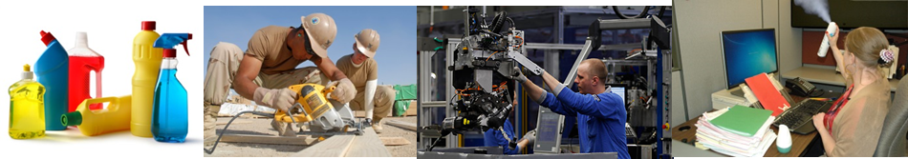
Widespread
Large numbers, big variety of exposures and contexts
Work should be asked about as routinely as environmental exposures, especially since exposure often is more preventable

Slide 30
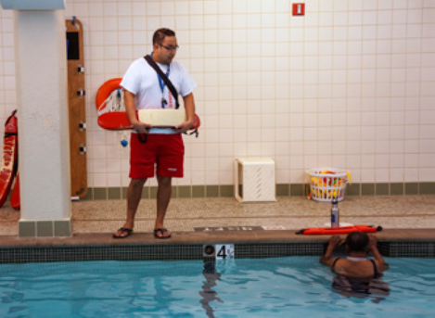
Case Report – teen lifeguard
17 year old lifeguard with preexisting asthma, indoor pool
Sometimes added pool chemicals, mostly lifeguarded
One day pool’s retractable roof was closed, led to attack
From then on sx much worse. Now uses daily medications (previously intermittently)

Slide 31
Teen data
Relevant to pediatric practice
360 cases < =21, many different jobs and exposures
Cashiers, construction laborers, dishwashers, firefighters, retail, food prep, landscaping, stock and material movers, janitors, lifeguards, entertainment attendants, security guards, stock clerks
Sama (2006) – 12% of new onset WRA cases were ages 15-17 in HMO population

Slide 32
Limitations of Surveillance
Known undercount--workers don’t get into the system
  Workers don’t make the connection to work
  Patients don’t tell, afraid of retribution, losing job
  HCPs may not think about work
  Pahar (2011) - barriers to recognition and reporting: low awareness, lack of knowledge, time

Slide 33
Screening questions
Underdiagnosis well established – Tarlo 1998, Nicholson 2005, American Thoracic Society 2008
Berger (2006) – Urban minority population, examining work-aggravated asthma (WAA)
  Asthma sx often start or worsen within 1st hour at work or soon after starting certain work activities?
  Certain activities or materials @ work that usually make your asthma sx start or worsen?
51% reported WAA from current job, 71% any job
Many different jobs, including janitorial, manufacturing, construction

Slide 34

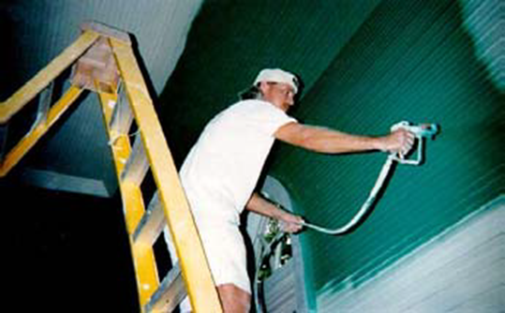
Screening Questions (cont)
Vandenplas (2005) – assessed symptoms at work—wheezing, nasal itching, ocular itching while at work. All predictive of occ asthma
Malo (1991) – Improvement of symptoms on weekends and vacations (77-88% sensitivity, 24-44% specificity)

Slide 35
Screening Questions (cont)
Pralong (2013) – Symptom questionnaire correctly identified 88% of cases
  When at work do you start to cough, wheeze, feel shortness of breath or chest tightness?
  If so, do these lessen or disappear during weekends or holidays?
Killorn (2014), Walters (2012) – Both use
  Do your symptoms worsen at work?
  Are they better on days off or vacation?

Slide 36
NAEPP Guidelines
Expert Panel Report 3: Guidelines for the Diagnosis and Management of Asthma
F I G U R E 3 – 2 1 . EVALUATION AND MANAGEMENT OF WORKAGGRAVATED
ASTHMA AND OCCUPATIONAL ASTHMA
Evaluation
Potential for workplace-related symptoms:
􀀎 Recognized sensitizers (e.g., isocyanates, plant or animal products).
􀀎 Irritants* or physical stimuli (e.g., cold/heat, dust, humidity).
􀀎 Coworkers may have similar symptoms.
Patterns of symptoms (in relation to work exposures):
􀀎 Improvement occurs during vacations or days off (may take a week or more).
􀀎 Symptoms may be immediate (<1 hour), delayed (most commonly, 2–8 hours after exposure), or nocturnal.
􀀎 Initial symptoms may occur after high-level exposure (e.g., spill).
Documentation of work-relatedness of airflow limitation:
􀀎 Serial charting for 2–3 weeks (2 weeks at work and up to 1 week off work, as needed to identify or exclude
work-related changes in PEF):
— Record when symptoms and exposures occur.
— Record when a bronchodilator is used.
— Measure and record peak flow (or FEV1) every 2 hours while awake.
􀀎 Immunologic tests.
􀀎 Referral for further confirmatory evaluation (e.g., bronchial challenges).
Management
Work-aggravated asthma:
􀀎 Work with onsite health care providers or managers/supervisors.
􀀎 Discuss avoidance, ventilation, respiratory protection, tobacco smoke-free environment.
Occupationally induced asthma:
􀀎 Recommend complete cessation of exposure to initiating agent.
*Material Safety Data Sheets may be helpful for identifying respiratory irritants, but many sensitizers are not listed.
Key: FEV1, forced expiratory volume in 1 second; PEF, peak expiratory flow

Slide 37
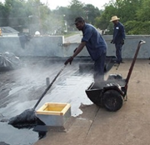
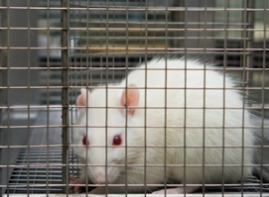
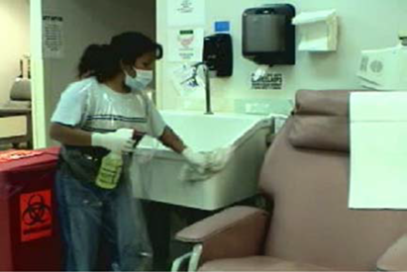
NAEPP Assessment Questions
Pt. cough or wheeze during week but not on weekends when away from work?
Pt’s eyes and nasal passages get irritated soon after arriving at work?
  Co-workers with similar symptoms?
  What substances are used in workplace?

Slide 38
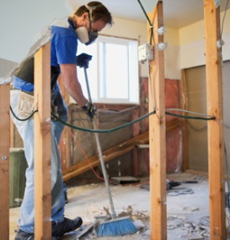
Case report – construction worker
28 year old male laborer, no asthma hx
4 months, cleaned industrial construction sites, sweeping with no mask
Sought care for recurring nosebleeds, leading to asthma dx.
Gradual onset, had to take time off work, to ER 5 times
Knows of one co-worker with breathing problems but not about others because 'we don't talk about those things.'

Slide 39
What can be done-- prevention
Clinically, follow guidelines for management of adults with asthma
Can refer to occupational medicine specialist
Proceed cautiously with confidentiality—prevent job loss
Control exposure—employer’s responsibility, sometimes simple, sometimes complicated

Slide 40
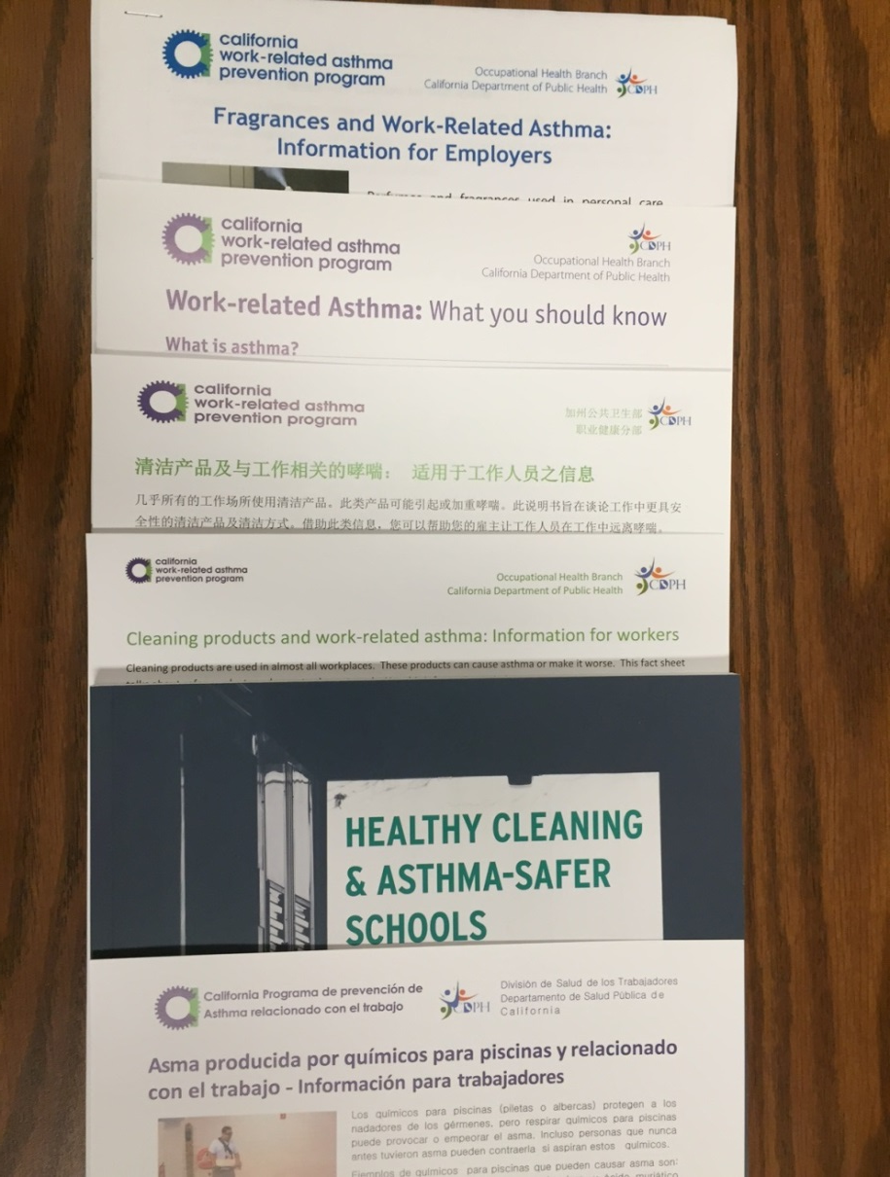
Resources
WRAPP is a resource: https://www.cdph.ca.gov/programs/ohsep/Pages/Asthma.aspx
Association of Occupational and Environmental Clinics http://www.aoec.org

Slide 41
Conclusions
Work-related asthma is a significant public health problem in California, affecting >1 million adults
Yet, largely under-recognized and diagnosed
As part of routine evaluation, clinicians should always ask adults what they do for a living
Always ask if their asthma sx are worse at work and better during time off
Opportunities for prevention are frequent and achievable
Relevant to all who evaluate or advocate for anyone who works and has asthma

