Slide 1
Understanding Racism to Better Care for Patients of Color
Zea Malawa, MD, MPH
Notes:
Discus how Gerbner did his stud

Slide 2
Meet “Ben”
Ben is a 6 yr old African American boy
Ben lives in the Bayview area of SF with his parents and grandmother
Ben’s family is very worried because Ben has asthma which has been hard to control
Every 3 months, Ben’s mother misses work to take him to the pulmonologist. On the bus, it takes 1.5 hours in either direction to get there.

Slide 3
I was calling to let you know that I have admitted your patient Ben for an asthma exacerbation…
His parents did not pick up his controller med refill last week and he’s missed a lot of school recently because of wheezing.
His father was arrested last month for drugs!
I called CPS. These parents need to learn to get serious about their son’s health.

Slide 4
What if the pulmonologist knew…
I cannot afford to pick up his refill until I get paid next week.
Median incomes for Blacks in San Francisco is $27,000 compared with $89,000 for Whites, a disparity twice as large as the national average.
(New York Times, 2016)
Notes:
Highest unemployment disparity

Slide 5
The Bayview district has more Black residents than any other SF neighborhood.
(City-data.com)
Because of it’s proximity to freeways and industrial sites, it has the highest concentration of air and surface pollutants in SF.
(Environmental Defense Scorecard, 2005)
I usually give him his medicine everyday but he still can’t stop wheezing.

Slide 6
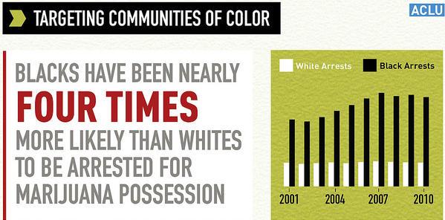
His father just had a little weed in his pocket. The police are always harassing us.

Slide 7
I cannot believe that doctor called CPS on us. I don’t want to bring my son to her any more.
Black children are 3 times more likely to enter foster care compared to white families with the same characteristics.
Families of color receive fewer services than White families do and experience lower rates of reunification.
(Annie E Casey Foundation. Report: Race Matters: Unequal Opportunity within the Child Welfare System, 2006)
Notes:
But how could the pulmonologist know? We talk around racism, but don’t talk much about racism in our work
An the end result is that many people of color have poor health outcomes.

Slide 8
From the New England Journal of Medicine
“…even as research on health disparities has helped to document persistent gaps in morbidity and mortality between racial and ethnic groups, there is often a reluctance to address the role of racism in driving these gaps.
A search for articles published in the Journal over the past decade, for example, reveals that although more than 300 focused on health disparities, only 14 contained the word “racism” (and half of those were book reviews)…”

Slide 9
Let’s Talk About Racism!!!

Slide 10
The Gardeners Tale
Jones, C. P. (2000). Levels of racism: a theoretic framework and a gardeners tale. American Journal of Public Health, 90(8)

Slide 11
The Gardeners Tale
Jones, C. P. (2000). Levels of racism: a theoretic framework and a gardeners tale. American Journal of Public Health, 90(8)

Slide 12
Progressive City, Racist Outcomes

Slide 13
Progressive City, Racist Outcomes
Brookings Institute. (2017, February 27). Employment by race and place: snapshots of America (Rep.).
Notes:
SF has the 4th highest employment rates of whites and second lowest employment rate of blacks (second to detroit)

Slide 14
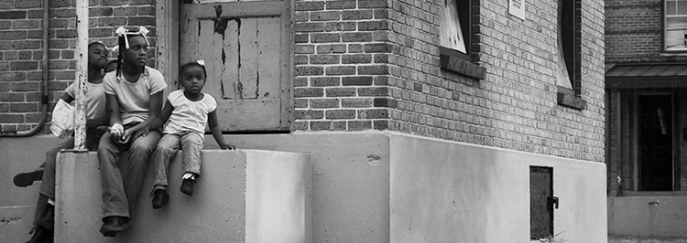
Progressive City, Racist Outcomes
San Francisco Kids Growing Up in Poverty
48% of Black children live in households earning less than 100% of the Federal Poverty Level. Only 2% of White children do
Source: SFHIP, CHNA 2016

Slide 15
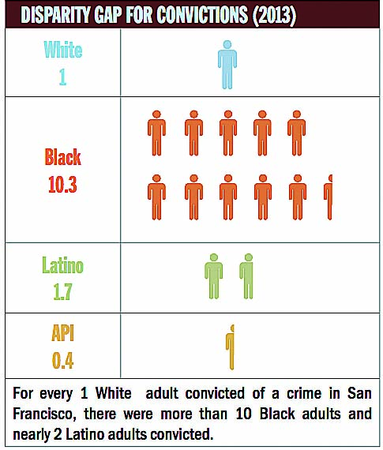
Progressive City, Racist Outcomes
Racially Biased Policing
although black people accounted for less than 15% of all SFPD traffic stops in 2015, they accounted for over 42% of all no-consent searches following stops
Black people who were searched were typically found to not have anything illegal
Source : New York Times,2016
Source: SF Examiner,2014
Notes:
Blacks make up btwn 4-6 % of SF residents but 50% of SF jail pop’l

Slide 16
But San Francisco Hates Racism!!!!

Slide 17
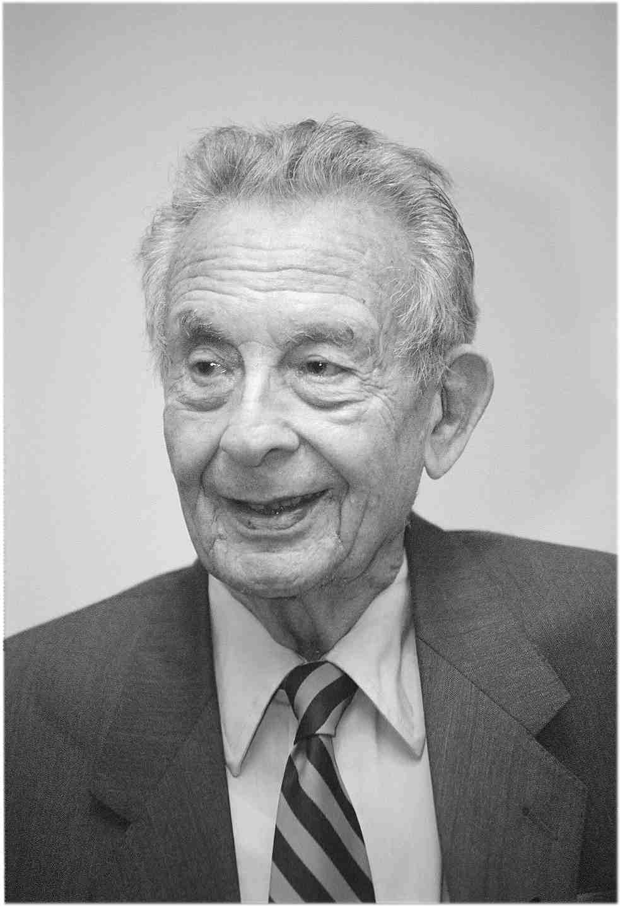
Cultivation Theory
George Gerbner
Notes:
3rd most used theory in Mass Communication research since 1956—20, 000 articles reviewed

Slide 18
Cultivation theory Heavy TV viewers believe that what they see on a TV is an accurate reflection of reality
Notes:
Theory later expanded to include media consumed online

Slide 19
Cultivation theory
TV watching and other types of media consumption cultivate the norms of a society
Notes:
Television and internet has a wide reach because it is easily accessible and easily consumed
Mainstream: broadest range of shared meanings and assumptions

Slide 20
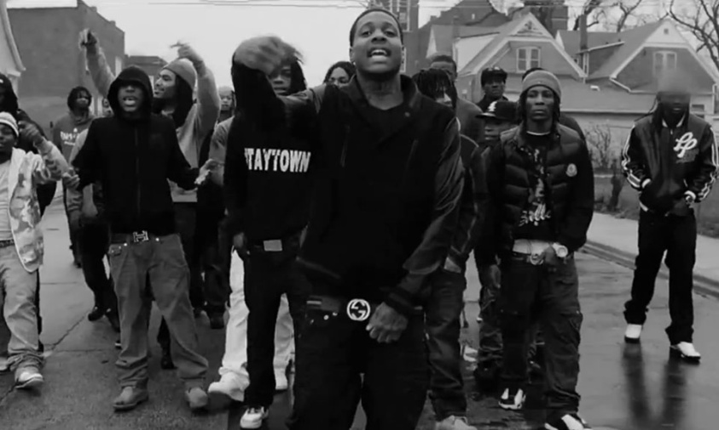
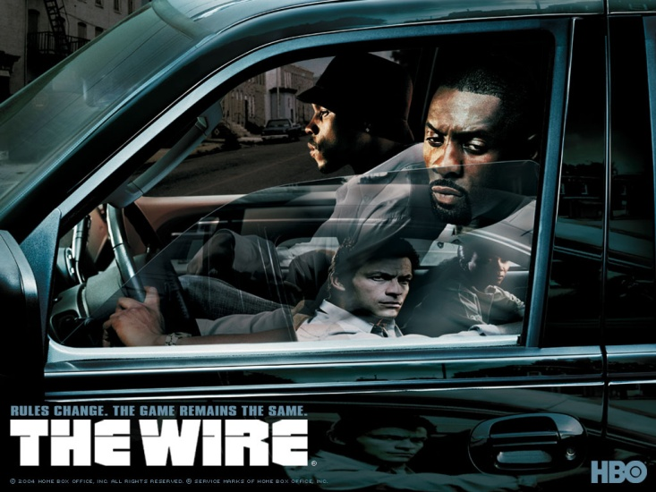
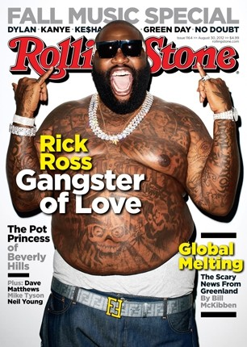
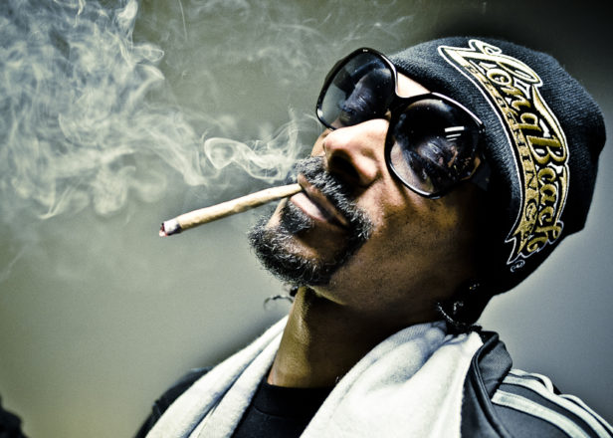
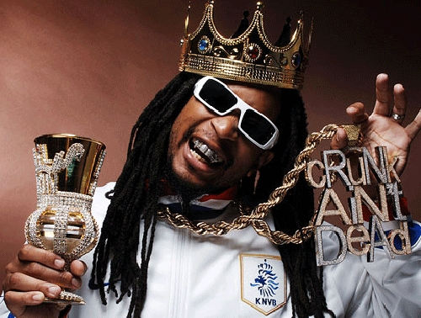
MeDia And Race

Slide 21
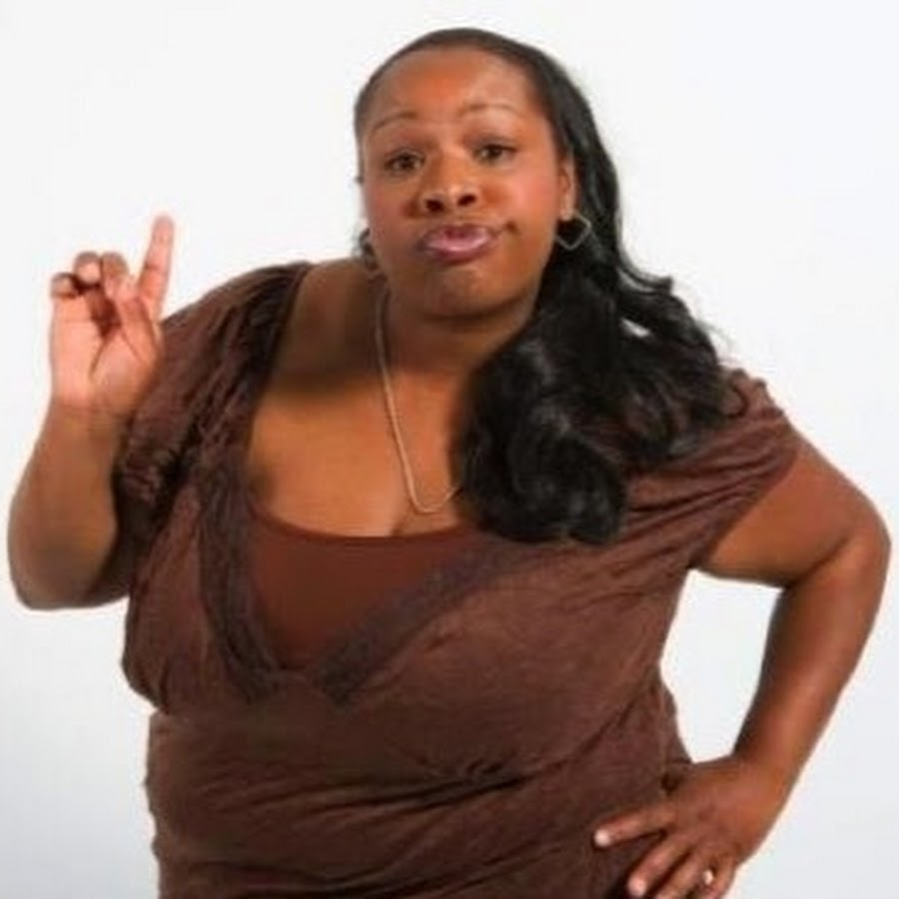
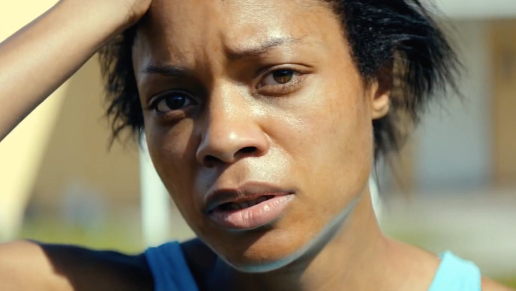
MeDia And Race

Slide 22
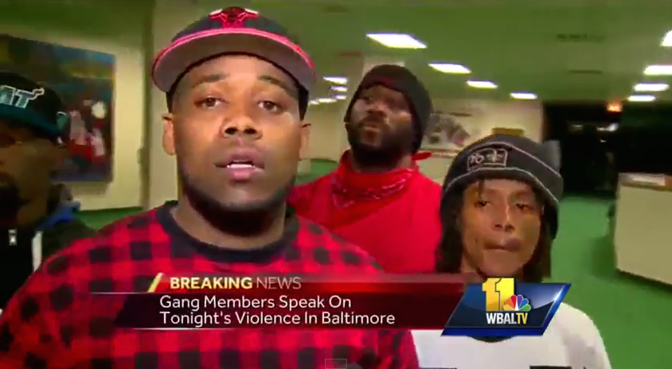
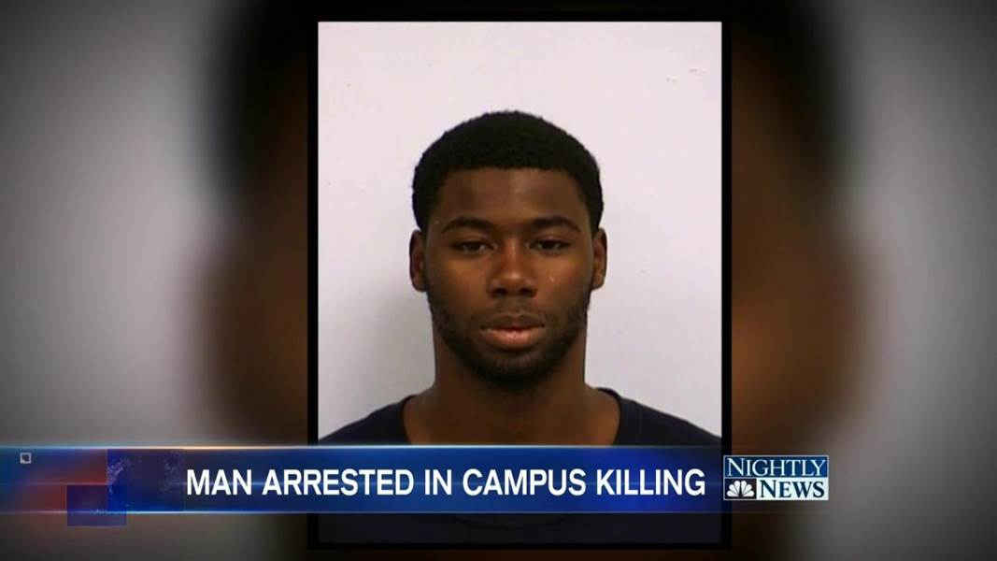
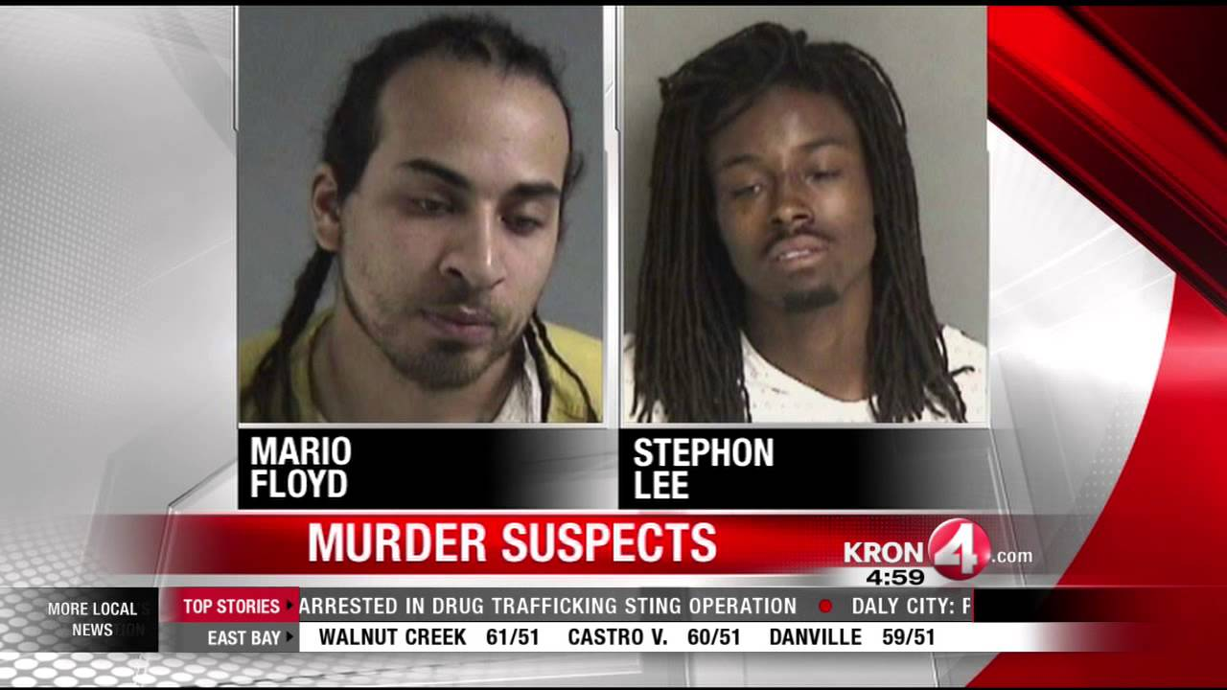
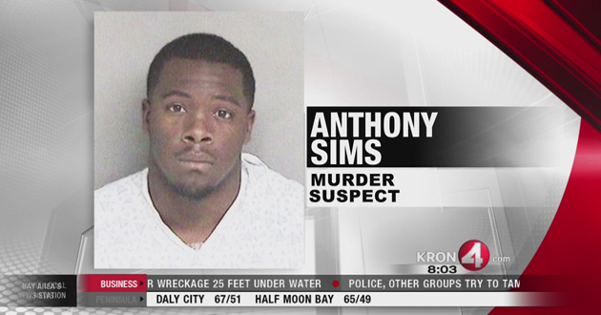
MeDia And Race

Slide 23
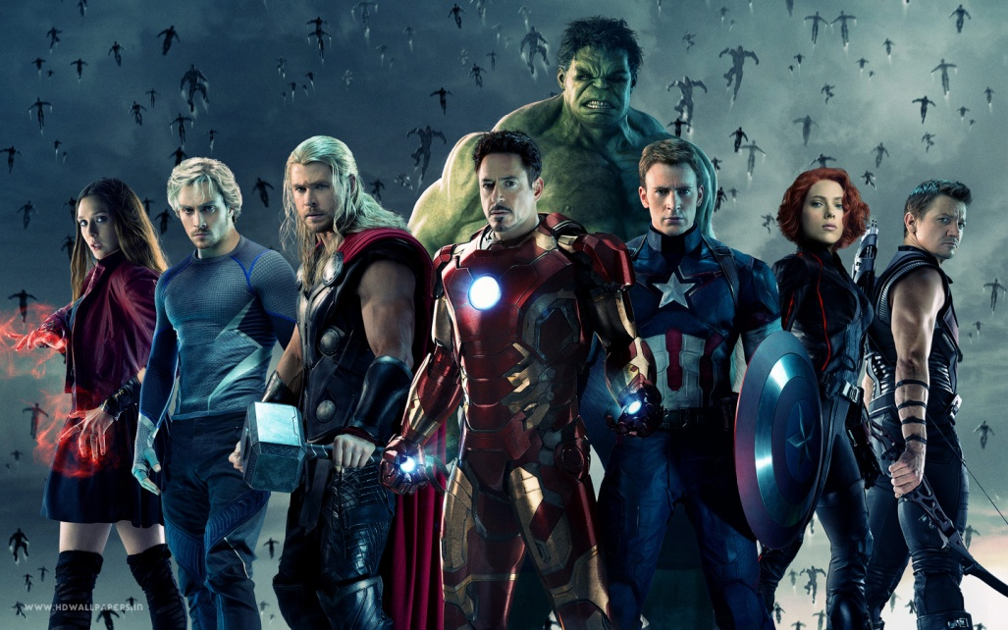
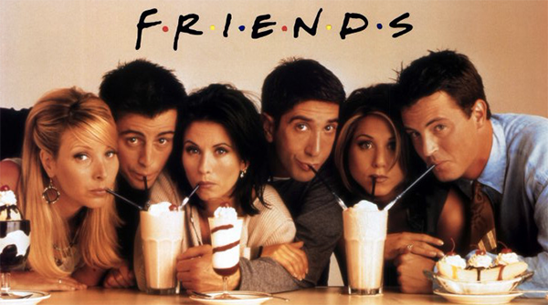
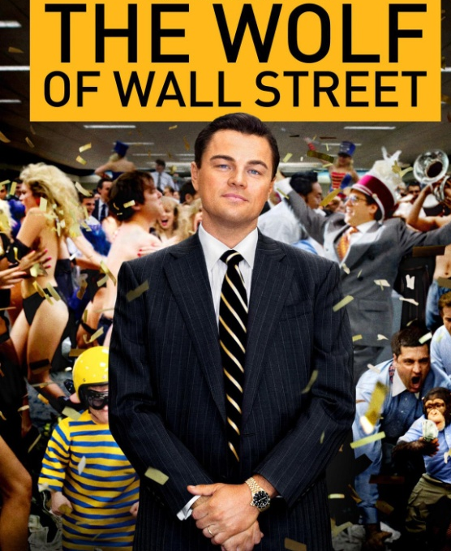
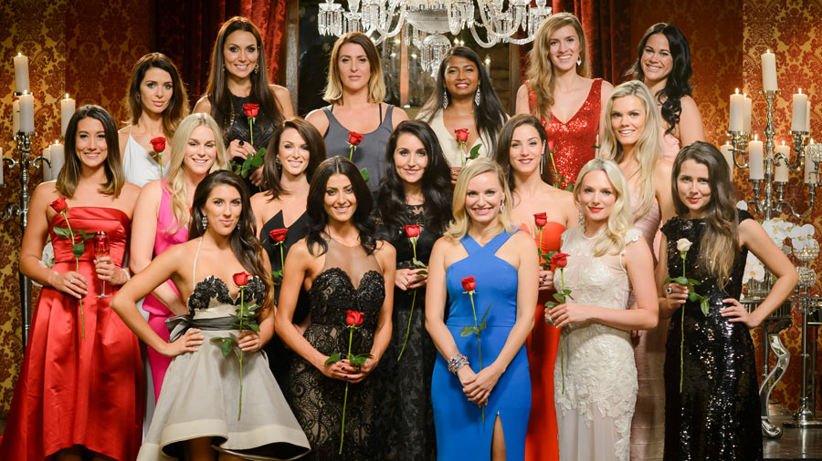
MeDia And Race

Slide 24
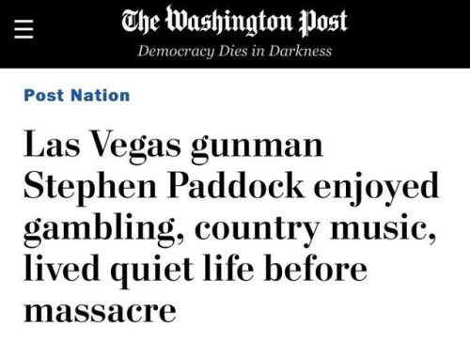
MeDia And Race

Slide 25
Racial Socialization
Copyright @ W.W. Norton, Inc.
Notes:
No one escapes this socialization

Slide 26
Racial Socialization
These Media impressions become the lens through which we see the world

Slide 27
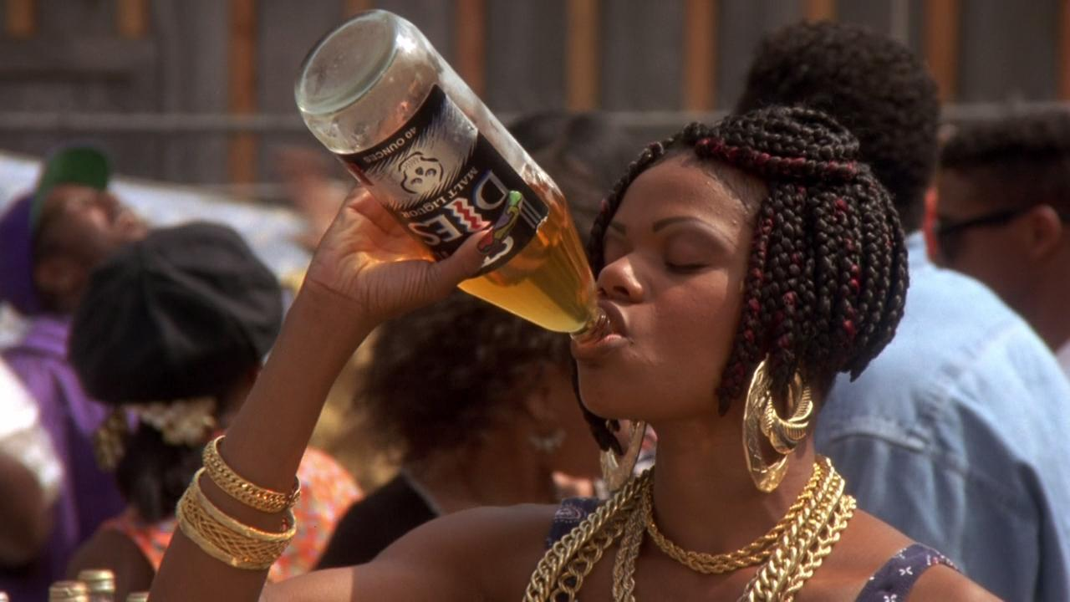
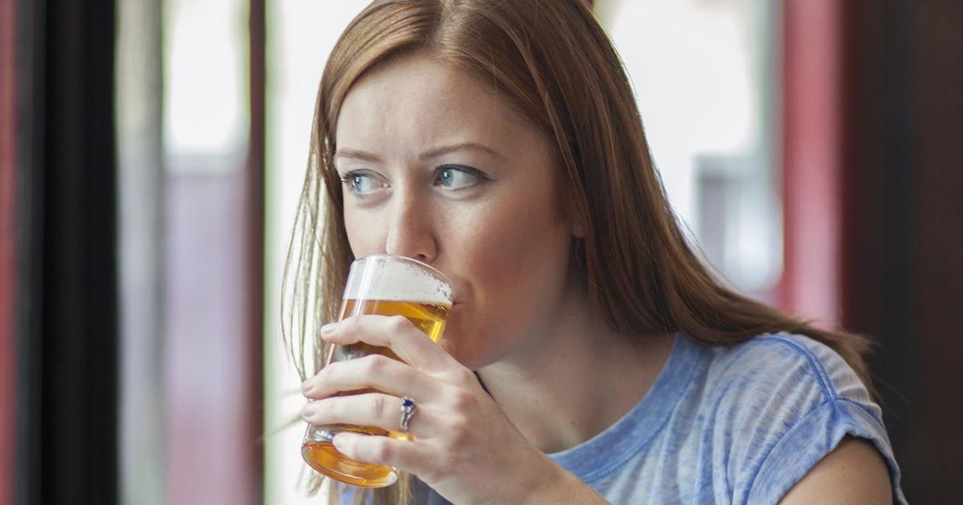
Why Do We Feel Differently about …
Drinking Beer
Notes:
So if we are really honest with our selves, most of us will have a different moral judgement of activities based on the race of the actor

Slide 28
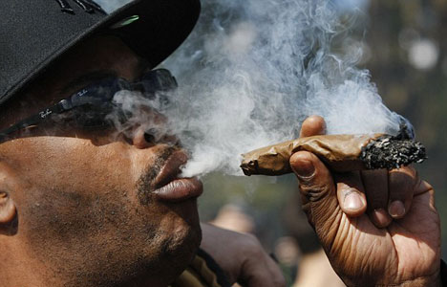
Why Do We Feel Differently about …
Smoking Marijuana

Slide 29
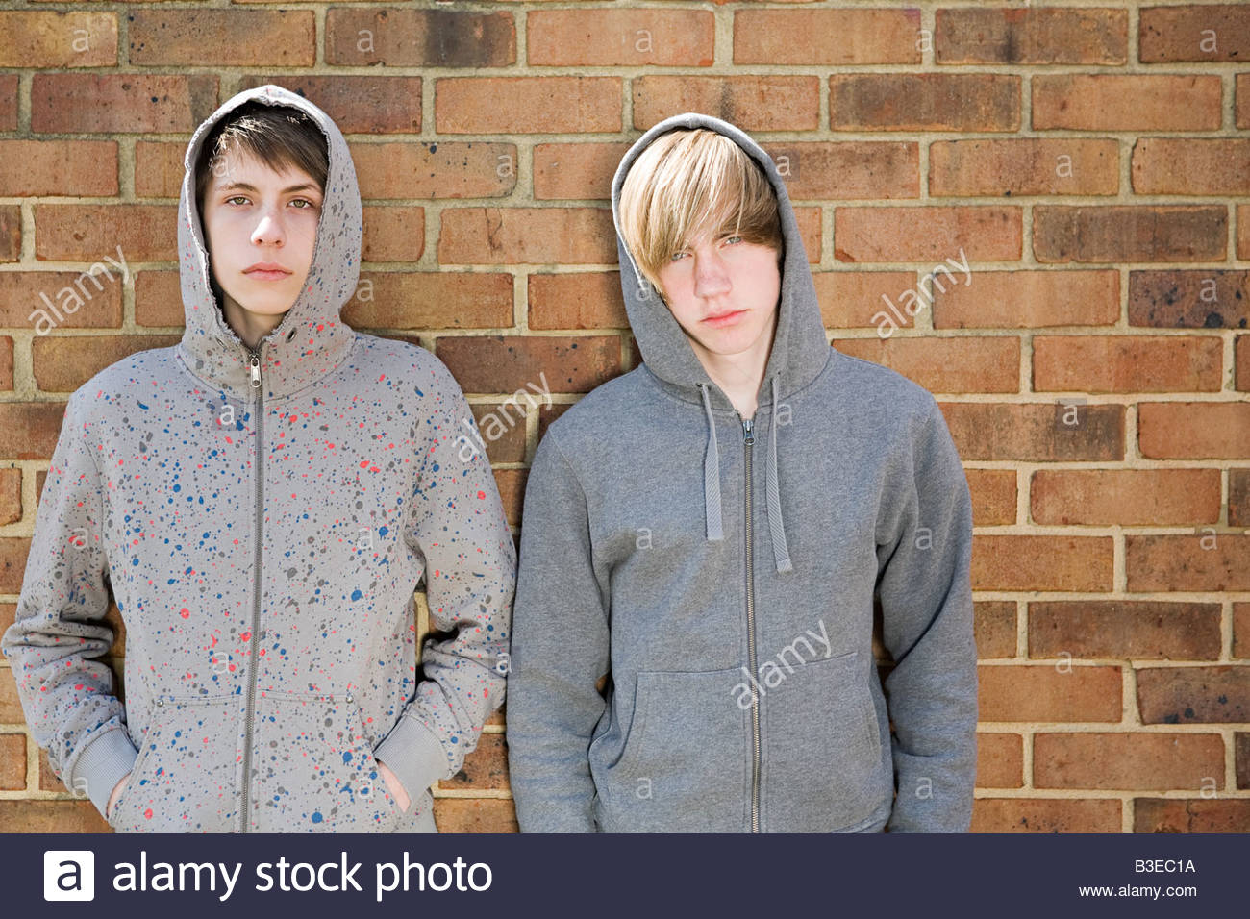
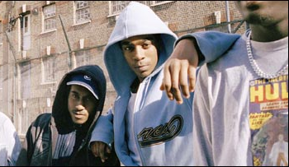
Why Do We Feel Differently about …
Wearing Hoodies

Slide 30
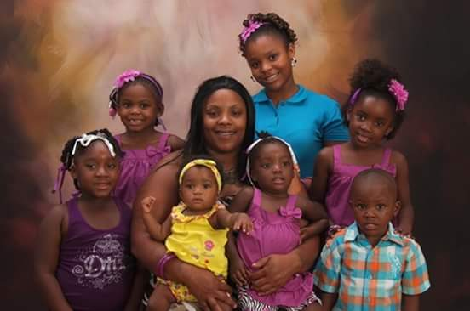
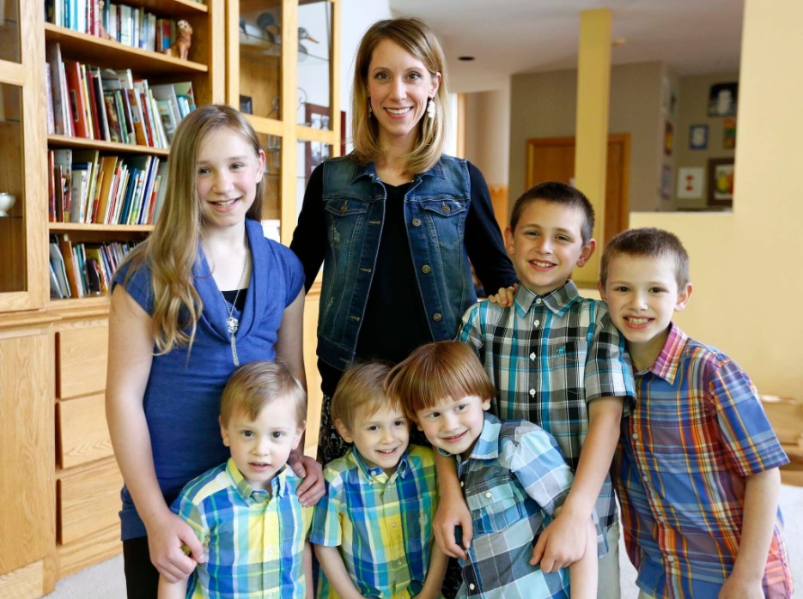
Why Do We Feel Differently about …
Large Families

Slide 31
Why Do We Feel Differently about …
Belt Avoidance

Slide 32
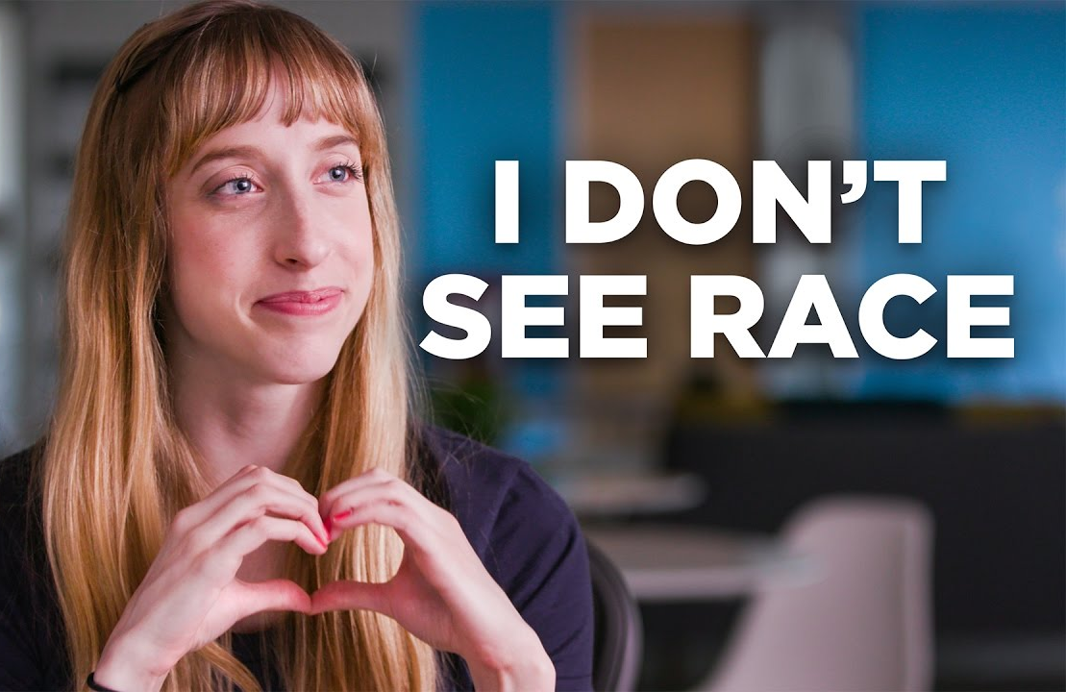
Racial socialization
Notes:
Most of us are not honest with ourselves about our racialized feelings…Dr. King’s message has become warped

Slide 33
The Color Blind Ideology
Being Racist
Acknowledging Race

Slide 34
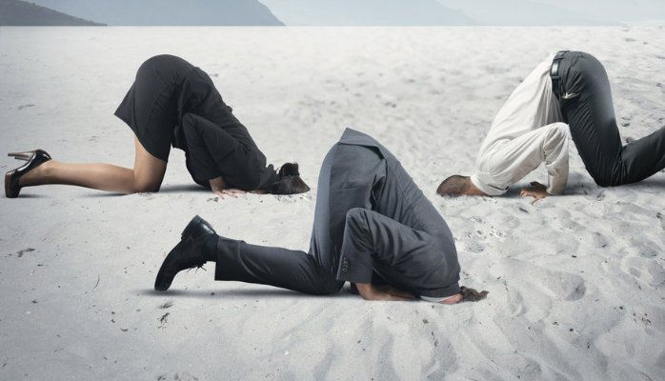
The Color Blind Ideology
Most of our racial socialization is unnoticed and unexamined

Slide 35
How Does This Impact Patient Care
Racial Socialization
Impaired Rapport
Color Blind Ideology
Non-Adherence
Structural Racism
Provider
Burn Out
Unexamined Biases

Slide 36
So…What do we do?
Its OK to see race!
Its part of people’s identity
It structures people’s opportunities
It is integral to the story of America
Its front and center in your Black clients’ lives

Slide 37
Talk About Racism
Practice talking about race with colleagues you trust (before you try it with clients)
If you hear something racist, say something about it
Conversations about race don’t have to be confrontational
Notes:
Challenge yourself to talk about explicitly about race at least once a week
Don’t fear discomfort

Slide 38
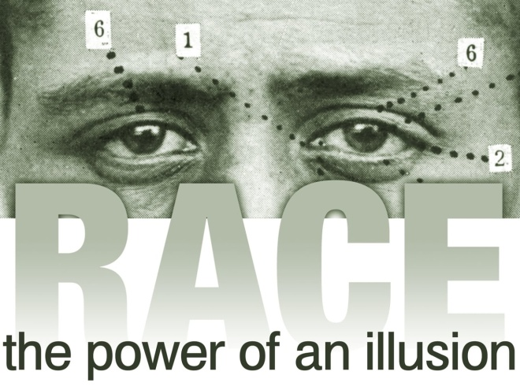
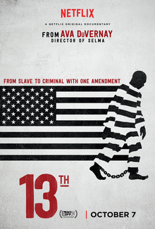
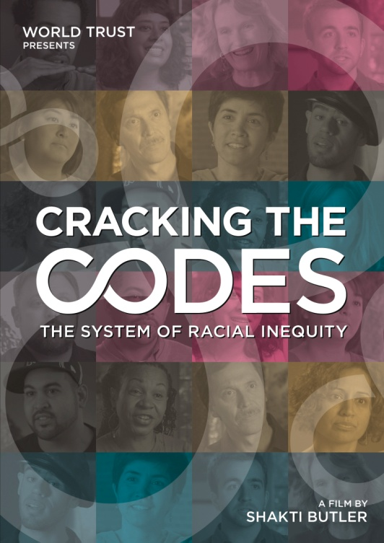
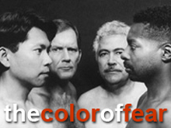
Get Knowledgeable About Racism
One implication of our racial socialization is that we don’t learn about racism in school

Slide 39
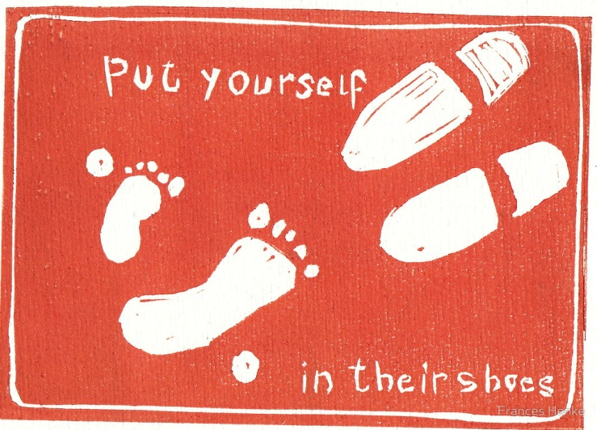
Practice Perspective Taking
Try to do what you are asking your clients to do
Observe how black people are treated
Try taking your black clients perspective during meetings
Notes:
Try to run errands on the bus
Try to grocery shop on your client’s salary or in your client’s neighborhood
Try remembering to take a daily medication
Drive through the housing projects and explore neighborhood ammenities

Slide 40
Connect to your client’s humanity
Ask about your patients day-to-day life
Structural vulnerability assessment
Adherence issues—ask why!
Avoid assumptions and judgments
From charity → to solidarity
Notes:
We struggle to see blacks as indviduals, rather we see them as a group. That’s why we don’t all walk around terrified of white men
Assumptions are usually negative b/c of our racial socialization

Slide 41
Talk with our clients about racism
Co-create understandings of the impact of racism
Ask don’t tell
Do your homework before embarking
Do more listening than talking
Build trust before engaging in this conversation

Slide 42
Advocacy
Vote with your dollars
Vote the regular way
Talk to your elected representatives

Slide 43
Become an Activist!

Slide 44
THANK YOU!!!!!!

