Slide 1
AT&T Network Emergency Management Overview
San Francisco Lifelines Council
June 17, 2010

Slide 2
Origin of National Security Emergency Preparedness in Telecommunications
Study for National Communications System (NCS) began in 1962 by President Kennedy after Cuban Missile Crisis
Ordered National Security Council to examine telecommunications network and outdated emergency preparedness practices
NCS established by Presidential Memorandum on August 21, 1963 under Department of Defense
April 3, 1984, President Reagan signed Executive Order 12472 broadening the NCS’ National Security and Emergency Preparedness (NS/EP) capabilities
NCS initiated planning and coordination of NS/EP telecommunications to support crises and disasters

Slide 3
Origin of National Security Emergency Preparedness in Telecommunications (Cont’d)
Heighten awareness of telecommunications threat after September 11, 2001 attack on World Trade Center
On March 1, 2003, President Bush transferred NCS to Department of Homeland Security
As part of the NCS directive, all telecommunications entities were required to establish a Network Emergency Management Plan
Most adopted the NSEP concept/name
One AT&T NSEP concept being deployed throughout the entire company

Slide 4
NSEP Mission Statement
The National Security Emergency Preparedness (NSEP) team formulates, implements, and maintains Corporate policies, procedures, and processes to meet government NSEP requirements and provides the necessary Emergency Preparedness and business continuity programs that ensure network survivability and customer service.
Notes:
National Security
Emergency Preparedness
Network Reliability
Infrastructure Protection
Federal NSEP Program Management

Slide 5
Roles and Responsibilities
Serve as Single Point of Contact for all external agencies (FEMA, Homeland Security, Local and State agencies) regarding AT&T Emergency Management Policies and Procedures
Provide oversight for execution and implementation of the Network Emergency Management (NEM) Plan
Serve as a member of the Network Disaster Recovery (NDR) Team when needed

Slide 6
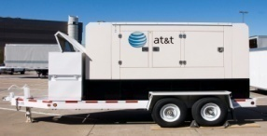
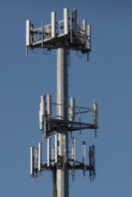
Network Emergency Management
One AT&T Network Emergency Preparation and Response
Support Services
Wireline
Wireless
Outside Plant
Inside Plant
U-verse

Slide 7
EOC Roles & Responsibilities
The primary 5 functions of the EOC are:
Anticipate
Assess Damage
Prioritize Response
Provide Resources
Communicate
Anticipate issues that may arise from an event.
Assess initial findings regarding an event and develop restoration plan.
Provides tactical command and control of the local restoration efforts, including prioritization of all AT&T network elements.
Obtain additional resources to facilitate service restoration.
Disseminate & communicate damage/status reports to leadership upon request, based on the AT&T Golden Report Template.
Notes:
Examples for each of the bullets forthcoming

Slide 8
The NDR Team is composed of AT&T managers, engineers, and technicians who have received special training in the physical recovery of the AT&T Network. Team members (AT&T employees from across the United States) volunteer for this assignment. Members participate in several recovery exercises each year to sharpen and practice their skills using the disaster recovery equipment and processes.

Slide 9
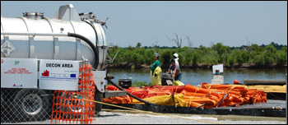
The NDR team was activated on Friday, May 21, to deploy an Emergency Communications Vehicle (ECV) with microcell capability to Hopedale, LA to support local, state and federal responders involved in the cleanup efforts.

Slide 10
Disaster Recovery Exercise in Dearborn, MI May 2010

Slide 11
Utility Interdependencies
Power
Water
Fuel
Security / Access

Slide 12
Questions

