Slide 1
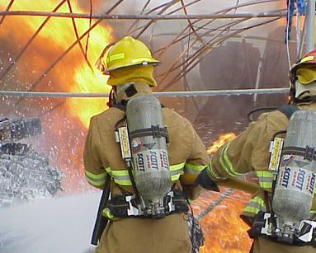
Accelerating Recovery from Landscape Scale Disasters
Doug Ahlers
Arrietta Chakos
Arn Howitt
Dutch Leonard
Lifelines
San Francisco
February 4, 2010

Slide 2
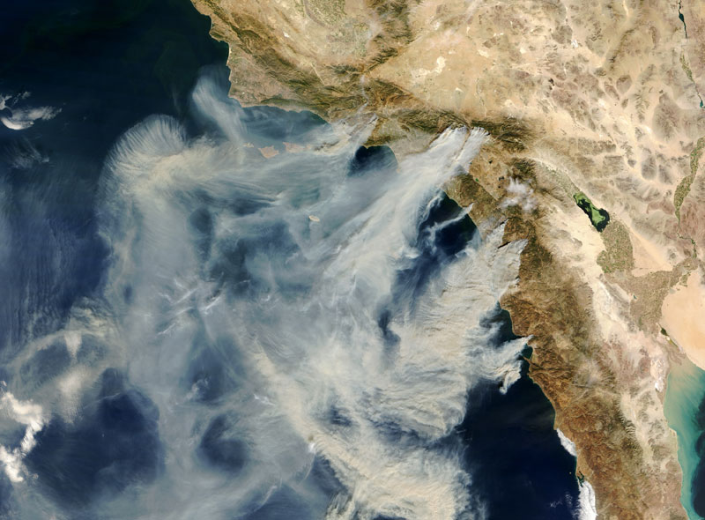
ICS Rule #1 :
If they can see your incident
from space –
it is generally not a good thing.

Slide 3
The Simple Analytics of Acting in Time
Can the hazard be – and is it –
foreseen?
No
Yes
“Visibility”
Can we develop high
value actions?
No
Yes
“Actionability”
Can – and do – we
mobilize to take action?
No
Yes
“Mobilizability”
NOT Acting in Time
ACTING IN TIME

Slide 4
The Comprehensive Risk Management Framework:
Five Points of Action against Landscape-Scale Social Hazards
Pre-Event
Event
Post-event
Response Recovery
Advance Mitigation
(prevent/mitigate consequences
in advance of an event)
Response
(respond to an
ongoing event)
Preparation of Response
(prepare to prevent/mitigate
consequences during an event)
Recovery
(recover from the
consequences of an event)
Preparation of Recovery
(prepare to prevent/mitigate
consequences after an event)
© Herman B. Leonard and Arnold M. Howitt 2009

Slide 5
Example:
The post-earthquake world in the Bay Area
ASSUME:
Mitigation was effective:
buildings do not collapse
basic services disrupted but restorable
relatively few deaths and injuries
Response was effective
survivors rescued, injuries treated
fires contained
BUT THERE IS STILL:
Massive disruption, displacement, destruction
Many buildings unusable

Slide 6
Implications
“Tipping”: People (home and business owners) have to decide whether and when to reinvest while they
o are uncertain about how rapid and effective government (and other) recovery efforts will be
o are uncertain about what others will do
o have just witnessed the destruction of many of the things that they loved about their the Bay Area
o stand in the midst of widespread system collapse
o are suddenly not creditworthy (along with nearly all other people and organizations in the area)
o are traumatized
They are sudden, involuntary pioneers
in a new and scary land…
and they don’t have to stay.

Slide 7
Perceptions, Perceptions, Perceptions
“Tipping” will:
begin quickly
take place (at the outset) in the absence of much real data about the recovery
go on for a long time
→ Accelerated actions that drive positive perceptions are key to an effective recovery

Slide 8
Why the Lifelines work is so important
Focused on rapid restoration of key services
Crucial early indicator of competence/ rate of recovery
Major driver of confidence – one direction or the other

Slide 9
Challenges of Lifelines design, planning, and response
Lifelines are systems – subject to the rules of system dynamics
Charles Perrow “Normal Accidents” – tightly coupled systems are subject to collapse
Your systems are
-- individually tightly coupled (there are complex internal interdependencies within each system)
-- collectively tightly coupled (there are complex interdependencies across your systems
-- tightly coupled to the SF social and economic ecology

Slide 10
Increasing vulnerability within and between your systems
Many systems tend to become more tightly coupled and complex over time
-- They form (rather than being intentionally designed)
(they are “self-organizing”)
-- Economic forces (efficiency demands) produce incentives for “just in time,” elimination of buffers, …
-- Technology improvement allows greater complexity

Slide 11
Implications for Lifelines work
Carefully examine system vulnerabilities
Recognize that your systems are embedded within other systems
→ increases your vulnerability
→ you are contributing to the larger system’s vulnerability
Recognize that in the aftermath of a major event here, you will be trying to undertake rapid restoration in the context of a shattered system ecology → carefully examine your assumptions about what capabilities will be available to you, and plan accordingly

Slide 12
What should we do?
Build a comprehensive strategy for social risk management (based on the Comprehensive Risk Management Framework)
Assemble a comprehensive, five-domain description of current activities
Search for additional valuable investments in each domain
Build an “advance recovery” strategy – and execute it
(which is just what you are doing!)

Slide 13
The bottom line
Recovery will be long and difficult – no matter what you do.
But it will be a lot faster, less expensive, and more reliable if you build a platform for accelerated recovery in advance.
This can be done.
And you can do it.
It’s best to move in advance with all deliberate speed.

