Slide 1
Priority Access Routing Working Group Update
Lifelines Council

Slide 2
Working Group Members
Chris Poland – Private Sector Co-chair
Patrick Otellini – City Co-chair
Cynthia Chono (DPW)
Nick Majeski (GSA)
Micah Hilt (ESIP/GSA)
Linda Yeung (Deputy City Administrator)
Lifelines Council

Slide 3
Goal: To better prepare the City of San Francisco for post-event recovery by working with city agencies and private industry utility providers to identify critical locations and access points to better determine, coordinate, and prioritize opening key access routes. This should include the creation a dynamic route setting process that will allow access to critical facilities in a post disaster setting and provide clear criteria for the closure of particular routes or geographic areas.
Lifelines Council

Slide 4
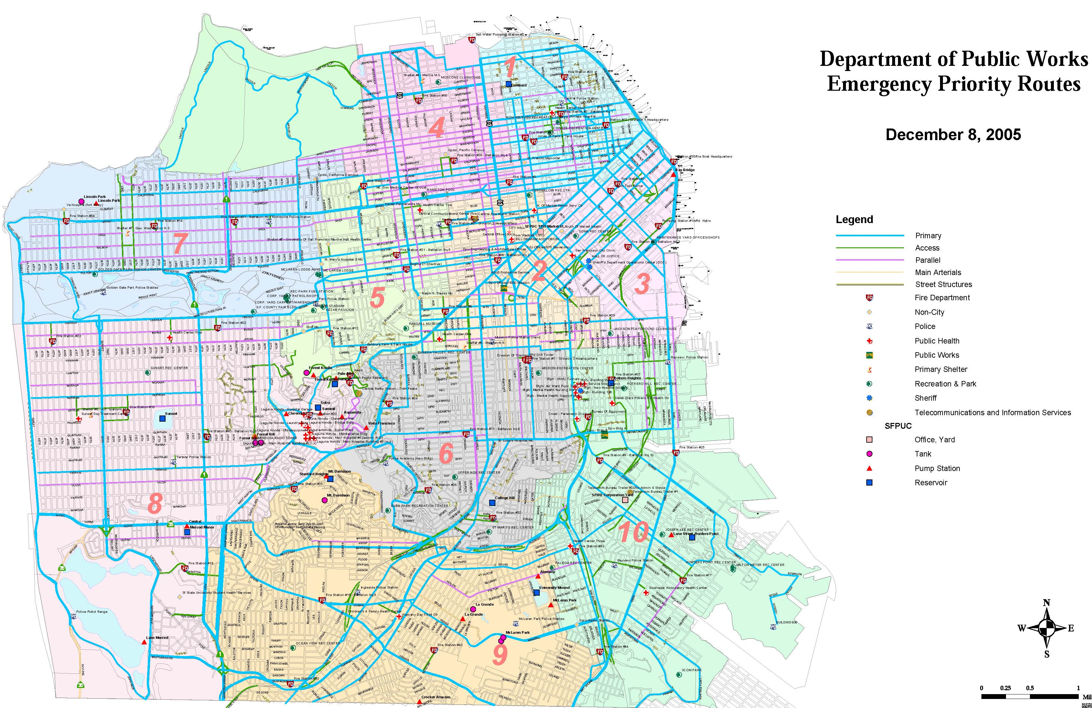

Slide 5
Phase I
Identify Stakeholders from Public Sector and Private Industry. (Completed)
Phase II
Identify Critical Facilities July 2013 – Sept. 2013
Phase III
Data Analysis, Process Development and Project Completion. Sept. 2013 – March 2014
Lifelines Council

