Slide 1
San Francisco Department of Police Accountability
Chief of Staff Sarah Hawkins
Notes:
History and Mission of the DPA
Most common complaints
Investigative process
Discipline and appeals process
Recent developments/trends (BWC)
Tips

Slide 2
Mission
Fairly and impartially investigate complaints against San Francisco police officers,
Make policy recommendations regarding police practices, and
Conduct periodic audits or reviews of the San Francisco Police Department.
Notes:
Civilians who have never been police officers in San Francisco staff the Department of Police Accountability.
Mediation
Coming Soon: Restorative Justice

Slide 3
Complaint Investigations
Audits
Policy Recommendations

Slide 4
History
1982
2003
2016
Creation by Charter Amendment
Independent form SFPD
Reports directly to Police Commission
Police Commission increased from 5 to 7
DPA Director empowered to file charges directly with the police commission
Voters clarified and twice expanded DPA jurisdiction
Renamed DPA (formerly OCC)
Commission nominates director, Mayor appoints with BOS approval
Mandatory OIS Investigations
Mandatory biennial audits: Use of Force and Misconduct Investigations
Discretionary audit powers
Notes:
TREND: Steady increase in jurisdiction over the years.
RECENT CHANGES: Immediately started investigating all OISs (previously only investigated if we had a complaint). Still working on implementing the use of force and misconduct audits. Director of almost 10 years retired. Interim director Paul Henderson now.
STAFF: Investigators + Attorneys + Mediation Team + Auditing Team (Building now). One line investigator for every 150 sworn members. Individuals who have previously served as a uniformed member of the San Francisco Police Department may not join DPA staff.
The Department of Police Accountability was originally the Office of Citizen Complaints which was created as a city department separate from SFPD by charter amendment (section 4.127) in 1982 and placed under the direct supervision of the Police Commission. In 2016, another charter amendment (section 4.136) renamed the Office of Citizen Complaints the Department of Police Accountability and provided to the Department of Police Accountability the power to conduct periodic audits of the San Francisco Police Department.
DETAIL:
Created by Board of Supervisors’ Initiated Charter Amendment in1982 (4.127). Proposition A 1982
Historical Context:
SFPD was under a Consent Decree in 1979 (Discrimination in employment based on race, sex, national origin) .
There was also negative sentiment because supervisor and former SFPD officer Dan White murdered Mayor Moscone and supervisor Harvey Milk
Arguments for DPA:
Cost-saving measure to decrease the work of internal affairs (civilian investigators are more cost effective)
difficult for officers to investigate themselves
discipline decisions and policy remained with Chief and Commission
“Proposition A would, after 1985 when a court ordered consent decree expires, allow a savings in salary costs that could be well over $400,000 when high priced police officers are replaced with less expensive civilian investigators. Furthermore, Prop A will provide professional and unbiased investigations of complaints against police officers. Currently, police officers accused of misconduct are investigated by fellow officers. That’s just not fair for the officer or for the person making the complaint. - engenders an atmosphere of distrust.
“Reject Moscone-Milk “killer-cop” Dan White – Moscone Memorial Democratic Club Leland Dam
Support: BOS (including future City Attorney Louise Renee),
Sheriff Michael Hennessey, Commissioner Jo Daly, Bar Association
Proposition H (November 2003) – 51.94% passage rate
Added 2 Police Commissioners (5 →7)
Allowed the DPA Director to file charges directly with the Police Commission if misconduct warranted over 10 days suspension
Proposition D (June 2016) – 80.92% passage rate
Mandatory investigation of Officer-Involved-Shootings
Admin Code 96.11
Proposition G – November 2016 0 80.77% passage rate
Name change to Department of Police Accountability
Mandatory Biennial Audit: Use-of-Force policies and handling of all misconduct investigations
Discretionary audit powers of any policy, procedure, or practices (Director determines scope)
DPA Director nominated by Police Commission but appointed by the Mayor with Board of Supervisors approval. Still supervised by Police Commission.
Now under City Charter 4.136

Slide 5
Investigations and Audits
INVESTIGATIONS
PERFORMANCE AUDITS AND REVIEWS
Complaints about on-duty officers made by non-officers
Misconduct and Neglect of Duty
All OIS with injury
Department-wide use of force practices
SFPD handling of sustained misconduct (DPA and IAD)

Slide 6
Allegations
Neglect of Duty
Unwarranted Action
Conduct Unbecoming an Officer
Use of Force
Referrals and Informational
Policy
Notes:
In accordance with DGO 2.04
NEW: Sexual Slurs, Racial Bias and Discourtesy are now under Conduct Unbecoming an Officer and Neglect of Duty
Unnecessary Force is now Use of Force
Allegations & DPA-Added Allegations
2020 Totals:
Neglect of Duty 706
Unwarranted Action 354
Conduct Unbecoming 560
Use of Force 162
Referrals and Informational 57
Policy 5
TOTAL: 1844
NEW: Conduct Unbecoming an Officer (CUO) replaced CRD in 2019

Slide 7
Allegations Subtypes
Neglect of Duty
Failure to activate body-worn camera
Failure to follow SFPD policy or law
Failure to write an incident Report
Failure to provide name and star number upon request
Conduct Unbecoming an Officer
Inappropriate comments or behavior
Racial bias
Sexual slurs
Misrepresenting the truth
Misused police authority
Unwarranted Action
Misused city property for personal use
Issuing a citation without cause
Handcuffing without cause
Improper search or seizure of a person, property, or vehicle
Use of Force
Used a carotid restraint hold
Failure to comply with
DGO 5.01
Unnecessary or excessive force
Intentionally and improperly discharged a firearm, on- or off-duty

Slide 8
Investigative Process
Interview Complainant
Gather Evidence
Interview Officers
Interview Witnesses
Preliminary Findings
Notes:
Interview Complainant
Gather Evidence
Review Video
Interview Witnesses
Interview Officers
Preliminary Findings

Slide 9
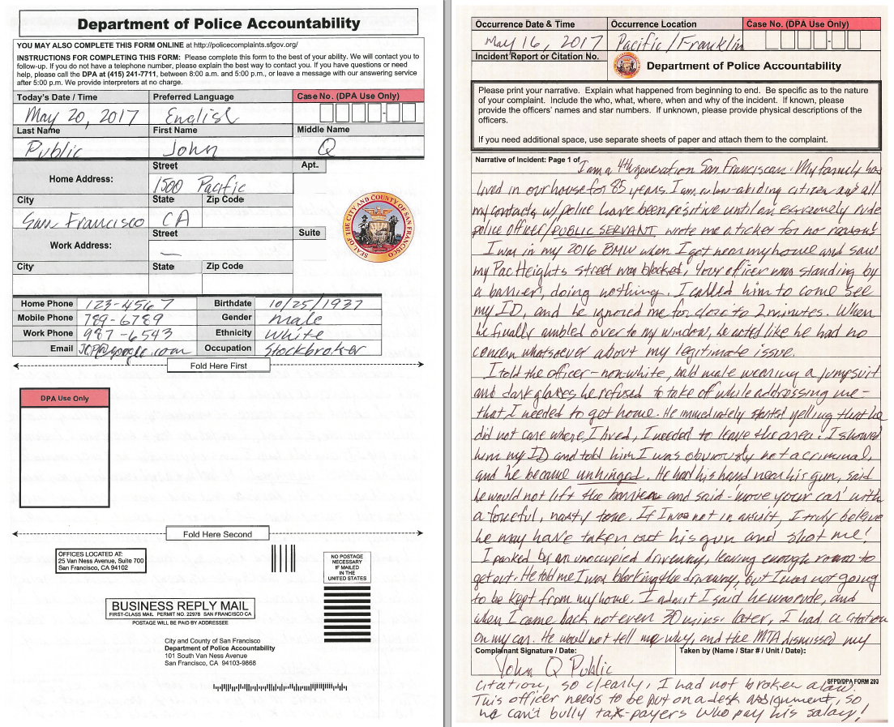
Sample Complaint
Notes:
Read then issue spot.
Doing nothing, refused to remove barrier
Yelling v. ambient noise
Unhinged
Refusal to remove sunglasses
Ordered to move car, leave area
Hand near gun
Parked in driveway
Why was the street blocked? (planned event v. emergency)
Who issued the citation? (SFPD, DPT)
Citation dismissal v. citation w/o cause

Slide 10
Mediation
Notes:
50 Mediations in 2020
31% Increase from Last year
Alternative to investigations.
Unlike investigations, mediation will not lead to discipline.
Both parties must agree
Neutral setting with independent mediators (volunteer)
Brings parties together in an effort to achieve mutual understanding
Dispute resolution format
Higher satisfaction for both sides (than investigation)
One per year
Noted as ”mediated” in your employment records
Winner of Community Boards’ 2012 excellence in ADR practices award
Recognized by California State Legislature and San Francisco Board of Supervisors

Slide 12
Findings
Other
No Findings
Improper Conduct
(Sustained)
By a preponderance of the evidence, the DPA found that misconduct or neglect occurred.
Proper Conduct
Unfounded
Insufficient Evidence
Training Failure
Supervision Failure
Policy Failure
Withdrawn
Information Only Referral
Information Only (Other)
Mediated

Slide 13
Discipline
NON-DISCIPLINARY
Admonishment
Counseling
Training
Written Reprimand
Suspension
Fines
Termination
Criminal Prosecution
Notes:
Fines may also be imposed.
Don’t know if that is used much. Our agency does not generally recommend fines.

Slide 14
DPA COMPLAINT PROCESS OVERVIEW
DPA Office
DPA MEDIATION
Police Station
DPA COMPLAINT
INTAKE
Online
DPA INVESTIGATION
DPA Investigative Team (Investigator, Senior Investigator, and Attorney) makes findings
Reviewed by
Chief of Investigations
Complainant
Officer(s)
Witnesses
Video
Documentary Evidence
Phone
Referral
Discipline of 10 day suspension or lesser
Reviewed and Decided by
DPA Director
Officer can request Chief’s Hearing
DPA defends findings
DPA File to POLICE CHIEF with DPA Sustained Finding(s)
Letter to Complainant:
Sustained or Not
Policy or Training Failure
POLICE
CHIEF
DPA Director recommends discipline level to Chief, who can determines discipline level up to 10 days suspension
If Chief disagrees or declines to impose discipline, case concludes unless DPA files charges with the Police Commission
Alternately, DPA Director can recommend that, on Chief’s behalf, DPA file charges directly with the Police Commission for proposed discipline greater than 10 days
Officer can appeal
To POLICE COMMISSION
Adjudicates officer appeals from Chief’s Level discipline
Adjudicates discipline greater than 10 days suspension, up to and including termination
DPA defends findings at both types of hearings
Letter to Officer:
Sustained or Not
Policy or Training Failure
POLICE CHIEF
or
DPA
DIRECTOR
POLICE COMMISSION
DPA Publishes Findings in Reports
Officers and Complaints not named
California law protects confidentiality of most peace officer personnel records

Slide 15
US CONSTITUTION
CALIFORNIA LAW
SAN FRANCISCO LAW
SFPD RULES

Slide 16
TOTAL ALLEGATIONS BY TYPE
799 COMPLAINTS = 1844 ALLEGATIONS
FOR INVESTIGATION
Data Source: 2020 Annual Report
Notes:
MOST COMMON TYPES OF ALLEGATIONS HAVE REMAINED CONSISTENT OVER THE YEARS
2020
Neglect of Duty 706
Unwarranted Action 354
Conduct Unbecoming 560
Use of Force 162
Referrals and Informational 57
Policy 5
2018 DATA
Neglect of Duty 1514
Unwarranted Action 952
Conduct Reflecting Discredit 795 →became “Conduct Unbecoming” in 2019
Unnecessary Force 352
Referrals and Informational 218
Discourtesy 73
Racial Slur 14
Sexual Slur 14
2017 DATA
504 complaints received in 2018
691 complaints closed
24 mediated – 4% of closed complaints
61 sustained cases –9% of closed complaints
2015 DATA: Out of 700 complaints, 1900 allegations
Unwarranted Action 662
Conduct Reflecting Discredit 534
Neglect of Duty 465
Unnecessary Force 155
Discourtesy 54
Racial Slur 13
Sexual Slur 11
compare received: approx.. 600 (2016); 673 (2015); 728 (2014); and 727 (2013)

Slide 17
Frequency of Findings
Data Source:
2020 Annual Report
Notes:
2020
Proper Conduct 864
Unfounded 418
Insufficient Evidence 254
No Finding 187
Referral 159
Improper Conduct (Sustained) 110
Mediated 105
Withdrawn 85
Informational 48
Policy Failure 31
Training Failure 11
Supervision Failure 2
2018
Proper Conduct 488
Unfounded 396
Not Sustained 174
Sustained 116
No Finding 102*
Withdrawn 70
Referral 86
Mediated 47
Informational 37
Supervision or Training Failure 3
Policy Failure 2 1521
*No finding outcomes occur when the complainant does not provide required evidence, the officer cannot reasonably be identified, or the officer retires or resigns before the investigation concludes, which precludes discipline.
2015
Sustained 157
Proper Conduct 281
Unfounded 52
Not Sustained 1162
No Finding Withdrawn 45
No Finding (Other) 65

Slide 18
IMPROPER CONDUCT (SUSTAINED) FINDINGS BY ALLEGATION TYPE
Data Source: 2020 Annual Report
Notes:
2020
Use of Force 7
Unwarranted Action 15
Conduct Unbecoming an Officer 18
Neglect of Duty 70
Total : 110
2018
Neglect of Duty 95
Conduct Reflecting Discredit 9
Unwarranted action 8
Unnecessary Force 3
Sexual Slur 1
2015:
Unnecessary Force 6
Unwarranted Action 47
Conduct Reflecting Discredit 18
Neglect of Duty 87
Racial Slur 0
Sexual Slur 0
Discourtesy 6

