Slide 1
Juvenile Probation Officer Field Safety and Monitoring Compliance
The Changing Landscape in
Community Corrections and Supervision of High Risk Offenders
San Francisco Juvenile Probation Department
Juvenile Probation Commission Meeting
January 9, 2013
Allen Nance, Assistant Chief Probation Officer

Slide 2
Objectives
Highlight the nature and characteristics of Juvenile Court referrals
Describe assessment of criminal risk (High Risk offenders)
Present updates regarding changes in state laws that impact juvenile probation supervision
Report on specific Community monitoring and Supervision strategies and challenges

Slide 3
By the Numbers

Slide 4
Notes:
Even though the number of over all petitions filed including those for weapons related charges, has steadily declined since 2008, the percentage of weapons related offenses compared to the total number of petitions filed has remained relatively constant at just over 20%. Petitions are duplicated counts (One youth may have more than one).

Slide 5
Weapons and violence related offenses
Analysis of youth with a weapon/violence related petition filed from 2007 – 2012 (N=1599)

Slide 6
Youths charged with weapon/violence by Ethnicity
Notes:
This is an unduplicated count.

Slide 7
Notes:
(Include data on High risk Youths. What percentage of the whole and demographics of the population. (We should also stress that violence deserves an override to high risk until otherwise determined)

Slide 8
Notes:
This slide identifies the zip codes of youths arrested for violence and gun related charges. Almost 20% of the youths reside outside of San Francisco. In many instances the zip code is unknown

Slide 9
A Snapshot of Youths detained at the Juvenile Justice Center (JJC) on January 7, 2013

Slide 10
Notes:
This slide should show a Pie Chart grouping the offenses (Could be possession, discharge, possession at a school, use in robbery, murder or att murder). We need to keep in mind that some of the weapons charges are knives or other weapon types.

Slide 11
Notes:
Snapshot: 65% of JJC Youths in custody on 1-7-13 had a petition filed alleging violence or gun related offenses. Current JJC detainees with Violence and Gun related petitions by age (1/7/13).

Slide 12
Assessment of Youth Risk and Needs
Comprehensive and empirically-based assessment of risk to reoffend using the Youth Assessment and Screening Instrument (YASI)
Juvenile Probation Officers assess risk and needs based on a number of factors
Risk and Protective factors (Static and Dynamic)
High Risk is often assessed based on the YASI and by criminal offense history with specific emphasis on chronic, serious, and violent offenses

Slide 13
Case processing and changes in state law
SB 81 and SF practice reduced the number of youths committed to the Division of Juvenile Facilities (DJF) (Formerly CYA)
Few 707(b) offenders are committed to DJF by SF. Most committed to group home placements or Log Cabin Ranch, juvenile camp
On December 31, 2012 State Juvenile Parole was eliminated shifting responsibility for supervision to the Counties
AB12 provides Extended Foster Care

Slide 14
Division of Juvenile Facilities
Youths committed to DJF by SF are adults at the time of release (Up to age 25 years old)
These youths were committed to DJF on serious and violent offenses including gun violence and murder
Most have a history of chronic criminal conduct including gang related offenses and probation violations
All return to SF jurisdiction and require community supervision by Juvenile Probation Officers

Slide 15
Community Supervision Strategies and Challenges

Slide 16
Community Supervision Efforts
School visits to monitor attendance and academic performance
Home and field visits to monitor compliance with curfew, court orders, and other probation conditions
Referrals for community-based counseling, substance abuse treatment, anger management, educational, vocational, and recreational programs
Coordination and collaboration with parents, guardians, and community partners

Slide 17
Community Supervision Efforts Cont’d.
Participation in cross-agency public safety operations
Operation Ceasefire
Peace Officer presence for Special Events
Pink Saturday
Halloween in the Castro
Public Housing events
Community Activities
Juvenile Collaborative Re-entry Unit
Enhanced supervision and service delivery for youths returning from group home placement and Log Cabin Ranch
Addition of social workers to focus on social and clinical case coordination

Slide 18
Risks and Challenges in Community Supervision
A small yet significant number of high risk offenders are not invested in behavioral change
History of serious, chronic, and violent offense patterns (Murder, gun violence, robberies, and assaults)
History of non-compliance with court orders and probation officer directives
Firearms possession is common, including high capacity assault weapons
Pose serious public safety risk with devastating impacts on victims and the community

Slide 19
Risks and Challenges in Community Supervision Cont’d.
Criminal sophistication including associations with criminal networks, gangs, sets, and adult offenders
Managing threats to youths in custody during transports to criminal court, especially in cases involving murder or other acts of violence
Arrests of absconders and other individuals with active arrest warrants
Weapons found during searches pursuant 1035 P.C.

Slide 20
Slideshow Presentation
Warning: The images on the following slides may be disturbing to some viewers, particularly younger viewers. The faces of the individuals have been altered to protect their identity. All individuals depicted in the images are innocent until otherwise determined by a court of competent jurisdiction.
Notes:
Note that the faces of the Juveniles have been altered to protect the

Slide 21
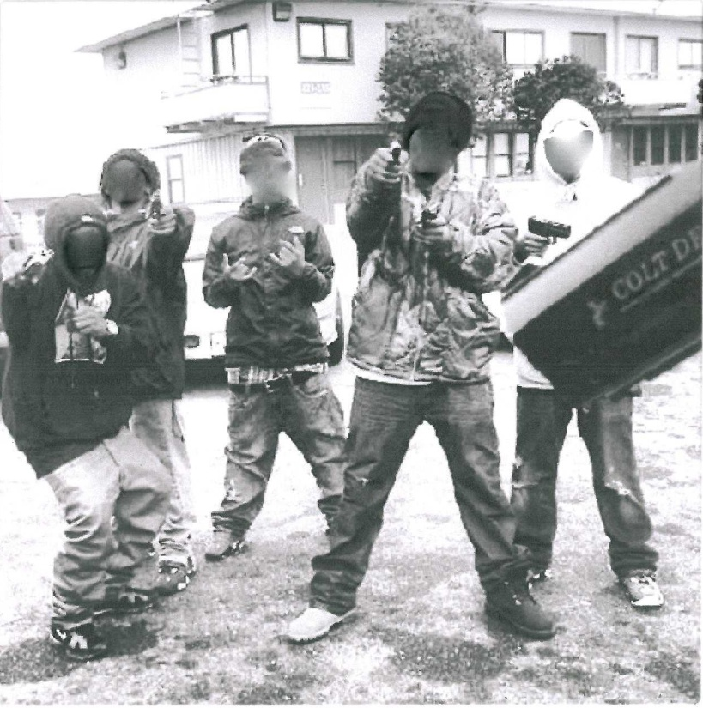
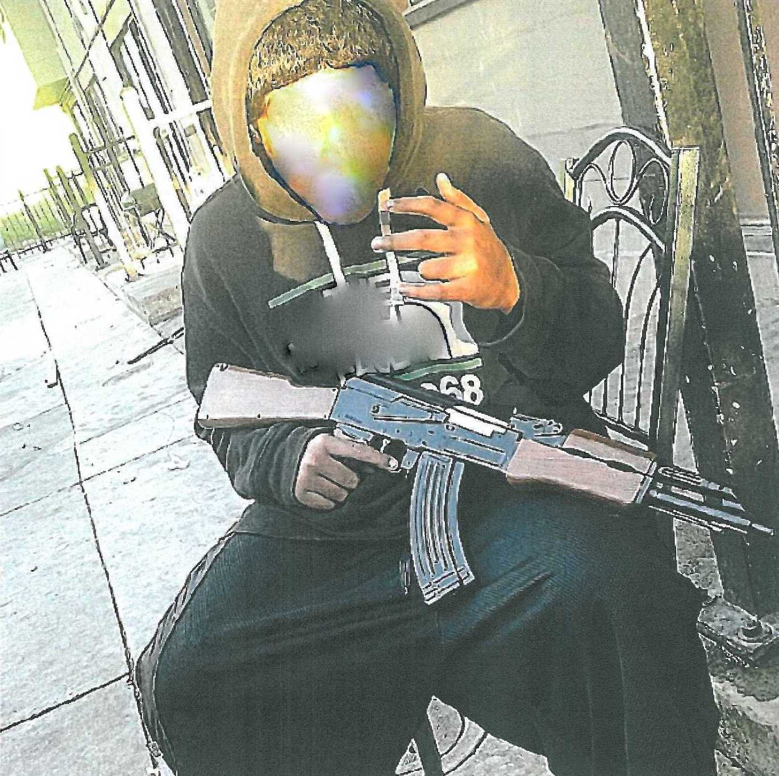
Guns possessed by Juveniles in San Francisco
Notes:
Photos of each gun including a brief synopsis of the circumstances under which the weapon was recovered as well as visual characteristics of the weapon (marks, attempts to remove serial numbers, capacity of clip, bullets, type of weapon, etc).

Slide 22
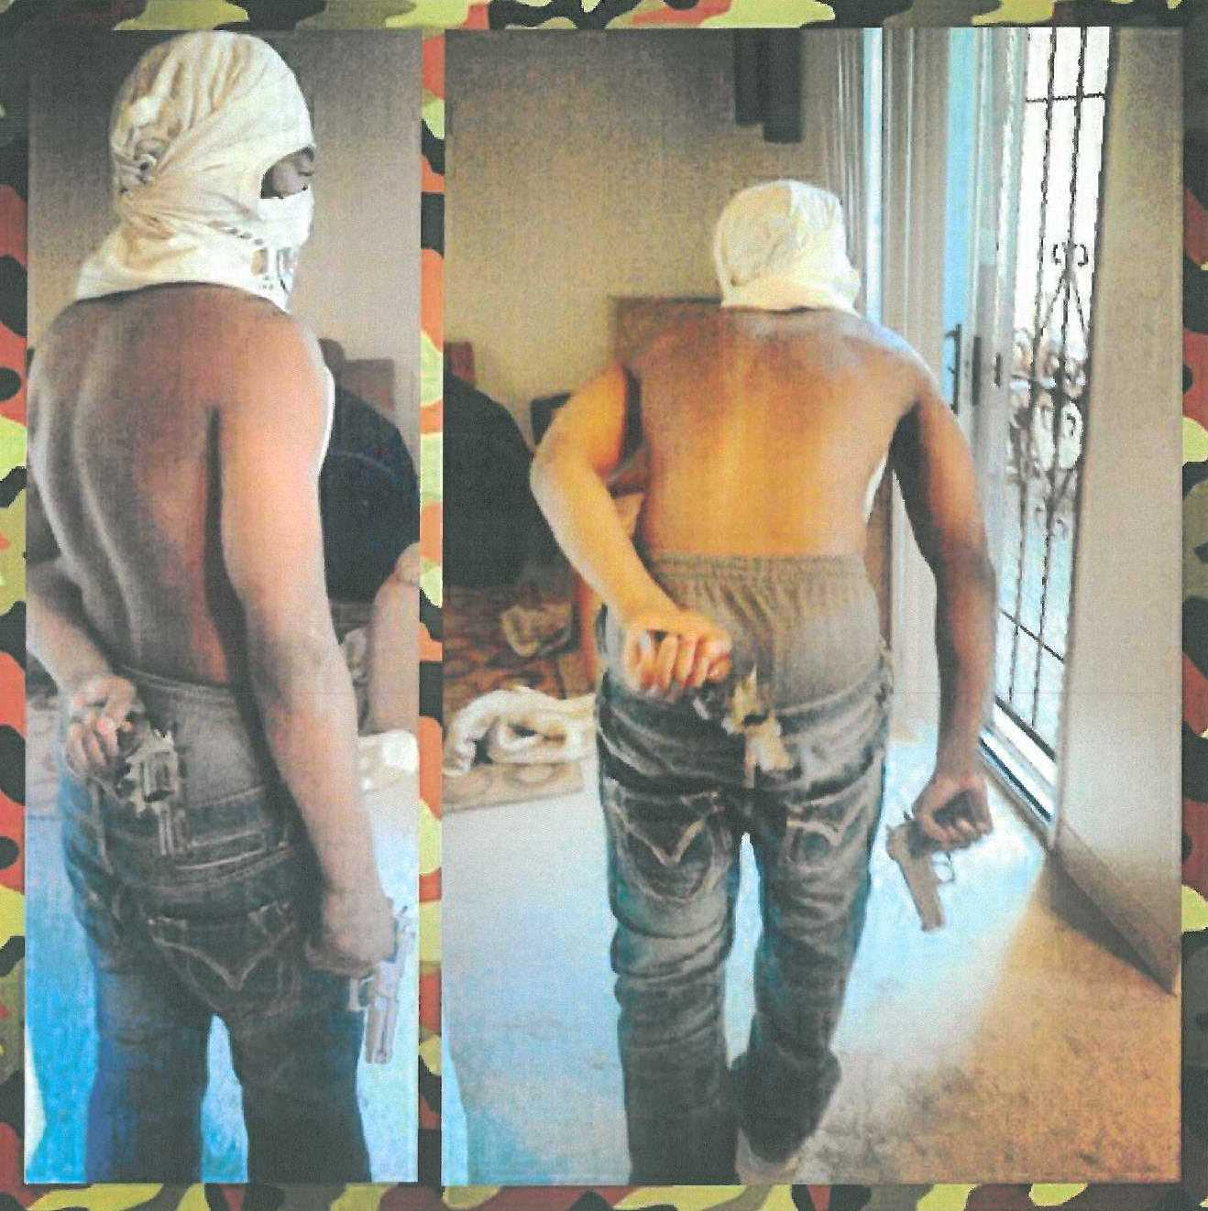
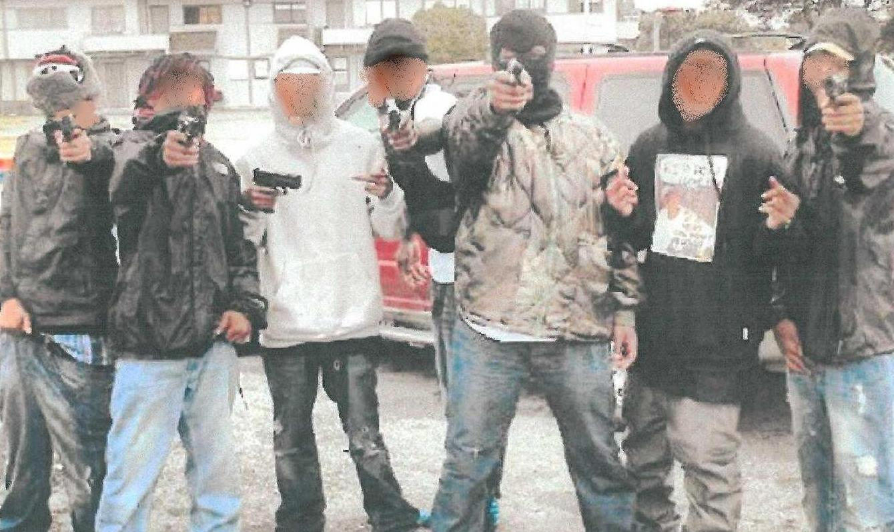
Guns carried by Juveniles cont’d
Notes:
The last slide should show the two probationers at the gun range perfecting their aim and capacity to use these weapons, thus further illustrating their lack of regard for court orders, probation directives, and societal norms. They represent high levels of criminal sophistication that compromise public safety.

Slide 23
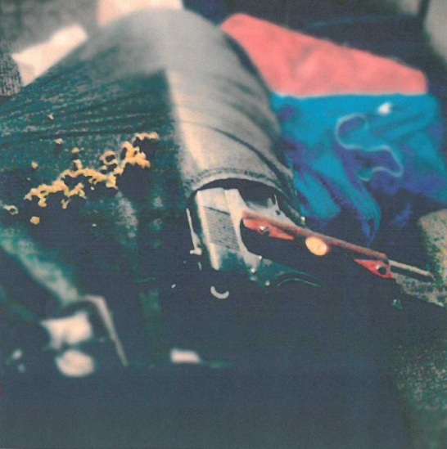
Juveniles with Guns Cont’d

Slide 24
Weapons Recovered by SFPD including those identified by SFJPD

Slide 25
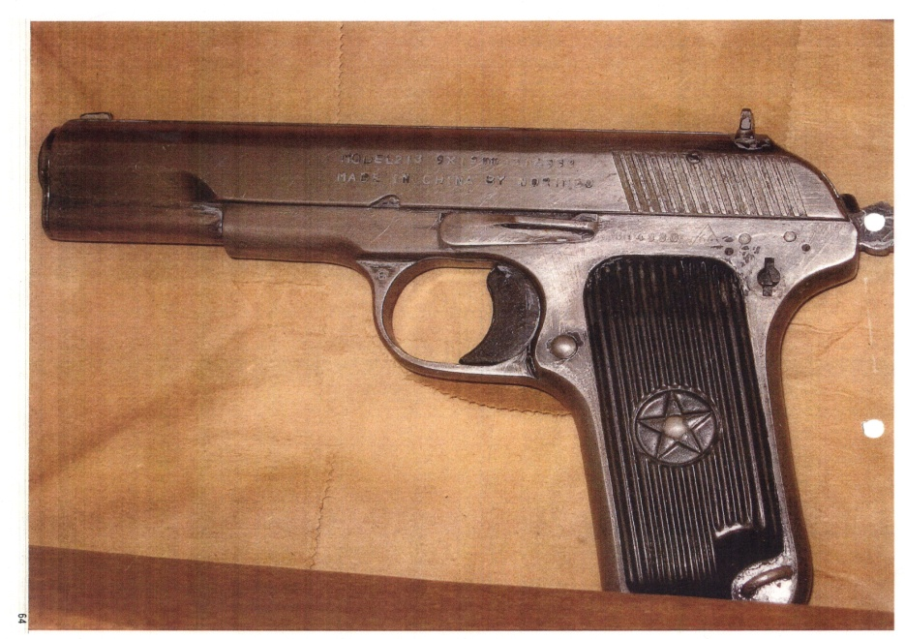
Weapons Recovered

Slide 26
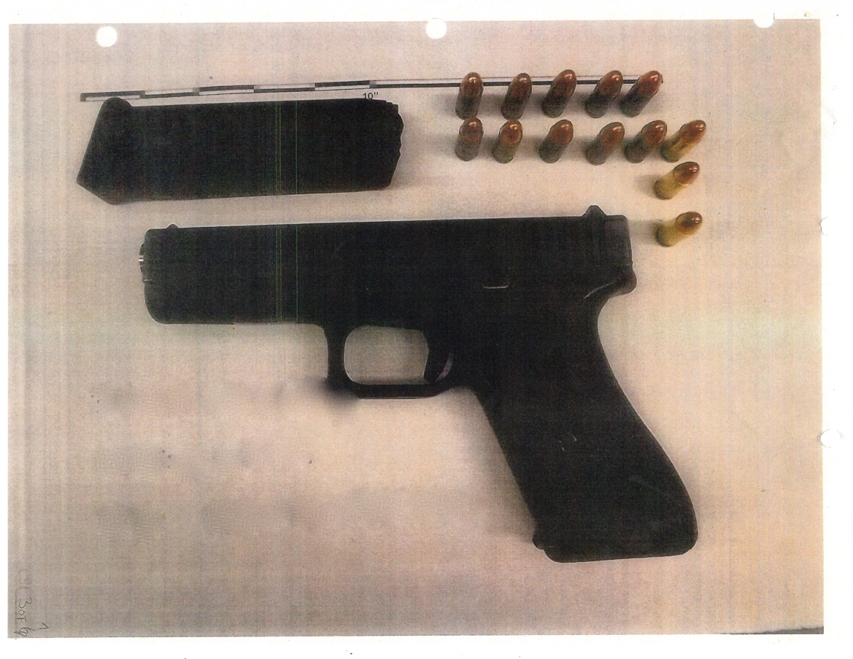
Weapons Recovered

Slide 27
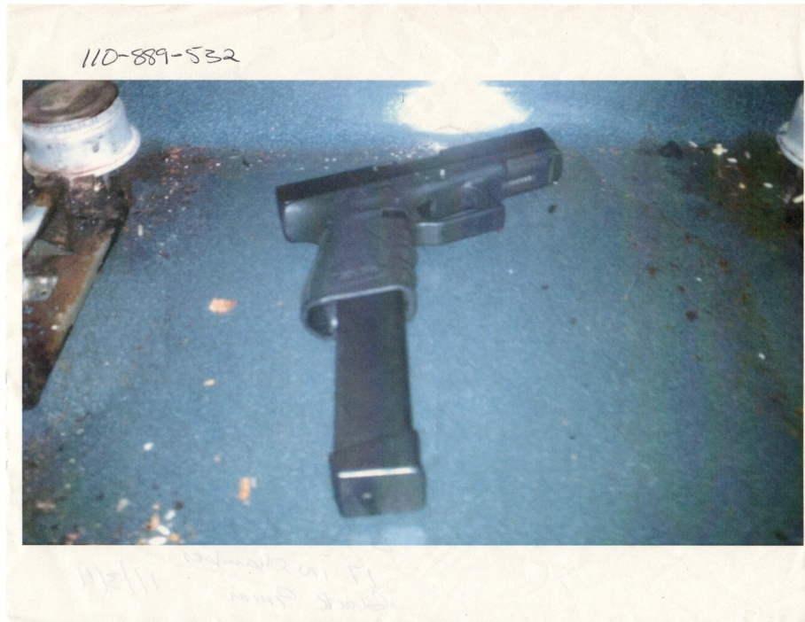
Weapons Recovered

Slide 28
Weapons Recovered

Slide 29
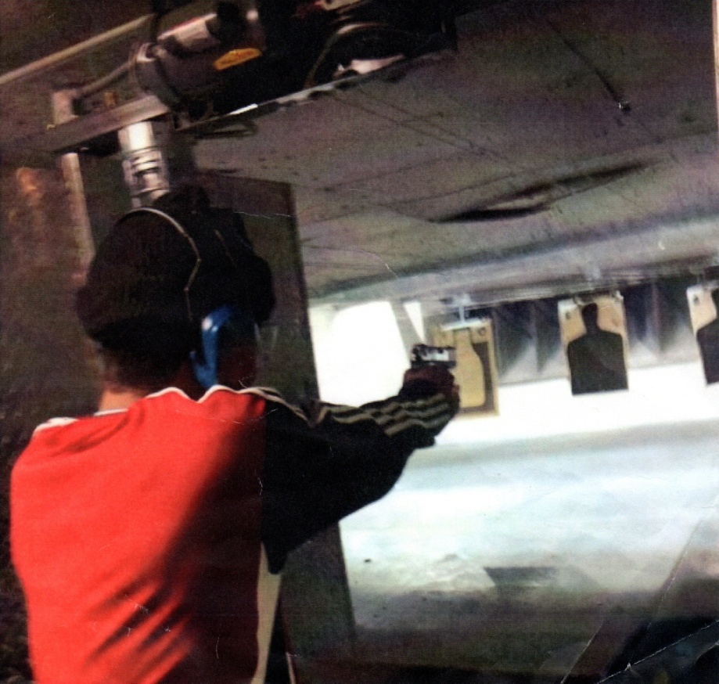
Juvenile Probationers At the Gun Range

Slide 30
End

Slide 31
Questions

