Slide 1
San Francisco Juvenile Probation Department Monthly Statistics
Through August 2022
PREPARED FOR THE 10/12/22 JUVENILE PROBATION COMMISSION MEETING

Slide 2
Monthly Data Report
The Juvenile Probation Department is engaged in efforts to generate more comprehensive, accurate, and meaningful metrics.
This report compiles data through the month before last (August 2022).
  A recent daily snapshot of the Juvenile Hall population will be included for the Commission meeting.
Starting on page 5, each chart slide is preceded by a definition/methodology slide explaining the chart's content.
Time periods range depending on data availability and are noted on each chart.
An Executive Summary for the month has been added to slide 3, with headings that hyperlink to relevant graphs in the report.
Recent Changes: Peak population by month and youth active in programs by month have been added to this presentation in recent months. ALOS by demographics has been removed due to small Ns.

Slide 3
Executive Summary - August
Referrals: There were 52 referrals, a 100% increase from August 2021.
Admissions: There were 24 admissions, a 100% increase from August 2021.
Population: The average daily population was 16 youth, with a peak population of 19 youth.
Length of Stay: The median LOS for releases was 4 days, slightly lower than August 2021.
Caseload: There were 288 youth on active caseload, about the same as August 2021.
  Diversion: 29% of pre-adjudicated cases were being handled through various types of diversion.
Programs: 58% of youth on active caseload were active in San Francisco programs
Placements: There were 28 youth in alternative placements, a 32% decrease from August 2021.
To come: Warrants

Slide 4
Juvenile Hall Snapshot: 10/11/2022 (N = )
[This slide was left intentionally blank as a placeholder -- to be updated prior to the Commission meeting]

Slide 5
JH Chart 1.1 & 1.2: Admissions, Releases, & Population
Description
  Chart 1.1 displays Juvenile Hall admissions and releases by calendar month.
  Chart 1.2 displays the average daily population (ADP) by month - the average number of youth in custody per day for each month, & the peak population by month - the highest population count reached each month.
In August,
  There were 24 admissions and 21 releases.
  The ADP was 16 youth and the peak population was 19 youth.

Slide 6
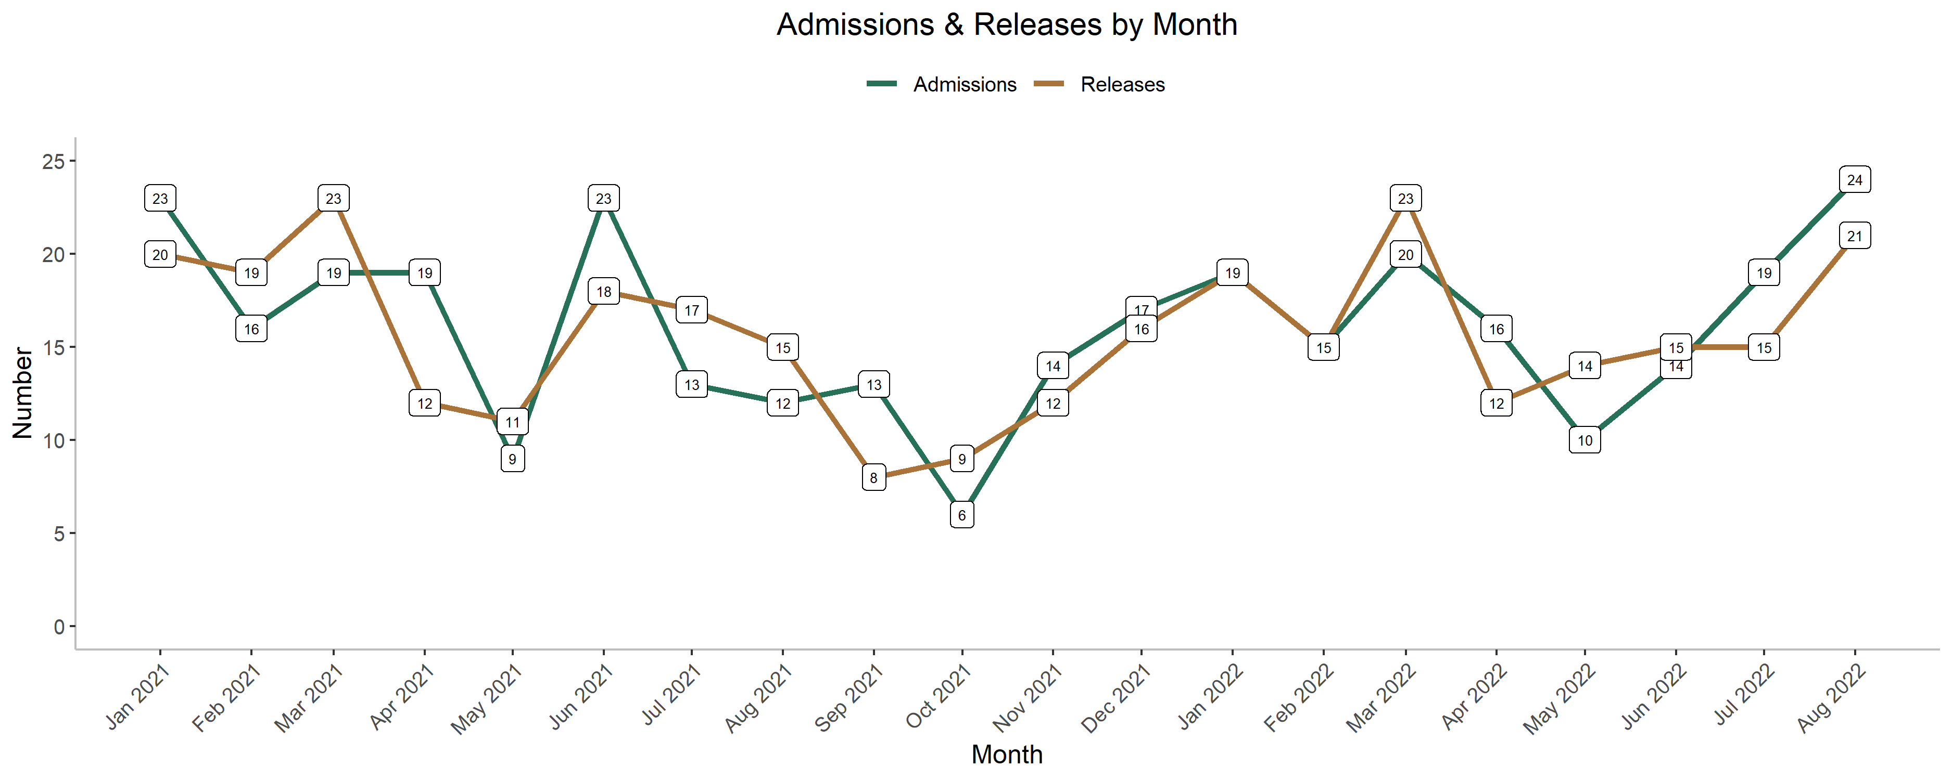
JH Chart 1.1: Admissions & Releases

Slide 7
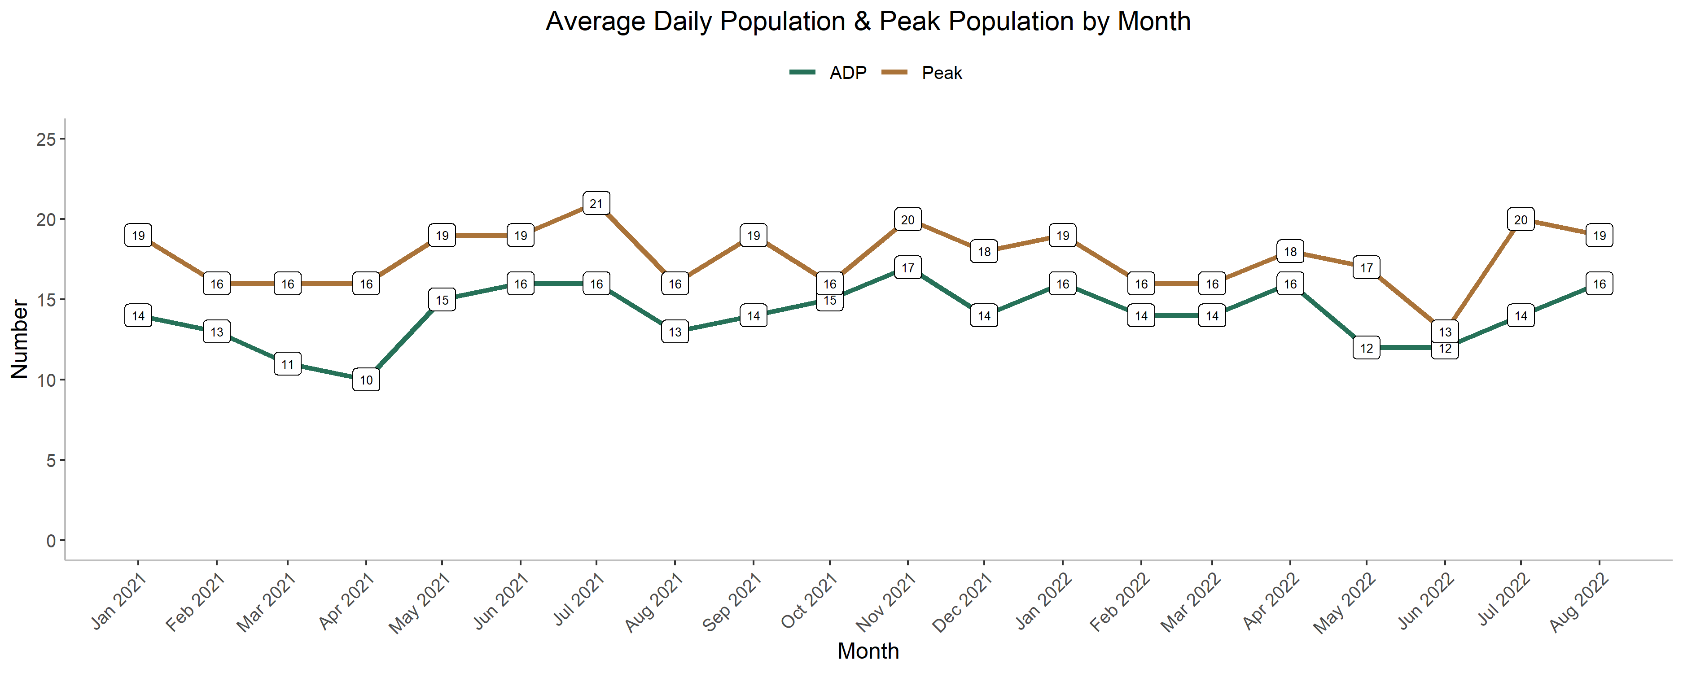
JH Chart 1.2: Average & Peak Population

Slide 8
JH Charts 2.1 - 2.3: ADP by Demographics
Description
  Charts in this section display Average Daily Population (ADP) of youth in Juvenile Hall by gender (2.1), by race/ethnicity (2.2), and by age (2.3).
    Note: Due to rounding errors, ADP by demographics may differ from overall ADP.
In August,
  The gender breakdown of the ADP in Juvenile Hall was 88% boys.
  The racial/ethnic breakdown of the ADP in Juvenile Hall was 65% Black youth, 24% Latinx youth, and 12% AAPI youth.
  The age breakdown of the ADP in Juvenile Hall was over 44% young adults ages 18 and older.

Slide 9
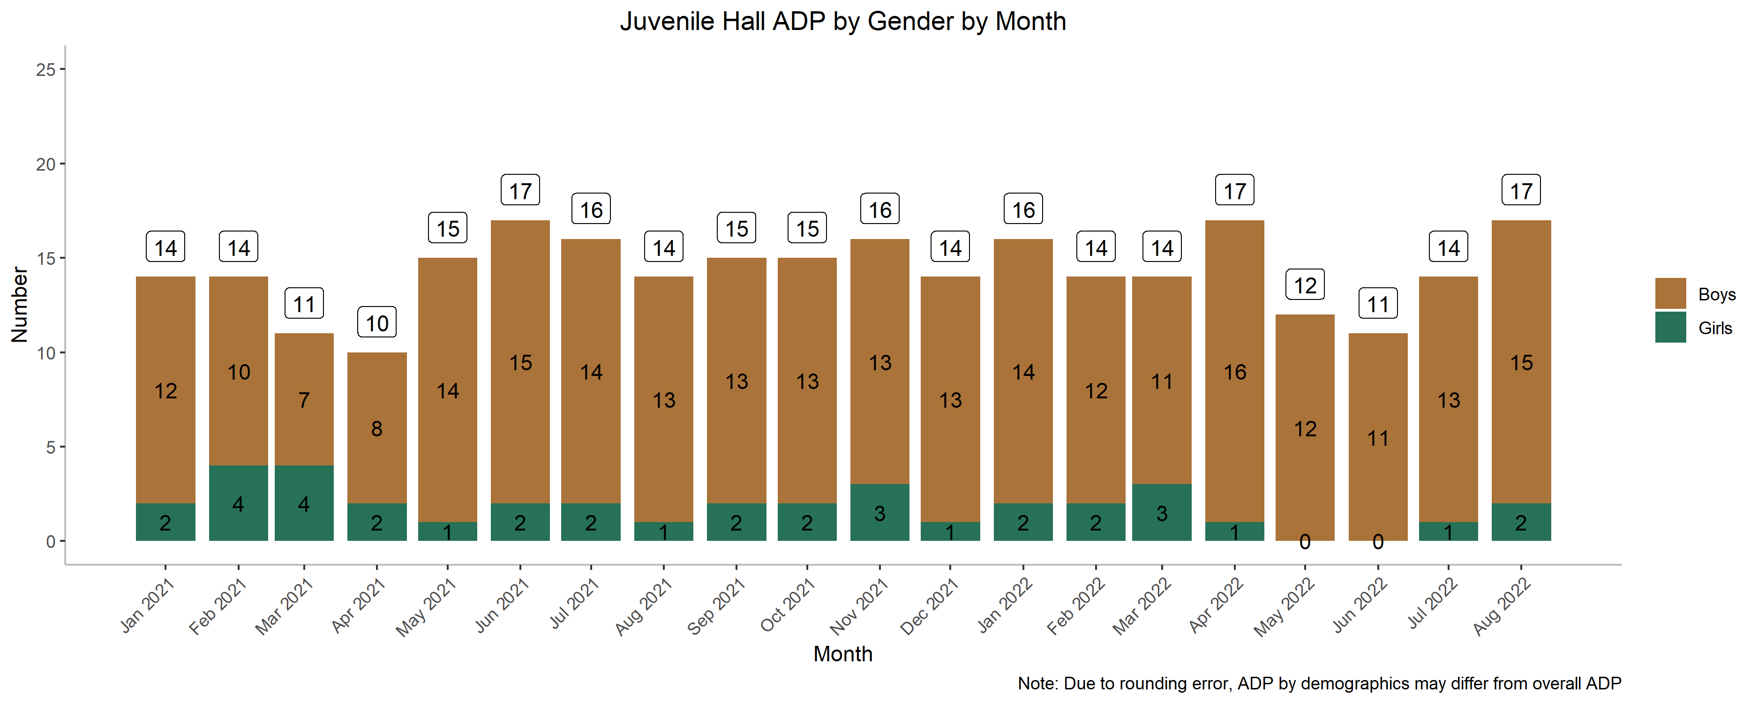
JH Chart 2.1: ADP by Gender

Slide 10
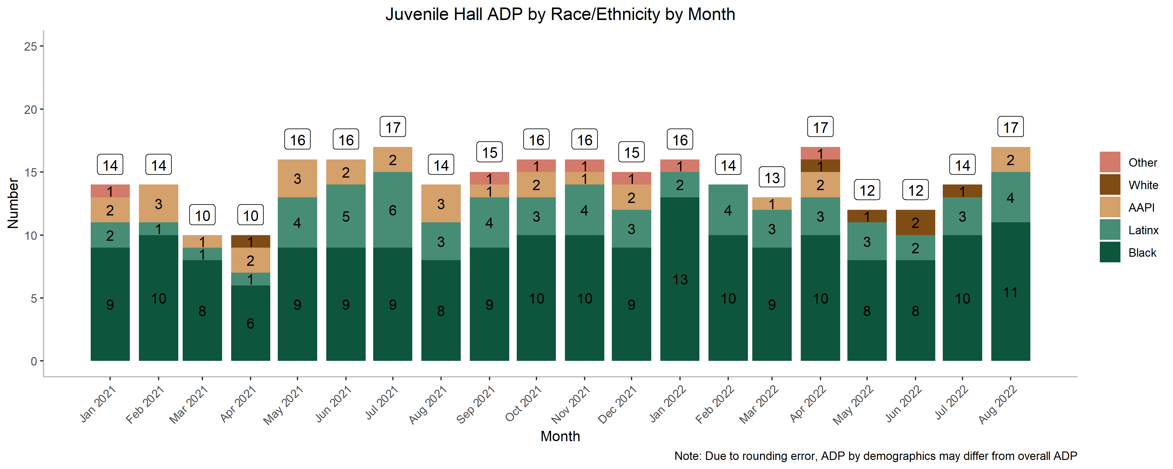
JH Chart 2.2: ADP by Race/Ethnicity

Slide 11
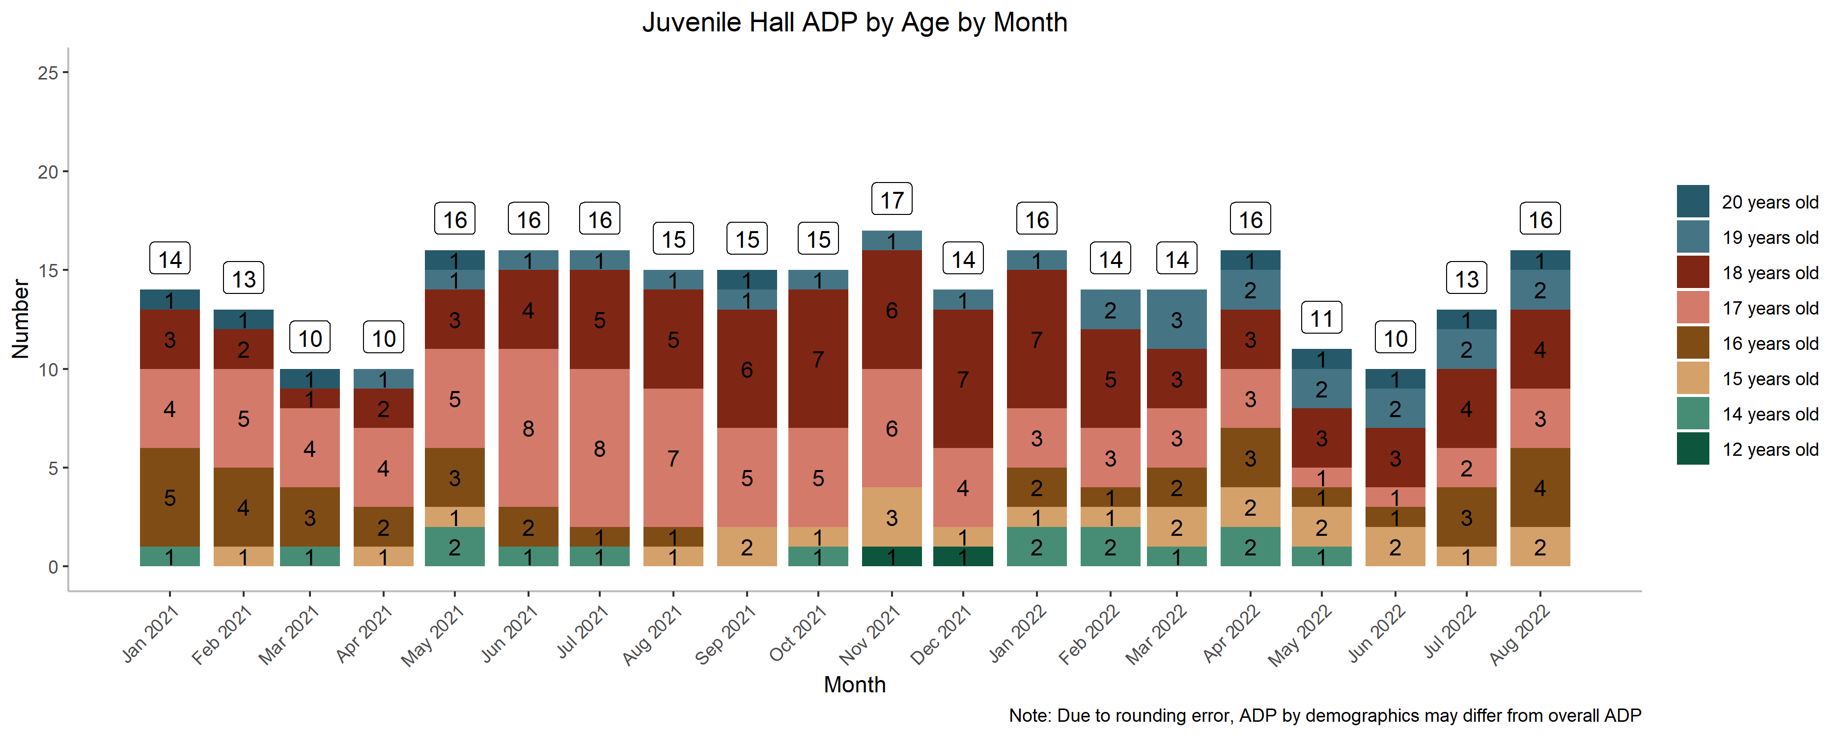
JH Chart 2.3: ADP by Age

Slide 12
JH Charts 3.1 - 3.3: Average Length of Stay
Description
  Chart 3.1 shows the range in length of stay for youth released throughout the month and youth in custody on the last day of the month.
  Charts 3.2 & 3.3 present the mean and median length of stay (ALOS) for: (3.2) youth released each month and (3.3) youth in custody on the last day of the month.
In August,
  For the 21 youth released from Juvenile Hall throughout the month, the mean LOS was 7 days and the median LOS was 4 days.
  For the 23 youth in custody on the last day of the month, the mean LOS for youth in custody was 197 days and the median LOS was 36 days.
    The very long lengths of stay for youth in custody on the last day of the month were driven by commitments.

Slide 13
JH Chart 3.1: Length of Stay - Range
Sample | N | Min | Median | Mean | Max
Youth Released | 21 | 1 | 4 | 7 | 34
Youth in Custody | 17 | 5 | 36 | 197 | 1072
Non-Commitments |  |  | 16 | 64
Commitments |  |  | 295 | 387

Slide 14
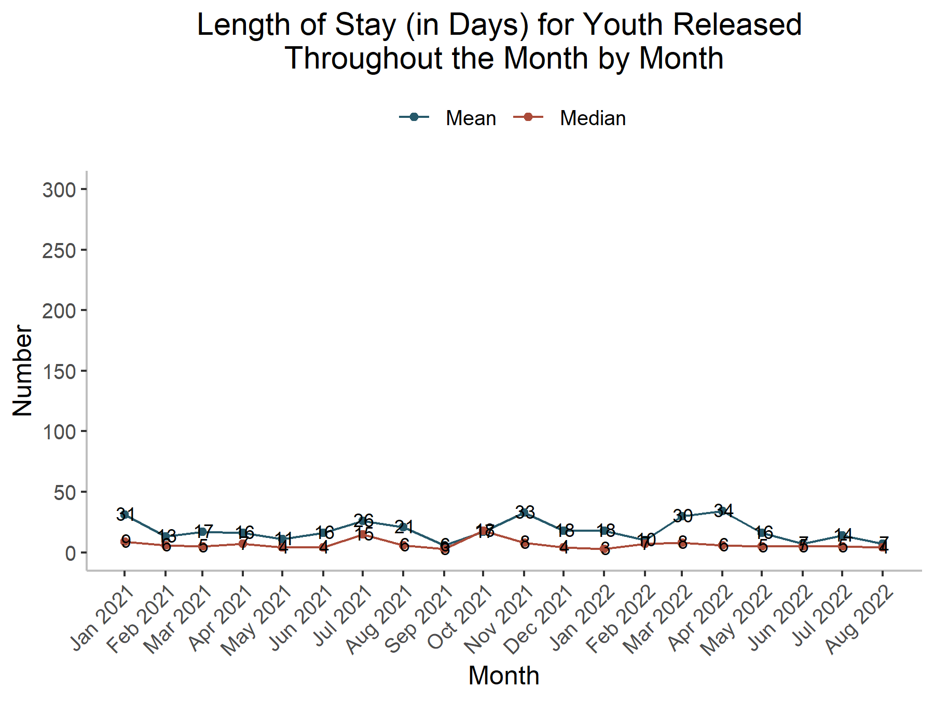
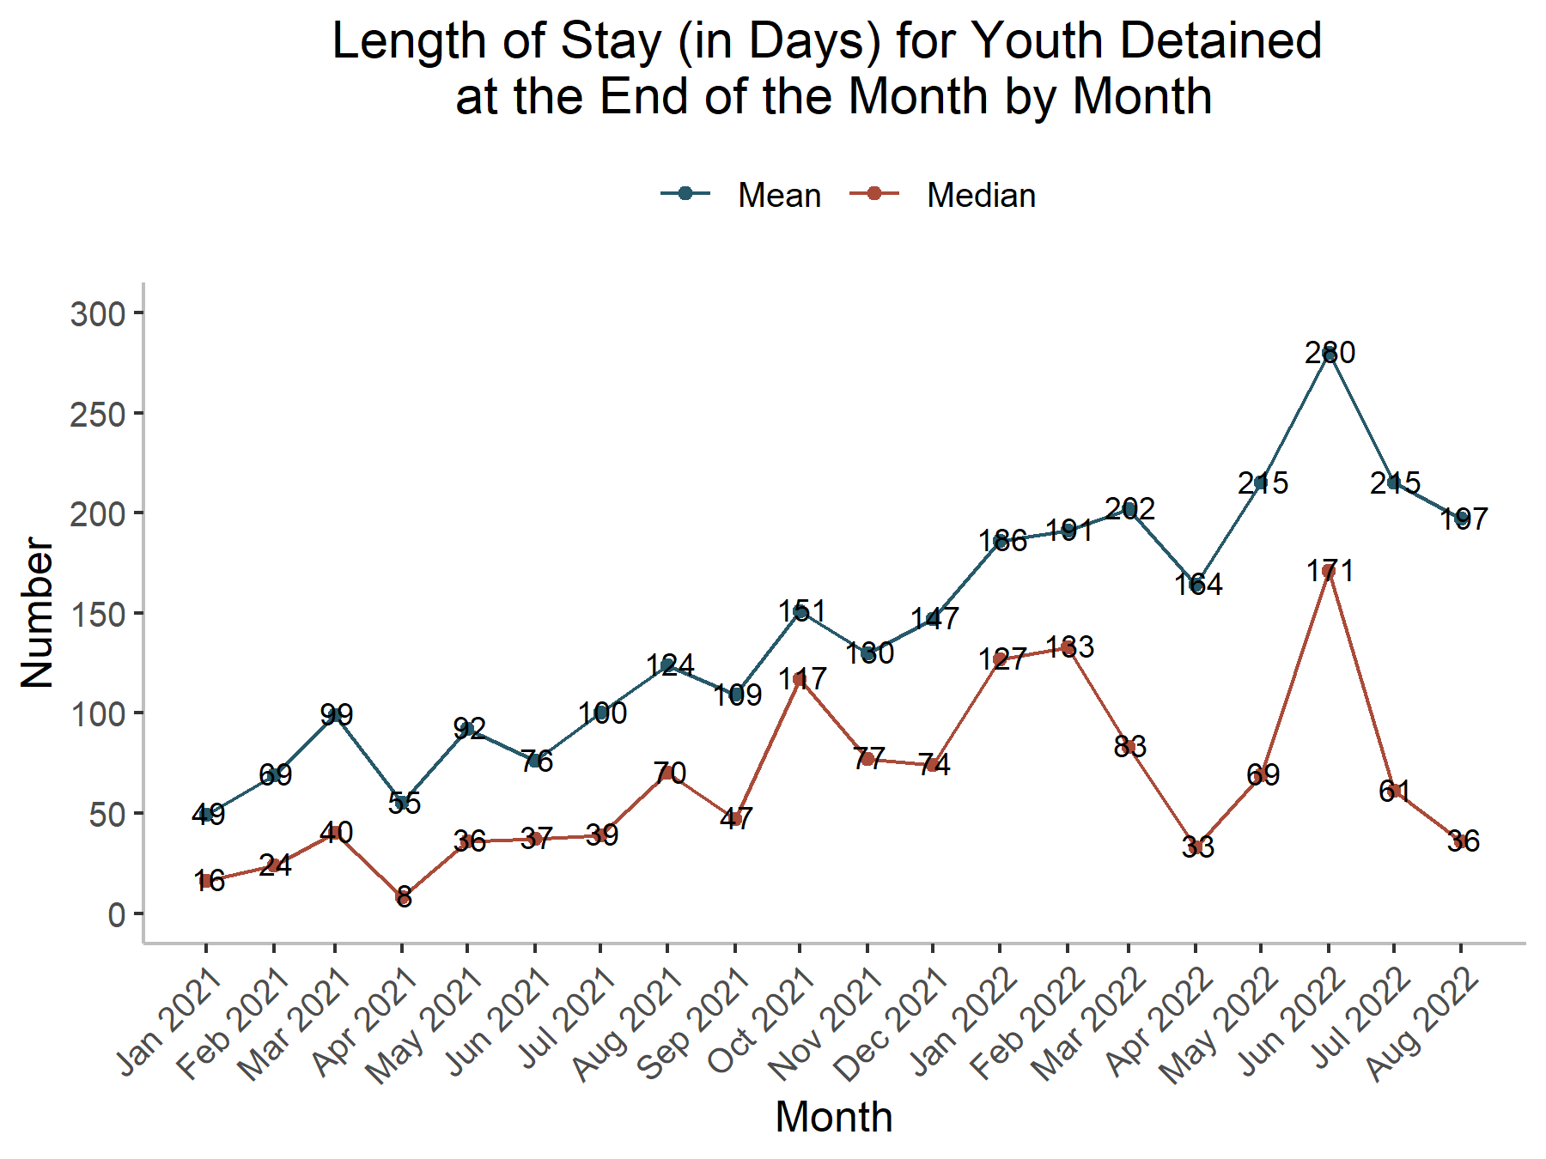
JH Charts 3.2 & 3.3: Average Length of Stay

Slide 15
JH Chart 4: Admissions by Primary Reason
Description
  Chart 4 displays Juvenile Hall admissions by primary detention reason for the entire month.
  Law mandates that youth brought into custody for the following must be detained until they can appear before a judge:
    Youth at least 14 years old, arrested for personal use of a firearm in the attempt or commission of a felony; or any offense listed in Welfare and Institutions Code section 707(b).
    Youth brought into custody pursuant to a court order, bench warrant, or arrest warrant.
    Youth transferred in custody from another jurisdiction.
  Non-mandatory detentions include new law violations that are non-707(b) and/or felonies involving the use of a firearm, and detentions for technical violations-where the DRI outcome recommends detention, or where there was a DRI override.
In August,
  There were 24 admissions to Juvenile Hall.
    63% were mandatory: 10 new law violations, 4 warrants/court orders, and 1 transfer-in
    37% were non-mandatory: 7 DRI scores >= 11 and 2 DRI overrides for repeated failures to engage after prior citations

Slide 16
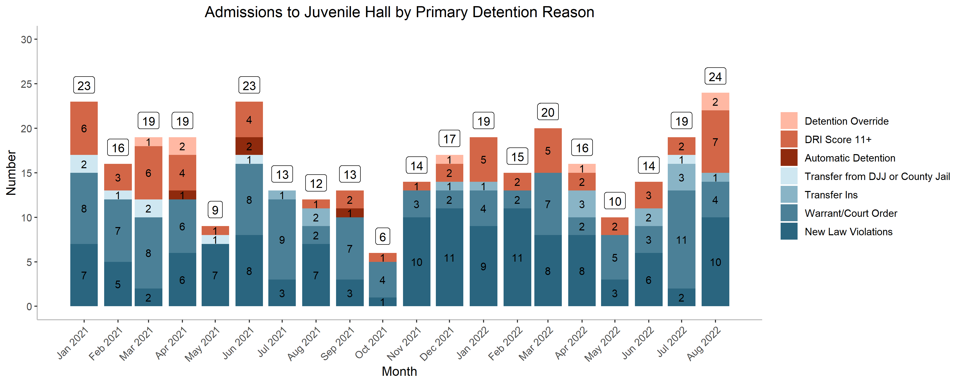
JH Chart 4: Admissions by Primary Reason

Slide 17
JH Chart 5: Placement Youth in Custody
Description
  Chart 5 provides a snapshot of alternative placement youth in custody on the last day of each month.
  Alternative placement includes youth awaiting adjudication, youth pending disposition, youth awaiting placement, youth committed to Juvenile Hall, and youth committed to Secure Track
On the last day of August,
  41% of youth in custody were alternative placements
    Note: There were also 2 youth in SF County Jail pending trial
  Only 2 youth have been in custody awaiting placement on the last day of the month in the first 8 months of 2022, in comparison to 18 youth in the first 8 months of 2021.

Slide 18
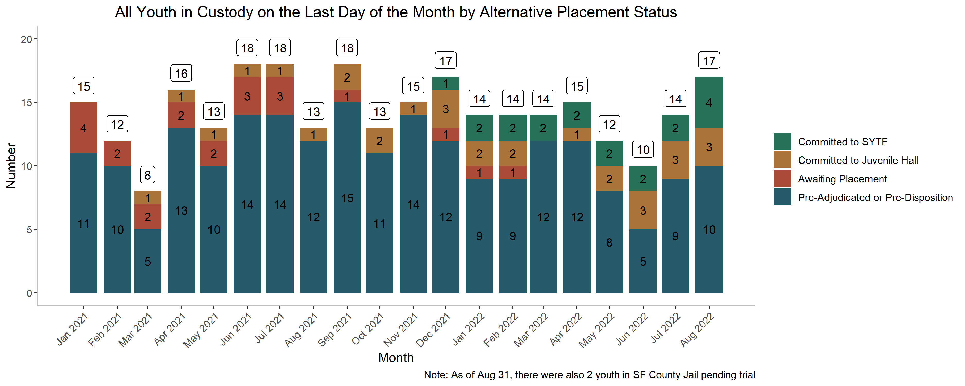
JH Chart 5: Placement Youth in Custody

Slide 19
PS Chart 1: Probation, CARC, & MIR Referrals
Description
  The first Probation Services chart provides statistics about the number of probation referrals, the number of CARC referrals, and the number of referrals to Make it Right each month.
  CARC & Make it Right are both included in the total number of Probation Referrals.
    Note: Data on this chart will be refreshed monthly to account for delays in data entry for referrals.
In August,
  There were 52 referrals to Probation:
    40 were for felonies (77%); 15 of which were for 707(b) offenses (29%)
    7 were for misdemeanors (13%)
    5 was for warrants/probation violations (10%)
  There were 13 CARC referrals and 6 Make it Right referrals.

Slide 20
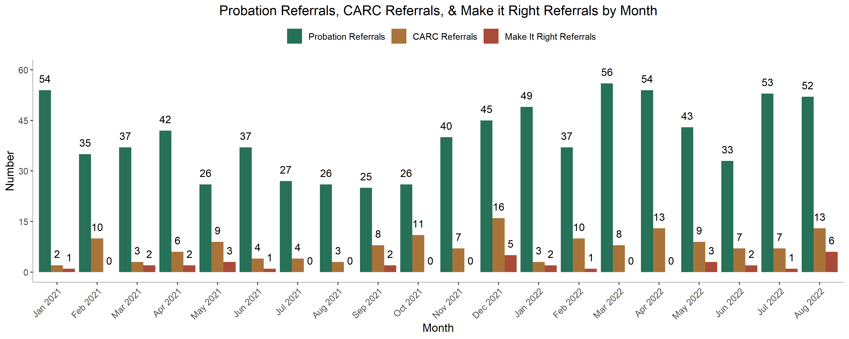
PS Chart 1: Probation, CARC, & MIR Referrals

Slide 21
PS Chart 2.1: Probation Active Caseload
Description
  Chart 2.1 provides the total number of active cases on JPD's caseload for all units, both pre-and post-adjudication, as well as AB12, as of the last day of the month.
On the last day of August,
  The JPD active caseload was 288 youth.
    There were 179 pre-adjudicated cases, 50 post-adjudicated cases, and 59 AB12 cases.
  The total active caseload is about the same as this time last year.

Slide 22
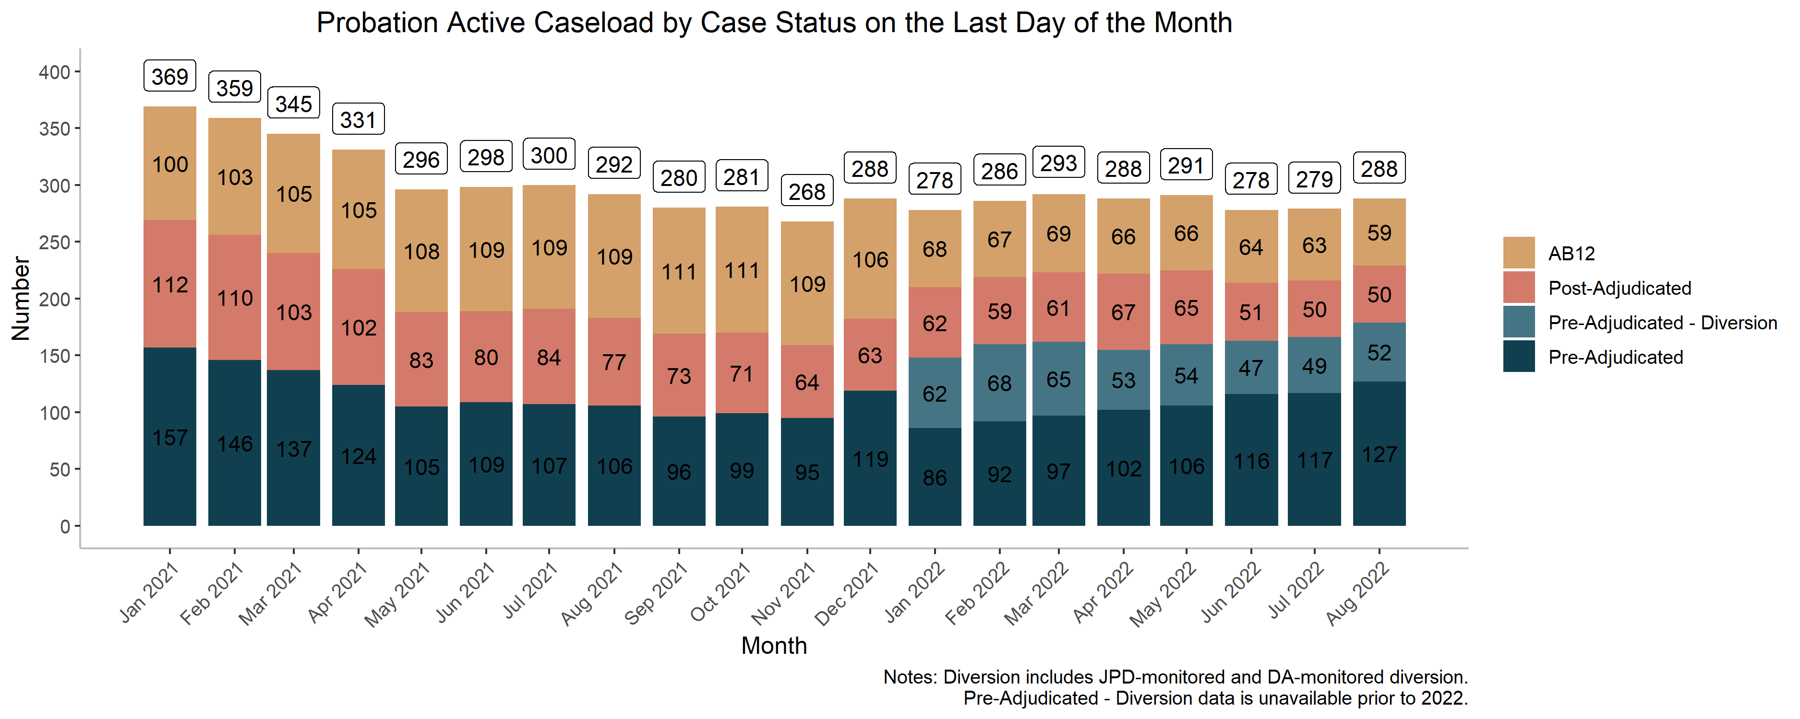
PS Chart 2.1: Probation Active Caseload

Slide 23
PS Charts 2.2 & 2.3: Active Caseload by Unit & Average Caseload Size
Description
  Chart 2.2 shows active caseload by Unit by month, reflecting the most recent Unit restructurings.
    Vertical 1 & Vertical 2 have been combined for the purpose of this graph.
  Chart 2.3 shows the average caseload size per case manager by unit.
    Note: This includes all JPD staff that carry a caseload, including CARC, as well as JPD's AB12 social workers.
On the last day of August,
  The largest caseload was the combined Vertical at 158 youth and the smallest was Placement/JCRU at 29 youth.
  The average caseload size per case manager was 19 youth.
  Vertical had the highest average caseload size per case manager at 26 youth, while Placement/JCRU had the lowest at 10 youth.

Slide 24
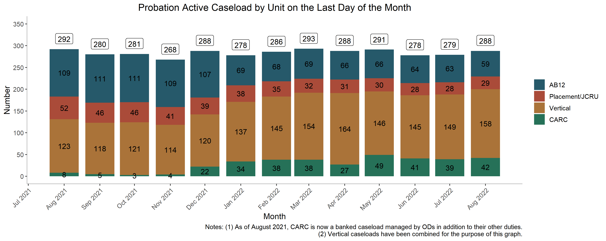
PS Chart 2.2: Active Caseload by Unit

Slide 25
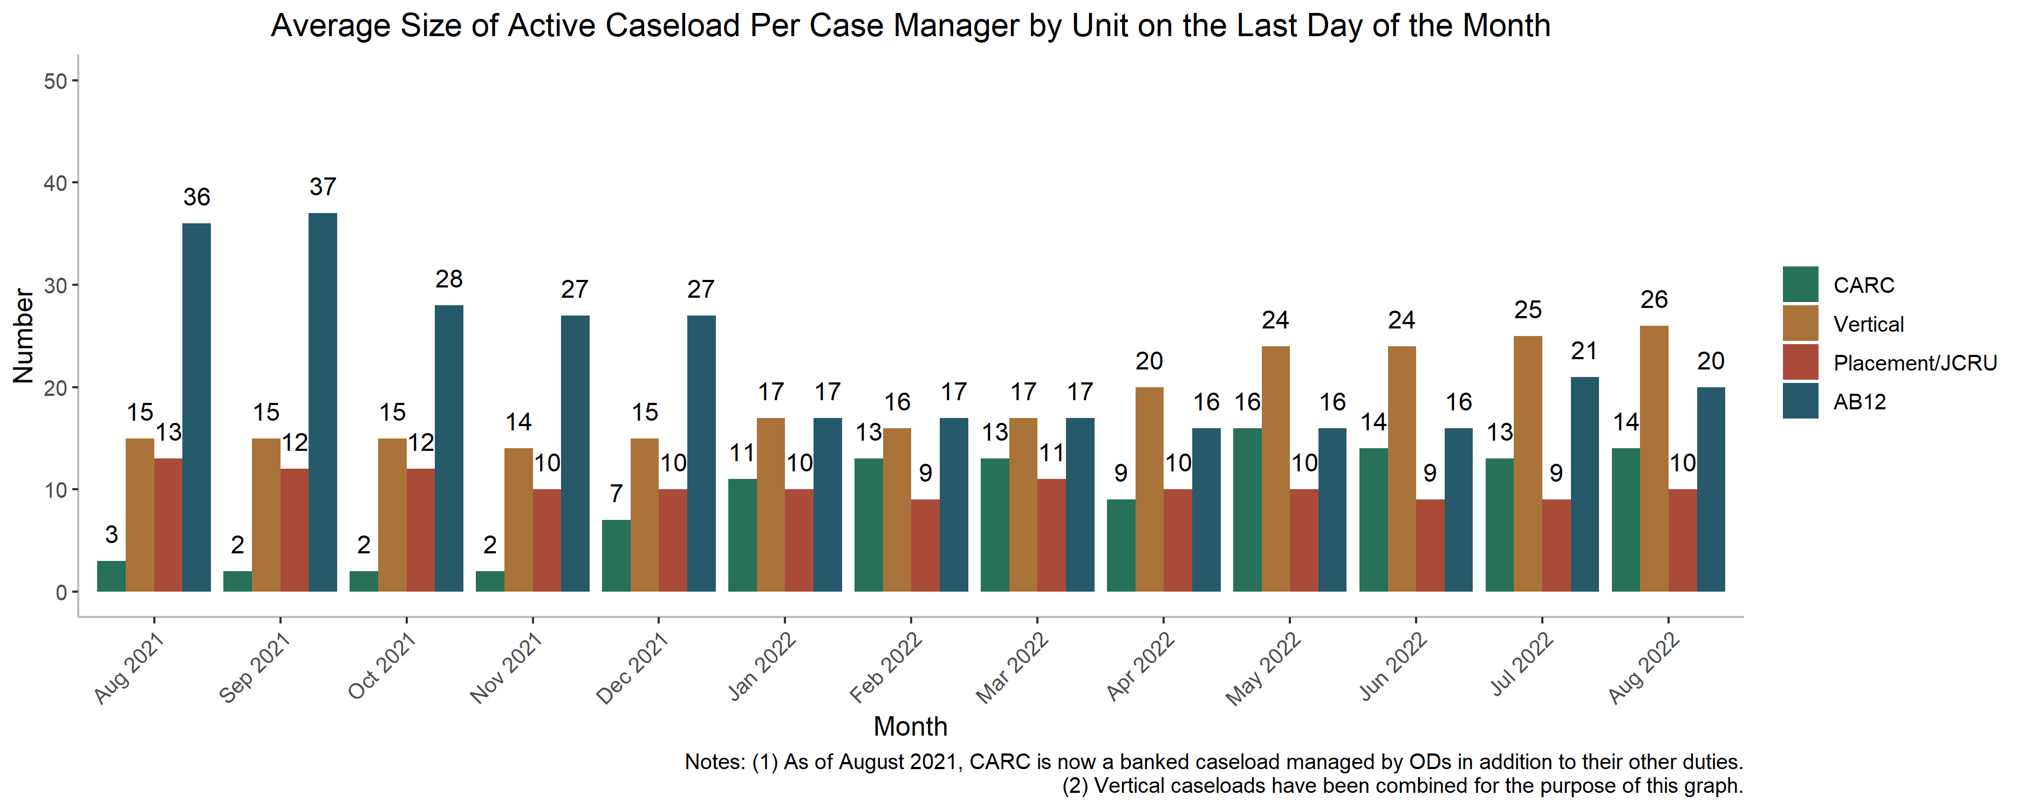
PS Chart 2.3: Active Caseload by Average Caseload Size

Slide 26
PS Chart 2.4 & 2.5: Active Caseload Demographics
Description
  The next two slides show active caseload demographics (race/ethnicity, gender, age), residential zip codes, and age as of the last day of the month. Chart 2.4 shows the age breakdown for the active caseload, by Unit.
As of the last day of August,
  Girls represented 19% of the active caseload, and boys represented 81%.
  46% of the active caseload was Black, 39% was Latinx, 5% was AAPI, 6% was white, and 4% was other/unknown race/ethnicity.
  43% of youth supervised by JPD live outside of San Francisco, and 28% of youth live in five zip codes, with the largest group (11%) living in Bayview/Hunter's Point (94124).
  44% of JPD's active caseload is 18 or older, with AB12 and Placement/JCRU supervising a larger percentage of young adults than other units.

Slide 27
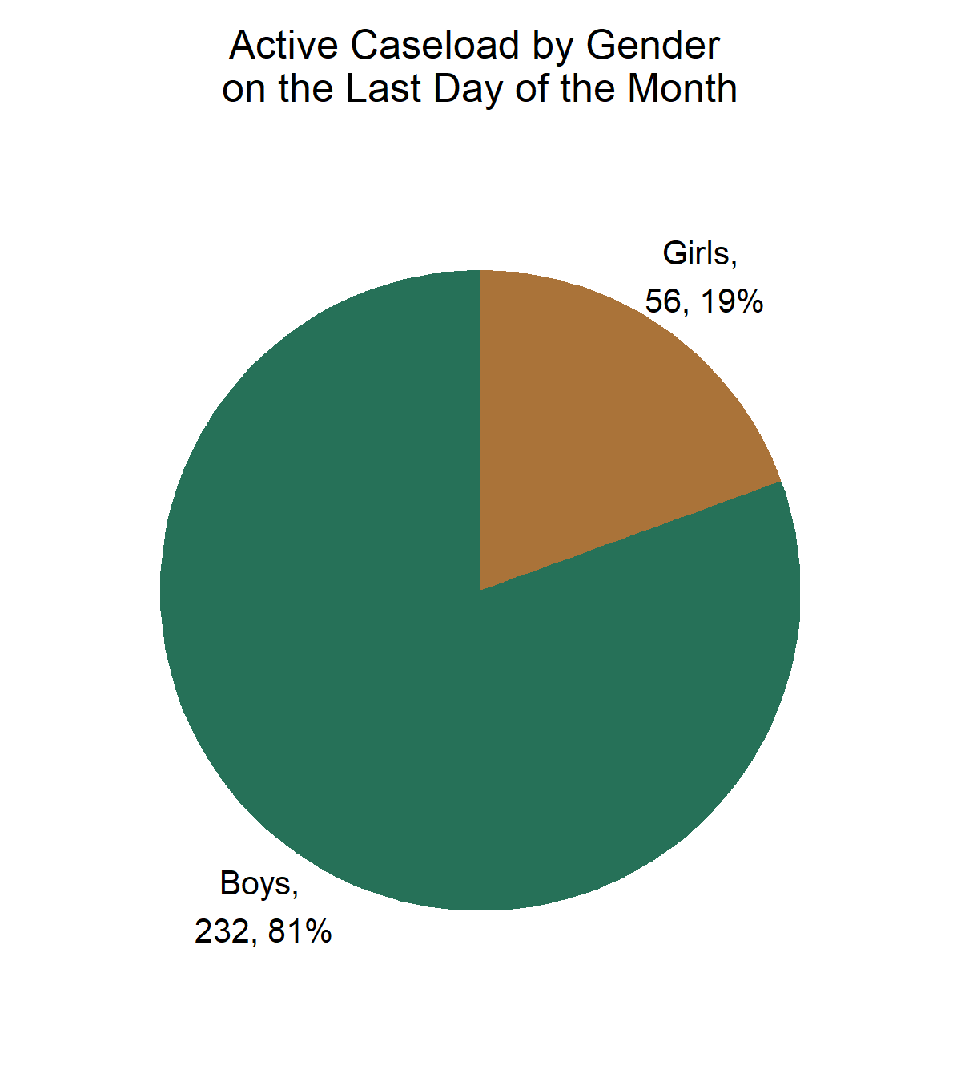
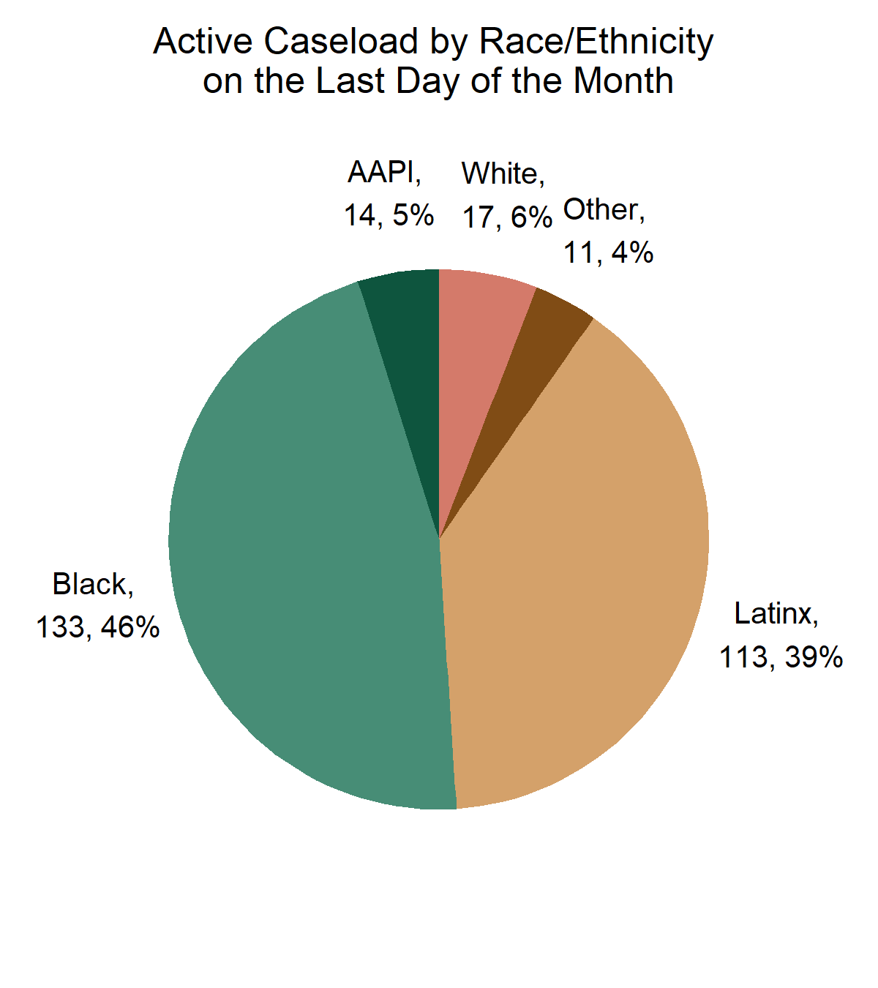
PS Chart 2.4: Active Caseload Demographics
Neighborhood | # of Youth
Out of County | 125
Bayview/Hunters Point (94124) | 31
Visitacion Valley/Sunnydale (94134) | 14
Ingleside/Excelsior (94112) | 13
Mission/Bernal Heights (94110) | 12
Tenderloin/West. Addition (94102) | 12

Slide 28
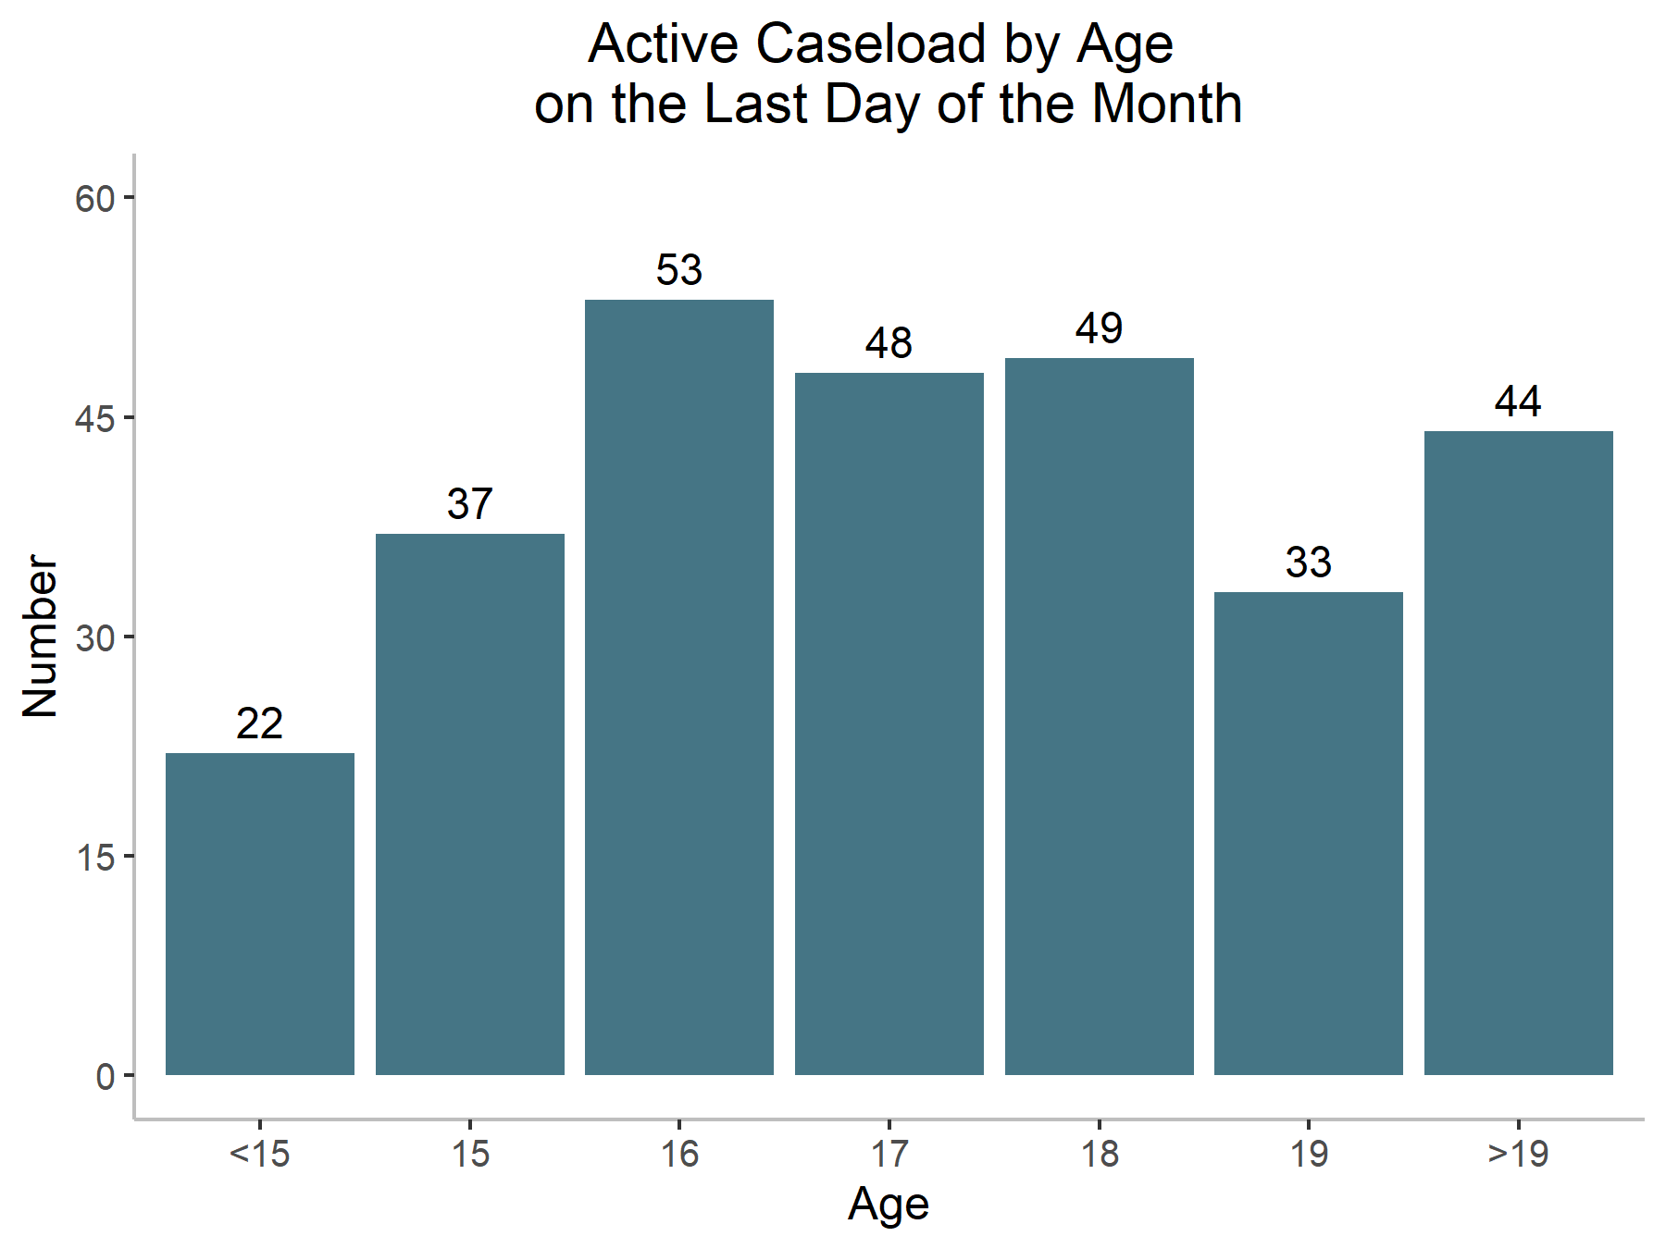
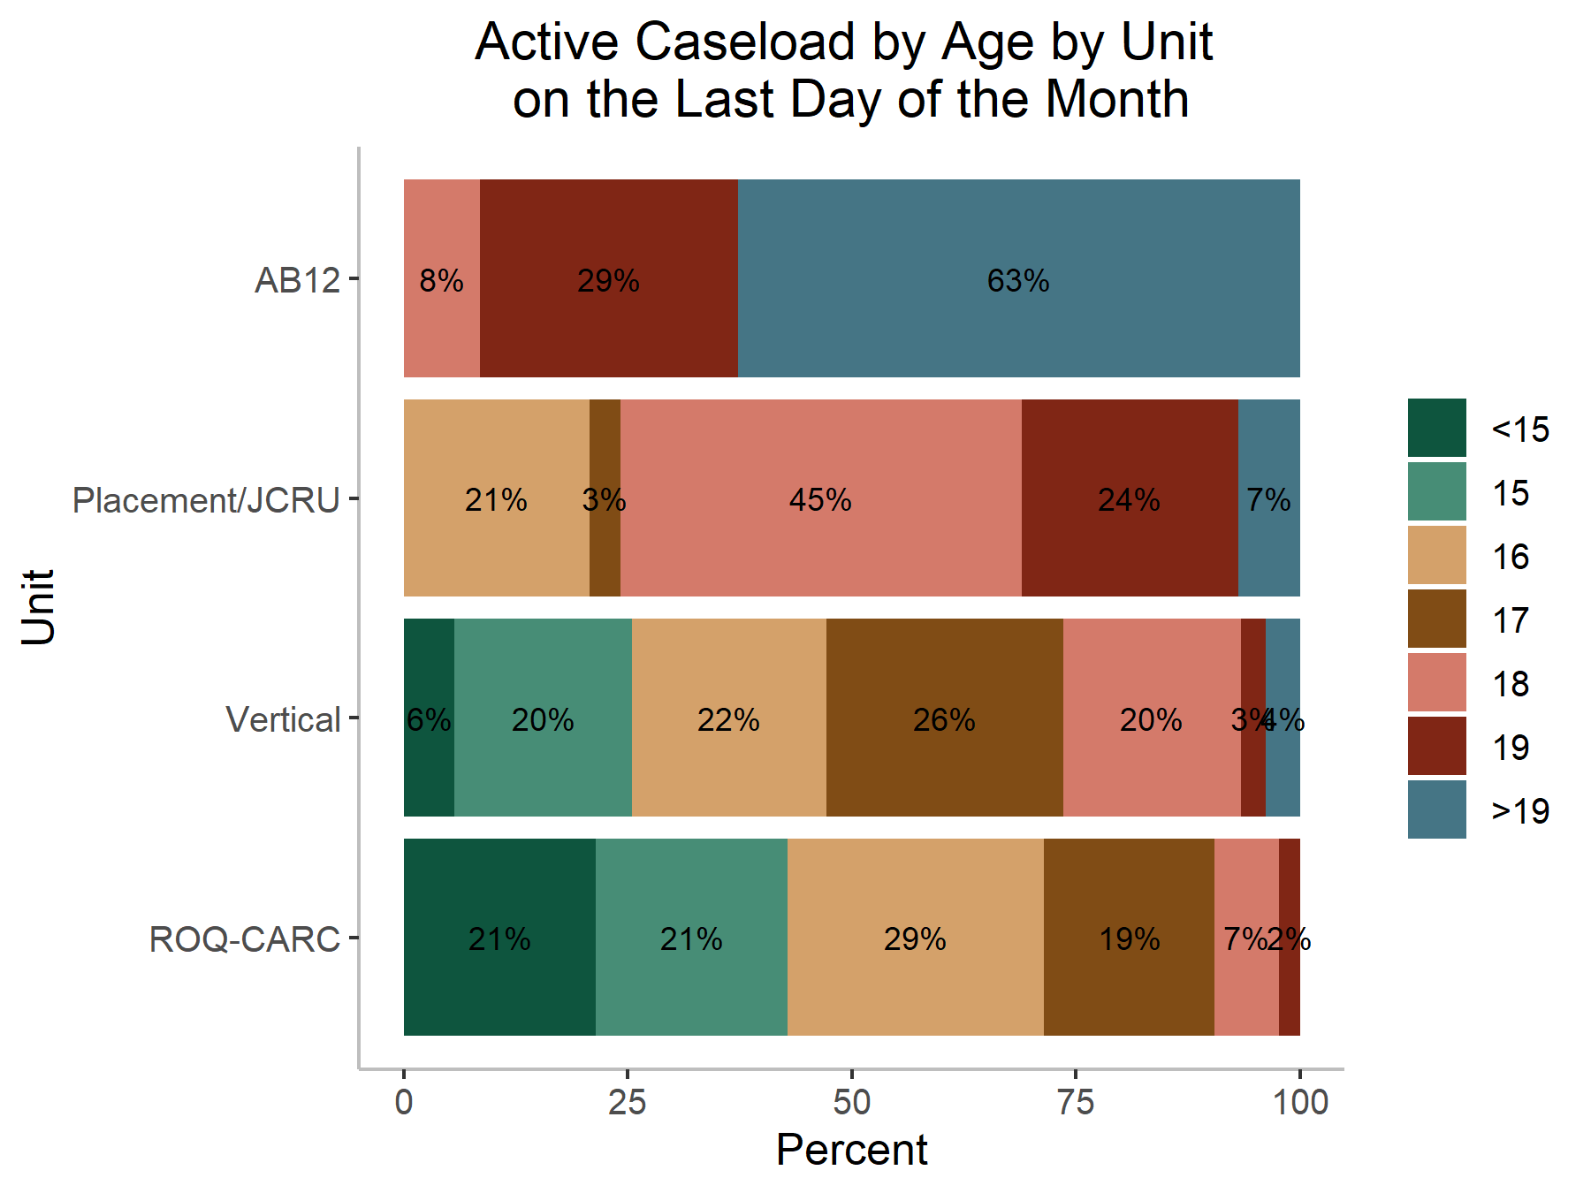
PS Chart 2.5: Active Caseload Demographics

Slide 29
PS Chart 3: Active Caseload Active in Programs
Description
  This is a new slide that depicts the percentage of JPD's active caseload that is active in SF programs by month.
    Note: This figure excludes AB12 from active caseload and program counts due to a lack of programs data in JPD's case management system for AB12 youth.
As of the last day of August,
  58% of youth on active caseload were active in SF programs
    Notes: (1) Youth who are only on electronic or alcohol monitoring are not included in this calculation. (2) Youth active in programs outside of SF will not be captured in this graph.

Slide 30
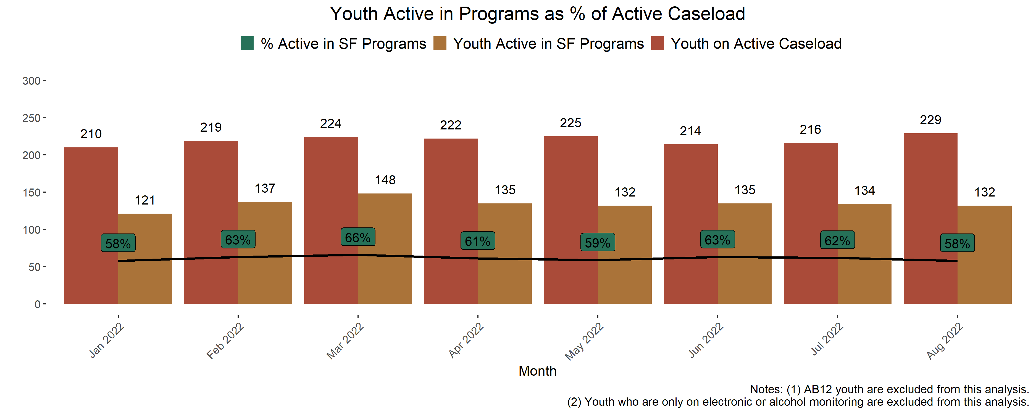
PS Chart 3: Active Caseload Active in Programs

Slide 31
PS Chart 4.1 - 4.3: Alternative Placement
Description
  Chart 4.1 shows all youth in alternative placements by Gender, as of the last day of each month for all status categories (see Alternative Placement Glossary):
  Table 4.2 provides details for each alternative placement category, as of the last day of each month.
  Chart 4.3 provides the county breakdown for all alternative placements as of the last day of the month.
As of the last day of August,
  The total alternative placement population was 28 youth, a 32% decrease from the same time last year.
  So far in 2022, RFAs have accounted for an average of 18% of alternative placements per month, STRTPs have accounted for 9% were placed in STRTPs, and commitments have accounted for 16%.

Slide 32
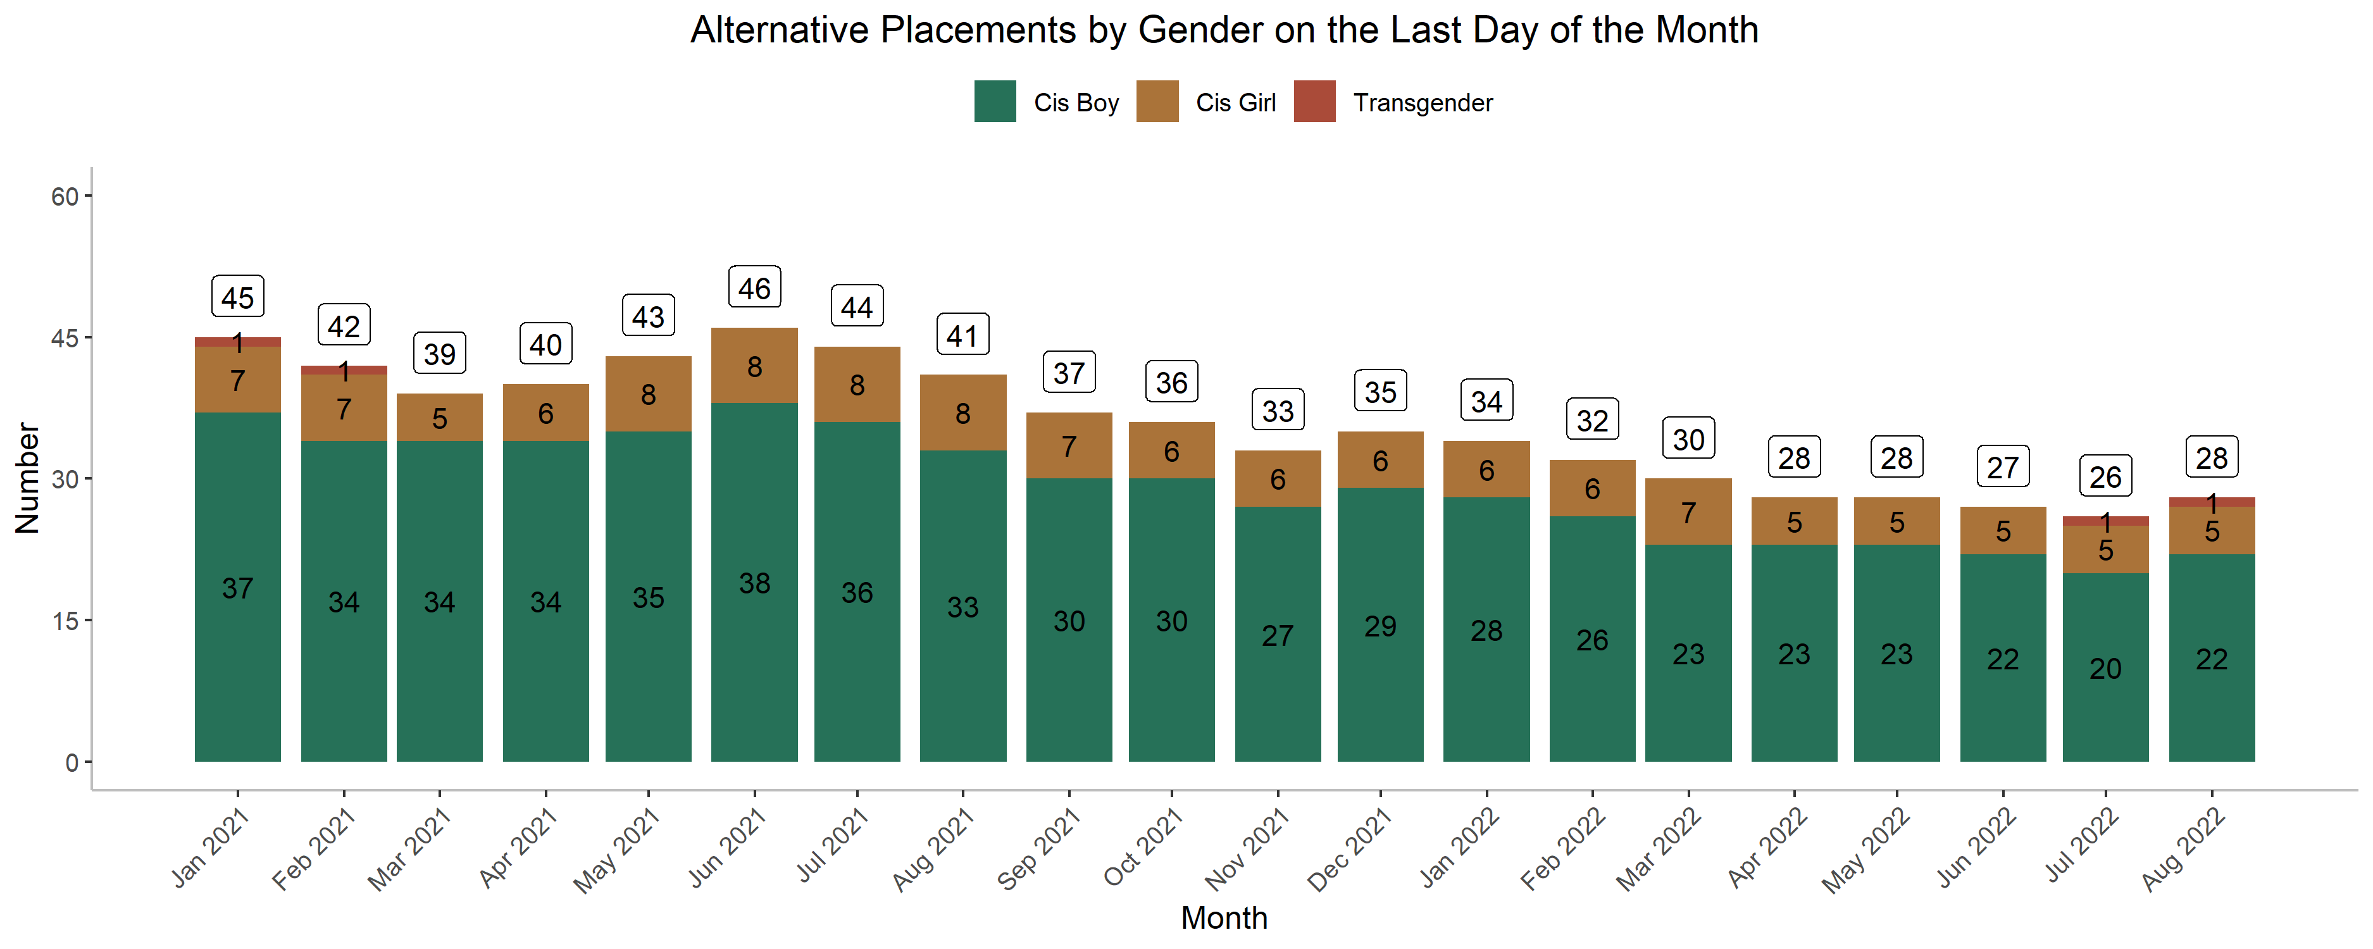
PS Chart 4.1: Alternative Placements by Gender

Slide 33
PS Chart 4.2: Alternative Placements by Details
Alternative Placements | Jan-22 | Feb-22 | Mar-22 | Apr-22 | May-22 | Jun-22 | Jul-22 | Aug-22 | Avg % 2022
Pending Adjudication | 3 | 2 | 1 | 0 | 1 | 1 | 0 | 0 | 3%
Pending Disposition | 3 | 2 | 3 | 3 | 3 | 1 | 1 | 1 | 7%
Pending Placement | 1 | 1 | 0 | 0 | 1 | 0 | 0 | 0 | 1%
STRTP | 2 | 2 | 2 | 3 | 3 | 3 | 4 | 3 | 9%
RFA | 6 | 5 | 6 | 5 | 5 | 6 | 5 | 5 | 18%
SFUSD Out-of-State | 1 | 1 | 1 | 1 | 1 | 0 | 0 | 0 | 2%
Community Treatment Facility | 0 | 0 | 0 | 0 | 0 | 0 | 0 | 0 | 0%
Home Trial (Re-Entry) | 1 | 3 | 4 | 3 | 4 | 4 | 2 | 2 | 10%
THP+FC | 4 | 3 | 3 | 3 | 2 | 3 | 4 | 5 | 12%
THPP | 0 | 0 | 0 | 0 | 0 | 0 | 0 | 0 | 0%
MHRC | 0 | 0 | 0 | 0 | 0 | 0 | 0 | 0 | 0%
Residential Treatment Services | 0 | 0 | 0 | 0 | 0 | 0 | 0 | 0 | 0%
Juvenile Hall/Ranch Commitment | 3 | 3 | 1 | 1 | 2 | 3 | 3 | 3 | 8%
Secure Youth Treatment Facility | 2 | 2 | 2 | 2 | 2 | 2 | 2 | 4 | 8%
County Jail (adult criminal complaint) | 5 | 4 | 2 | 3 | 2 | 3 | 3 | 3 | 11%
AWOL | 3 | 4 | 5 | 4 | 2 | 1 | 2 | 2 | 10%
Warrant Hold | 0 | 0 | 0 | 0 | 0 | 0 | 0 | 0 | 0%
Total | 34 | 32 | 30 | 28 | 28 | 27 | 26 | 28 | 100%

Slide 34
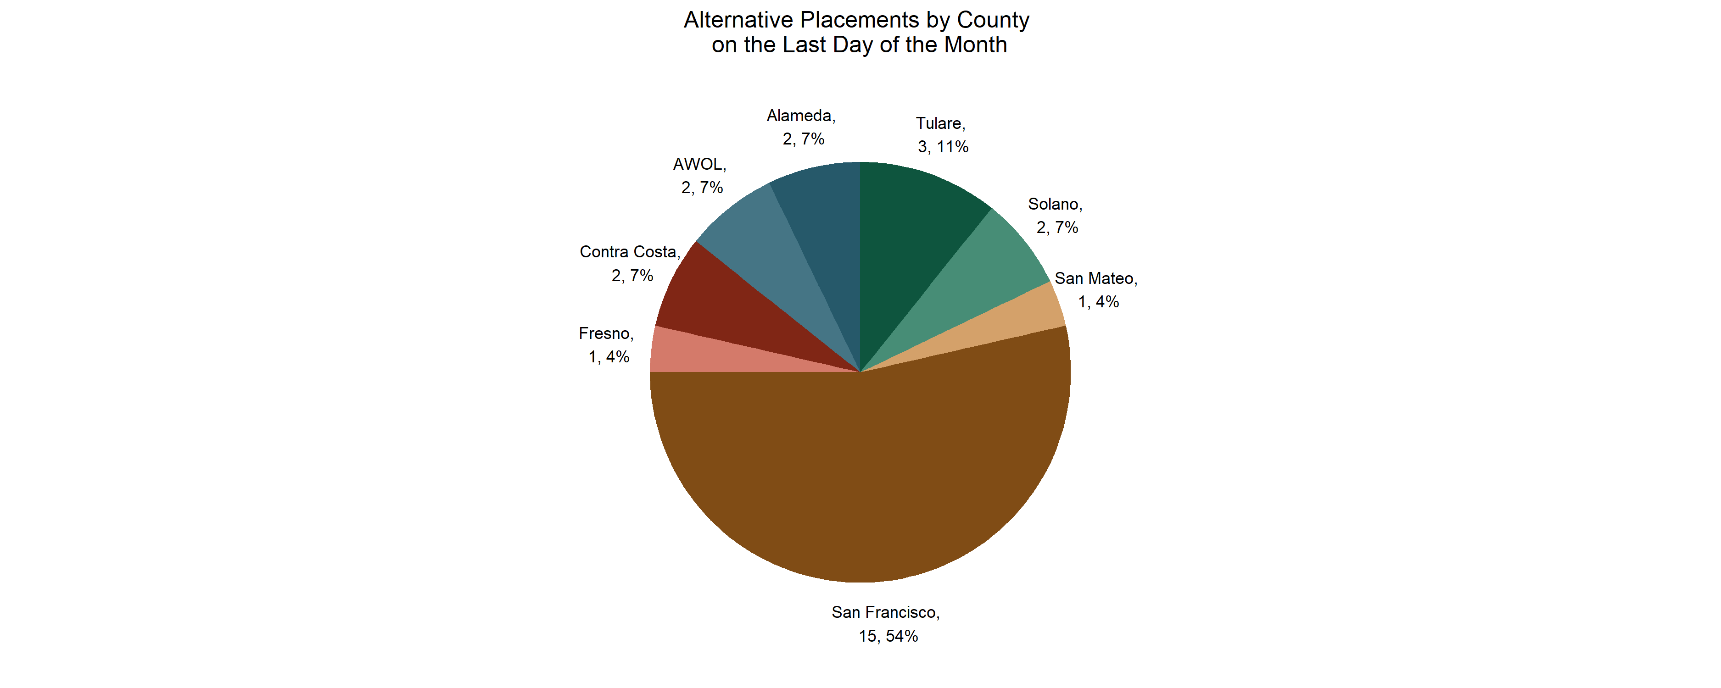
PS Chart 4.3: Alternative Placements by County

Slide 35
Alternative Placement Glossary
Status | Definition
Pending Adjudication | When a youth previously ordered to out of home placement who has a petition filed and is moving through the court process however, the petition has yet to be found true or dismissed.
Pending Disposition | When a youth who has sustained charges and is now awaiting disposition or the court to make a determination on the outcome of the case.
Pending Placement | When a youth who has been committed to out of home placement by the court but is waiting for interviews, notice of acceptance, and the scheduling of transportation is pending placement.
RFA | A Resource Family (RFA) is a caregiver who provides out-of-home care for children in foster care.
STRTP | Short-term Residential Therapeutic Program (STRTP), formerly referred to as a Group Home, is a residential facility operated by a public agency or private organization that provides an integrated program of specialized and intensive care and supervision, services and supports, treatment, and short-term 24-hour care and supervision to children and nonminor dependents.
SFUSD (Out-of-State STRTP) | When a youth has been placed in an STRTP outside of California by the San Francisco Unified School District.
Community Treatment Facility | A Community Treatment Facility is a locked facility that provides intensive clinical services to the highest needs youth experiencing mental health challenges.
Home Trial (Re-Entry) | Home Trial is the period a youth is provided by the Court upon returning from an STRTP.
THP + FC | Transitional Housing Placement-Plus Foster Care (THP+FC), also referred to as AB 12, allows eligible foster youth to extend foster care beyond age 18 and up to age 21. The eligible foster youth are designated Non-Minor Dependents (NMDs) and are entitled to various foster placement options including Supervised Independent Living Settings (SILPs).
THPP | The Transitional Housing Placement Program (THPP) is a community care licensed placement opportunity for youth in foster care between the ages of 16 and 18 years old. The goal of THPP is to help participants emancipate successfully by providing a safe environment for youth, while learning skills that can make them self-sufficient.
MHRC | A Mental Health Rehabilitative Center (MHRC) is a program where adults that have mental health issues that prevent their ability to live independently reside.
Residential Treatment Services | A Residential Treatment Services facility is an adult facility that delivers specific services but does not qualify as a THPP.
Juvenile Hall/Ranch Commitment | When the Court orders a youth to remain in Juvenile Hall or orders them to a ranch as their Disposition.
Secure Track Commitment | Due to the closure of DJJ, youth who would have previously been eligible to be committed to DJJ are now eligible to be committedto a Secure Youth Treatment Facility (SYTF). Currently, San Francisco is using Juvenile Hall as its SYTF.
County Jail (adult criminal complaint) | When a young adult (18+) has an outstanding juvenile warrant and is in county jail due to adult charges.
AWOL | When a youth leaves their court ordered placement or home without approval or consent of the program or parent/guardian/caregiver.

Slide 36
PS Chart 5: Electronic Monitoring
Description
  Chart 4 provides data about the number of youth on electronic monitoring as of the last day of each month and the average length of monitoring.
As of the last day of August,
  There were 10 youth on electronic monitoring, with an average length of monitoring of 76 days
    90% were boys
    80% were Black, 10% were Latinx
  There were 0 youth on alcohol monitoring

Slide 37
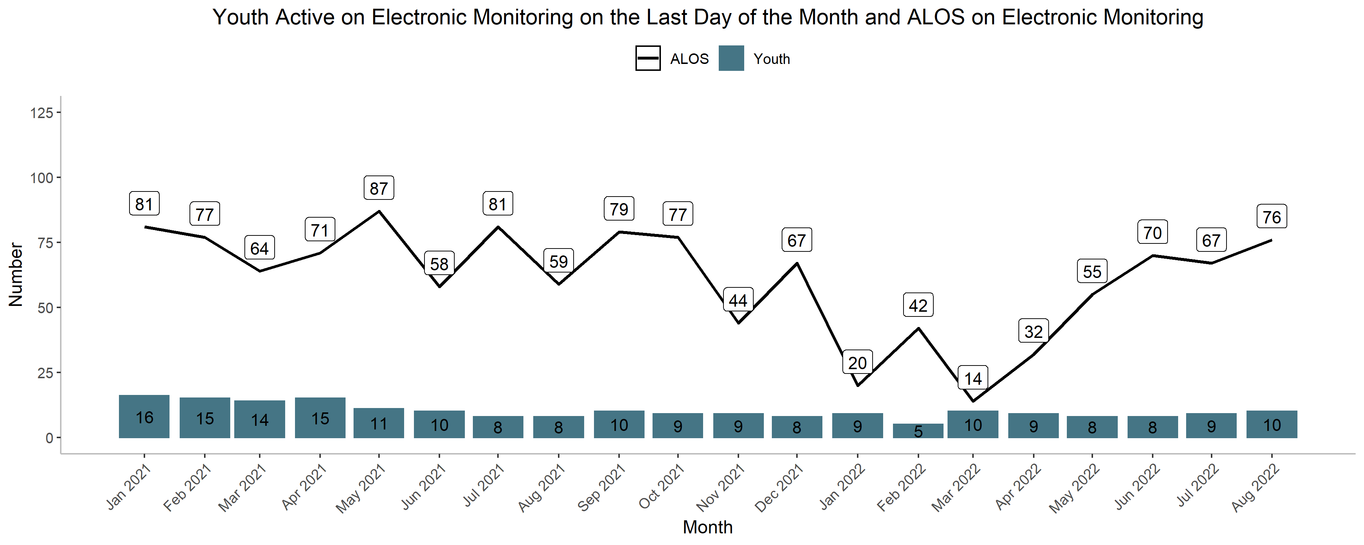
PS Chart 5: Electronic Monitoring

Slide 38
PS Chart 6: Home Detention
Description
  Chart 5 provides data for the number of youth on Home Detention as of the last day of the month.
  Chart 5 also shows the average length of Home Detention on the last day of the month.
As of the last day of August,
  There were 16 youth on Home Detention. The average length of stay was 118 days.
    81% were boys
    50% were Black and 50% were Latinx
  94% were pre-adjudicated

Slide 39
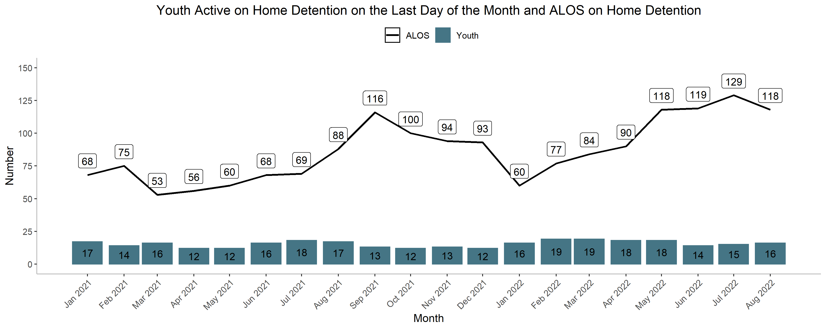
PS Chart 6: Home Detention

Slide 40
PS Chart 7: Petition Dispositions
Description
  Chart 6 shows all petition dispositions by month.
Since the start of 2021,
  4% resulted in commitments to SYTF or Juvenile Hall
  13% resulted in out of home placement (commit + recommit to out of home placement)
  35% of dispositions resulted in wardship probation (ward probation + wardship redeclared).
  5% resulted in 725(a) non wardship probation
  15% resulted in 654 informal probation
  10% resulted in transfers out
  19% resulted in dismissals

Slide 41
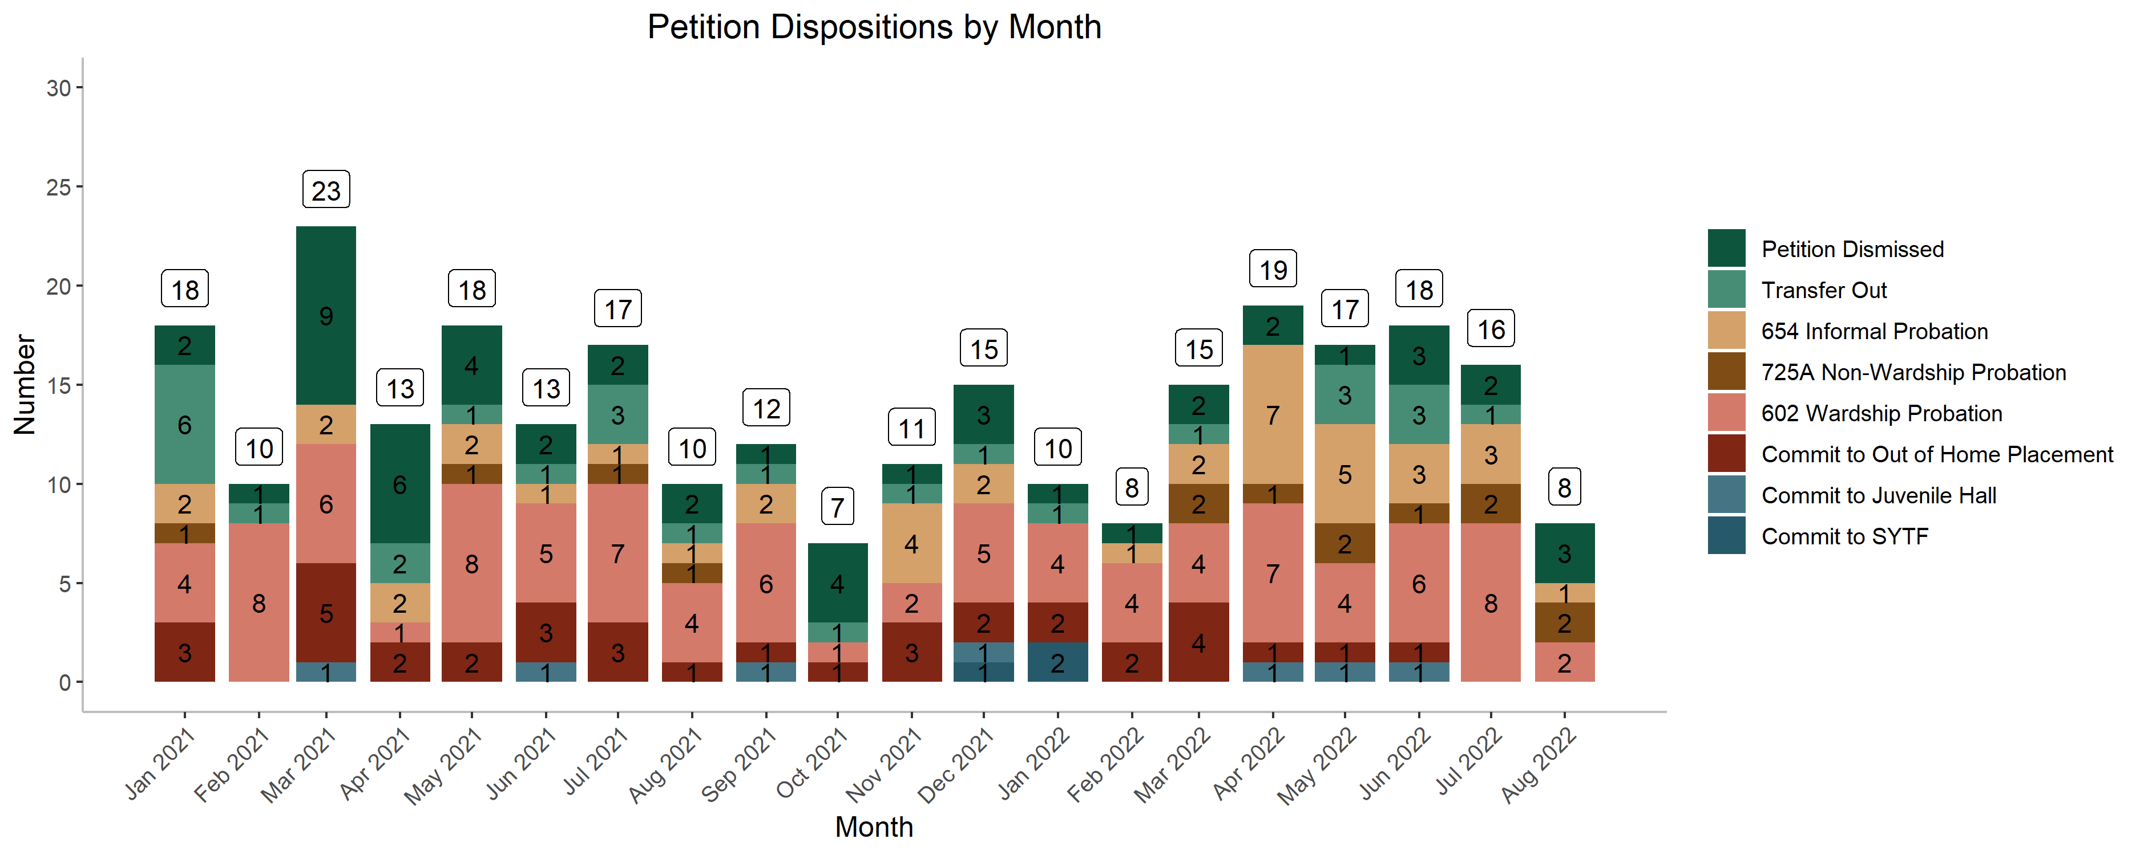
PS Chart 7: Petition Dispositions

Slide 42
THANK YOU
QUESTIONS?

