Slide 1
Committee on Information Technology
Acquisition of Surveillance Technology
October 21, 2019
1 Dr. Carlton B. Goodlett Place, City Hall, Room 305
San Francisco, CA 94102

Slide 2
Purpose of Ordinance
Promote Transparency
Protect privacy rights of residents and business
Initiate a public discussion on government surveillance

Slide 3
“Surveillance Technology” is
  Any software, electronic device, system utilizing an electronic device, or similar device used, designed, or primarily intended to
  Collect, retain, process, or share
  Audio, electronic, visual, location, thermal, biometric, olfactory or similar information
  Associated with, or capable of being associated with, any individual or group
  ...with 15 exemptions
Notes:
Exemption 1) Office hardware in common use by City Departments and used for routine City business & transactions
Exemption 2) City databases and enterprise systems that contain information kept in the ordinary course of City business
Exemption 3) City databases and enterprise systems that do not contain any data or other information collected, captured, recorded, retained, processed, intercepted, or analyzed by Surveillance Technology
Exemption 4) Information technology security systems, including firewalls and other cybersecurity systems intended to secure City data
Exemption 5) Physical access control systems, employee identification management systems, and other physical control systems
Exemption 6) Infrastructure and mechanical control systems, including those that control or manage street lights, traffic lights, electrical, natural as, or water or sewer functions
Exemption 7) Manually-operated technological devices used primarily for internal City communications, which are not designed to surreptitiously collect surveillance data, such as radios, personal communication devices, and email systems.
Exemption 8) Manually-operated and non-wearable handheld cameras, audio recorders, and video recorders, that are not designed to be used surreptitiously and whose functionality is limited to manually capturing and manually downloading video and/or audio recordings
Exemption 9) Surveillance devices that cannot record or transmit audio or video or be remotely accessed, such as image stabilizing binoculars or night vision equipment
Exemption 10) Medical equipment and systems used to record, diagnose, treat, or prevent disease or injury, and used and/or kept in the ordinary course of providing City services
Exemption 11) Parking Ticket Devices
Exemption 12) Police Department interview rooms, holding cells, and internal security audio/video recording systems
Exemption 13) Police department computer aided dispatch (CAD), records/case management, Live Scan, booking, DMV, California Law Enforcement Telecommunications Systems (CLETS), 9-1-1 and related dispatch and operation or emergency services systems.
Exemption 14) Police department early warning systems
Exemption 15) Computers, software, hardware, or devices intended to be used solely to monitor the safety and security of City facilities and City vehicles, not generally accessible to the public.

Slide 4
Otherwise stated:
A “Surveillance Technology” is any technology used to collect information on any individual or group.

Slide 5
Exemptions
15 types of technologies excluded from ordinance compliance:
  TVs, credit card machines, copy machines, telephones, printers
  HR, permitting, license, and business record systems
  Physical/access control systems (i.e. badge systems)
  Systems controlling street lights, traffic lights, electrical, natural gas, water or sewage
  Manually-operated, non-wearable handheld audio/visual equipment
  Manually-operated radios, personal communication devices, and email systems
  Binoculars or night vision equipment
  Medical equipment
  Parking Ticket Devices
  SFPD audio/visual recording systems in interview rooms, holding cells, internal security
  Dispatch, operation, or emergency services systems
  Early warning systems
  Technology solely used to monitor safety of City facilities and vehicles

Slide 6
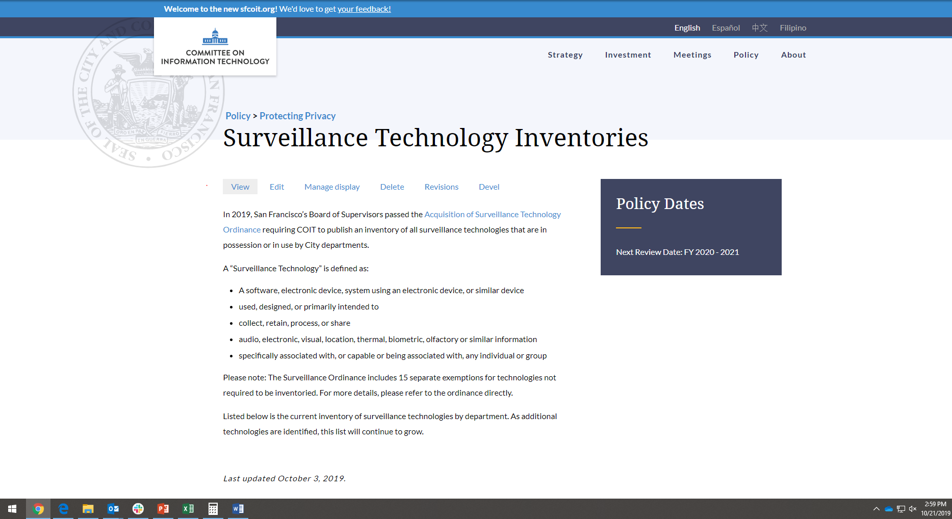
Surveillance Technology Inventory
https://sfcoit.org/SurveillanceInventory

Slide 7
Ordinance Requirements
Requirement | Description | Mandatory Requirements
Impact Report | Contains an assessment of the benefits, costs, privacy, and civil rights impacts. | 7
Technology Policy | Establishes rules of operations to safeguard privacy and civil rights. | 12
Annual Surveillance Report | Continued analysis of impacts and public response to ongoing use | 11

