Slide 1
City & County of San Francisco Technology Purchasing Guidelines
September 2019

Slide 2
Table of Contents
City Policy on Technology Purchases
II. Two Primary Considerations for Purchasing Technology for the City: Commodities v. Professional Services On Premise v. Cloud Computing
III. City Policy on Cloud Computing
IV. How does the City buy Technology?

Slide 3
I. City Policy on Technology Purchases
All technology purchases must go through the Office of Contract Administration (OCA).
May be subject to review by the City’s Department of Technology (“DT”).
Can NEVER be completed using Departmental Delegated Authority (aka Prop Q), even if under $10,000.

Slide 4
II. Two Primary Considerations for Purchasing Technology for the City
Before you begin thinking about a solution, consider the following two concepts because they will impact the what, why and how of your purchase.
1. Commodities v. Professional Services
2. On Premise v. Cloud Computing

Slide 5
Consideration 1: Commodities v. Professional Services
 | Commodities | Professional Services
Examples | Hardware Software Standard software support Cloud computing software w/out technical services Non customized training | Customizations Services Configuration Services Integration Services Cloud computing software w/ technical services Managed Services Customized Training
Solicitation Model | Low Bid Request for Proposals (RFP) | Request for Proposals (RFP) Request for Qualifications (RFQ)
Who Does the Solicitation? | Low Bid: OCA RFP: Department | RFP: Department RFQ: Department
Solicitation Model:

Slide 6
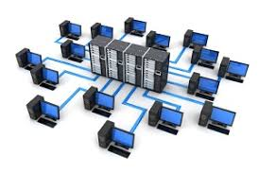
Consideration 2: On Premise v. Cloud Computing
On Premise:
The product is located within the physical confines of YOUR enterprise. Whether a software, network, data center or application, YOU maintain it.
Most importantly, your data is under YOUR control.
Cloud Computing:
The product is hosted within the physical confines of the SERVICE PROVIDER’S enterprise and accessed using a web browser.
The SERVICE PROVIDER is responsible for maintaining access to the cloud and storage of your data.
Cloud Computing Models:
Software as a Service (SaaS)
Infrastructure as a service (IaaS)
Platform as a service (PaaS)
Desktop as a service (DaaS)
Backend as a service (BaaS)
IT as a service (ITaaS)
PROCEED WITH CAUTION BECAUSE YOUR ARE GIVING UP CONTROL OF YOUR SYSTEMS AND/OR DATA!

Slide 7
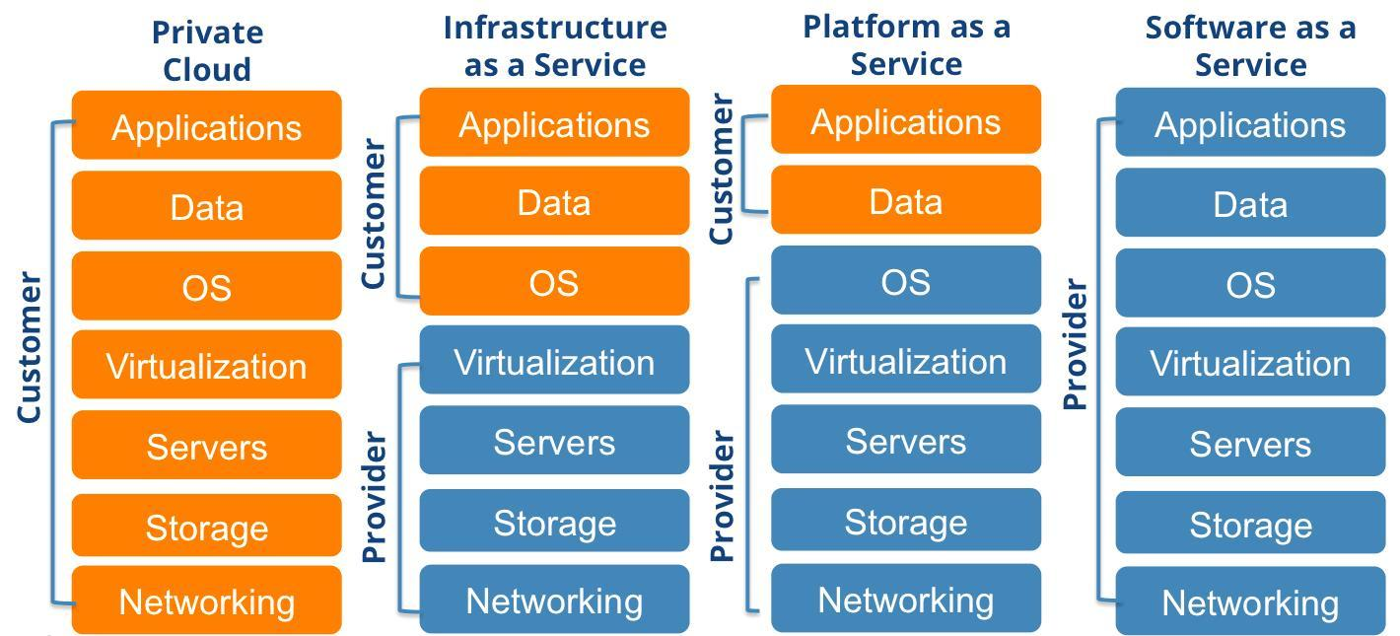
On Premise v. Cloud: Who is in control?
On Prem/
Private Cloud

Slide 8
III. City Policy on Cloud Computing
Use of cloud services encouraged when:
Cost-efficient;
Potential risks are considered and mitigated; and
Supports interoperable systems throughout City
Departments must conduct a risk assessment to identify data security/privacy issues and how to mitigate them. If they cant be mitigated, a Cloud solution is not appropriate.
Data/System Classification | Potential Risk
Level 1: Public | None - Low
Level 2: Internal Use | Low
Level 3: Sensitive | Low
Level 3: Sensitive | Moderate
Level 4: Protected | Moderate
Level 5: Restricted | High

Slide 9
IV. How does the City buy Technology?
 | Technology Marketplace Term Contracts | Public Bid / Direct Contract
Process Duration | 1-4 weeks | 3+ months
Transaction Limits | Tiers 1 & 2: $2.5MM Tier 3: Products: $110K, Services: $600K | None
Cloud Computing Ok? | Yes, if data risk is at or below “Level 3-Low” (See slide 8). Must buy from Tier 1 suppliers only. | Yes, in accordance with City policy on cloud computing.
Ok to Name Manufacturer? | Yes. You can name the product of your choice. | No. Must provide specs or make No Substitute request to OCA.
Solicitation Thresholds | ≤ $25K: Bid not required > $25K Commodities: Bid out by OCA > $25K Services: Bid out by Dept (See slide 5) Exception: No bid required for Tier 3 if under $110K. May not request to waive solicitation requirements. | ≤ $10K: Bid not required > $10K Commodities: Bid out by OCA > $10K Services: Bid out by Dept (See slide 5) Use OCA waiver portal to submit request to waive solicitation requirements. Guide to Request to Waive Solicitation Requirements.pdf Service Now Website
Solicitation Audience | Technology Marketplace resellers. Choose from one of three Tiers. | All suppliers w/ a City Supplier ID, Business Tax License and be 12B compliant. 12B Exception: 21.30 Software Licenses/Maintenance purchases < $10MM
Purchasing Method | RQ to PO, through OCA, using OCA’s Term Contracts. PO issued by OCA, accompanied with non-negotiable term sheets. Department cannot sign any agreements. Department must abide by manufacturer use terms. | Multi-year contract, regardless of amount. Department negotiates contract directly with supplier. Once contract has been approved, Department issues POs against it.
Civil Service Approval (Professional Services) | Not required. Submit request to Local 21. 10 day wait period. | Required. Submit request to Civil Service. Expedited 7 day review if < $100K. Otherwise min. 30 days for union review, then full commission hearing.
Other Agency Approvals | DT: See DT CIO policy to determine if applicable. Submit request in DT ServiceNow. CMD: Forms 2A and 2B if Professional Services over $110K. | Multiple agencies. Use OCA’s checklists as guide.
For details on each item above, go to https://sfgov.org/oca/resources and download the latest version of OCA’s Technology Purchasing Guidebook.

