Slide 1
Delegated Departmental Purchasing (DDP) Training (Prop Q Training)
Office of Contract Administration

Slide 2
Agenda
History & Purpose of Prop Q | Supplier Compliance
OCA/Policy Requirements | Additional Considerations and Resources
Authorized Purchases | Prop Q – Do’s and Don’ts
Restricted Purchases | Prop Q Exam

Slide 3
History & Purpose of Prop Q
In 1993, a charter amendment (Proposition Q) was passed that changed the City’s purchasing procedures to allow, with the Purchaser’s approval, departments to buy supplies and equipment on their own if the purchase was less than $5,000 (now $10,000).
Pursuant to this delegated purchasing authority, departments assume responsibility for ensuring that all processed purchases comply with the City’s legal requirements.
Historically, the City’s Prop Q spending has averaged approximately $75M-$80M/year.

Slide 4
OCA/Policy Requirements (§ 21.03(a))
Departments must submit roster of employees in the department who are authorized to purchase goods and services using Prop Q authority.
All designated employees must attend a Purchasing training class.
All designated employees shall file a Form 700, Statement of Economic Interests, annually.
All employees who exercise Prop Q purchasing authority must adhere to OCA’s standards of ethical purchasing conduct (see DDP Reference Guide).

Slide 5
OCA’s Ethical Purchasing Standards
Avoid the intent or even the appearance of unethical or compromising behavior. | Avoid any personal business or professional activity that would result in a conflict of interest.
Avoid soliciting or accepting money, gifts, lunches, or anything of value from current or potential suppliers. | Handle confidential and/or proprietary information with due care.
Promote positive supplier relationships through courtesy and impartiality. | Know and obey the letter and spirit of all applicable ordinances, rules and regulations.
Purchase without prejudice, seeking to obtain the maximum value for each dollar spent. | Avoid unfair practices, giving all vendors equal opportunity.

Slide 6
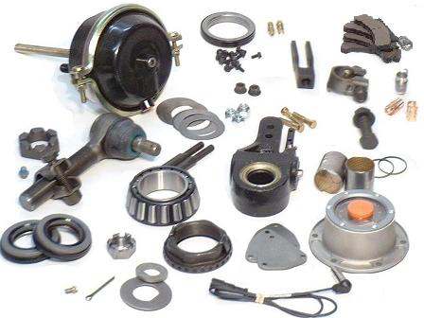
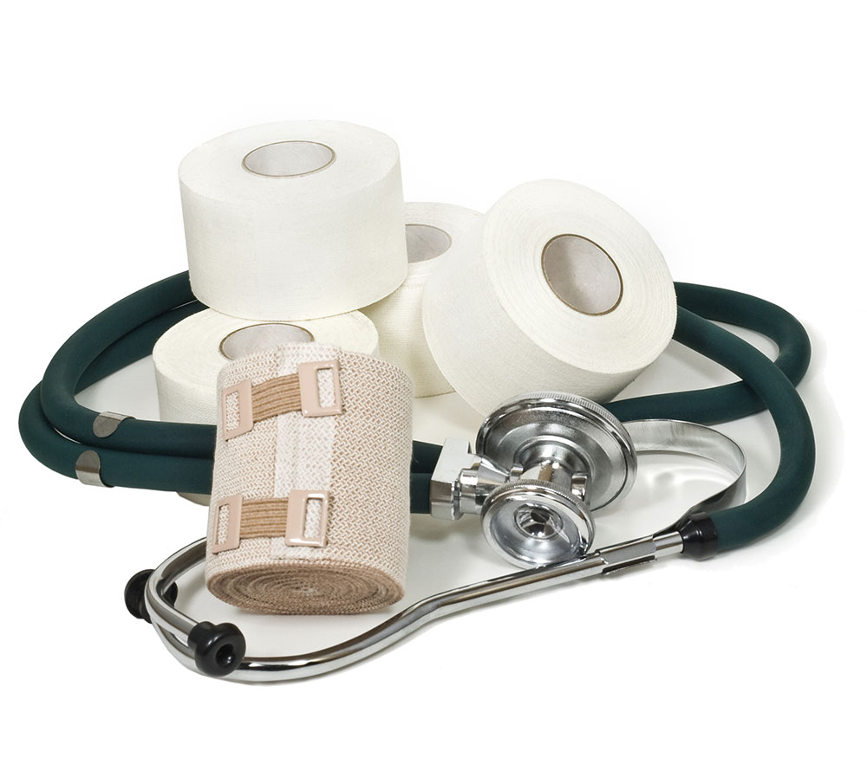
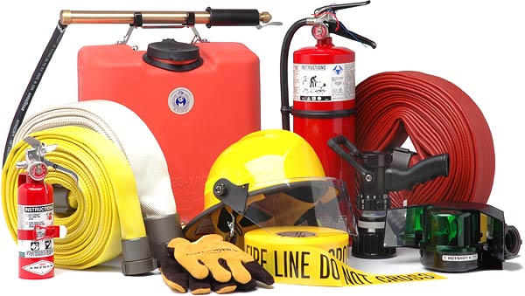
Authorized Purchases
Employees with Prop Q purchasing authority are authorized to procure material, equipment, supplies and general services up to $10,000 (including tax, delivery, and installation) unless otherwise limited by regulation.*
*See, §21.03(a), Rules and Regulations Pertaining to the San Francisco Administrative Code, Chapter 21.

Slide 7
Unauthorized Purchases – General Restrictions
Any commodity or service greater than $10,000 (including applicable sales tax and shipping)
Professional Services contracts
Construction contracts or services involving construction trade work
Bid/Order Splitting
> $10k
Bid/Order Splitting

Slide 8
Unauthorized Purchases - Categories
The following categories of equipment, goods and services are NOT allowed under Prop Q:
Unbudgeted Items
Items Available on Term Contracts
Equipment Leases
Mattresses
IT-Related Goods and/or Services
Telecom Equipment or Wiring
Vehicles
Gift Cards
Drones
Surveillance Equipment
If you’re not sure…Ask.

Slide 9
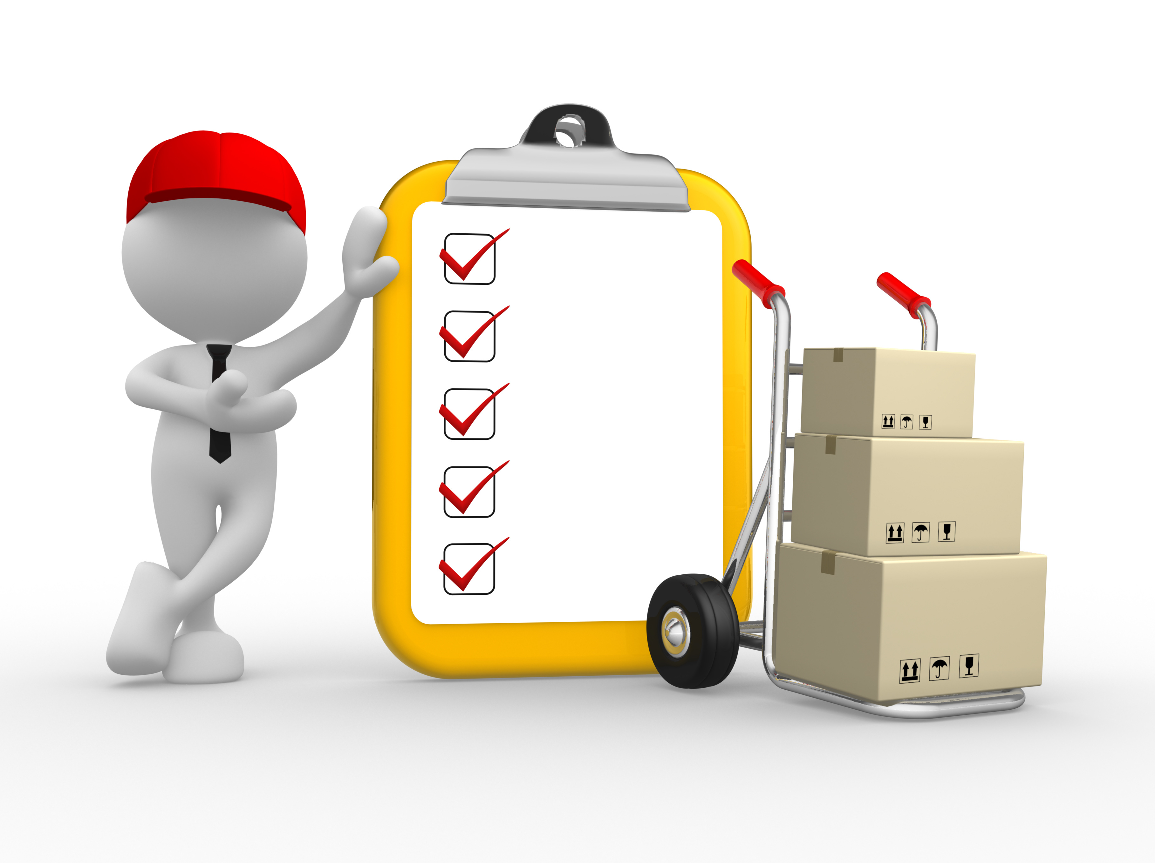
Supplier Compliance
Departments are responsible for verifying compliance with ALL City requirements when exercising their Prop Q purchasing authority.
Business Tax
Buying Green
Equal Benefits
Anti-LGBT & Restrictive Abortion Laws
Local Business Enterprises
=
Supplier
Compliance
The Controller’s Office will conduct periodic audits to ensure compliance.

Slide 10
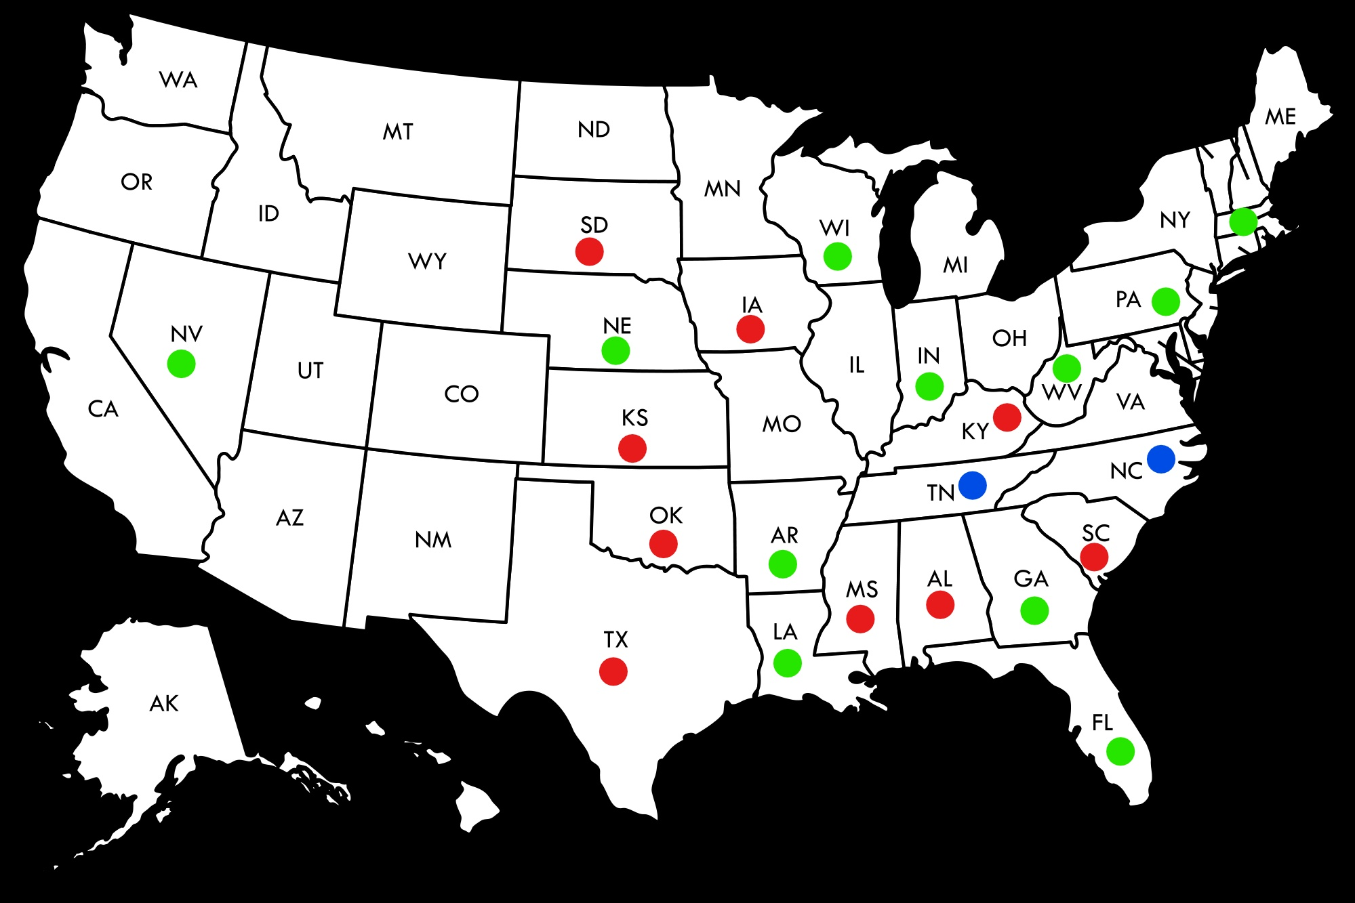
12X Covered State List
VT
NH
MA
RI
CT
NJ
DE
MD
DC
HI
Anti-LGBT Laws – Effective February 2017 (2 states)
Restrictive Abortion Laws – Effective January 2020 (13 states)
Covered Under Both Laws (9 states)

Slide 11
Supplier Compliance Resources
Business Tax Registration
https://sftreasurer.org/registration
Buying Green
https://www.sfapproved.org/guide-city-staff
LBE (14B) Program
https://sfgov.org/cmd/14b-local-business-enterprise-ordinance
Equal Benefits (12B) Program
https://sfgov.org/cmd/12b-equal-benefits-program
Ban on Anti-LGBT & Restrictive Abortion Laws (12X)
https://sfgsa.org/chapter-12x-state-ban-list

Slide 12
Additional Considerations and Resources
Additional Considerations
General Services that are allowable should be for one-time services (no recurring services) and should also include DHR or CSC approval when necessary.
Services provided on City premises could expose the City to potential liability so insurance may be required. Please check with Risk Management to discuss coverage and insurance documentation requirements.
Make sure to always include any applicable Sales or Use Taxes on your purchase order (www.cdtfa.ca.gov).
Additional Resources
Additional details regarding Prop Q, including a Delegated Departmental Purchasing Guidebook, can be found at the OCA website (www.sfgov.org/oca).
Information regarding ethical purchasing practices can be found at (www.cappo.org) or (www.instituteforsupplymanagement.org).

Slide 13
Prop Q – Do’s and Don’ts

Slide 14
Prop Q – Do’s
Ensure that City funds are spent wisely and adhere to all City laws, rules, regulations and policies
Purchase commodities and one-time general services up to $10,000 (including the costs associated with installation and freight)
Try to solicit three (3) quotes and always try to include LBEs when possible
Be mindful of the City’s Green Purchasing requirements and when buying chemicals or hazardous materials, always include a note on the PO that a Safety Data Sheet (SDS) must accompany the shipment

Slide 15
Prop Q – Don’ts
Bid/Order Splitting
Order items or services that are available on a Citywide Term Contract
Purchase unbudgeted equipment
Order computer hardware, software or IT-related supplies
Purchase vehicles, drones or gift cards

Slide 16
Prop Q Exam

