Slide 1
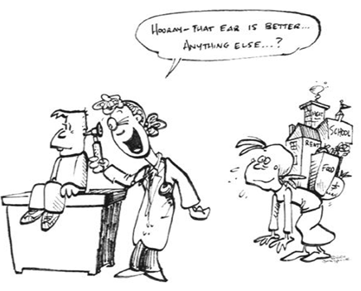
Incorporating SDH into Pediatric Clinical Settings
Laura Gottlieb, MD, MPH
Laura Gottlieb, MD, MPH, UCSF Center for Health and Community
Notes:
1:20 pm - Laura Gottlieb, MD, MPH, Assistant Professor of Family and Community Medicine at the University of California, San Francisco
Effectiveness of patient navigation programs to address social determinants of health in clinical settings: FIND, CCLIP & the Bay Area Regional Help Desk Consortium
Challenges to implementation and dissemination of social determinants of health interventions
Tracking social determinants of health in the EHR

Slide 2
Is it feasible to routinely screen and intervene around social factors in clinical settings?
Patients have no objection to being asked about their social and environmental conditions in health care settings (whether primary or urgent care);
Many social determinants can be actionable and this doesn’t have to interfere with clinical care;
Electronic screening likely results in higher disclosure of social needs.

Slide 3
Bay Area Regional Help Desk Consortium (bayareahelpdesks.org)

Slide 4
What is a Help Desk?
Help Desk Model
Referral to Social Work, Medical Legal Partnership or other professional -tier services.
Patients with
complex needs
Warm Hand-offs &
Culturally Responsive Care
Navigator interventions using desk resources, technology and algorithms.
Patients with
resource
needs
Standardized social & environmental needs screening.
All patients

Slide 5
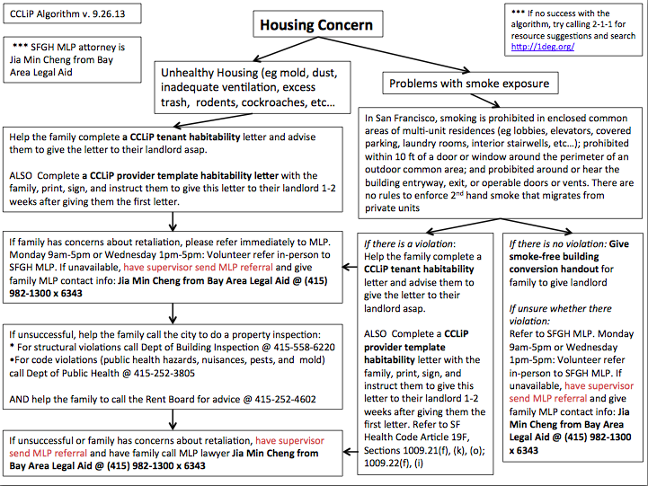

Slide 6
Pediatric Help Desk RCT at SFGH and CHO
Randomized controlled trial with cluster design (by day of the week)
Control group families still receiving more than “standard of care”
Outcomes
Process indicators: Impact on prioritized social needs; benefits access
Intermediate indicators: Impact on food security, caregiver satisfaction with health care services, subjective social status ladder
Longer-term indicators: Impact on child health, health care services utilization

Slide 7
Preliminary Results (Six weeks)
% of families with resolution one or more top rated needs

Slide 8
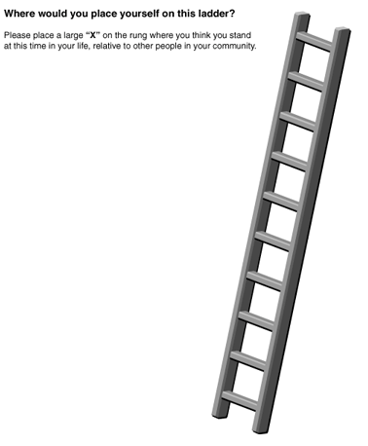
Preliminary Results
(Four months)
Subjective social status
Parent-reported child health

Slide 9
Scaling and Dissemination: Barriers and Opportunities
Evidence
Funding
Lay workforce
Professional silos
Regional work
Technology

Slide 10
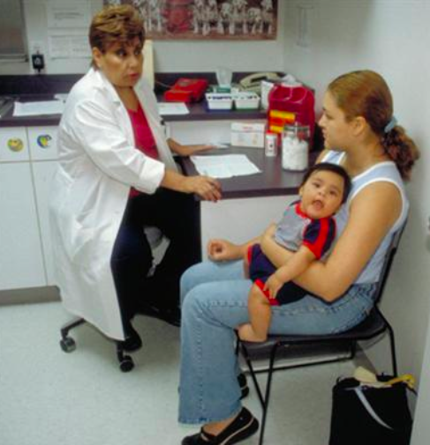
iScreen Study
VS

Slide 11
iScreen Study
Methods
Consenting caregivers in Children’s Oakland ED2 randomly assigned intervention (tablet-based social survey with optional audio assist in English and Spanish) or control (in-person survey) group;
Fully bilingual/bicultural Latina research assistants;
Respondents answered questions about health-related social factors (including IPV and substance use in addition to basic material needs).

Slide 12
Integrating SDH into EHRs
IOM Committee on Recommended Social and Behavioral Domains and Measures for Electronic Health Records

Slide 13
Integrating SDH into EHRs *Note: Not all categories/domains represented in table
Category* | Domain* | Reviewed and not selected*
Socio-demographics | Sexual orientation | Gender identity
 | Race/ethnicity
 | Country of origin
 | Education
 | Financial resource strain
 | Employment
Behavioral | Diet/physical activity | Abuse of other substances
 | Nicotine use/exposure | Sexual practices
 | Alcohol use | Cognitive function in late level, positive psychological fxn
Individual-Level Social Relationships | Social connections/isolation | Social support, work conditions, hx of incarceration
Neighborhoods/Communities | Socioeconomic characteristics | Environmental exposures
 | Race/ethnic characteristics | Neighborhood resources
Notes:
Some domains not included

Slide 14
Questions?

