Slide 1
Microaggressions and Toxic Stress
Leanna W. Lewis, LCSW
Clinical Social Worker
UCSF Benioff Children’s Hospital Oakland
Notes:
Who is Leanna Lewis?

Slide 2
Learning Objectives
How do we define and recognize micro-aggressions?
Cultural responsiveness: How do we engage patients around these issues, while acknowledging the power and privilege we have as providers?
What opportunities do we providers have to be allies, and how can I communicate this to my patients?

Slide 3
Brief and commonplace daily verbal behavioral or environmental indignities, whether intentional or unintentional, that communicate hostile, derogatory, or negative slights and insults that have harmful psychological impact on historically excluded people or groups
Derald Wing Sue 2007

Slide 4
Microinsult
Often Unconscious
Behaviors, actions, or verbal remarks that convey rudeness, insensitivity and demean a person’s group, or social identity, or heritage.

Slide 5
Microinvalidation
Often Unconscious
Verbal comments or behaviors that exclude, negate, or nullify the psychological thoughts, feelings, or experiential people who represent historically excluded groups

Slide 6
Microassault
Often Conscious
Explicit racial derogations characterized primarily by a violent verbal or nonverbal attack meant to hurt the intended victim through name-calling, avoidant behavior, or purposeful discriminatory actions.

Slide 7
Environmental Microaggressions
Assaults, insults and invalidations which are manifested on systemic and environmental levels
Notes:
Environmental microaggressions can occur on many levels and manifest in assaults insults or invalidations.
This example is an example of an invalidation
Environmental microaggressions can also be marriage inequality
Current reports that the Obama administration is habitually late, and more so than other administrations

Slide 8
Microaggression Activity

Slide 9
Age-Adjusted Asthma Deaths per 1,000,000 California Residents by Race/Ethnicity, 2003-2009 Aggregated
Data Source: CDPH Office of Health Information Research
Page 161 of full report
Notes:
Blacks have the highest asthma death rates—more than two times higher than that for Whites. Pacific Islanders also have a high asthma death rate—two times higher than that for Whites and 1.6 times higher than that for Asians. Rates among AI/AN are relatively low, but there is evidence of racial misclassification in this group.

Slide 10
People, Places, and Practices

Slide 11
Cultural Humility
Lifelong process of self-reflection and self-critique
Respectful partnership with patients and their families
Respectful appreciation and attitude towards diverse lived experiences
Notes:
Cultural Humility

Slide 12
Cultural Responsiveness
Refers to the ability to creating an open atmosphere to explore, discuss, and honor the range of cultural experiences.
Notes:
Cultural Responsiveness

Slide 13
Power
is the legitimate control of
or access to
those institutions sanctioned by the state.

Slide 14
PRIVILEGE
is a right favor, advantage, immunity, specially granted or available to one individual or group, and withheld from another.
Notes:
THE WORLD IS IN YOUR HANDS-PRIVILEGE
“Stereotypes, prejudices, and bias when combined with power, form systems of privilege known as “isms” (racism, sexism, classism, heterosexism, ageism, ableism, colonialism)” Hays, 2001, 1996)
Targeted unprivileged members of these system are socialized to be aware of the lines that separate those with privileges from those without privilege b/c lives are more dependent on recognizing these differences. (Hays 2001)
Powerful group are not socialized to see the differences largely because they do not need to ; oppressed groups have little impact on their daily lives” (hays, 2001)
Acknowledging and recognizing privilege because it is count to meritocracy – to recognize inequity is count to the belief that systems, the world, and life is just. Because if what you get isn’t about what you earned how can the world be just?

Slide 15
Allies in Action: Make the Invisible visible
Awareness: Where’s your blind spot? Learn it!
Experiential Reality
Be observant – notice reactions
Check out assumptions
Get feedback & Give feedback
Interrupt Microaggressions:
Be an Ally & Get an Ally
Educate Others
Notes:
Become aware of your own biases and fears.• Actively listen when someone raises a concern.• Don’t be defensive. (Be a CREATOR!) • Learn about other cultures. It is important in interacting with people who differ from you.• Be open to discussing your own biases and how they might have hurt others or reveal biases you have.• Be an ally – stand personally against all biases and discrimination and interrupt microaggressions when witnessing them.• Educate others about microaggressions and how to stop them.
Use your influence wisely– How many people can you influence?– What is your chain of influence?– How can you alter/use that positively?– Different levels of power.• Discrimination– What decisions do you make?– What power do you have?– How many people can you influence?

Slide 16
Allies in Action: What’s one way you will participate in your own growth around microaggressions?

Slide 17
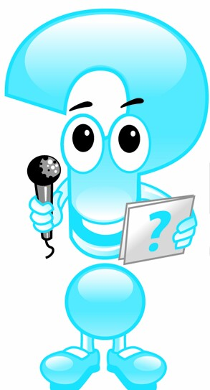
CONTACT INFO:
Leanna W. Lewis, LCSW FIND Program Coordinator EMC Oral Health Coordinator Center For The Vulnerable Child
UCSF Benioff Children's Hospital Oakland (510) 428-3885 Ext. 5136 Llewis@mail.cho.org

