Slide 1
Autonomous Vehicles and Disability Access
February 19, 2021
Erin McAuliff, Taxis, Access and Mobility Services Division
Katie Angotti, Autonomous Vehicle Policy Manager

Slide 2
Agenda
TNCs & Disability Access
AV Issues & Disability Access
SFMTA’s Work

Slide 3
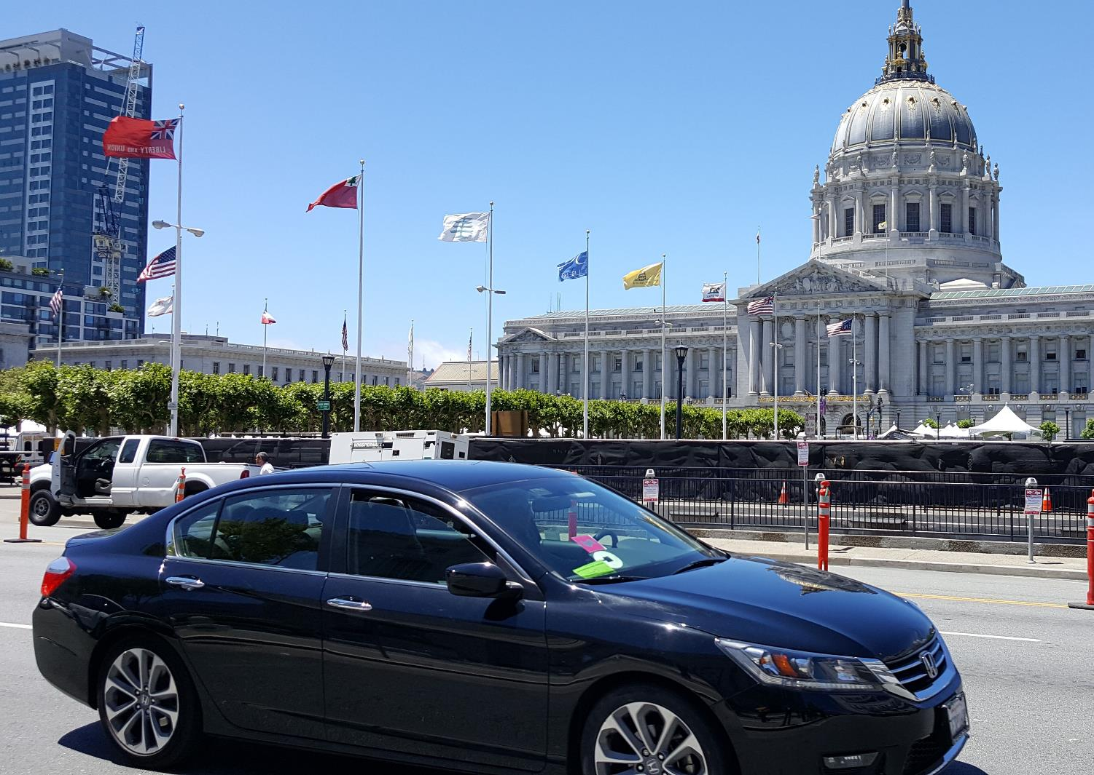
Transportation Network Companies in San Francisco
THE MARKET THE HISTORY THE GOAL OUR METHODS OUR RESEARCH
170,000 trips on a typical weekday
15% of all weekday vehicle trips starting and ending in SF
50% of the change in congestion between 2010 and 2016

Slide 4
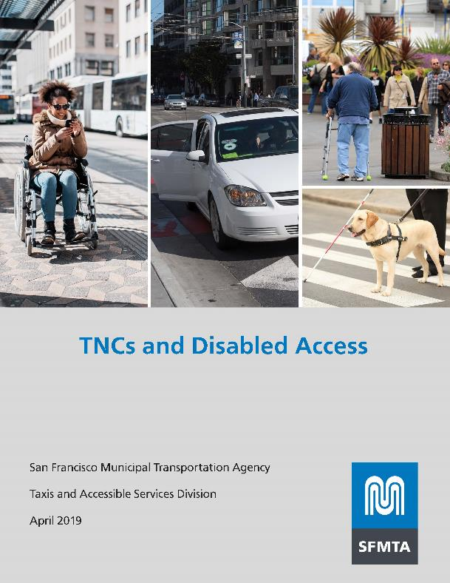
TNCs and Disabled Access
THE MARKET THE HISTORY THE GOAL OUR METHODS OUR RESEARCH
Report published April 2019
  TNCs expanded access for some but not equally for all
  Diminished access to other forms of transportation
  Case studies from other cities
  Recommendations to improve access
TNC Access for All Act
  Administered by the California Public Utilities Commission
  Fees on TNC rides fund WAV services offered by TNCs or other access providers

Slide 5

AVs & Disability Access:
Regulatory Context
CPUC Passenger Service Permits:
Pilot testing passenger service with safety drivers
Pilot testing passenger service without drivers
Regulations for deployment to provide commercial service

Slide 6
AVs & Disability Access: Issues
Human Machine Interface
Accessibility of ride-hail apps to hail
Wayfinding to vehicle and arrival notification
Accessible in vehicle directions, navigation, emergency notifications
Drop-off point orientation

Slide 7
AVs & Disability Access: Issues
Hardware
Accessible handles
Wheel-chair accessible (folding & non folding)
Lift/Ramp securement system
Passenger Service
Equivalent service
Data and privacy requirements

Slide 8
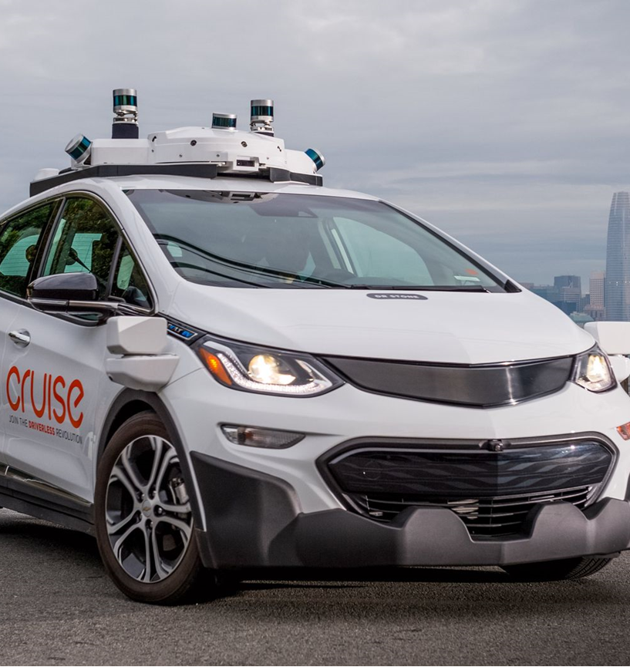
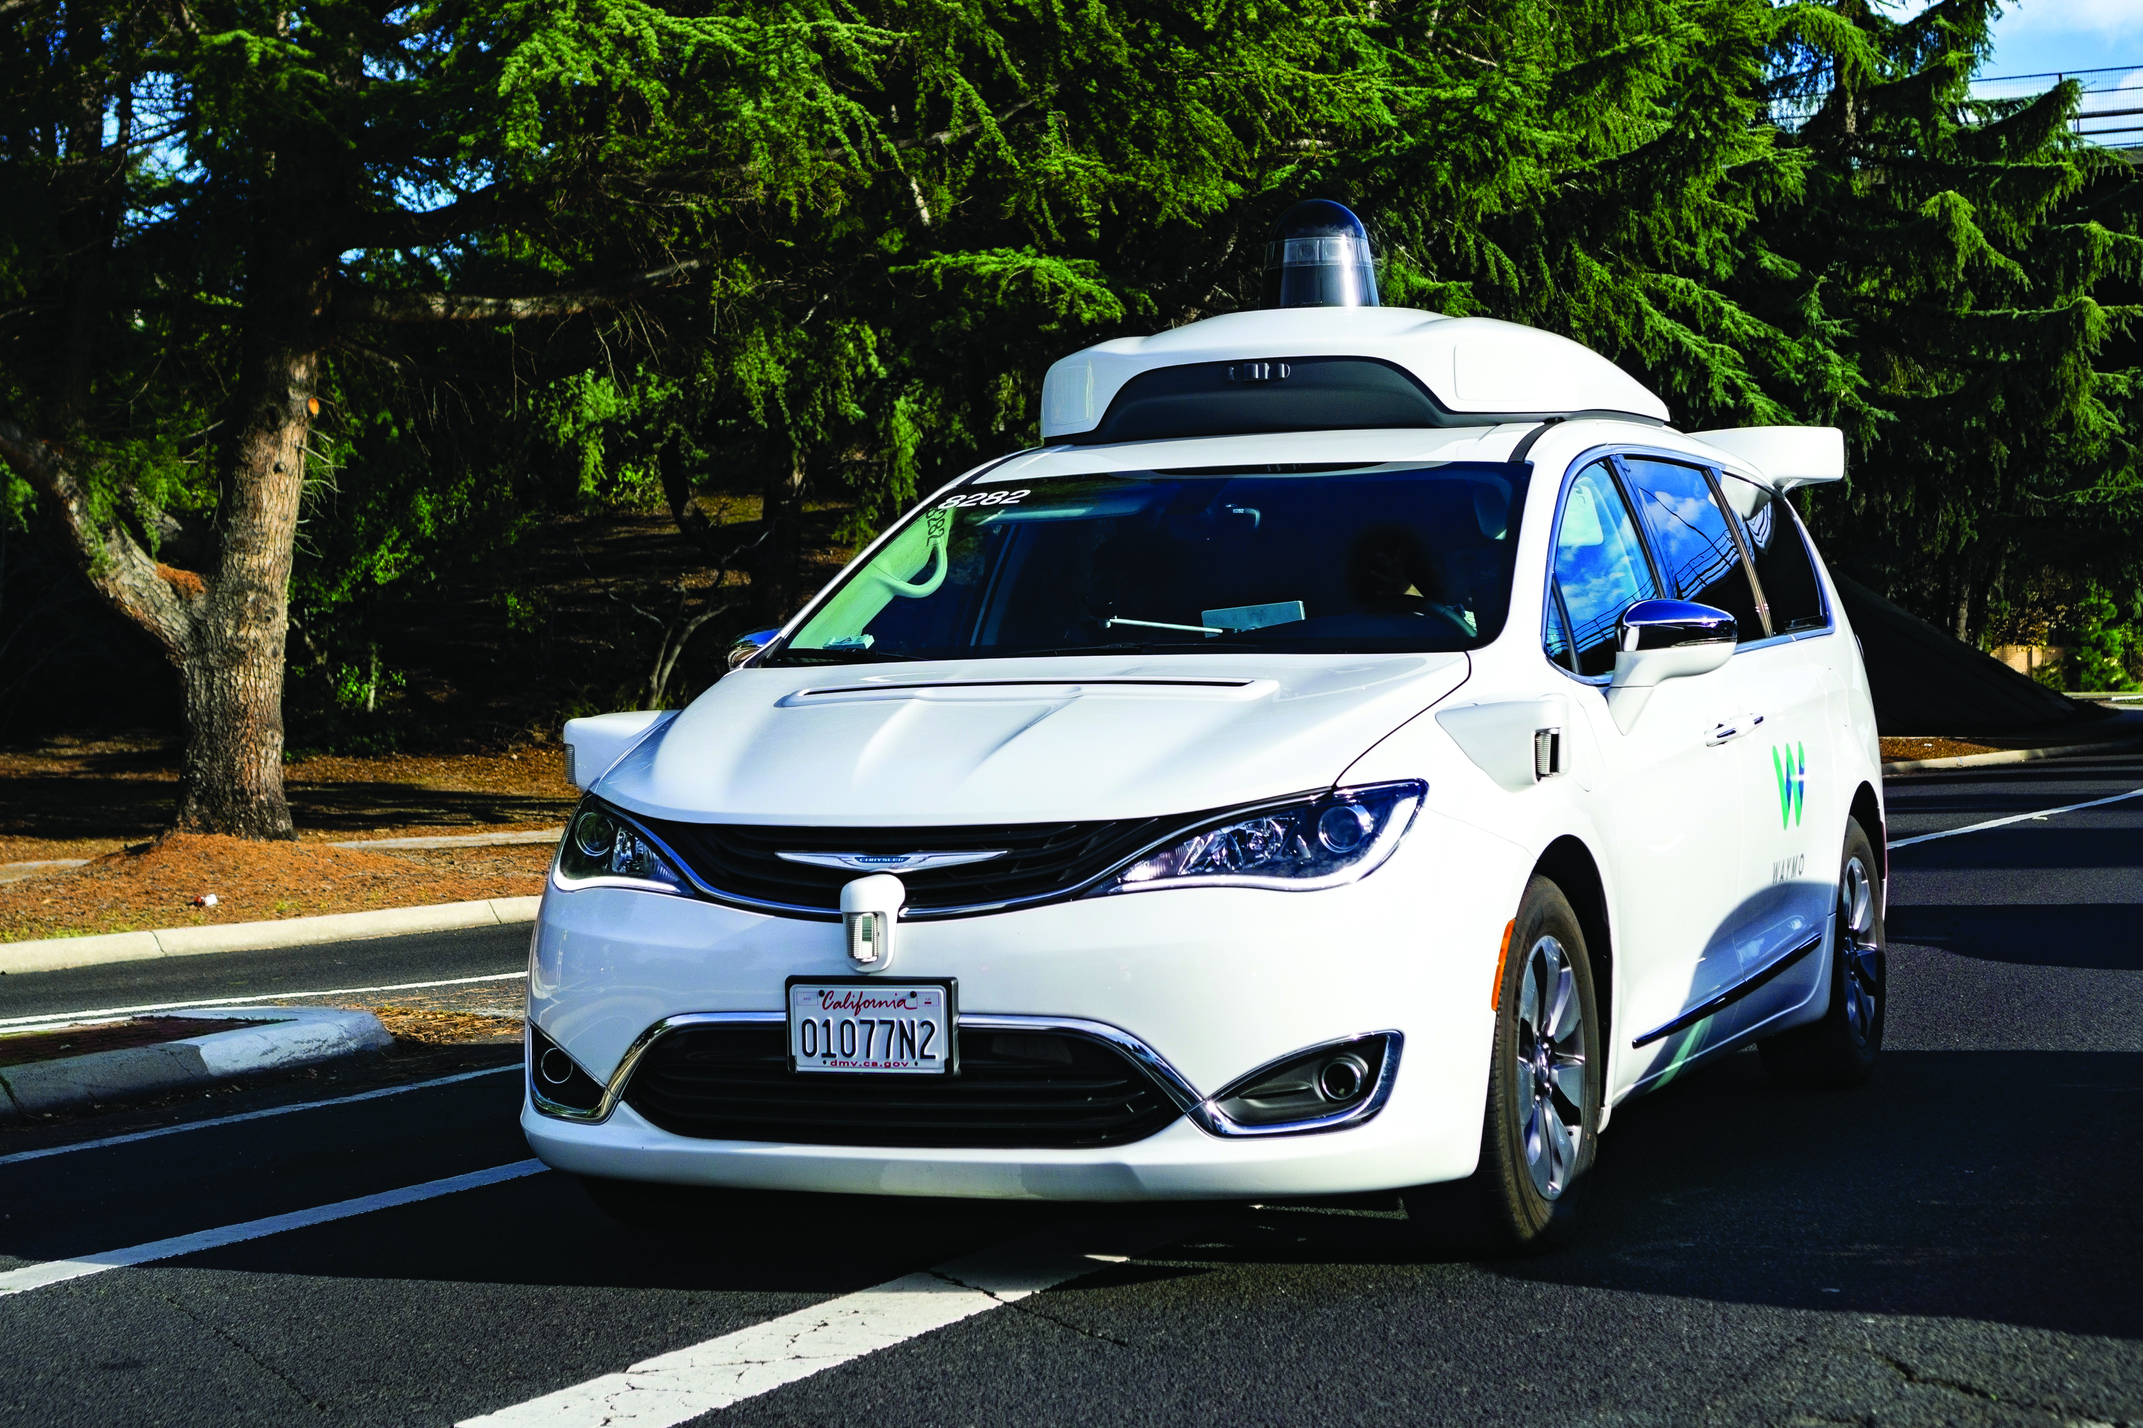
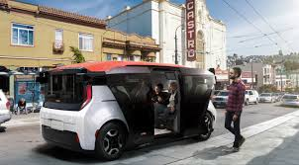
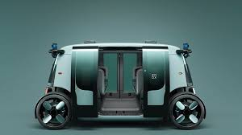
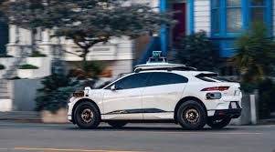
AVs & Disability Access:
Vehicle Types in San Francisco

Slide 9
AVs & Disability Access:
SFMTA’s Work - State
SFMTA Advocacy | CPUC Decision
- Accessibility Working Group - Workshop
- Include disability access goal to guide program “Provide equivalent service to people with disabilities, including people using wheelchairs” | - Included goal disability access “Expand the benefits of AV technologies to all of Californians, including people with disabilities”
- Require public permit process - Submit a Disability Access Plan as part of application | - Application subject to public review - Requires Passenger Safety Plan in application, must include addressing the safety risks of people with disabilities - Narrative in quarterly report

Slide 10
AVs & Disability Access:
SFMTA’s Work - Federal
AVs and services should be born accessible
Prioritize policies that break down barriers and expand accessible and affordable transportation for people with disabilities
Include organizations representing people who need wheelchair accessible vehicles on any federal advisory council

Slide 11
AVs & Disability Access:
SFMTA’s Work – Local
Meet with local AV developers to provide feedback on disability work
Encourage local AV developers to incorporate universal design standards in their prototypes
Educate local AV developers on needs of people with disabilities

Slide 12
THANK YOU
Resources
TNCs and Disabled Access report https://www.sfmta.com/sites/default/files/reports-and-documents/2019/05/tncs_and_disabled_access_report.pdf
Auto Alliance Workshop Series on Accessibility (Workshop Materials and registration) https://autoalliance.org/avsaccessibility/
Disability Rights Education & Defense Fund – AV Public Policy https://dredf.org/public-policy/transportation/autonomous-vehicles-avs-also-known-as-self-driving-cars/
The Ruderman White Paper: Self-Driving Cars: The Impact on People with Disabilities https://rudermanfoundation.org/wp-content/uploads/2017/08/Self-Driving-Cars-The-Impact-on-People-with-Disabilities_FINAL.pdf
Contacts
Erin McAuliff: Erin.McAuliff@sfmta.com
Katie Angotti: Kathryn.Angotti@sfmta.com

