Slide 1
Mayor’s Office on Disability Presentation to the Mayor’s Disability Council: Disability Access Successes 2021/2022, and Agenda Considerations for 2022/2023
Nicole Bohn, Director
July 15, 2022

Slide 2
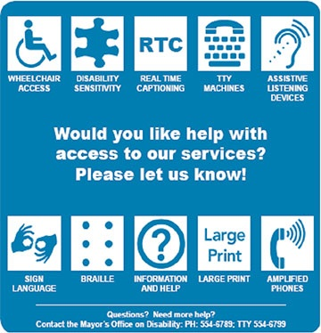
MOD is the City’s Overall ADA Coordinator
MOD is responsible for overseeing the implementation and local adherence to of Title II of the Americans with Disabilities Act (ADA) as well as other federal, state and local access codes, disability rights laws, and accessibility obligations, including the Citywide grievance procedure.
MOD serves as a liaison between the City and Deaf and disabled San Franciscans.
MOD serves as a resource and technical advisor to City departments, the Board of Supervisors and the Mayor regarding:
architectural and programmatic access
emergency planning, and
legislative impacts on accessibility and the disability community.
Image: Get help from MOD public poster

Slide 3
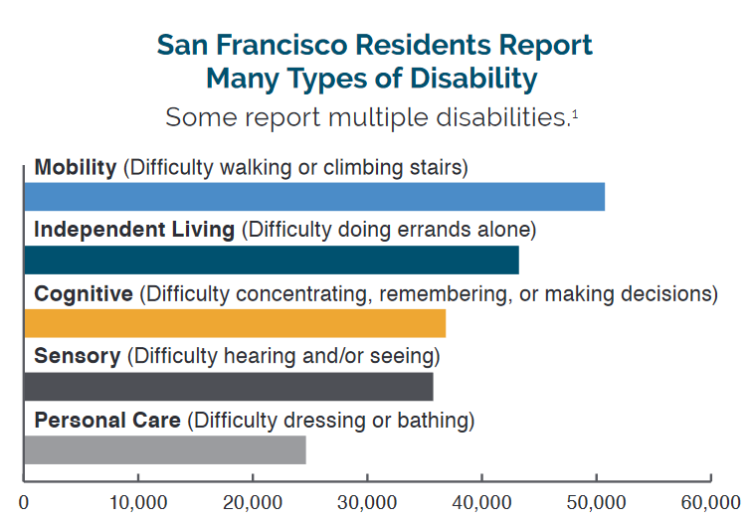
Disability Community in San Francisco (1 of 2)
1 in 10 San Franciscans reports a disability
All ages, race and ethnicities, and income levels
88-94,000 residents
Almost half of people with disabilities are under age 65
1 in 4 people with disabilities live in poverty.
Even adults with disabilities who are employed are more than twice as likely to experience poverty.
Source: https://www.sfhsa.org/about/reports-publications/disability-san-francisco

Slide 4
Disability Community in San Francisco (2 of 2)
64% of people with disabilities are people of color.
Based on 2019 American Community Survey (ACS), 5-year estimates
The ACS does not currently ask questions about behavioral/psychiatric disability
We expect the overlay is likely higher than 64%

Slide 5
MOD Budget, Staffing & Reporting Structure
Reporting
Directly to the City Administrator’s Office
Indirectly to the Mayor’s Office
Budget
Current Staffing: headcount = 9
8 full time and 1 part time position(s) (3 hours/week), funded
(1) Director, (2) Deputy Directors, (1) Grievance and Training Coordinator, (3) Senior Building Inspectors, (1) Office manager, (1) Program aide
3 vacant positions, not funded in budget
2 architectural and 1 programmatic
FY 21-22 Operating Budget | $1,996,594
FY21-22 Capital Budget* | $2,459,196
* Capital funding is not inclusive of all City barrier removal projects

Slide 6
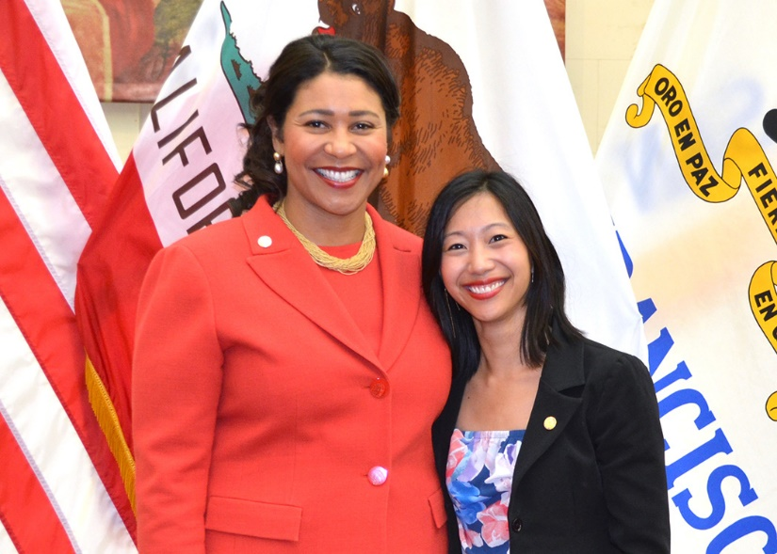
Mayor’s Disability Council (MDC) 2021-22
Advises the Mayor on disability issues, works with the MOD to ensure accessibility compliance, and provides a public forum for disability community feedback.
The MDC is currently a passive meeting body with 7 seats filled (4 vacant). MOD provides staff support to the Council.
All members are residents with disabilities, and/or parents of kids with disabilities, who in 2021-2022 advanced:
Resolution # 2022 – 01 Mayor’s Disability Council Resolution On Accessibility Of Golden Gate Park And Closure Of JFK Drive
Resolution #2022-02: Mayor’s Disability Council Resolution on the Reinstatement of the Mask Requirement on SF MUNI
Image: Mayor Breed and 2018-2022 Councilmember Tiffany Yu
Work on Sup. Peskin’ s e-scooter safety resolution
Accessibility advice to multiple City departments
TNC wheelchair access advocacy

Slide 7
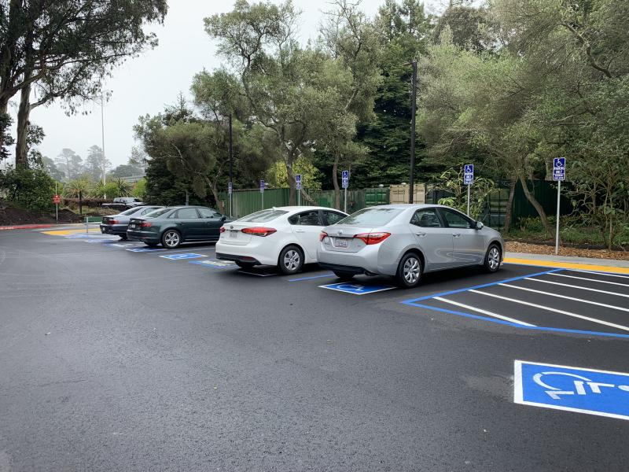
MOD Selected Successes: 2021-2022
Review of Accessible Affordable Housing, City Projects, and architectural barrier complaints
In calendar year 2021, MOD received 23 new non-housing city-funded projects and 25 housing projects for review.
2022 to date, we’ve received 23 total projects
Examples of non-housing projects include reviews on behalf of other City departments or City funded entities (e.g. Rec and Parks, Department of Homelessness and Supportive Housing, SFPUC).
Most of the architectural barrier removal technical assistance has involved our Parks system
Image: Accessible Golden Gate Park Bandshell Lot

Slide 8
MOD Selected Successes: 2021-2022
Impact on Citywide Pandemic Response specific to people with disabilities
Vaccine Equity Prioritization and Vaccine Call Center
Home Vaccination Program
Disability Community Specific Vaccination Clinics
Citywide Digital Accessibility and Inclusion Standard Adoption
Youth with Disabilities Interagency Collaborative
Summer programming and provider training
Enacting Anti-Ableist Strategies Training to Recreation and Parks Managers (June 2022)
Extensive involvement with legislation impacting residents with disabilities

Slide 9
Disability Impacts: Current Local Legislation
Accessible Business Entrance (ABE) Ordinance
Commercial property owners of public-serving businesses need to confirm that the primary entrances are accessible to people with disabilities by June 30, 2022.
Mayoral Housing Directives
MOD involved in daily efforts related to Mayoral affordable housing prioritization directives.
JFK & Golden Gate Park Access and Safety Program (multiple legislative items)
MOD is involved in advising all City bodies on accessibility impacts within this program.
Shared Spaces Legislated Program
MOD is involved in advising all City bodies on accessibility impacts and design manual of this program.
Affordable Housing Needs Assessment
MOD is a named partner in this legislation, which serves to inventory the availability and accessibility of current City and County housing stock.

Slide 10
Disability impacts: Current State and Federal Legislation
AB 2252: Accessible Vote By Mail
Along with Voting Accessibility Advisory Committee (VAAC), monitoring local adoption & exploring opportunities for expansion. Note that SB 1480, Remote Accessible Ballot Submission (June 2022) did not pass.
SB 1376: Transportation Network Companies (TNC) Accessibility for All Act
MOD participating in CPUC implementation comment process, along with MTA and CTA
Virtual Meetings Open meetings: state and local agencies: teleconferences (AB 361)
Continuation of virtual meetings is highly desired by the SF disability community and has proven to be a powerful advocacy tool
Monitoring:
Autonomous Vehicles and Accessibility (CPUC/DMV)

Slide 11
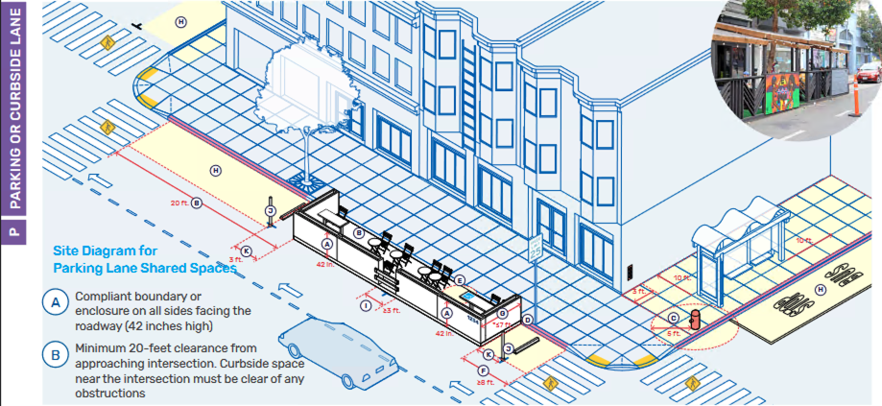
San Francisco Goes Above and Beyond
The following are programs or initiatives built to exceed federal accessibility compliance requirements that MOD advises or leads:
Curb Ramp Program
Architectural Access Affordable Housing Review
Accessible Passenger Loading Zones Standards
Accessible Business Entrance Ordinance
Shared Spaces Design Manual
Age and Disability Friendly San Francisco
Empowered San Francisco Technology Needs Assessment
Image: Accessibility drawing from Shared Spaces Manual
Notes:
Collaborations with Disability and Aging Services and Department of Public Works where we have particularly strong connections
Architectural Access Review for all affordable housing is accomplished in part through funding from DBI

Slide 12
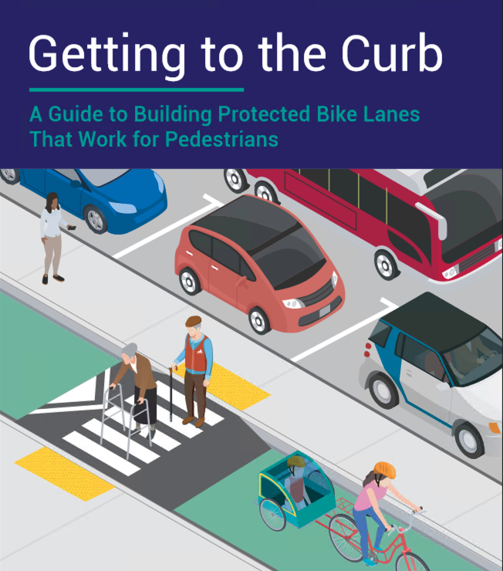
Current MOD and Citywide Accessibility Challenges
Adoption of disability access as an anti-ableist and equity strategy
Capacity for systemic architectural barrier removal identification and review (capital planning)
Capacity for building ADA Coordinator and contractor services knowledge of obligations
Capacity for addressing emerging issues, especially pertaining to the unhoused
Capacity for cross-departmental incorporation of accessibility initiatives and legislation
Capacity for enforcement of Disability Access within the Public Right of Way (DPW)
Involvement of MOD and/or people with disabilities early in planning and design
Effective outreach to the disability community
Image: Getting to the Curb Protected Bike Lanes Guide: https://walksf.org/wp-content/uploads/2019/12/getting-to-the-curb-report-final-walk-sf-2019.pdf
Notes:
MTA Streets Design
MTA Strategic Planning
Recreation and Parks
Homelessness and Supportive Housing
Age in Place initiatives (but housing needs assessment overview is underway)

Slide 13
MOD-Received Public Questions, Complaints and Concerns FY 20-21
Complaints = concerns pertaining to disability discrimination or access to City programs under ADA Title II
Curb Ramp Requests = requests for the construction of curb ramps.
RFA (Requests for Accommodation) = reasonable modification requests in City programs and reasonable accommodation requests in supportive housing.
Service requests = customer service issues such as requests for information, disability sensitivity concerns, assistance with navigating benefits and requests for updates.
Questions= customer service inquiries for information or general technical assistance information.
Referrals= referrals to other government agencies or community based organizations.
Note: This data represents disability-related interactions directly received by MOD.

Slide 14
MOD-Received Primary Complaint Category Definitions
Architectural Access
Examples: access concerns with parklets and outdoor accessible seating and architectural barrier removal.
Public Right of Way (PROW)
Examples: obstructions in the PROW such as barriers, inaccessible pathways around construction, and encampments blocking the sidewalk.
Housing
Examples: concerns with elevators out of service in City housing and delays in responses to reasonable accommodation requests, lack of knowledge by operator on how to provide accommodation or services
Other
Examples: digital access, recreation, transportation and communication access concerns

Slide 15
MOD-Received Comparative Complaint Data: FY19-20 – FY21-22
Disability access complaints are increasing
Top three complaint categories comprise 81% of the complaints in FY 21-22:
1) Public Right of Way (47%)
2) Architectural Access (21%)
3) Housing Complaint (14%)

Slide 16
Citywide Departmental ADA Coordinators January 2021
MOD surveyed ADA/Disability Access Coordinators
58 Respondents
49 Departments
Nearly all respondents (97%) requested training on various accessibility related topics.
Respondents most commonly indicated 10% of their overall duties focused on ADA Coordinator responsibilities.
Only three departments reported 100% of their job duties as Departmental ADA or Disability Access Coordinator.
Department of Public Works, SFMTA, Elections
Total: 58 Responses

Slide 17
Proposed MDC Considerations, 2022-2023 agenda
Any concern or challenge discussed in this report, or past Director’s Reports to the MDC
Budget and other advocacy with BOS and City Departments for barrier removal and ongoing or new accessibility initiative coordination, training initiatives, and the staffing capacity to support them (MOD, DPW, RPD, HSH, DEM, MOHCD, others)
Time-sensitive matters, including (but not limited to):
Safe and Accessible Parks for All (June 2022 Civil Grand Jury Report, to be presented to BOS in September)
Continuation of Local Hybrid Meetings
Ongoing implementation of CA Attorney General Accessibility Guidance and SF Digital Accessibility and Inclusion Standard

Slide 18
Questions? Contact us:
MOD
Website: https://sfgov.orgmod
MOD Email: mod@sfgov.org
MOD Main Phone: 415-554-6789

