Slide 1
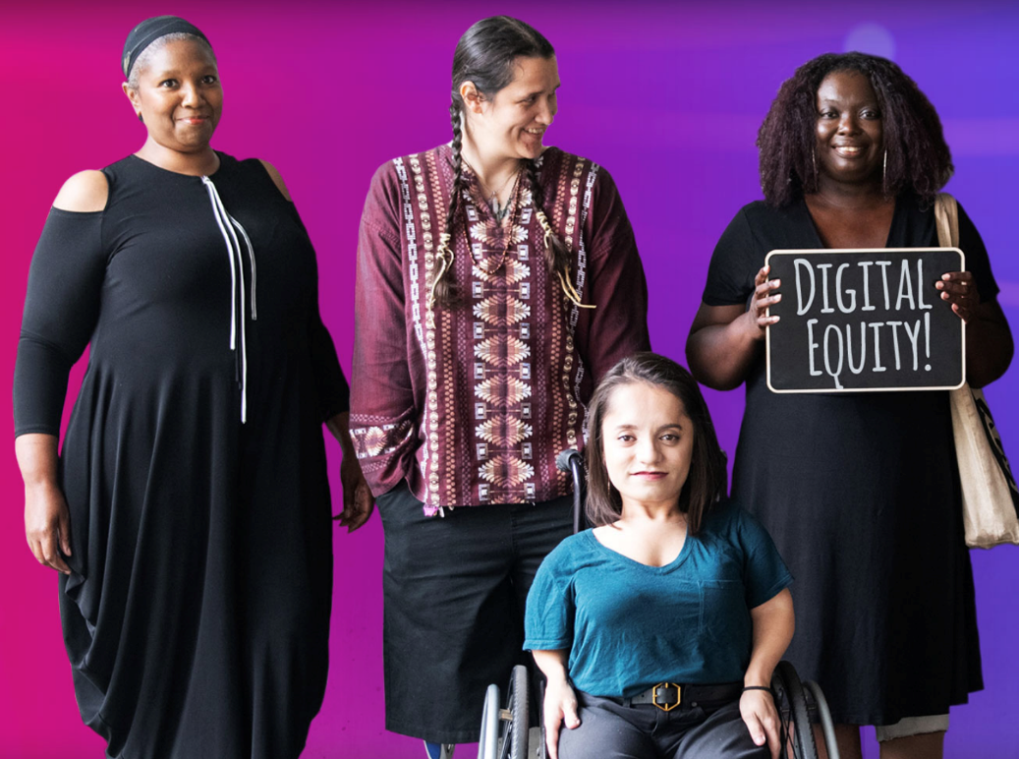
2021 Findings & Policy Recommendations: Empowered San Francisco Technology Needs Assessment Conducted by Cecile Puretz (lead author) and Andrea Aguinaldo (TIP)

Slide 2
Presentation for the Mayor’s Office on Disability
Friday, March 18, 2021
Presenters:
Marie Jobling, Co-chair, Dignity Fund Coalition
Karla Suomala, SF Tech Council

Slide 3
Why is this report important?
It provides a solid foundation to build a grassroots campaign to Bridge the Digital Divide for Older Adults and People with Disabilities
Here is the PDF Report and the Website

Slide 4
Why is this issue so URGENT?
Technology connects people with health providers, food, housing, employment, family and friends.
Without devices, internet, AT, and digital literacy support too many people are left behind.
Documented increase in social isolation & loneliness
Barriers to telehealth are a public health issue

Slide 5
Methodology
A total of 3,080 surveys were collected March 21 - June 30, 2021
Conducted as a multi-modal survey: Print, phone, digital, in-person, Braille
Total 1,529 survey pool (reported SF zip code)
Community-driven and inclusive participatory research

Slide 6
Age & Disability
By Age
55% (841) of survey respondents are older adults (60+)
9% (134) transition-age youth (18-24)
By Disability (Top 5)
394 (26%) Mobility Disability
388 (25%) Chronic Pain
270 (18%) Deaf or Hard of Hearing
259 (17%) Mental Health (PTSD, depression, anxiety)
252 (16%) Blind or low-vision

Slide 7
Income & Language
By Race/Ethnicity
Majority (70%) are from communities of color
By Income
510 (33%) have household income less than $20,000
By Language (Top 5)
755 (49%) English
304 (20%) Cantonese
146 (10%) American Sign-Language
119 (8%) Spanish
79 (5%) Mandarin

Slide 8
Housing & Veteran Status
Housing Residence
1,343 (88%) housed in either apartment rental, affordable housing, living with friends or family, supportive housing, SRO hotels.
69 (5%) were experiencing houselessness
Veteran Status
345 (23%) are veterans

Slide 9
Zip Codes (Top 10)
94102 (141, 9%) Western Addition / Tenderloin / Hayes / Mid-Market
94112 (70, 5%) Outer Mission / Excelsior
94107 (60, 4%) Potrero Hill
94122 (55, 4%) Sunset
94108 (49, 3%) Chinatown
94103 (48%, 3%) SOMA
94110 (46, 3%) Mission
94121 (44, 3%) Richmond
94116 (40, 3%) Parkside/Forest Hill
94134 (37, 2%) Visitacion Valley

Slide 10
Research Questions
What are the tech barriers and unmet needs of SF residents with disabilities, older adults (60+) and multiply-marginalized communities that have been most impacted during COVID-19?
What are the links between digital inequality and income, race/ethnicity, disability, age, language, housing, veteran status, and patterns of digital redlining?
What are opportunities for targeted and strategic interventions to increase levels of digital connectedness?

Slide 11
During the pandemic, we learned that…

Slide 12
64% of respondents said that technology was a barrier to receiving vital services
Although survey data indicated little need for devices or internet (14% reported no access to devices, 10% no access to internet)

Slide 13
Top 5 barriers to internet access:
unaffordable cost of high-speed internet (28%)
unaffordable cost of device (27%)
insufficient smartphone data (22%)
unreliable internet connection (21%)
and concerns about online safety/security (19%)

Slide 14
Top 5 internet sources:
Paid broadband internet (35%)
Public WiFi hotspot (24%)
Smartphone internet data plan (23%)
Paid discounted internet (23%)
Free internet (20%)

Slide 15
Top 5 service needs:
Health
Food
Housing assistance
COVID-information
Computer literacy training

Slide 16
Receiving medical services through telehealth was both vital and challenging.
67% reported receiving medical services through telehealth
57% reported missing important medical appointments
More than 50% of Latinx older adults reported not using telehealth

Slide 17
Top 5 barriers to telehealth:
lack of device
affordability
training
need for AT
language access

Slide 18
Public computer labs were essential.
Prior to COVID-19, the disability community used libraries, tech hubs, community centers to access the internet:
67% of transition-age youth with disabilities (age 18-24)
82% of people residing in assisted living or those experiencing homelessness
82% of veterans

Slide 19
Free or low-cost assistive technology (AT) and training is critical.
Top reported AT needs:
Low-cost AT as the primary need (53%)
Training (45%)
Information about available AT options (39%)
Access to free or low-cost repairs (30%)
The need for AT is greater for people with disabilities who are:
older adults;
experiencing chronic pain or mental health disability;
low-income;
SRO resident;
Black, Latinx, AAPI communities;
monolingual (Spanish or Cantonese).

Slide 20
Selected Policy Recommendations

Slide 21
Expand free or low-cost digital connectivity for residents with disabilities and older adults.
Expand Fiber-to-Housing pipelines in supportive and low-income housing + tech support
01
Create Digital Navigator hubs in partnership with SFPL (expanded access to public computer labs)
02
Develop outreach channels to build awareness around existing digital inclusion resources
03

Slide 22
Pilot initiatives aimed at lowering barriers to telehealth access (equip residents with internet access, telehealth tools and digital literacy skills).
1. Ensure that telehealth services are accessible to older adults (ages 60+), low-income, TAY youth, and BIPOC communities
2. Increase bilingual services and bilingual outreach

Slide 23
Increase funding and distribution of free or low-cost Assistive Technology
Expand access to free or low-cost AT, training & repairs
01
Equip community computer labs with AT
02
Facilitate training workshops for lab staff
03

Slide 24
What’s next?

Slide 25
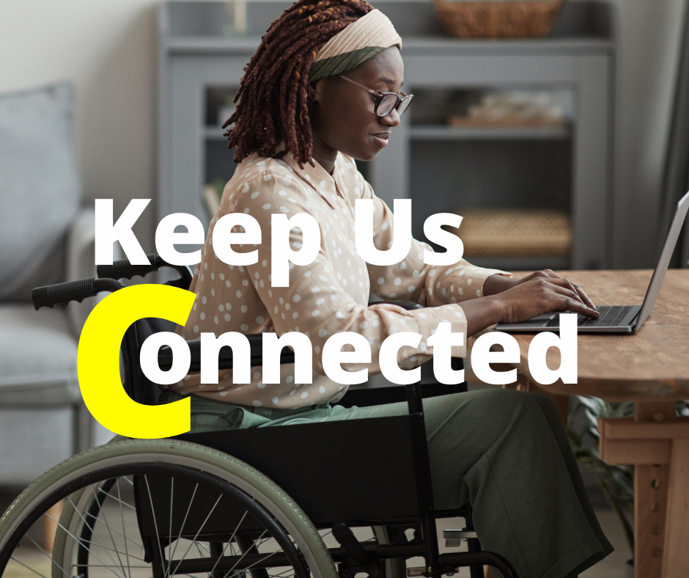
Keep Us Connected 2022 – Pandemic Edition
WE NEED TO EXPAND ACCESS TO:
Free or low-cost Internet
Free or low-cost Devices and Assistive Technology
Telehealth
Training & technical support in multiple languages
Creating clear pathways for people to find digital inclusion resources
Public technology hubs

Slide 26
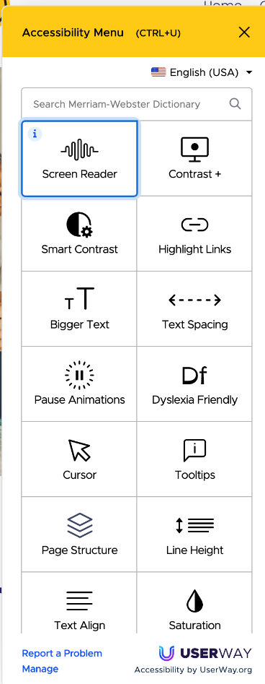
Here’s how you can help!
Visit www.sfdignityfund.org and click the icon for accessibility features.
Sign the petition available in English, Chinese, Spanish and Tagalog
Spread the word by downloading a flyer
For more information or to get involved, email info@sfdignityfund.org or call 415-821-1003 ext.115.

