Slide 1
Access to City Employment (ACE) Program
Mayor’s Disability Council Virtual Public Meeting
September 17, 2021
Porsche Bunton, Diversity Recruitment Manager
Workforce Development Team
Notes:
1

Slide 2
Who We Are: Diversity Recruitment Team
Created in 2019 as a result of Mayor Breed’s Executive Directive 18-02
Located at DHR-Workforce Development, One South Van Ness Ave.
Staffing: 1-Manager, 2-Diversity Recruiters, 1-ACE Analyst
We are here to:
Promote & assist City Depts. in hiring diverse qualified candidates by utilizing the City’s ACE Program
Expand outreach to engage & recruit diverse candidates
Provide resources to support City depts. with diversity recruitment strategies

Slide 3
DRT Community Engagement
ACE Program
Presentations: Department Spotlight, Information Sessions, How to Apply for Job Seekers, Train-the-Trainer
Better understanding of City depts. & services
Increased social media presence
SmartRecruiters Awareness, Transition, & Implementation
Notes:
This past year has been very busy for the DRT as we focused on creating several resources to support your departments with diversity recruitment efforts…. [talk about/show the resources listed here]

Slide 4
About the ACE Program
Notes:
Porsche will introduce Peter Rosel at this slide!

Slide 5
ACE - CSC Rule 115
Rule 115 program began in 1985
Proposition A: Enacted to increase representation of qualified individuals with disabilities in the City workforce
Civil Service Commission rule was adopted to implement Proposition A (CSC Rule 115, Article I)
Goals:
Increase employment opportunities
Increase flexibility for Depts. to fill vacant positions
Increase the diversity of the workforce
5
Notes:
ACE Program is internally known as Rule 115. Which is a program that began in 1985
Proposition A-Which was to increase representation of qualified individuals with disabilities in the City workforce was put on the ballot and was voted by San Franciscans in 1985.
The hiring process at that time was actually less lengthy and cumbersome (there was no DOJ background or fingerprinting). The ballot measure and the resulting CSC Rule received strong support from the Mayor’s Office, the BOS, the CSC, the disabled community. City government support and staff resources allocated to conduct outreach and recruitment were the reason the Program was successful.
5

Slide 6
ACE - Rule 115: How it works
Civil Service Rule 115: Allows for departments to fill Permanent Civil Service entry-level positions through an expedited hiring process.
**Entry-level consist of classifications that are the first level in a class series and any standalone classification.
6
Notes:
Allows for departments to fill positions in any classifications rather than our “post and pray” method. Applicants have already deemed deemed qualified and are ready to be interviewed.
6

Slide 7
ACE Rule 115: Requirements
Entry-level classification (all occupational categories)
Appointees meet the minimum qualifications of the class
Certification of disability from DOR/Veterans Administration
ACE positions are designated by Departments
Appointees are PEX and transition to PCS status after completing satisfactory 1-year evaluation period
7
Notes:
ACE Program requirements include:
Entry-level classification (all occupational categories);
Appointees meet the minimum qualifications of the class;
Certification of disability from DOR/Veterans Administration;
ACE positions are designated by Departments;
Appointees are PEX and transition to PCS status after completing satisfactory 1-year probation.
Additionally, the EF’s of the position are identified and reviewed with the candidate to establish their ability to perform the EF’s of the position with/without reasonable accommodation.
7

Slide 8
ACE - Rule 115: Benefits
Up to 80% faster than the normal civil service hiring process
Ready pool of qualified candidates
Minimum qualifications have already been reviewed
Department of Rehabilitation can provide reasonable accommodations for the first year
Increase flexibility for depts. to fill vacant positions
Hire a qualified candidate in less than 30 days!
8
Notes:
8

Slide 9
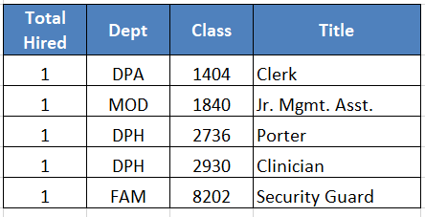
ACE Rule 115 Placements
ACE Rule 115 Hired from 7/13/2015 - 3/7/2020 (Pre-Pandemic = 51)
ACE Rule 115 Hired from 8/3/2020 - 8/7/2021 (Post-Pandemic = 5)
Grand Total ACE Rule 115 Hired = 56

Slide 10
Expansion of ACE All Classifications
Launched a Exempt Pilot Program in 2016 with four City departments: HSA, DPH, GSA & AIR
Allows for depts. to fill Temporary-Exempt & Permanent-Exempt positions in ANY classifications
Depts. may review applications of qualified candidates that meet MQ’s in a TEX or PEX classification pool
2016-Present: 49 total hired (Placements)
10
Notes:
In addition to the ACE program, the City has implemented an “Exempt Appointment for Qualified Applicants with Disabilities Pilot Program” (Pilot Program) to allow the City to appoint qualified individuals who are severely disabled to fill specific temporary or permanent exempt positions.
Departments may review applications of qualified candidates that meet MQ’s in a TEX or PEX classification pool.
Schedule interviews immediately
And save time looking for qualified “As-needed” candidates.
Is there a pending amendment to CSC Rule 115 re TEX hiring of disabled?
Is there pending amendment to CSC Rule 114 Appointments, Article VIII Exempt Appointment, re hiring of disabled?
These are HR people, there may be Rule-related questions of this sort….
10

Slide 11
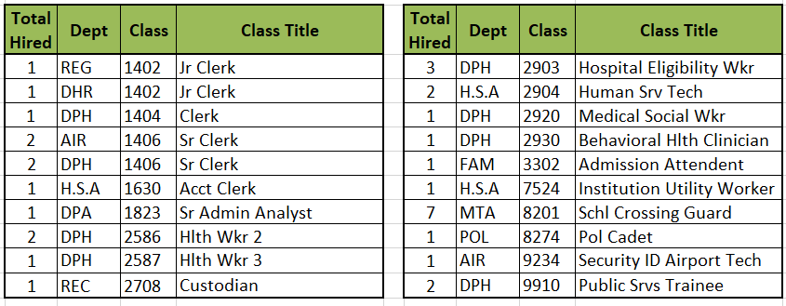
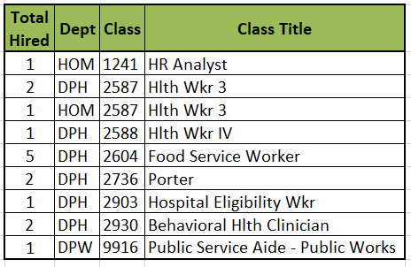
ACE Exempt Placements
ACE Exempt Hired from 7/9/2016 - 3/21/2020 (Pre-Pandemic = 33)
ACE Exempt Hired from 5/9/2020 - 8/21/2021 (Post-Pandemic = 16)
Grand Total ACE Exempt Hired = 49
11

Slide 12
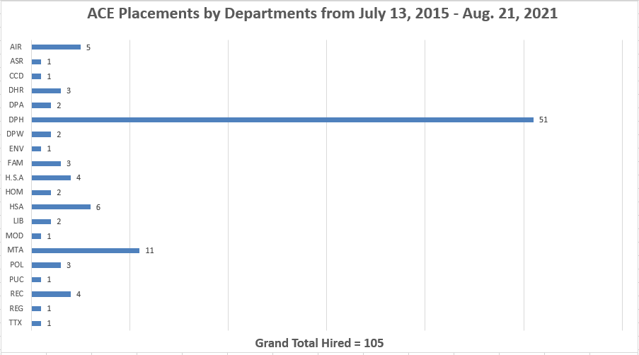
Thank you! ACE Department Support
12

Slide 13
ACE Program Accomplishments
ACE Appointments
Rule 115 Hires:
Grand Total Hired = 56
Pre-Pandemic = 51
Post-Pandemic = 5
Exempt Hires:
Grand Total Hired = 49
Pre-Pandemic = 33
Post-Pandemic = 16
Total last year 2020: 86 ACE Hires
Updated Total: 105
ACE Utilization by City Department
5 years (2011 to 2015) = 5 departments
2 years (2016 to Present) = 21 departments
An additional 31 individuals with disability who applied via ACE were appointed via the regular civil service selection process
13
Notes:
13

Slide 14
ACE Satisfaction Surveys 2020-2021
Notes:
Porsche will introduce Peter Rosel at this slide!

Slide 15
Survey Participation
Surveys sent out in October-December 2020
Collaborated with Mayor’s Disability Council to get the word out
Survey responses included:
External Job Seekers: 113
HR Managers: 16
ACE Employees: 46
Community-Based Organizations: 38

Slide 16
Progress & Implementations
Update website to include exemptions and clear program guidelines
Increase brand awareness
Develop internal trainings in collaboration with EEO + DOR for Dept. hiring managers
ACE specific transition to SmartRecruiters
Notes:
based on the survey responses and internal team review here are our recommendations and planned implementation for the next fiscal year

Slide 17
Quarter 1-2 Goals/ Next Steps
Notes:
Porsche will introduce Peter Rosel at this slide!

Slide 18
Upcoming Events
How to Apply: Introducing SmartRecruiters - DHR’s New Applicant Tracking System
Wednesday, September 29, 2021- 4:00pm – 5:30pm
October National Disability Employment Awareness Month
Thursday, October 14th- 4:00pm-5:30pm
Sign up: https://sfdhr.org/career-events

Slide 19
CBO Outreach Partnership
Alameda County
Arriba Juntos
CAASF
Chalk
City and County of San Francisco
Code Tenderloin
Compass-SF
CPASF
Department of Rehabilitation
DevMission
Five Keys
Hire-Ability
Hospitality House
JVS
Larkin Street Youth Services
Meda SF
MLVS
Oakland Housing Authority
PRC
PRCSF
Rubicon Programs
San Francisco State University
Sead Center
Self Help for the Elderly
SF Goodwill
SFCCSC
SFLGBT Center
Toolworks
University of California, Berkeley
Upwardly Global
Young Community Developers
First Place For Youth - Rising Up
University of California, Merced- Office of Leadership Service and Career
Notes:
This is representative of some of the CBO’s that we have been engaged with. Our Recruitment Source List is updated quarterly. *DNA Note* We can share the list if you are comfortable

Slide 20
Presentation Collaboration
Office of Economic and Workforce Development
Collaborated on initial Train-the-Trainer presentations
Piloted with OEWD Neighborhood Access Points
Used their extended network to promote events
Library
Offered cross promotion on their platforms
Mayor’s Office on Disability
Supported expanded accessibility tools for presentations
Cross promotion with their networks
SF Unified School District
How to Apply Presentations for HS Seniors
Notes:
DCYF + HSA

Slide 21
Learn more about ACE
ACE Webpage: http://sfdhr.org/access-to-city-employment
ACE Employment Opportunities page: http://sfdhr.org/ace-employment
21
Notes:
21

Slide 22
Learn more about ACE & Contact Us!
ACE Webpage:
http://sfdhr.org/access-to-city-employment
ACE Employment Opportunities Webpage:
http://sfdhr.org/ace-employment
Porsche Bunton
Diversity Recruitment Manager
porsche.bunton@sfgov.org
Danielle N. Anderson John F. Weber Leorah Dang
Diversity Recruiter Diversity Recruiter ACE Analyst
danielle.n.anderson@sfgov.org john.f.weber@sfgov.org leorah.dang@sfgov.org
Choosing purpose is a reflection of who we are and reminds us of the commitment
we make to residents of the City and County of San Francisco.
Notes:
Add presenter information if applicable. Left this slide as an example
22

Slide 23
Upcoming Events
Notes:
STOP RECORDING CUE….
DRT- Can feed FAQ questions to Peter Rosel-

