Slide 1
Citywide Inclusion Collaborative
A coordinated effort amongst City departments to provide greater access for children and youth with disabilities
Notes:
Intro Slide
Citywide Inclusion Collaborative - We are a coordinated effort amongst City departments to provide greater access to city sponsored public programs for children and youth with disabilities (draft)

Slide 2
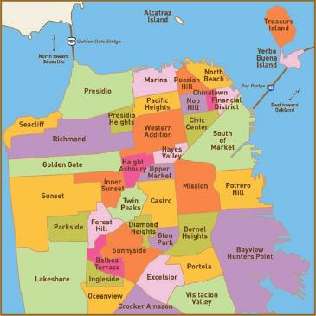
The City and County of San Francisco ❤️
Department of Children, Youth & Their Families
Recreation and Parks
Mayor’s Office on Disability
Community Advisory Committee for Special Education
Unified School District
Support for Families
Notes:
Introductions
City and County of San Francisco

Slide 3
OUR JOURNEY ~
Planning
the Hubs
Spring/Summer, 2020
Ongoing
Cross- training
Winter/Spring,
2022
Visioning for our Future
Summer, 2022 & beyond…
Coordinating Summer Together
Spring/Summer, 2021
We’re all in this Together, Launch
Winter/Spring, 2020
Notes:
Our Journey to date…- Lucas
High level review - we’ll go deeper on subsequent slides
Alt text for whole page

Slide 4
A worldwide Pandemic is upon us.
We’re all in this together - Launch
Winter/Spring, 2020
Notes:
Lucas
Our Launch - how we came to be…
SF Chronicle 03-17-2020

Slide 5
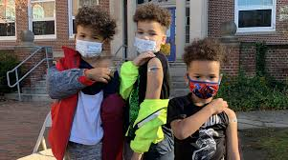
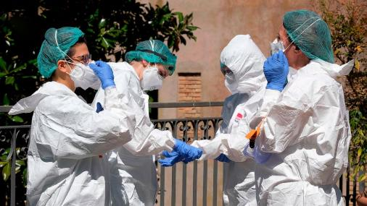
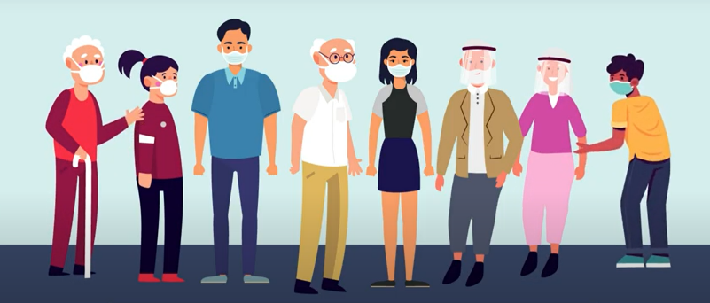
March 13, 2020—schools close
March 16, 2020—emergency child and youth care sites open
Notes:
Lucas
Launch Details - We’re all in this together
Consider capturing the urgency of what was happening worldwide, photos of children/youth from around the world, a little bit re: the urgency of coordinating resources throughout the city. Masks, Food urgency, Employment issues - working from home vs. essential workers, etc.

Slide 6
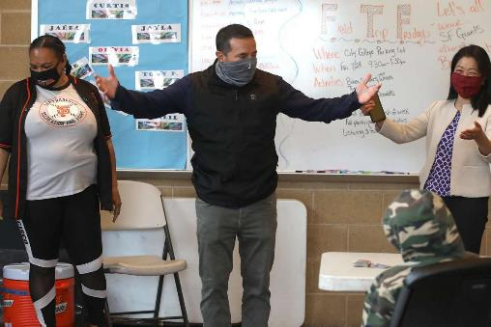
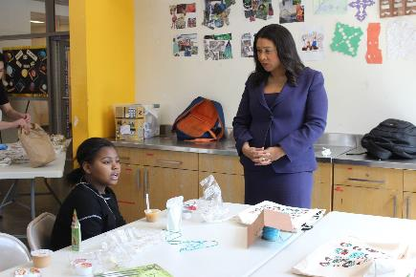
Planning the Hubs
Spring/Summer, 2020
There is an urgent need to create learning environments for children of essential workers.
What we knew at the time
SFUSD has planned for distance learning for the Fall 2020-2021 Academic year
There were a significant number of children who did not fully benefit from distance learning since Shelter-In-Place Order was issued
The American Academy of Pediatrics, the CDC and CDE all agree that children need in-person learning to prevent further decline in academic and social-emotional development
As the City reopens our economy, parents/guardians need safe places for their children to go during the day
Public transportation is projected to operate at 30% of normal capacity by end of August
What did the Community Hubs provide:
Access to safe & sanitized spaces
3 Healthy Meals
Access to technology & Internet connectivity
Support by dedicated youth development professionals
Mental health and wellness supports
Enrichment Activities
Outdoor recreation and physical activity
Notes:
Sherrice
(we may be able to share some photos from the Eureka Valley inclusive hub)
Planning the Hubs
July 28, 2020 - Dept. of Children Youth and Families - coordinate supporting students with disabilities in the learning hubs (YMCA, Rec & Park, Boys & Girls Clubs) - Tapped each other to carry this lift: List out some of these efforts -
SFUSD, coordinated release of information paperwork for families of kids on IEP’s, shared IEP’s at a glance, provided guidance documents for school contact information and provided training modules on accommodations and promoting positive behaviors and de-escalation in the classrooms.

Slide 7
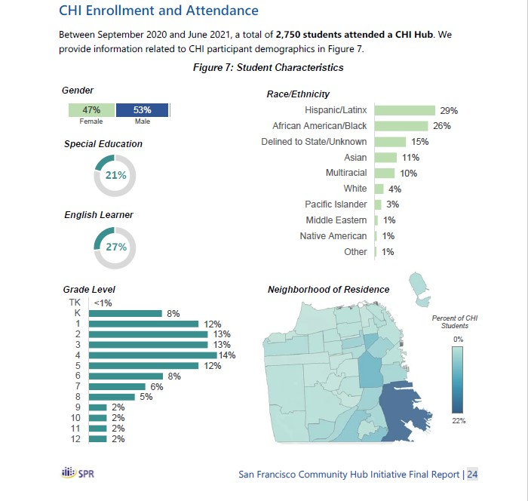
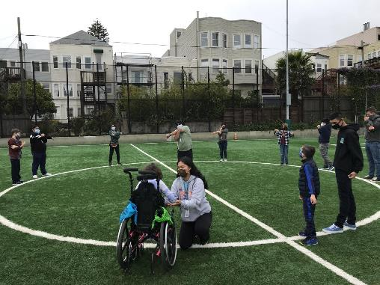
Students connected daily to distance learning
Students focused on lessons and completed homework
Students received individualized attention
Students had fun and interacted with peers
Students were safe and supported
Students learned new skills and built confidence
Notes:
Sherrice
Planning the Hubs Details: Sherrice and Jean
Consider bullets outlining the charter behind the HUBS
Or a map w/ learning hubs or photos of students in class - age range, diversity
Training Slides for visuals/graphics, high level content
QUOTES:
SFUSD Board Commissioner, Kevine Boggess: “The pandemic and the Hubs collaboration created new energy,” he said. “Hopefully, we can seize that momentum and push forward something that’s more permanent — part of our new normal.”
SF Department of Children, Youth and Their Families, Director, Maria Su
“We don’t have to wait for a pandemic to do good. We actually have the right recipe for it. We do have all the ingredients.”
We were up against significant barriers - see Link to Chronicle Article, 7-24-21

Slide 8
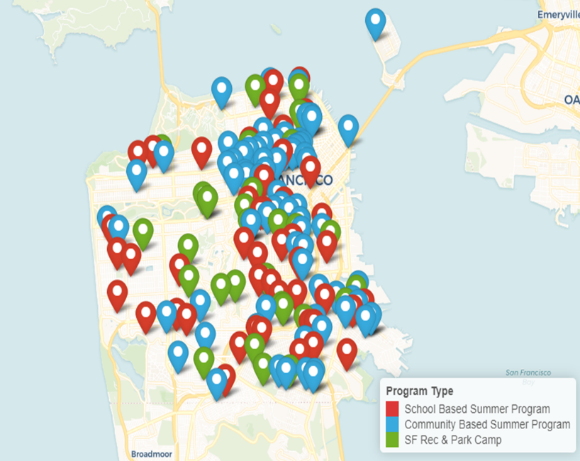
Coordinating Summer Together
Spring/Summer, 2021
Launched in Summer 2021, Summer Together is a coalition of community organizations, nonprofits, businesses, schools and SF city departments working together to offer in-person summer experiences for our highest need and hardest to reach youth to address the devastating impact of the pandemic. Over 25,000 youth were served across the city.
Program Types
CBO- 68 agencies at 80 sites
Rec & Park- 31 sites
School-based- 80 agencies at 77 sites
Private Camps- 27 Camps at 24 Sites
Notes:
Sherrice
Summer Together-Sherrice
Lucas—talk about how Nicole called us all together (after hearing about issues families were having finding camps). We were able to address some issues right away and had some success stories!
Continued to meet regularly beginning fall, 2021

Slide 9
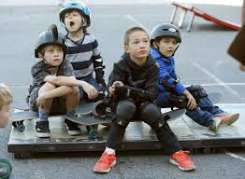
Recognizing the benefits of our collaboration, pre-planning for staff training is a priority.
Ongoing Cross-training
Winter/Spring, 2022
Notes:
Lucas
Ongoing Cross Training

Slide 10
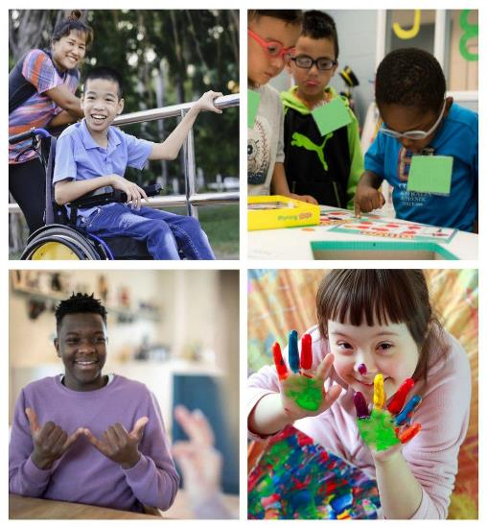
In partnership with the Department of Recreation and Parks, Mayor’s Office on Disability, SFUSD
and Support for Families and DCYF
presents:
Summer Inclusion Workshops
We are inviting all of you to participate in workshops that will focus on how to support and accommodate youth with disabilities in your program. Learn and understand the importance of inclusion, the reasonable accommodation process, behavior management and de-escalation tips and techniques. Trainings are happening on Tuesday and/or Thursday from 10:00am-12:00pm.
March 8th –The Why of Inclusion
March 15th–Reasonable Accommodation Process
March 17th Behavior Management
March 22nd–De-Escalation
Notes:
Julia/Jean?
Highlight the level of training on accommodations, modifications, understanding behavior, provident support and de-escalation strategies.

Slide 11
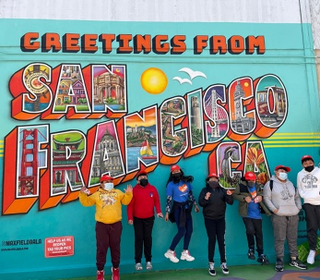
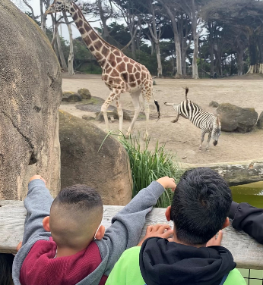
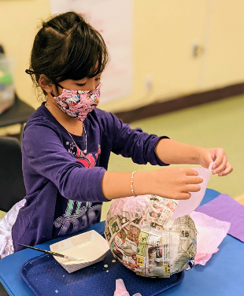
Summer Together provided an opportunity for youth to re-engage, rebuild and foster positive attitudes towards learning, relationship building and social emotional support. The additional funding allowed CBOs to increase program quality and better serve children, youth and families.
Summer Together 2022
Will focus on:
Comprehensive wellness support for
young people & their families
Social and Emotional Learning support
Literacy and Math support
Project-based enrichment and physical activities
High school credit recovery & college/career prep
All sites will have access to Mental Health and Wellness support.
Notes:
Jean/Julia? Start this slide, Sherrice finish it?
Summer Together Details- Sherrice
2,457 youth in Special Education were served
This year outreach began with focusing on ELL, youth with disabilities and youth living public housing/SRO’s, underhoused and youth in foster care
Learnings from the previous year was that more CBO’s needed training around how to work with and include youth with disabilities into program
SF Chronicle Article, 05-14-2021 - S.F.’s ambitious plans for free summer programs for 20,000 kids are taking shape. But will they help enough?
KTVU Article 06-14-2021 - San Francisco's Summer Together program aims to get students back on trackShare information -
DCYF Summer Together 2022 - DCYF Website
.

Slide 12
Our momentum is strong, what’s next?
Visioning for our Future
Explore opportunities with other city partners–(ex. SF Library)
Ongoing inclusion training
Expand our cross-training opportunities
Staff recruitment
Increase parent collaboration
???????
Notes:
What’s next for us? Can we tie in other city agencies? Libraries? More ideas? Opportunities?
Tweens, teens and TAY

Slide 13
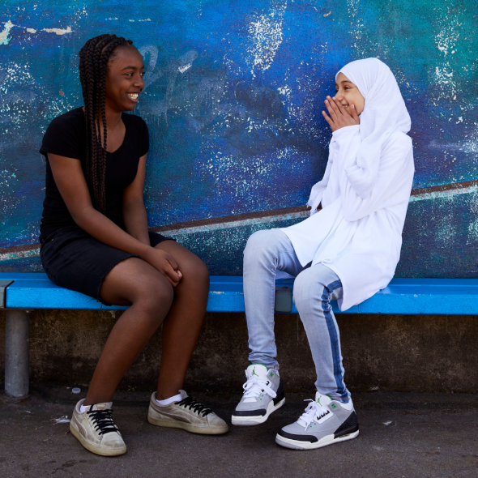
Our Work Continues…
Thank you!
Notes:
Perhaps put our contact information? Names, emails, phone numbers?????

