Slide 1
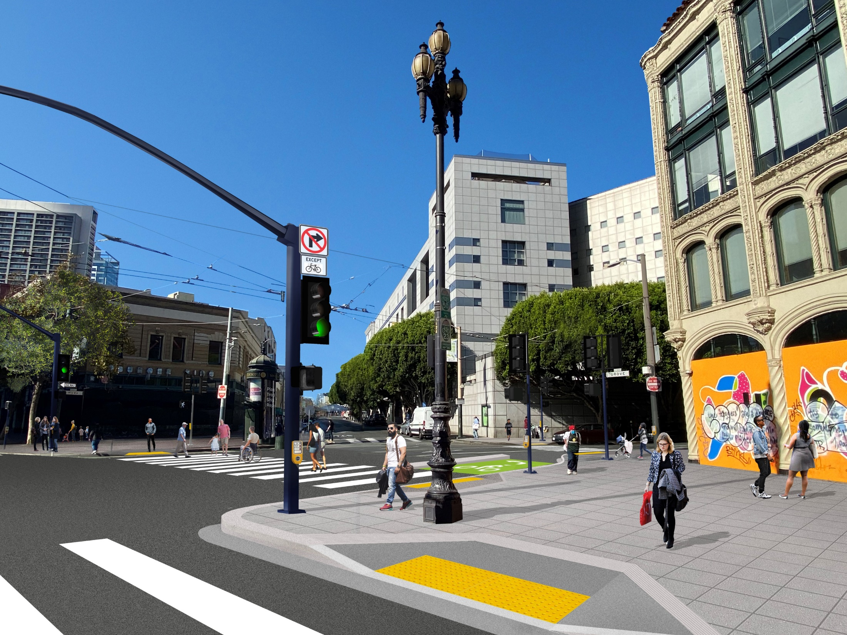
Mayor’s Disability Council
7/15/22

Slide 2
Community Outreach
6 rounds of community outreach
Focus groups hosted by the Lighthouse for the Blind
Senior & Disability Action updates
Community Working Group
Business Working Group
2

Slide 3
Better Market Street Phase 1
Future F Loop 6th St. boarding islands
Phase 1
Phase 1
8th UN Plaza 7th Jones/McAllister 6th Mason/Turk 5th
3

Slide 4
Phase 1 Scope of Work
5 traffic signal upgrades
Repave curb lane and intersections
Construct four bulb outs at Hyde, Sixth, and Mason/Turk to shorten crossing distances and improve safety
Streetscape improvements including new trees, benches and bike racks
Improve roadway drainage near 6th Street
Minimal work to Overhead Contact System (OCS), sewers, sub-sidewalk basements, and one fire hydrant triggered by the above work
* Sidewalk level bikeway has been eliminated
4

Slide 5
Accessibility Improvements
Phase 1 between 5th to 8th streets:
Repaved crosswalks
Accessible Pedestrian Signals (APS) at all crossings
Construct ADA-compliant curb ramps that are twice as wide as today
Replace sidewalks at the corners with pavers that meet our ADA guidelines – increase slip resistance and minimize vibrations for wheelchair users
Opening the crosswalk at Market/Hyde from BART to the Main Library
Future improvements:
New transit boarding islands that are 2 times larger than existing
5

Slide 6
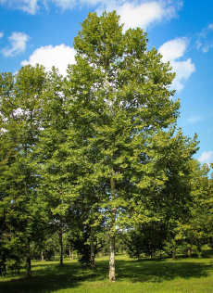
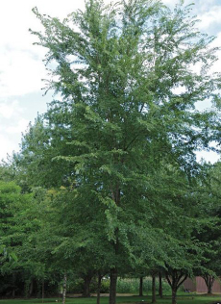
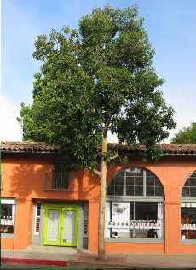
New Trees
Platanus
(London Plane)
Ulmus
(Chinese Elm)
Lophostemon (Brisbane Box)
6

Slide 7
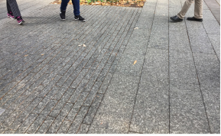
Site Furnishings
Concrete Pavers
Bike Racks
7

Slide 8
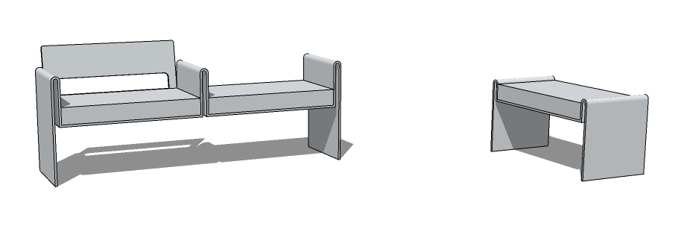
Site Furnishings: Seating
The project will install a mix of benches, some with backrests and armrests. Benches will provide wheelchair user areas for accessible companion seating.
8

Slide 9
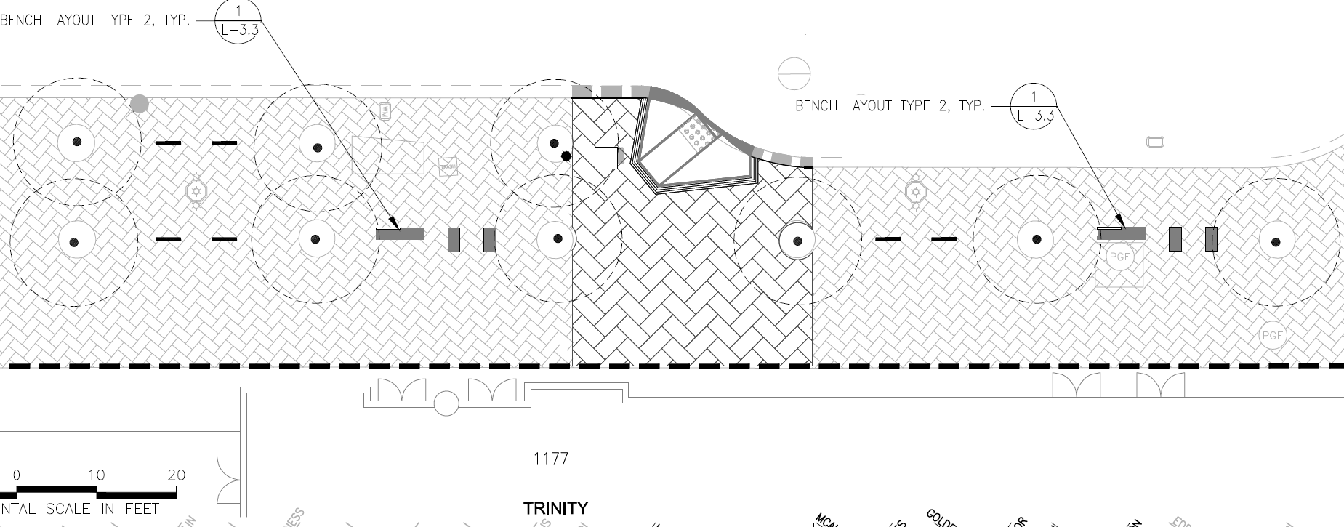
Site Furnishings: Seating
9
Notes:
Any seating the City provides will be in partnership with the adjacent properties who sign an agreement to help manage and maintain it
Bike racks will be provided on an as-needed basis as requested in partnership with adjacent properties who sign an agreement to help manage and maintain them

Slide 10
Phase 1 Schedule
10

Slide 11
Questions
11

