Slide 1
Taxi Meter Rate Proposal
September 2022

Slide 2
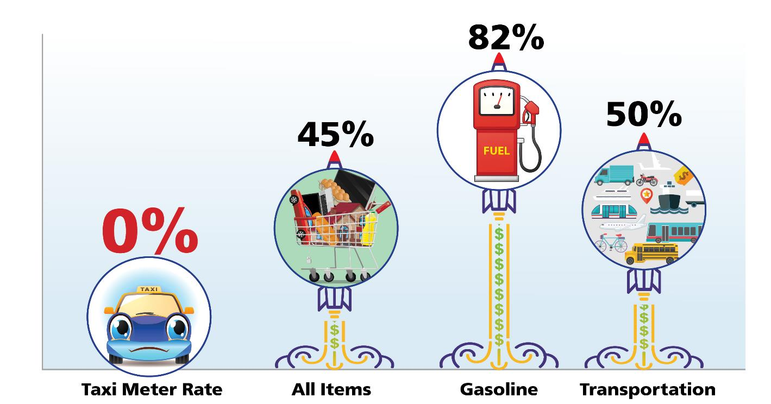
SFMTA is Proposing to Raise the Taxi Meter Rate
The taxi meter rate has not increased since 2011.
Price Increases Since 2011 in SF/Bay Area
^{Rate increase} ^{goes directly to driver.}

Slide 3
SF Taxi Meter Rate: Current and Proposed
Fare Component | Current Meter Rate | Proposed Meter Rate Increase
Flag Drop: First one-fifth of a mile | $3.50 | $4.15
Distance: Each additional one-fifth mile or fraction thereof | $0.55 | $0.65
Time: Each minute of waiting or traffic delay time | $0.55 | $0.65

Slide 4
Taxi Meter Rate
SF Trip Characteristics Jan-May 2022
Median cost for all trips: $12.85
Taxi Outreach Meeting

Slide 5
Taxi Meter Rate
Fare Components by Trip Distance Jan-May 2022
Taxi Outreach Meeting

Slide 6
Taxi Meter Rate
Comparison Across Jurisdictions
Taxi Outreach Meeting
*cost of living is higher in SF

Slide 7
Recent Fare Surcharges in Other Jurisdictions
Cities Enacting Trip Surcharges
Houston | $0.50 per trip
Seattle | $1 per trip
Las Vegas | $0.39 increase / metered mile
Chicago (proposed) | $1 for trips < $20 $2 for trips $20-$40 $3 for trips > $40
Taxi Outreach Meeting

Slide 8
Recent Fare Adjustments in Other Jurisdictions
Cities Raising Base Fare (Flag Drop)
Toronto | $1 per trip
New York (proposed) | $2.50 increase from $3.30 to $5.80
Cities Raising Fares
Montreal | 17% increase in fares and increased rates allowed for late night rides
Los Angeles | Flag increase to $3.10, $0.33 per 1/9th mile and per 37 seconds of wait time
Taxi Outreach Meeting

Slide 9
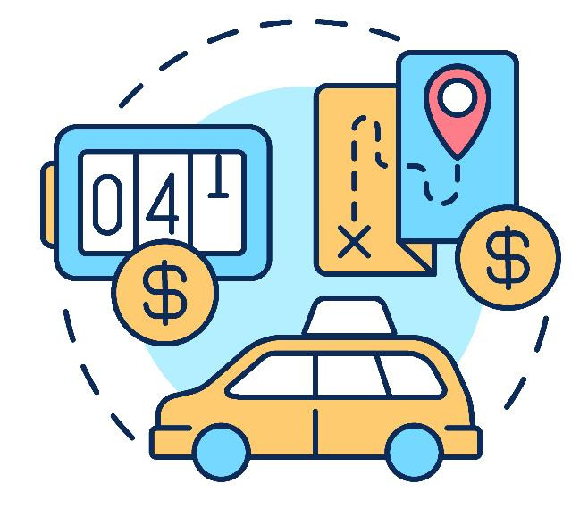
Taxi Meter Rate
Initial Staff Considerations
Considered fuel surcharge
Fares based on time of day or location
Meter and a half structure
Not proposing either fuel surcharge or other fare restructuring at this time, but may consider them in the future
Taxi Outreach Meeting

Slide 10
Estimated Cost Impact for a Typical Trip
General Public Rider: $2.94 Increase
 | Flag Drop | Distance/ Wait Time | 15% Tip | Total Cost
Current | $3.50 | $10.45 | $2.09 | $16.04
Proposed | $4.15 | $12.35 | $2.48 | $18.98

Slide 11
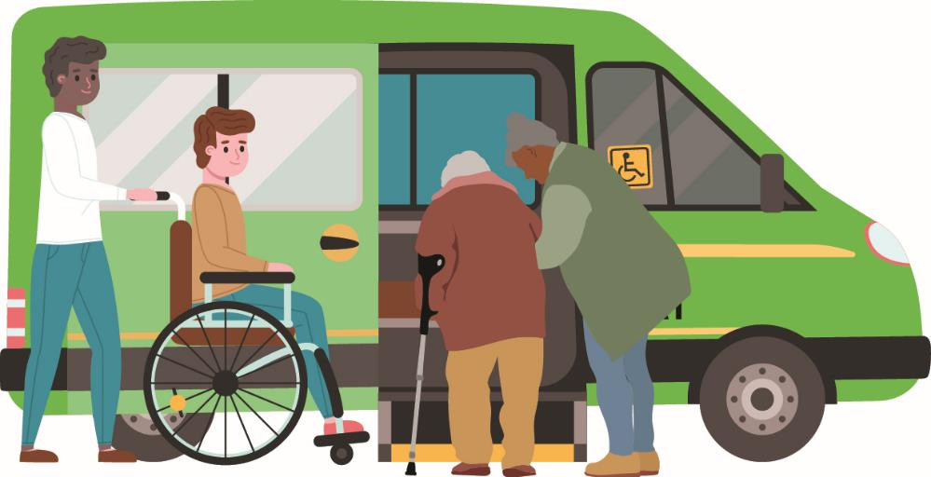
Estimated Cost Impact for a Typical Paratransit Taxi Trip
Paratransit Rider: $0.50 Increase
 | Flag Drop | Distance/ Wait Time | 15% Tip | Total Cost | Rider's Share*
Current | $3.50 | $8.25 | $1.76 | $13.51 | $2.70
Proposed | $4.15 | $9.75 | $2.09 | $15.99 | $3.20
^{*SFMTA subsidizes 80% of}
^{Paratransit taxi trip cost.}

Slide 12
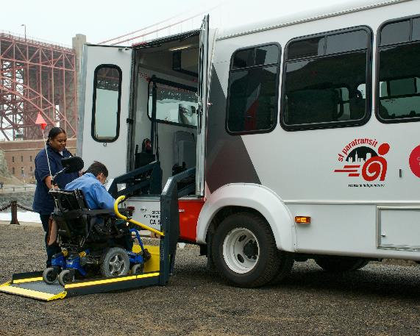
Taxi Meter Rate
Impacts on Paratransit Riders
SFMTA would increase allotment for Paratransit riders and for Essential Trip Card programs and maintain subsidy ratio
SFMTA subsidizes Paratransit Taxi Trips
80% paid by SFMTA
20% paid by rider
Taxi Outreach Meeting

Slide 13
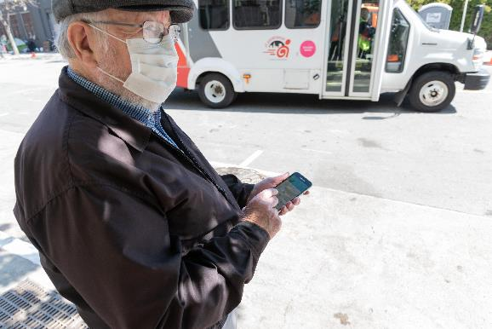
Taxi Meter Rate
Outreach and Feedback
SFMTA Citizens’ Advisory Council (CAC)
Taxi Industry quarterly outreach meeting
Taxi Workers Alliance
Color Scheme meetings
SF Paratransit / Transdev
Paratransit Coordinating Council, Multimodal Accessibility Advisory Committee, Mayor’s Disability Council
Board of Supervisors
Taxi Outreach Meeting

Slide 14
Taxi Meter Rate
Approval Process for Rate Change
Gather Community Feedback
Taking comments at SFTaxi@sfmta.com
Rate change must be approved by SFMTA Board
Targeting late fall to bring the proposal before the SFMTA Board
Rate change would take effect 30 days after SFMTA Board approval
Taxi Outreach Meeting

