Slide 1
Ride with UberWAV
January 2022

Slide 2
Intros
Austin Heyworth
Senior Manager Public Affairs
Uber
Cameron Hendrickson
UberWAV Outreach Team
Kearns & West

Slide 3
Agenda
01 What is WAV?
02 Our accessible transportation partner
03 Safety
04 How to ride with UberWAV
05 Q&A

Slide 4
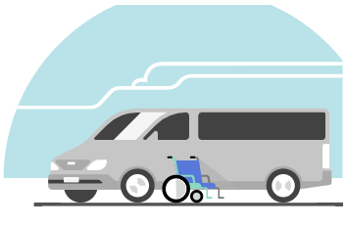
What is WAV?
UberWAV provides affordable rides in wheelchair-accessible vehicles (WAV). In certain cities, riders who use motorized wheelchairs or scooters can request a ride in a WAV. WAV driver-partners are certified by a third party in safely driving and assisting people with disabilities.

Slide 5
Fast, reliable rides
When and where WAV is available, rides are requested on demand, and work around your life, not the other way around.
Trips that fit your budget
The price of a WAV ride is similar to an uberX trip, our basic ride option.
Specialized drivers to assist you
Every WAV driver has completed a certification course offered by a third party to help you enter and exit the vehicle.

Slide 6
Safety
Uber has implemented comprehensive health and safety standards for the protection of both riders and drivers, including:
“Go Online” Checklist and Mask Verification. Before a driver can go online and become active, they will be asked to confirm, via a new Go Online Checklist, that they’ve taken certain safety measures and are wearing a mask or face cover.
Supplies for Riders and Drivers. To assist with sanitization, Uber is dedicating $50 million to purchase and distribute cleaning supplies and protective equipment to active drivers.
Accountability. Accountability works best when it goes both ways. That’s why we’re encouraging drivers to cancel trips without penalty if they don’t feel safe, including if a rider isn’t wearing a face cover.

Slide 7
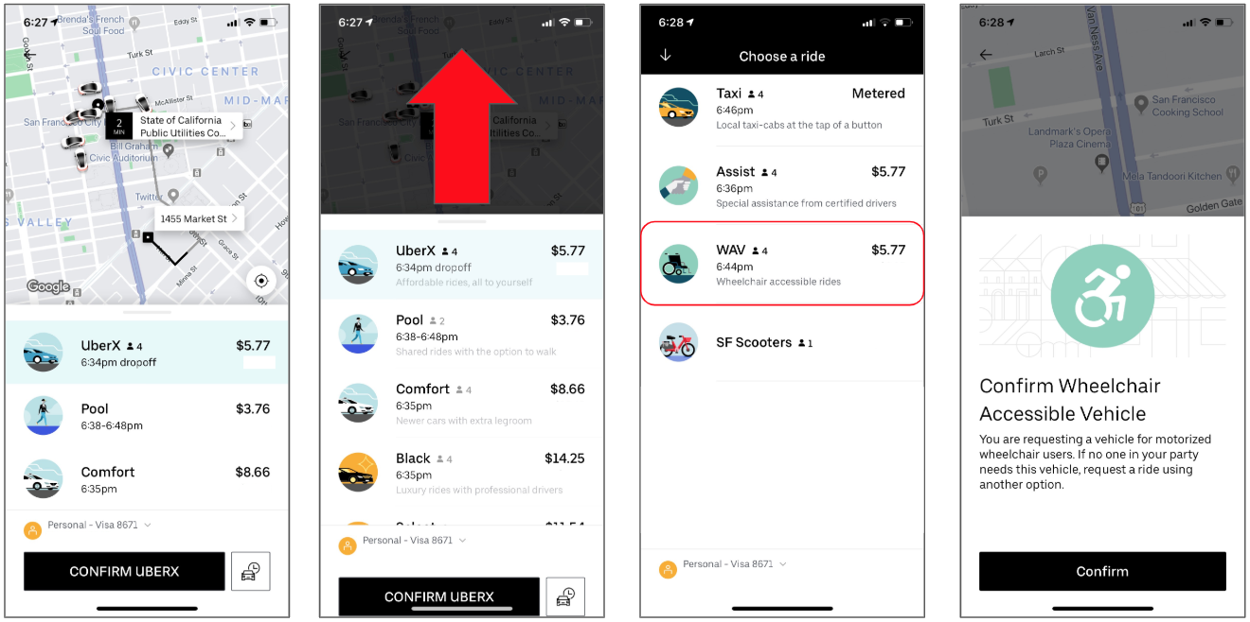
How to ride with WAV

Slide 8
Q&A

Slide 9
Thank you
Cameron Hendrickson (chendrickson@kearnswest.com)
Notes:
[Introduce yourself]

