Slide 1
Sidewalk Repair and Accessibility
Land Use and Transportation Committee
January 21, 2021

Slide 2
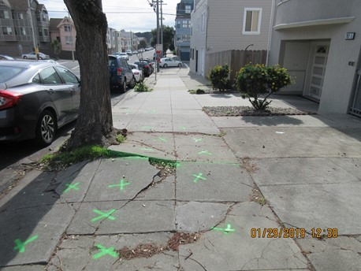
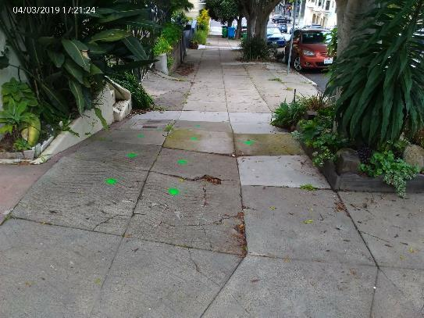
Sidewalk-Related Complaints
Historically, Public Works accepts 1,200-1,500 complaints each month
All complaints directed to the Bureau of Street-use and Mapping (BSM) from 311 are reviewed and either accepted or redirected within one business day.
Inspection response times vary between three and five business days
Sidewalk and roadway obstructions – three business days
Sidewalk and roadway defects – five business days
Notes:
With COVID-19, we experienced a slight reduction in the number of complaints received but have seen complaint volumes return to standard levels as we advanced further into calendar year 2021. Total complaints received by BSM each month are shown below:
January – 905
February – 1,125
March – 1,335
April – 1,153
May – 1,057
June – 1,043
July – 1,207
August – 1,266
September – 1,298

Slide 3
Responsibilities: Property Owners vs. The City
Property owners are responsible for all sidewalk repairs except when:
The damage is in the angular return of the sidewalk
The damage is related to a utility
It’s a special instance where the City maintains (Ex. Market Street bricks)
The damage is caused by a City-maintained tree
Property owners are generally responsible from property line to the curb. For unaccepted streets, they are responsible for maintenance and repair to the mid-point of the street.

Slide 4
Sidewalk-Related Complaints – Making Repairs
In most instances, the timeline for sidewalk-related complaints is 45 days when a private property owner is involved.
30 days
Initial notice provides 30-day window for repairs to be made.
+15 days
If defects remain after 30 days, property owners are given 15 additional days to make repairs.
45 days
After 45 days, the location will be subject to abatement by the City if defects remain.
Notes:
The timelines for compliance are shorter when the underlying issue(s) involve permittees. In those instances, contractors may be instructed to address issues immediately, within 24-hours, 72-hours, 3-days or longer depending on the issue involved.

Slide 5
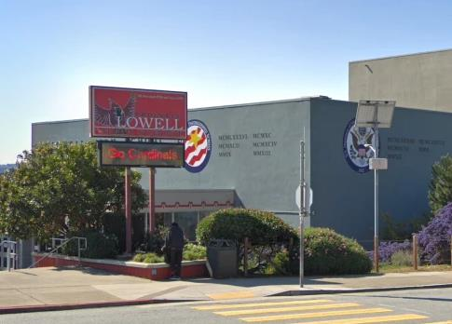
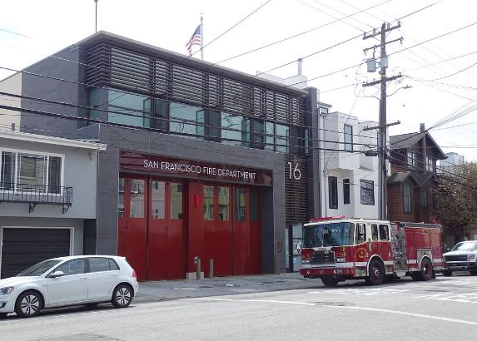
Responsibilities: City Agencies and Schools
City agencies are treated in the same manner as private property owners and are responsible for the maintenance and repair of the adjacent right of way.
The San Francisco School District (SFUSD) is a quasi-state agency and are not responsible for the maintenance and repair of sidewalks adjacent to schools.

Slide 6
Applicable State and Local Codes
State: California Streets and Highways Code Section 5610
Municipal (Non-exhaustive list):
PWC Article 15, Section 706: Owners of Frontage Responsible for Repair – Liability for Unsafe Conditions
PWC Article 2.4: Excavation in the Public Right of Way
PWC Article 5.2: Tables and Chairs in Public Sidewalk or Roadway
PWC Article 5.3: Display of Fruits and Vegetables or Nonfood Merchandise on Public Sidewalks
PWC Article 5.4: Regulation of Newsracks
PWC Article 5.8: Permit Regulations for Mobile Food Facilities Concerning Products for Human Consumption
PWC Article 9: Unaccepted Streets
PWC Article 15, Section 723: Obstruction of Public Right-of-Way Prohibited
PWC Article 15, Section 723.1: Sidewalk Barriers
PWC Article 15, Section 723.2: Minor Sidewalk Encroachments
Municipal Police Code, Section 63(a): Obstruction of Streets and Sidewalks
Regulations:
DPW Order No. 178,884: Guidelines for Inspection of Sidewalk Defects
DPW Order No. 177,526: Good Neighbor Policy re Repair of Sidewalk Defects
Notes:
Response to sidewalk defects and obstructions in the right of way are guided by a series of codes…

Slide 7
Sidewalk Safety Near Construction Sites
The City enforces codes that ensure safe and accessible sidewalks surrounding active construction sites.
Street Occupancy Permit Required (PWC 724)
Material and Equipment (PWC 724)
Path-of-Travel and Clearance Requirements (PWC 724)
Housekeeping (PWC 724)
Defects & Maintenance (PWC 724.2)
Construction & Demolition Sites (PWC 724.4)
Exceeding Permissible Use or Occupation Without Permission (PWC 724.5)
DPW Order 165176 – Temporary Occupancy of PROW
DPW Order 167840 – Guidelines for Placement of Barricades at Construction Sites
Regulations Concerning Excavation Sites (PWC 2.4.53)
PWC Section 723 – Obstruction of the Streets Prohibited

Slide 8
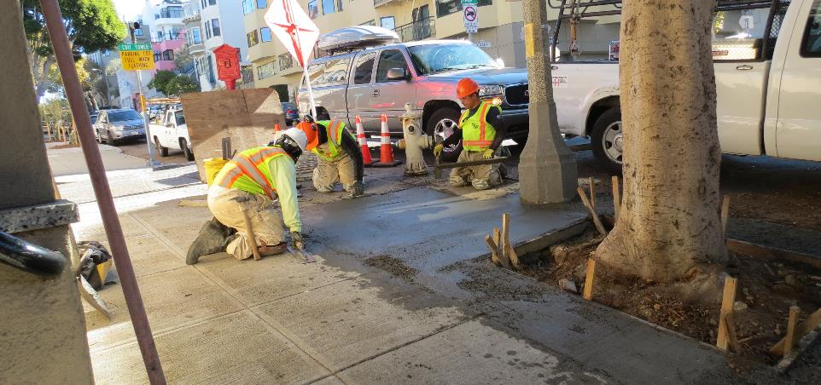
Sidewalk Inspection and Repair Program (SIRP)
Inspect and repair all the sidewalks in San Francisco on every 25 years
Sidewalk damage that is the responsibility of City agencies or private utilities are repaired as part of the program
Annual goal to repair 200 blocks and 200,000 square-feet of sidewalk
Staffing and annual goals are expected to return to pre-pandemic standards at the turn of the next fiscal year
Notes:
Mention the cost associated for proactive programs (i.e. constituents getting more notices).

Slide 9
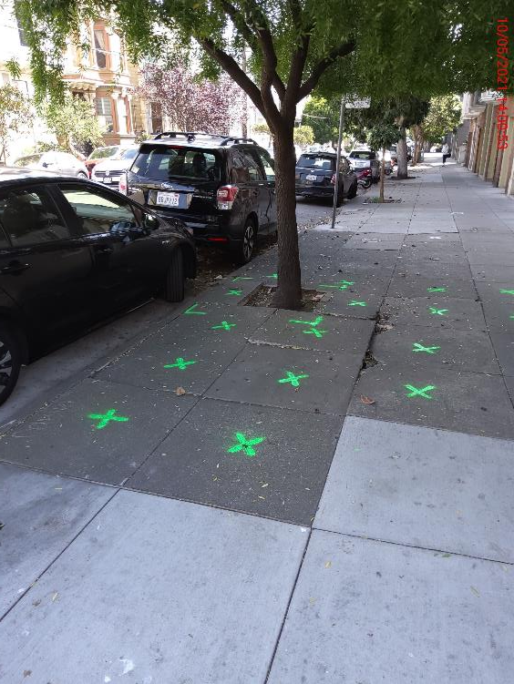
Accelerated Sidewalk Abatement Program (ASAP)
Inspects and expedites corrective action for sidewalks that meet certain criteria:
Sidewalks in extremely poor condition along residential and commercial throughways.
Accessibility-related sidewalk complaints
High-priority pedestrian right-of-way sidewalks
On sidewalks around City-maintained trees
On sidewalks fronting buildings owned by select City agencies
Notes:
Property owners are responsible for the repair and maintenance of the sidewalk. If they fail to repair the sidewalk, the City is entitled to perform the repair and invoice the property owner for the cost.

Slide 10
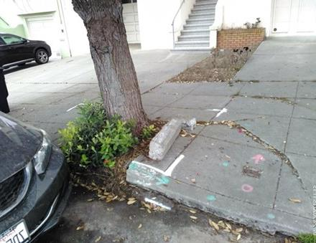
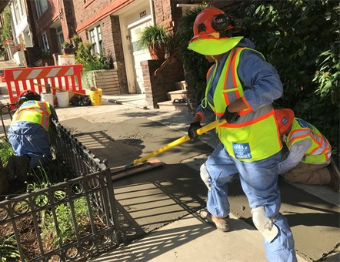
Sidewalk Defects Caused by Trees
Proposition E went into effect in 2017, transferring responsibility of the maintenance of tree-related sidewalk damage from property owners to Public Works.
To-date, Public Works and private contractors have repaired approximately 535,000 square-feet of sidewalks with tree-related damages.
More than 40,000 tree-related tripping hazards have been removed by a concrete slicing contractor.
Notes:
Sidewalk raised by tree roots are either removed and replaced or sliced. Some repairs include basin expansions or relocations.
To date (since July 1, 2017), 535,000 sq. ft. of tree-related sidewalk repairs have been completed by contractors and City concrete crews (~12.3 acres).
40,406 tree-related tripping hazards have been removed by concrete slicing contractors. This work was made possible by the hiring of a fast and extremely responsive and efficient slicing contractor.
100% of the repaired and sliced sidewalks were in high priority (red and orange) keymaps.
-----------
Concrete slicing is a cheaper and more environmentally friendly alternative to pouring fresh concrete. When applied to minor concrete uplifts (1-2”), slicing significantly reduces risk and improves pedestrian safety.
What is also helpful about slicing, is they have a much shorter impact on the neighborhood, they don’t have to take parking for a long period of time, and they can keep a pedestrian path of travel while working.
In addition to the positive environmental savings, another benefit of the concrete slicing is that it can allow us to repair the sidewalk without impacting tree roots, which is always preferable for maintaining the tree for longer. We have been under a lot of scrutiny for the trees we’re removing due to health or structural issues, so we really are happy to be able to maintain some trees for much longer due to this technology.
Cost Savings
San Francisco saved an estimated $5.3 million (or 84%) compared to traditional removal and replacement.
Water Savings
DRY CUT process with Hepa filtered high-powered vacuums use no water
Concrete sliced under StreetTreeSF used no water; removal and replacement would have resulted in approx. 314,000 gallons used to pour concrete
Environmental Savings
Precision is a member of the U.S. Green Building Council
Concrete sliced under StreetTreeSF resulted in less than 3.58 tons of concrete removed and recycled; removal and replacement would have resulted in 7,987 of waste concrete in landfills
Estimated 23,847 gallons of gas saved
Estimated 213 metric tons of CO2 gas emissions prevented

Slide 11
Prioritization Process for Tree-Related Repairs
The Bureau of Urban Forestry prioritizes tree-related sidewalk repairs by starting with the most damaged sidewalks and those in high-traffic areas.
Condition Assessment
Prioritize the sidewalks in the worst condition.
Targeted Locations
Start with damaged locations in high-traffic pedestrian corridors and near senior centers, hospitals and bus stops.
Public Works has a contract in place to address smaller uplifts with sidewalk slicing in a more efficient manner than larger uplifts.
Notes:
Sidewalk raised by tree roots are either removed and replaced or sliced. Some repairs include basin expansions or relocations.
To date (since July 1, 2017), 535,000 sq. ft. of tree-related sidewalk repairs have been completed by contractors and City concrete crews (~12.3 acres).
40,406 tree-related tripping hazards have been removed by concrete slicing contractors. This work was made possible by the hiring of a fast and extremely responsive and efficient slicing contractor.
100% of the repaired and sliced sidewalks were in high priority (red and orange) keymaps.
-----------
Concrete slicing is a cheaper and more environmentally friendly alternative to pouring fresh concrete. When applied to minor concrete uplifts (1-2”), slicing significantly reduces risk and improves pedestrian safety.
What is also helpful about slicing, is they have a much shorter impact on the neighborhood, they don’t have to take parking for a long period of time, and they can keep a pedestrian path of travel while working.
In addition to the positive environmental savings, another benefit of the concrete slicing is that it can allow us to repair the sidewalk without impacting tree roots, which is always preferable for maintaining the tree for longer. We have been under a lot of scrutiny for the trees we’re removing due to health or structural issues, so we really are happy to be able to maintain some trees for much longer due to this technology.
Cost Savings
San Francisco saved an estimated $5.3 million (or 84%) compared to traditional removal and replacement.
Water Savings
DRY CUT process with Hepa filtered high-powered vacuums use no water
Concrete sliced under StreetTreeSF used no water; removal and replacement would have resulted in approx. 314,000 gallons used to pour concrete
Environmental Savings
Precision is a member of the U.S. Green Building Council
Concrete sliced under StreetTreeSF resulted in less than 3.58 tons of concrete removed and recycled; removal and replacement would have resulted in 7,987 of waste concrete in landfills
Estimated 23,847 gallons of gas saved
Estimated 213 metric tons of CO2 gas emissions prevented

Slide 12
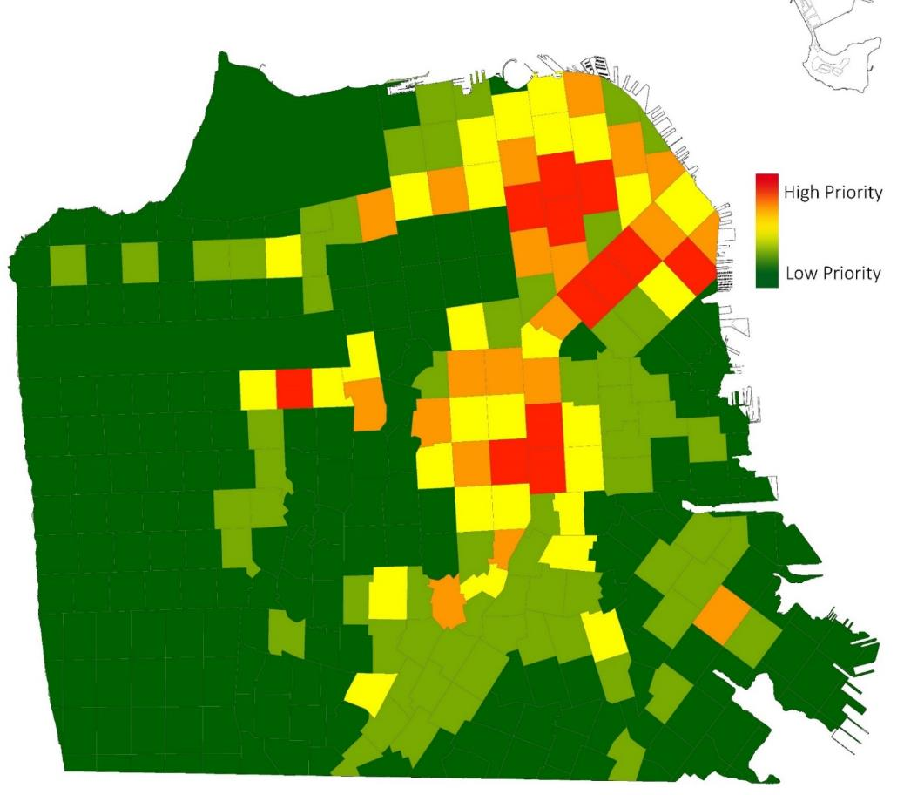
Prioritization Map for Tree-Related Repairs
Notes:
Using the prioritization criteria, Public Works can identify locations throughout the City that are in the highest need for sidewalk repairs.
Sidewalk raised by tree roots are either removed and replaced or sliced. Some repairs include basin expansions or relocations.
To date (since July 1, 2017), 535,000 sq. ft. of tree-related sidewalk repairs have been completed by contractors and City concrete crews (~12.3 acres).
40,406 tree-related tripping hazards have been removed by concrete slicing contractors. This work was made possible by the hiring of a fast and extremely responsive and efficient slicing contractor.
100% of the repaired and sliced sidewalks were in high priority (red and orange) keymaps.
-----------
Concrete slicing is a cheaper and more environmentally friendly alternative to pouring fresh concrete. When applied to minor concrete uplifts (1-2”), slicing significantly reduces risk and improves pedestrian safety.
What is also helpful about slicing, is they have a much shorter impact on the neighborhood, they don’t have to take parking for a long period of time, and they can keep a pedestrian path of travel while working.
In addition to the positive environmental savings, another benefit of the concrete slicing is that it can allow us to repair the sidewalk without impacting tree roots, which is always preferable for maintaining the tree for longer. We have been under a lot of scrutiny for the trees we’re removing due to health or structural issues, so we really are happy to be able to maintain some trees for much longer due to this technology.
Cost Savings
San Francisco saved an estimated $5.3 million (or 84%) compared to traditional removal and replacement.
Water Savings
DRY CUT process with Hepa filtered high-powered vacuums use no water
Concrete sliced under StreetTreeSF used no water; removal and replacement would have resulted in approx. 314,000 gallons used to pour concrete
Environmental Savings
Precision is a member of the U.S. Green Building Council
Concrete sliced under StreetTreeSF resulted in less than 3.58 tons of concrete removed and recycled; removal and replacement would have resulted in 7,987 of waste concrete in landfills
Estimated 23,847 gallons of gas saved
Estimated 213 metric tons of CO2 gas emissions prevented

Slide 13
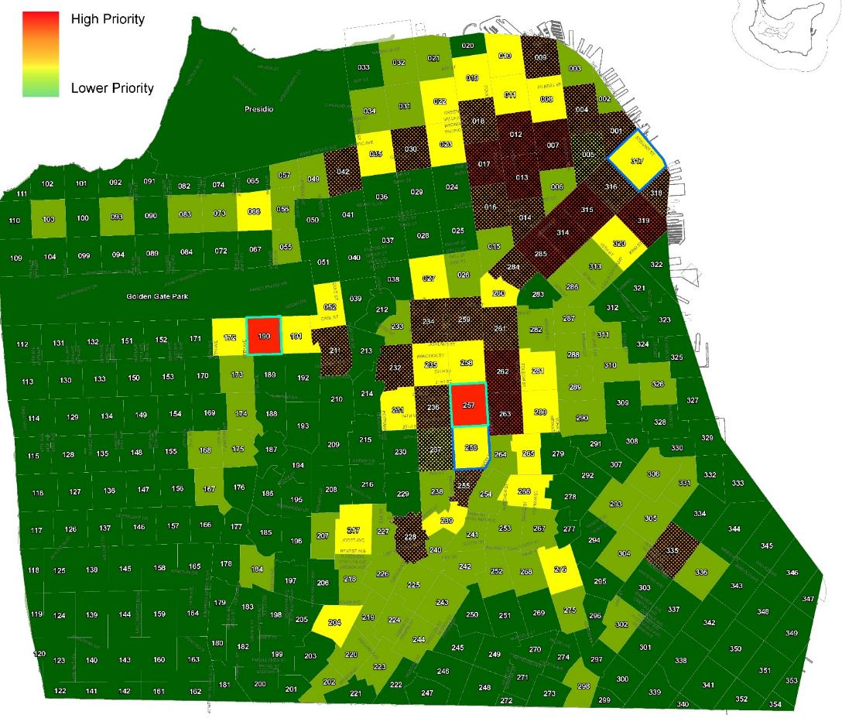
Progress on Tree-Related Sidewalk Repairs
Notes:
The upside is that the keymaps with the most damage in the ROW and proximity to vulnerable populations are complete. Remaining keymaps with less damage will take less time to complete.
In the process of prioritization, there are some caveats: there might be a school or senior center that has sever tree-related sidewalk damage nearby but isn’t in an area dense with sidewalk damage or it could be that back when we completed our census in 2016 the sidewalk damage was not as severe or may not have existed. That same site may now have severe tree-related sidewalk damage. This is where 311 service requests come into play.
Since we can’t be everywhere and have eyes all over the City, we rely on the public to report issues through 311 so we can mitigate any immediate public safety issues.

Slide 14
www.sfpublicworks.org

Slide 15
Tree Slide Cont.
Number of outstanding tree-related requests
Number in the queue
Turnaround time for these requests
Talk about different claims, priorities
Who performs which type of repair, costs of each, etc.
Notes:
Sidewalk raised by tree roots are either removed and replaced or sliced. Some repairs include basin expansions or relocations.
To date (since July 1, 2017), 535,000 sq. ft. of tree-related sidewalk repairs have been completed by contractors and City concrete crews (~12.3 acres).
40,406 tree-related tripping hazards have been removed by concrete slicing contractors. This work was made possible by the hiring of a fast and extremely responsive and efficient slicing contractor.
100% of the repaired and sliced sidewalks were in high priority (red and orange) keymaps.
-----------
Concrete slicing is a cheaper and more environmentally friendly alternative to pouring fresh concrete. When applied to minor concrete uplifts (1-2”), slicing significantly reduces risk and improves pedestrian safety.
What is also helpful about slicing, is they have a much shorter impact on the neighborhood, they don’t have to take parking for a long period of time, and they can keep a pedestrian path of travel while working.
In addition to the positive environmental savings, another benefit of the concrete slicing is that it can allow us to repair the sidewalk without impacting tree roots, which is always preferable for maintaining the tree for longer. We have been under a lot of scrutiny for the trees we’re removing due to health or structural issues, so we really are happy to be able to maintain some trees for much longer due to this technology.
Cost Savings
San Francisco saved an estimated $5.3 million (or 84%) compared to traditional removal and replacement.
Water Savings
DRY CUT process with Hepa filtered high-powered vacuums use no water
Concrete sliced under StreetTreeSF used no water; removal and replacement would have resulted in approx. 314,000 gallons used to pour concrete
Environmental Savings
Precision is a member of the U.S. Green Building Council
Concrete sliced under StreetTreeSF resulted in less than 3.58 tons of concrete removed and recycled; removal and replacement would have resulted in 7,987 of waste concrete in landfills
Estimated 23,847 gallons of gas saved
Estimated 213 metric tons of CO2 gas emissions prevented

