Slide 1

Creative Currency hack-a-thon project winner
Event sponsored by City of SF, GAFTA, Amex
All-volunteer group of programmers, designers, business consultants

Slide 2
Working with you to develop a platform that facilitates real time, customized information exchange.
Provide availability data for multiple services; initially shelter
Connect provider and users: mobile phone, internet, public access points

Slide 3
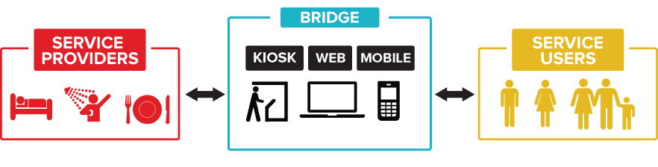
Notes:
Physically represent the design with the "platform" as a brige; rename it bridge.
a bridge between "service providers" and "service recipients"

Slide 4
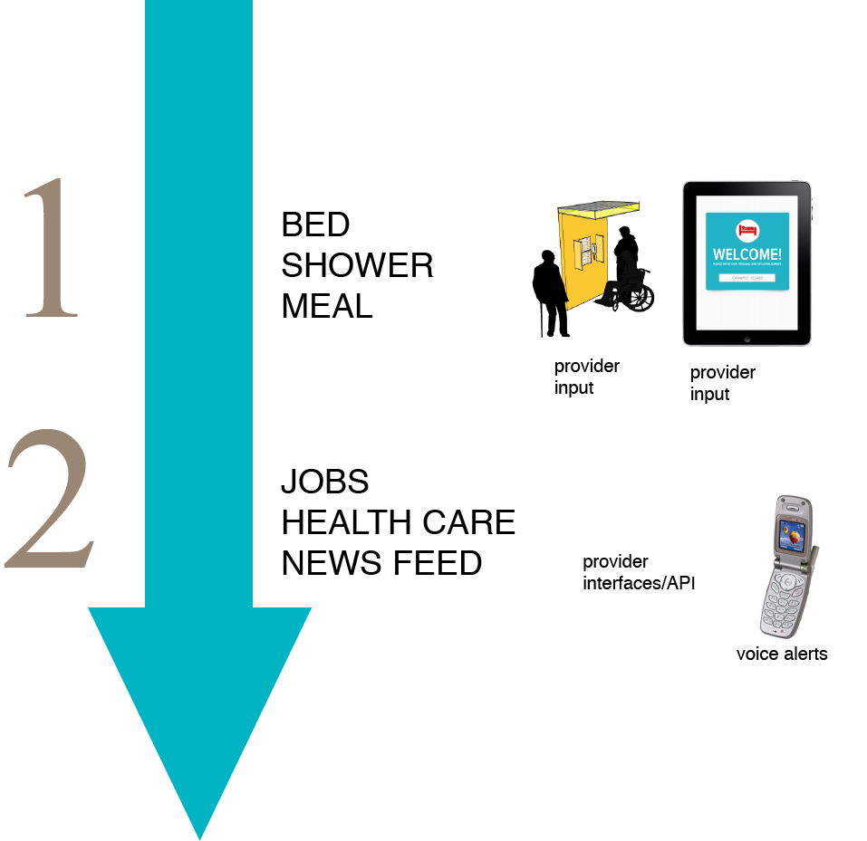
Notes:
Food, Shelter, Finance, Jobs, Health
Info and action
Personalized communications
Replace legacy systems for agencies
Strong data
Short term...
Shelter functionality
Other core areas include strong content

Slide 5
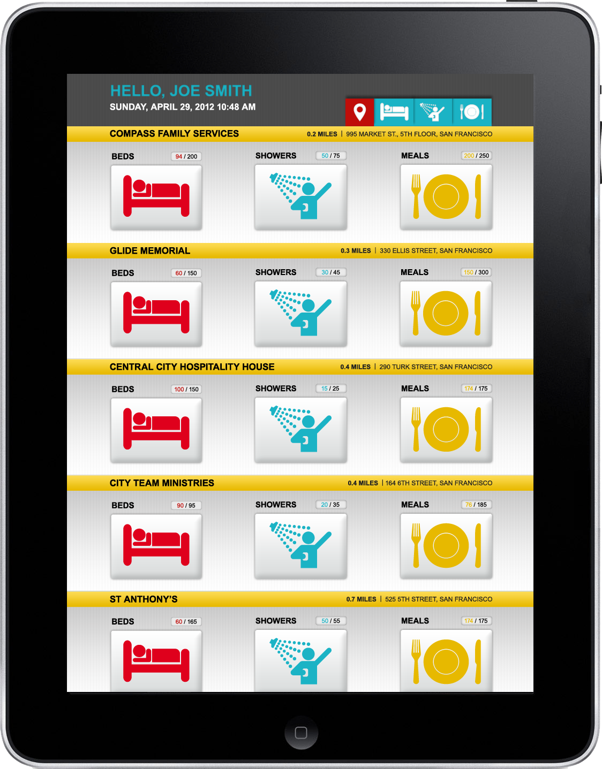

Slide 6
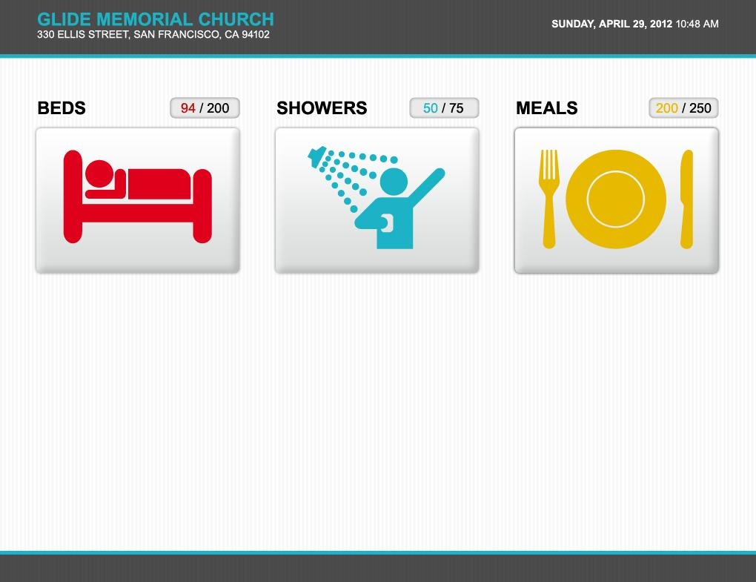
platform demo
Notes:
Double click this slide.

Slide 7
Research & Partnership
SF Community-based Organizations
  Providers, Advocates, Government, other (inclusive)
Other Communities
  Atlanta: 30-day pilot SMS (text message) system
  Australia: HitNet access points
  Berkeley: EveryoneHome single-agency system
  Los Angeles: Hotline, internet directory, homeless cell phone program
  London: Mobile service designed by homeless users
  New Jersey: Project Reach mobile app challenge
  Seattle: Shelter information service
  Washington, DC: Pilot cell phone program

